Slide 1
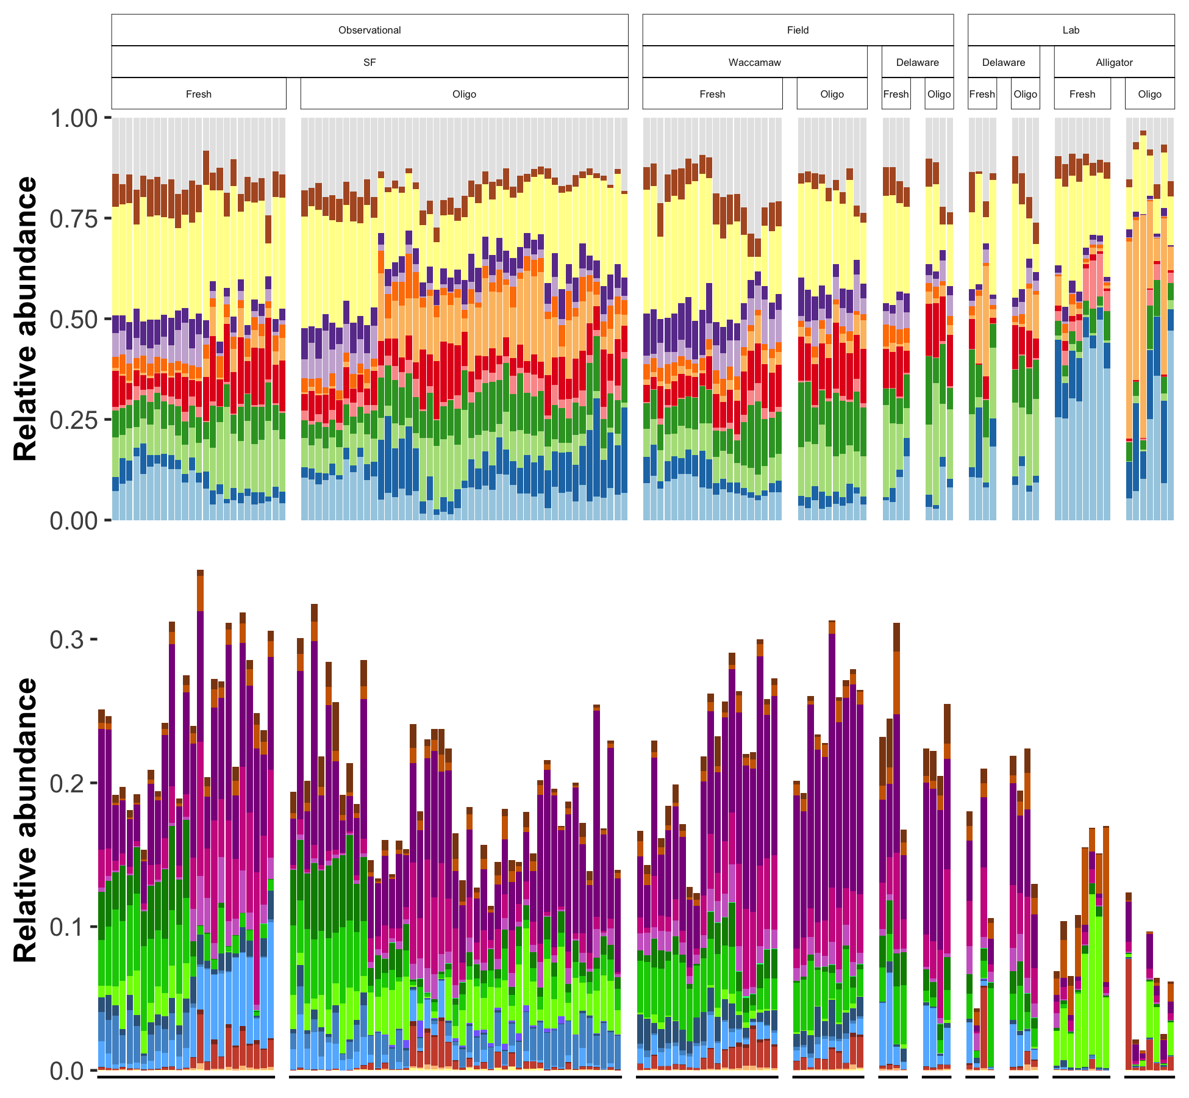
Salinity effect
Phylum |  | SF | WA | DEF | DEL | AL
 | Other
 | Verrucomicrobiota | - | - |  |  | -
 | Proteobacteria | - |  |  |  | -
 | Planctomycetota
 | Nitrospirota |  |  |  |  | -
 | Myxococcota |  | - |  |  | -
 | Firmicutes | + |  |  |  | +
 | Desulfobacterota |  | + |  |  | -
 | Crenarchaeota | + |  |  |  | -
 | Chloroflexi | + | +
 | Bacteroidota | - | +
 | Actinobacteriota | +
 | Acidobacteriota |  | -
Guild |  | SF | WA | DEF | DEL | AL
 | FeRB |  | -
 | FeOB |  | + |  |  | -
 | SRB |  | +
 | SRB_syn | -
 | SOxB
 | Anamx | +
 | NOB |  | -
 | AOB
 | AOA | + |  |  |  | -
 | ANME | +
 | MOB_IIa | -
 | MOB_II
 | MOB_I | -
 | CH4_ac
 | CH4_H2
 | CH4_me | -
 | CH4_mix
Salinity effect

Slide 2
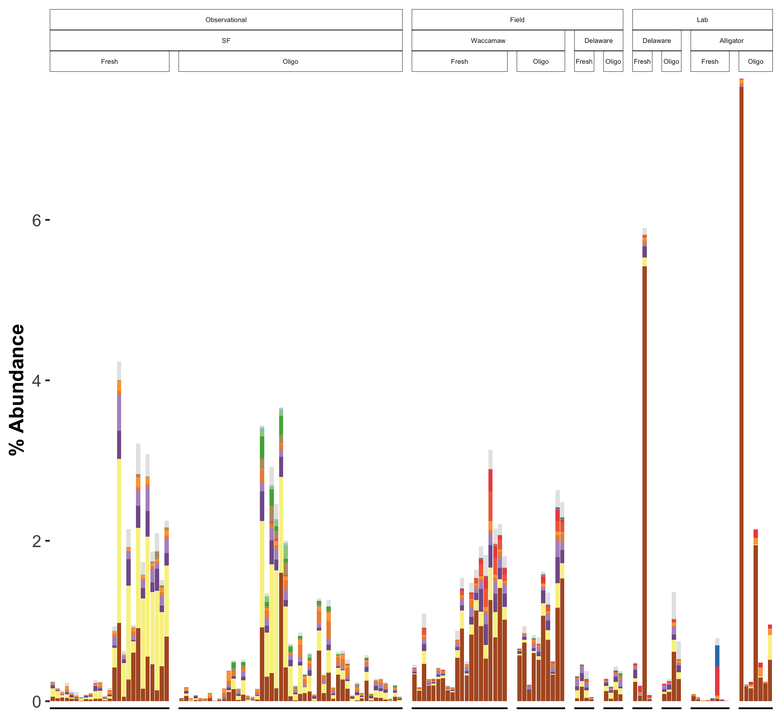
Acetate
Pathway
 |  |  |  |  |  | Family | SF | WA | DEF | DEL | AL
 |  |  |  |  |  | Unclassified
 |  |  |  |  |  | Methanomethylophilaceae |  | NP |  | NP | NP
 |  |  |  |  |  | Methanomethyliaceae | NP |  |  | NP
 |  |  |  |  |  | Methanocorpusculaceae | + | NP | NP | NP | NP
 |  |  |  |  |  | Methanofastidiosaceae | + | + |  | NP | NP
 |  |  |  |  |  | Methanospirillaceae | + |  |  |  | NP
 |  |  |  |  |  | Rice Cluster II | NP
 |  |  |  |  |  | Methanomicrobiaceae |  |  |  |  | NP
 |  |  |  |  |  | Methanocellaceae
 |  |  |  |  |  | Methanosarcinaceae | +
 |  |  |  |  |  | Methanomassiliicoccaceae
 |  |  |  |  |  | Methanosaetaceae |  |  |  |  | NP
 |  |  |  |  |  | Methanoregulaceae | -
 |  |  |  |  |  | Methanobacteriaceae |  |  |  |  | +
H₂
CH₃-Red.
Salinity effect
CH₃-Dis.

Slide 3
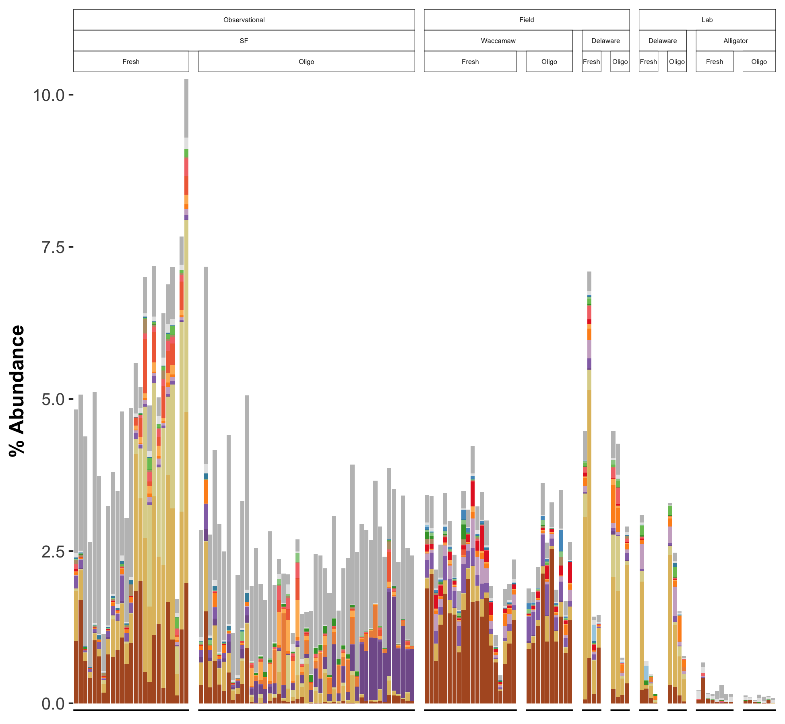
MOB_I
Guild
 |  |  | Genus | SF | WA | DEF | DEL | AL
 |  |  | Unclassified
 |  |  | Other
 |  |  | MM2 | NP |  |  |  | NP
 |  |  | Methyloterricola | - |  |  | NP | NP
 |  |  | Methylomagnum | - | - |  |  | NP
 |  |  | Methylosarcina | + |  |  |  | NP
 |  |  | pLW-20 | - |  |  |  | NP
 |  |  | Methylobacterium-Methylorubrum | +
 |  |  | Methyloglobulus | - |  |  | NP | NP
 |  |  | Methylomonas
 |  |  | Methylomicrobium |  |  |  |  | NP
 |  |  | Methylovulum |  |  |  |  | NP
 |  |  | Methyloparacoccus |  |  |  |  | NP
 |  |  | Methylobacter |  |  |  |  | NP
 |  |  | Candidatus Methanoperedens | + |  |  |  | NP
 |  |  | Candidatus Methylospira | - | -
 |  |  | Methylocaldum | -
 |  |  | Methyloceanibacter | + | +
 |  |  | Methylotenera | - |  |  |  | NP
 |  |  | Crenothrix | -
 |  |  | Methylocystis | -
MOB_II
Salinity effect
MOB_IIa
Salinity effect
ANME

