Slide 1
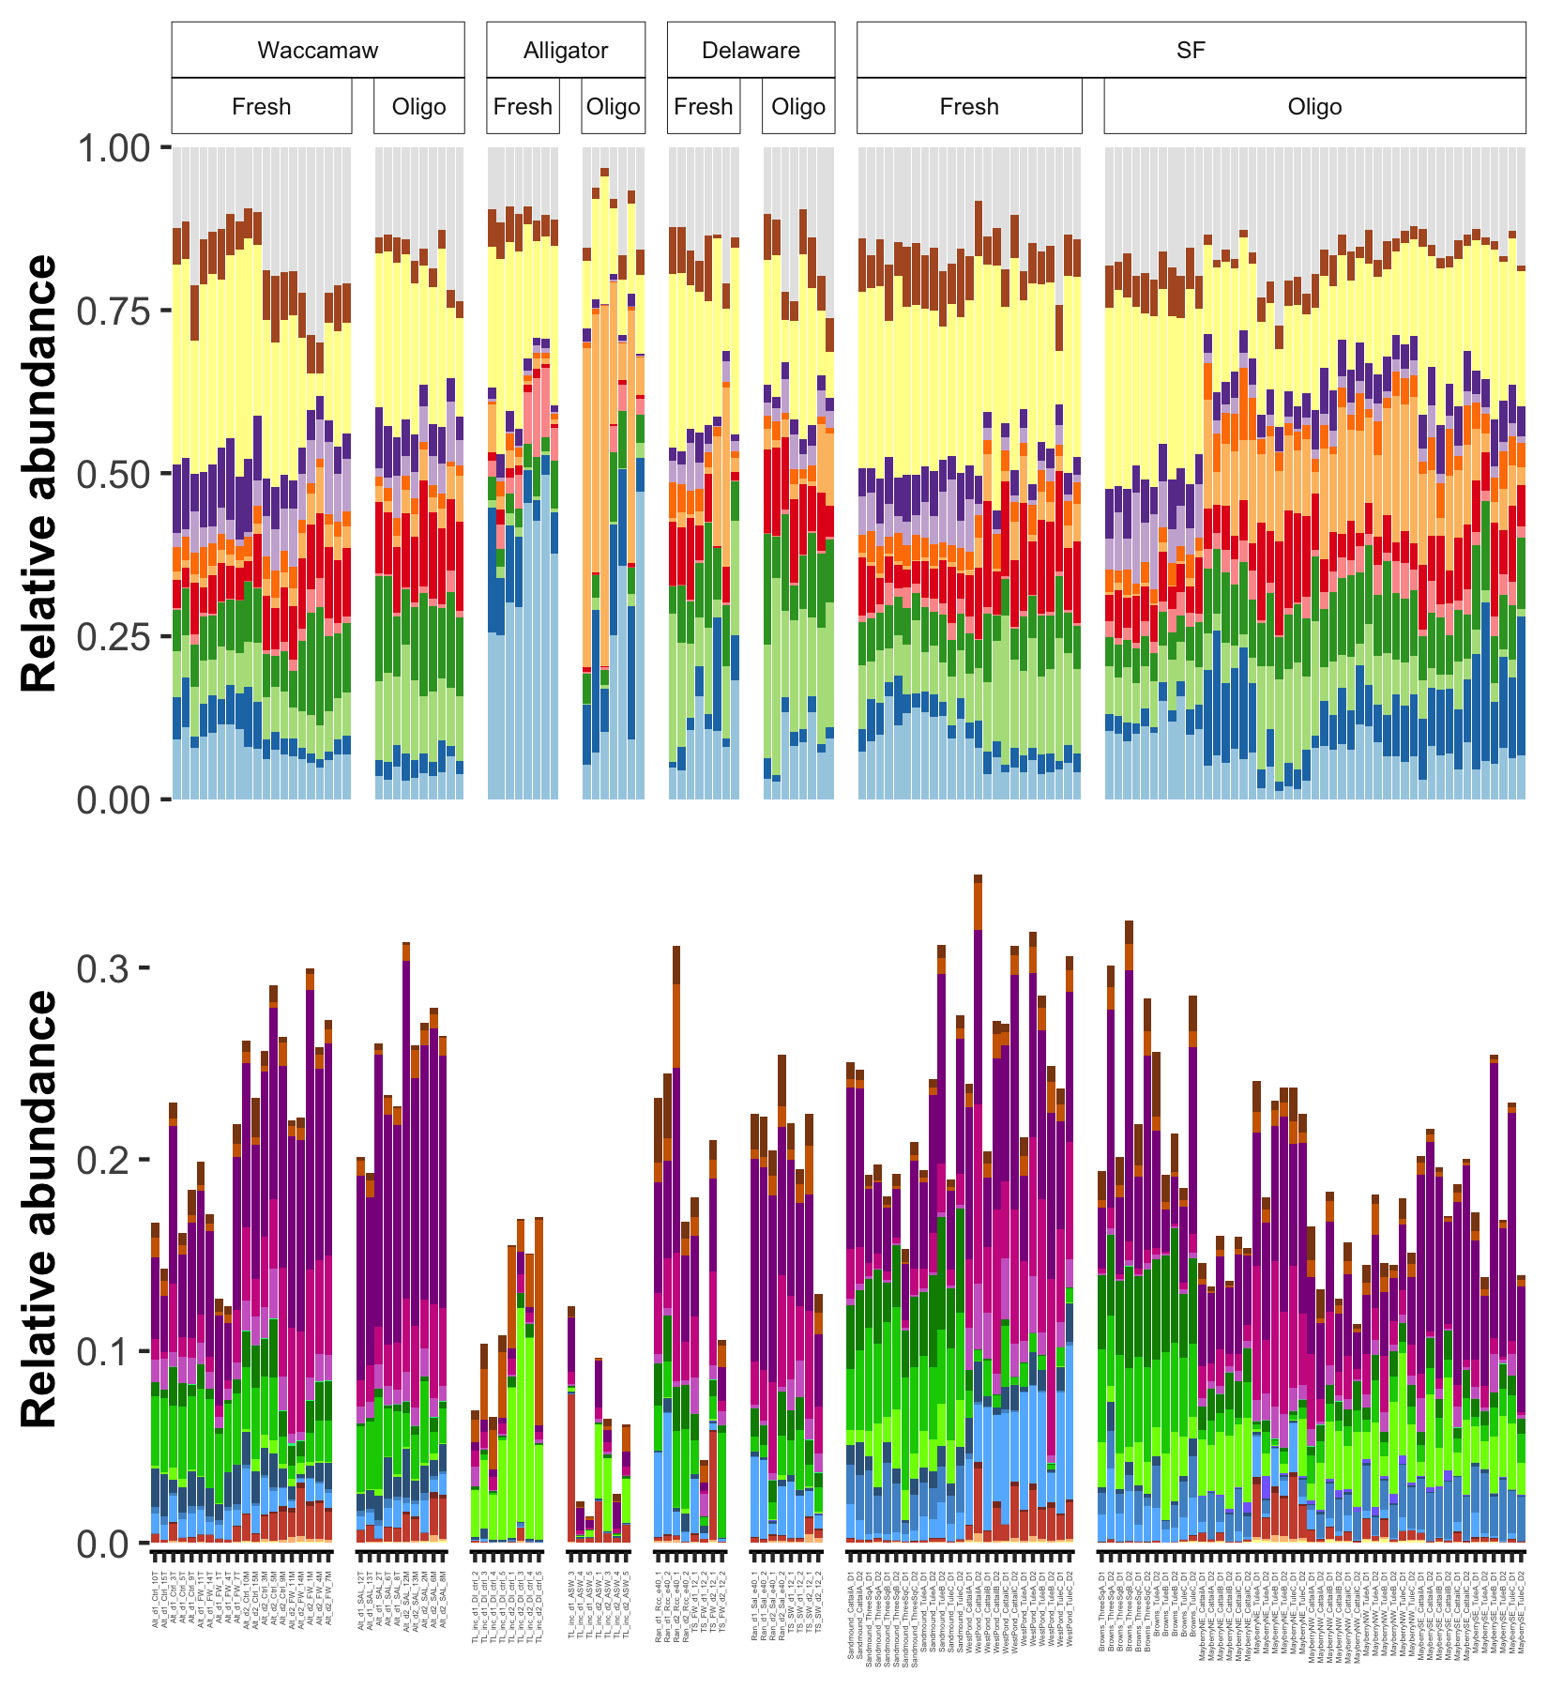
Salinity effect
Phylum |  | WA | AL | DE | SF
 | Other
 | Verrucomicrobiota | - | - |  | -
 | Proteobacteria |  | - |  | -
 | Planctomycetota
 | Nitrospirota |  | -
 | Myxococcota | - | -
 | Firmicutes |  | + |  | +
 | Desulfobacterota | + | -
 | Crenarchaeota |  | - |  | +
 | Chloroflexi | + |  |  | +
 | Bacteroidota | + |  |  | -
 | Actinobacteriota |  |  |  | +
 | Acidobacteriota | -
Guild |  | WA | AL | DE | SF
 | FeRB | -
 | FeOB | + | -
 | SRB | +
 | SRB_syn |  |  |  | -
 | SOxB
 | Anamx |  |  |  | +
 | NOB | -
 | AOB
 | AOA |  | - |  | +
 | ANME |  |  |  | +
 | MOB_IIa |  |  |  | -
 | MOB_II
 | MOB_I |  |  |  | -
 | CH4_ac
 | CH4_H2
 | CH4_me |  |  |  | -
 | CH4_mix
Salinity effect

