Slide 1
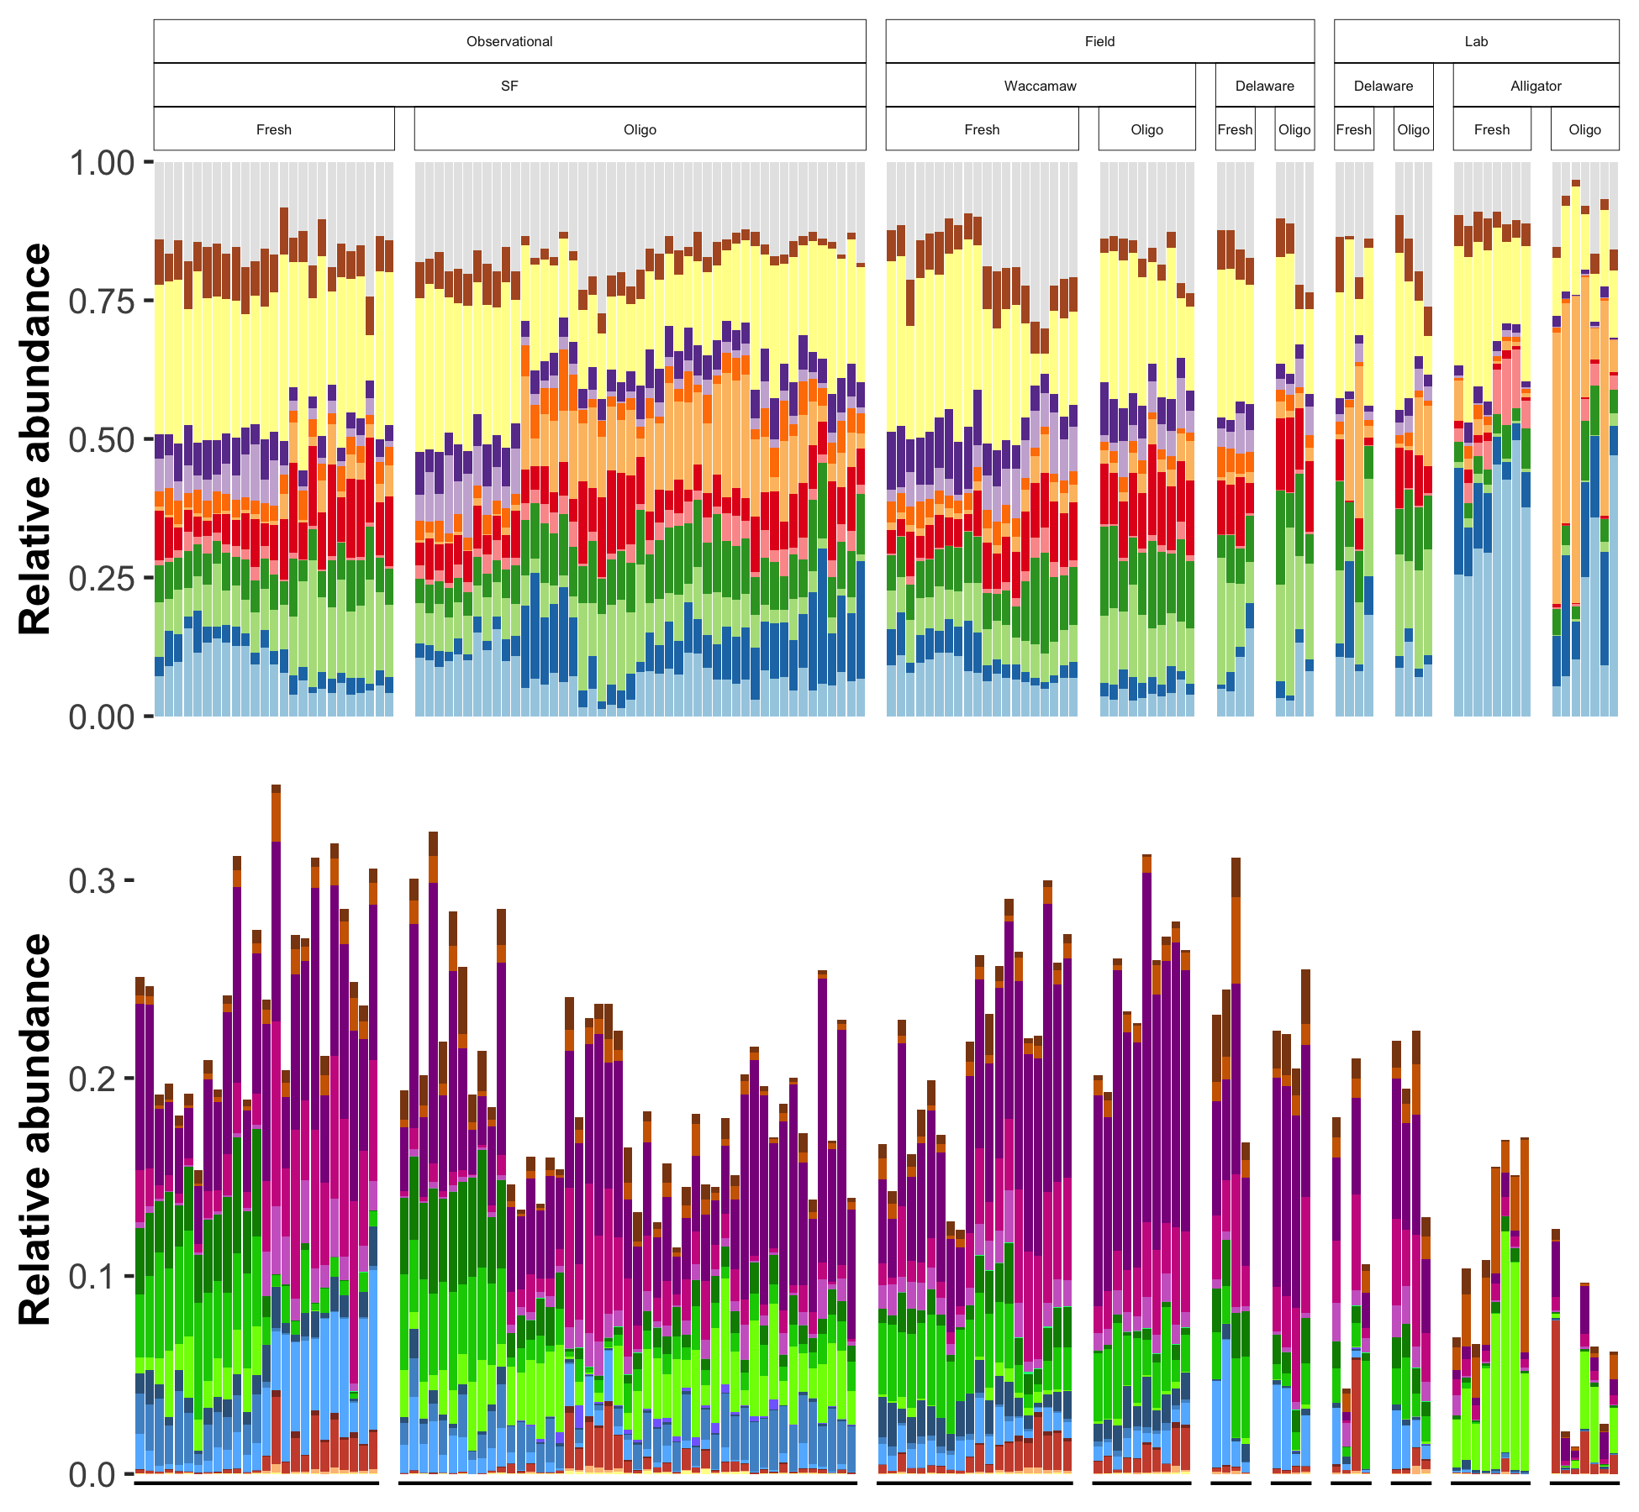
Salinity effect
Phylum |  | SF | WA | DEF | DEL | AL
 | Other
 | Verrucomicrobiota | - | - |  |  | -
 | Proteobacteria | - |  |  |  | -
 | Planctomycetota
 | Nitrospirota |  |  |  |  | -
 | Myxococcota |  | - |  |  | -
 | Firmicutes | + |  |  |  | +
 | Desulfobacterota |  | + |  |  | -
 | Crenarchaeota | + |  |  |  | -
 | Chloroflexi | + | +
 | Bacteroidota | - | +
 | Actinobacteriota | +
 | Acidobacteriota |  | -
Guild |  | SF | WA | DEF | DEL | AL
 | FeRB |  | -
 | FeOB |  | + |  |  | -
 | SRB |  | +
 | SRB_syn | -
 | SOxB
 | Anamx | +
 | NOB |  | -
 | AOB
 | AOA | + |  |  |  | -
 | ANME | +
 | MOB_IIa | -
 | MOB_II
 | MOB_I | -
 | CH4_ac
 | CH4_H2
 | CH4_me | -
 | CH4_mix
Salinity effect

Slide 2
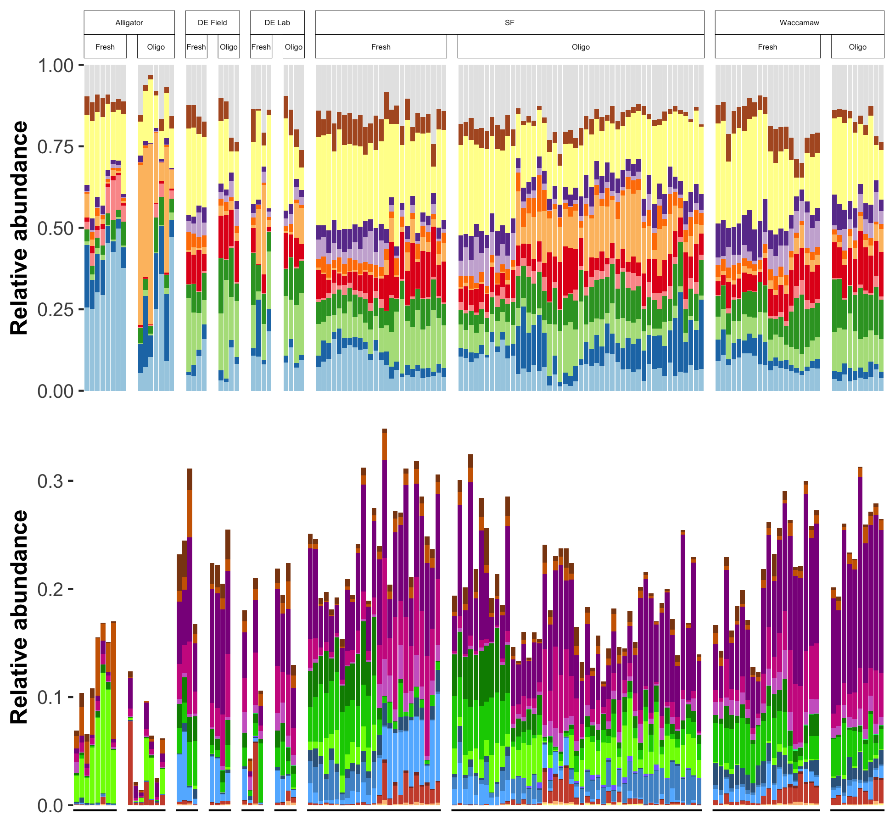
Salinity effect
Phylum |  | SF | WA | DEF | DEL | AL
 | Other
 | Verrucomicrobiota | - | - |  |  | -
 | Proteobacteria | - |  |  |  | -
 | Planctomycetota
 | Nitrospirota |  |  |  |  | -
 | Myxococcota |  | - |  |  | -
 | Firmicutes | + |  |  |  | +
 | Desulfobacterota |  | + |  |  | -
 | Crenarchaeota | + |  |  |  | -
 | Chloroflexi | + | +
 | Bacteroidota | - | +
 | Actinobacteriota | +
 | Acidobacteriota |  | -
Guild |  | SF | WA | DEF | DEL | AL
 | FeRB |  | -
 | FeOB |  | + |  |  | -
 | SRB |  | +
 | SRB_syn | -
 | SOxB
 | Anamx | +
 | NOB |  | -
 | AOB
 | AOA | + |  |  |  | -
 | ANME | +
 | MOB_IIa | -
 | MOB_II
 | MOB_I | -
 | CH4_ac
 | CH4_H2
 | CH4_me | -
 | CH4_mix
Salinity effect

