Slide 1
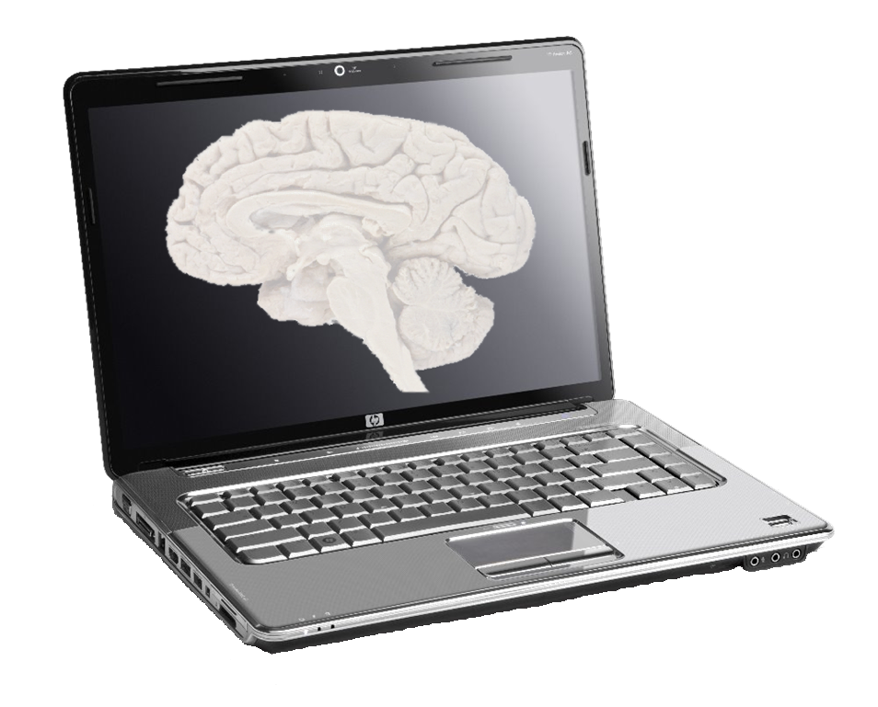
Multiscale modeling of cortical information flow in Parkinson's disease
Cliff Kerr, Sacha van Albada, Sam Neymotin, George Chadderdon, Peter Robinson, Bill Lytton
Neurosimulation Laboratory, SUNY Downstate Medical Center www.neurosimlab.org

Slide 2
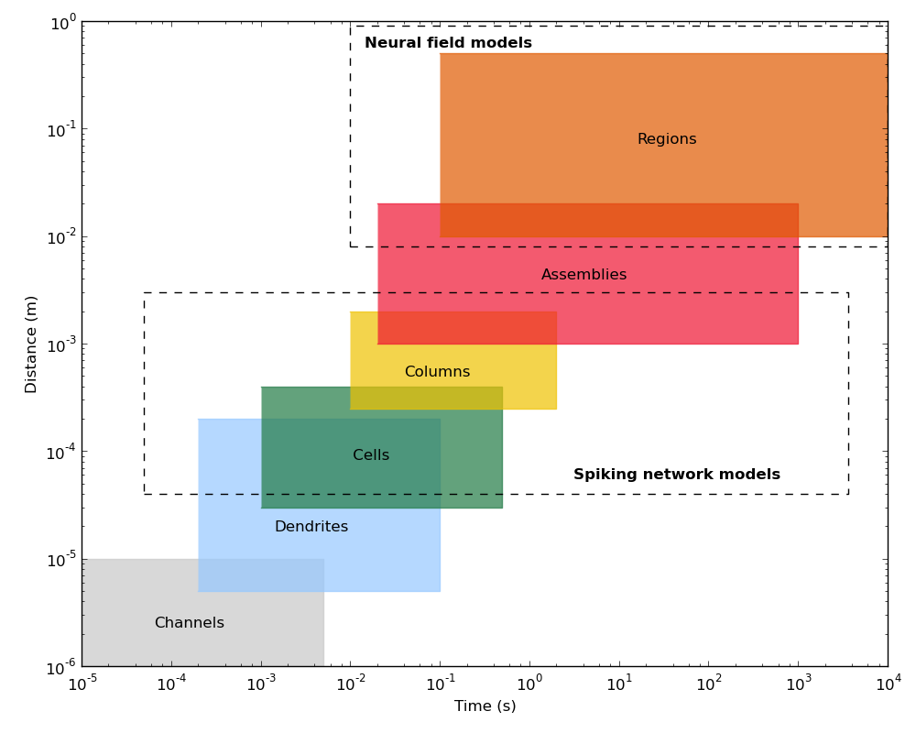
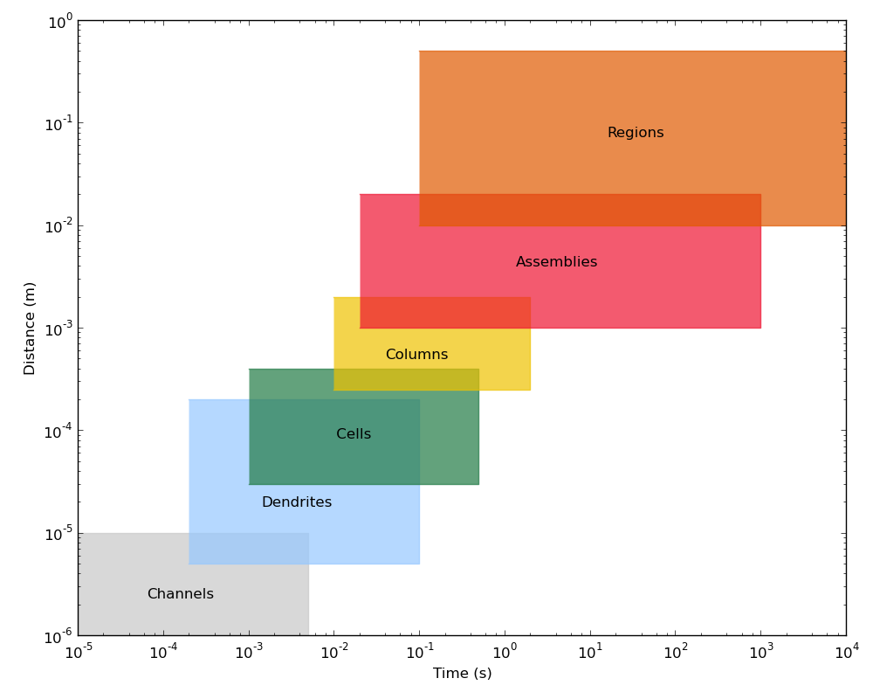
Multiscale modeling

Slide 3
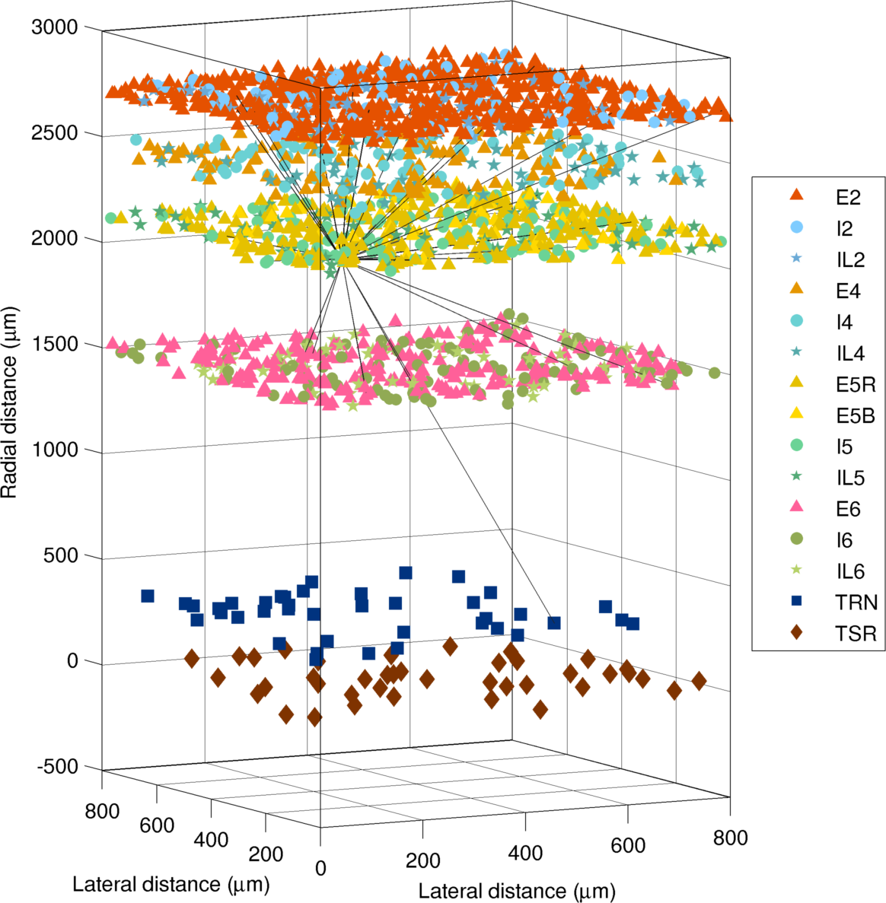
Spiking network model
Event-driven integrate-and-fire neurons
6-layered cortex, 2 thalamic nuclei
15 cell types
≥5000 neurons

Slide 4
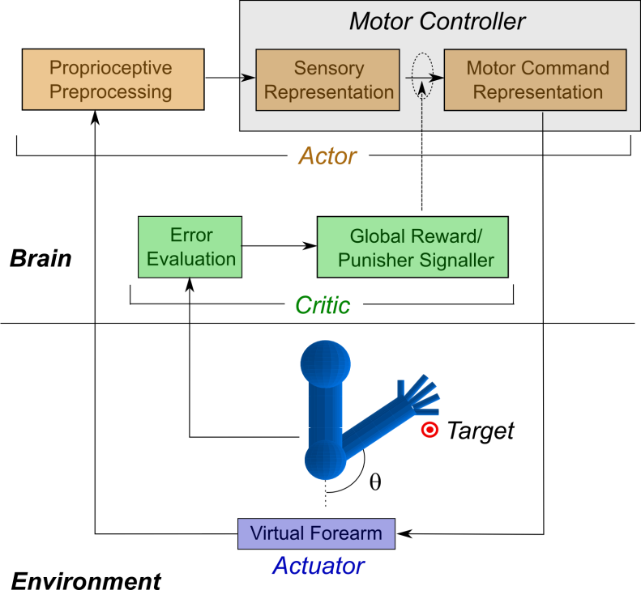

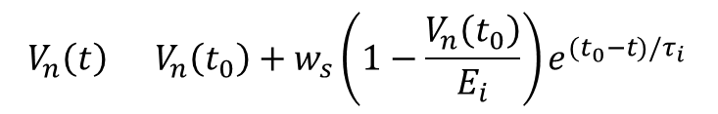
Spiking network model
Anatomy & physiology based on experimental data
Generates realistic dynamics
Adaptable to different brain regions depending on cell populations/ connectivities
Demonstrated control of virtual arm
Chadderdon et al., PLoS ONE 2012
Synaptic input:
Learning (STDP):
$$V_{n}\left(t\right)=V_{n}\left(t_{0}\right)+w_{s}\left(1−\frac{V_{n}\left(t_{0}\right)}{E_{i}}\right)e^{(t_{0}−t)/τ_{i}}$$
$$w_{s}^{f}=w_{s}^{i} +αs\left(Δt\right)e^{−|Δt|/τ_{L}}$$

Slide 5
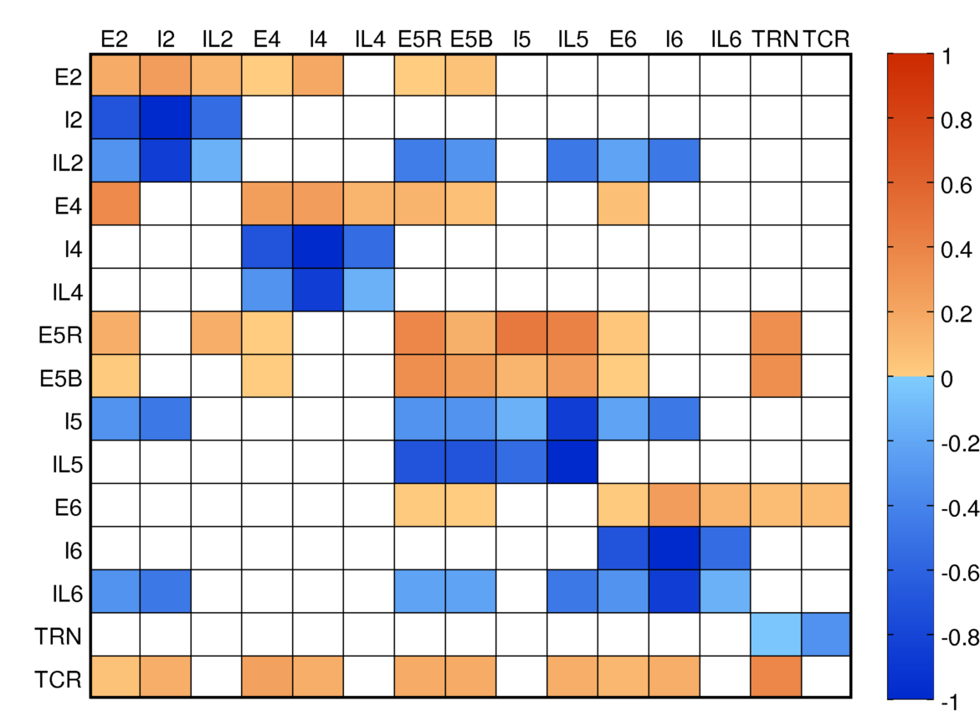
Spiking network model
Connectivity matrix based on rat, cat, and macaque data
Strong intralaminar and thalamocortical connectivity

Slide 6
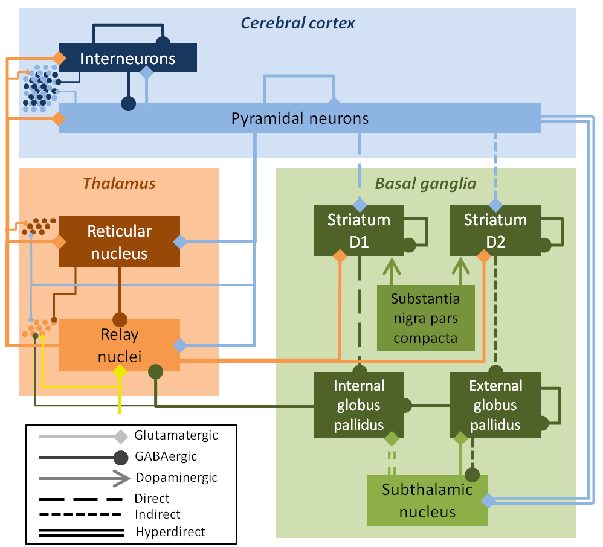
Neural field model
Continuous firing rate model
9 neuronal populations
26 connections
Field model activity drives network model

Slide 7
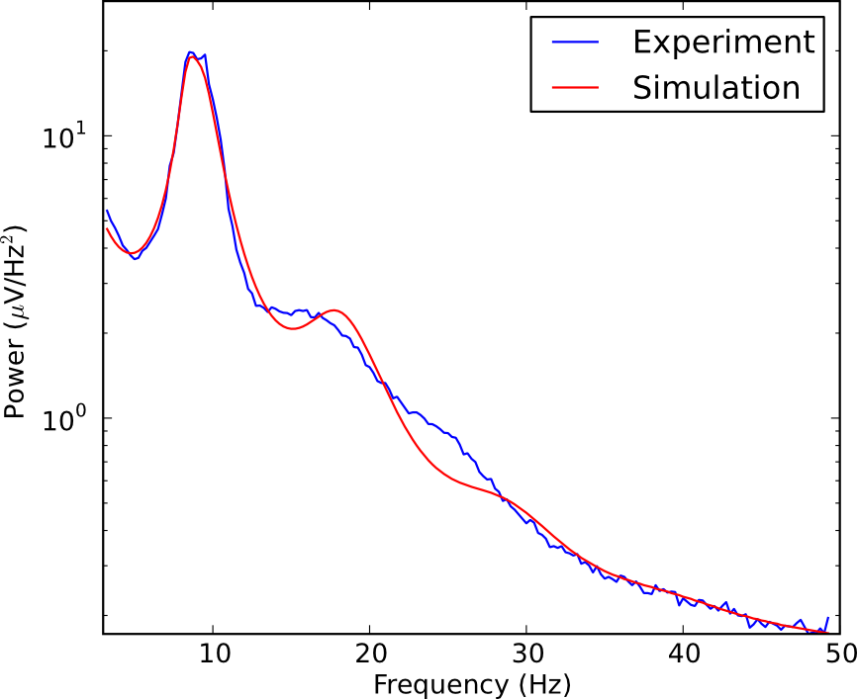
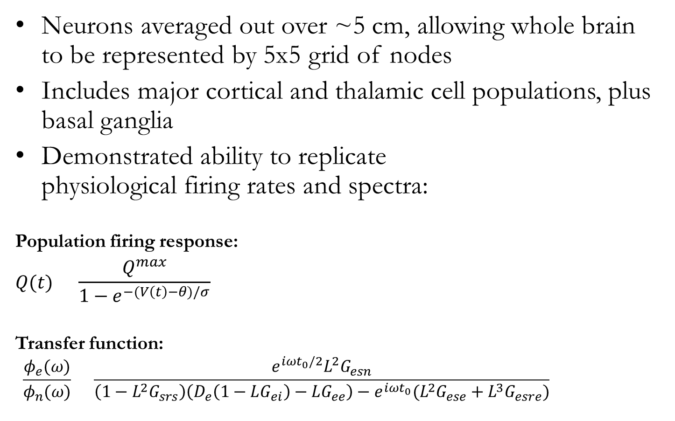
Neural field model
Neurons averaged out over ~5 cm, allowing whole brain to be represented by 5x5 grid of nodes
Includes major cortical and thalamic cell populations, plus basal ganglia
Demonstrated ability to replicate physiological firing rates and spectra:
Population firing response:
$$Q(t)=\frac{Q^{max}}{1−e^{−(V\left(t\right)−θ)/σ}}$$
Transfer function:
$$\frac{φ_{e}(ω)}{φ_{n}(ω)}=\frac{e^{iωt_{0}/2}L^{2}G_{esn}}{\left(1−L^{2}G_{srs}\right)\left(D_{e}\left(1−LG_{ei}\right)−LG_{ee}\right)−e^{iωt_{0}}(L^{2}G_{ese}+L^{3}G_{esre})}$$

Slide 8
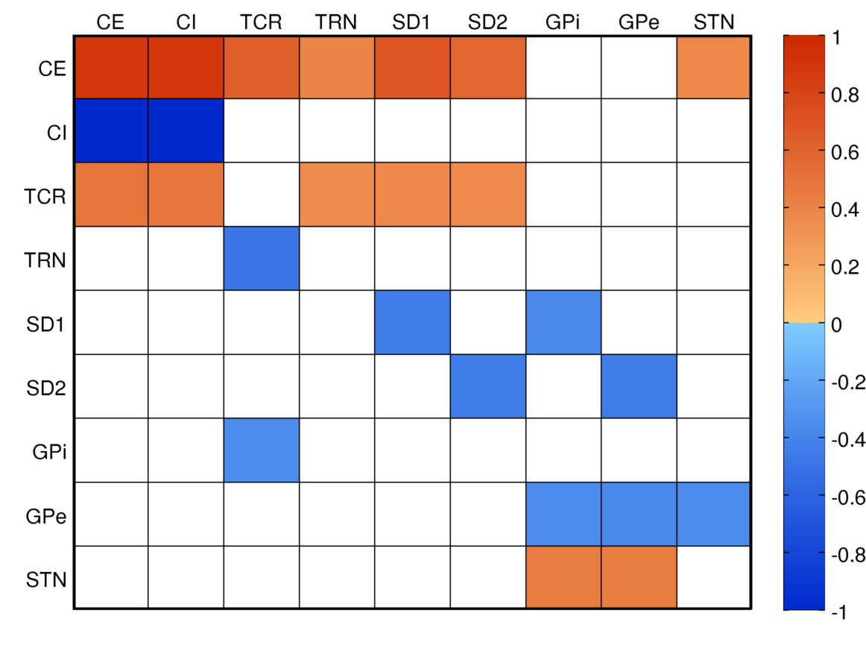
Neural field model
Thalamocortical connectivity dominates
GPi links basal ganglia to rest of brain

Slide 9
From field to network
Firing rates in the field model drive an ensemble of Poisson processes, which then drive the network
Poisson
Network
Field
p₁
p₂
p₃

Slide 10
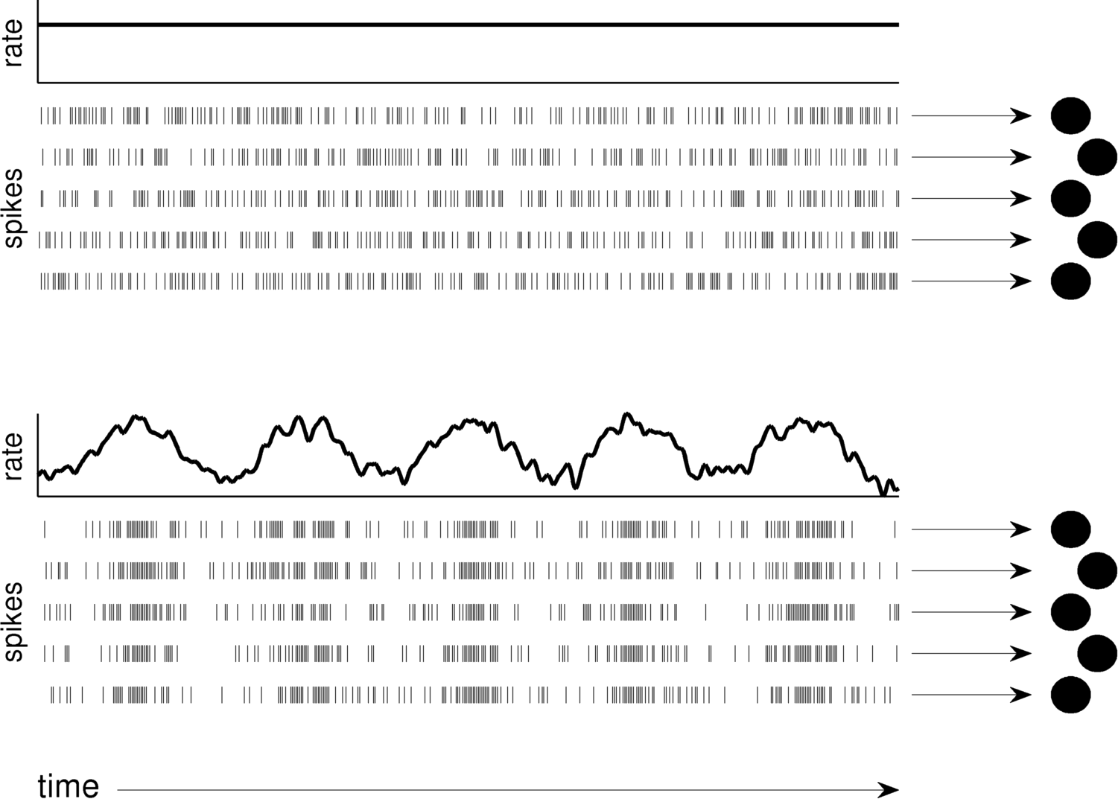
From field to network

Slide 11
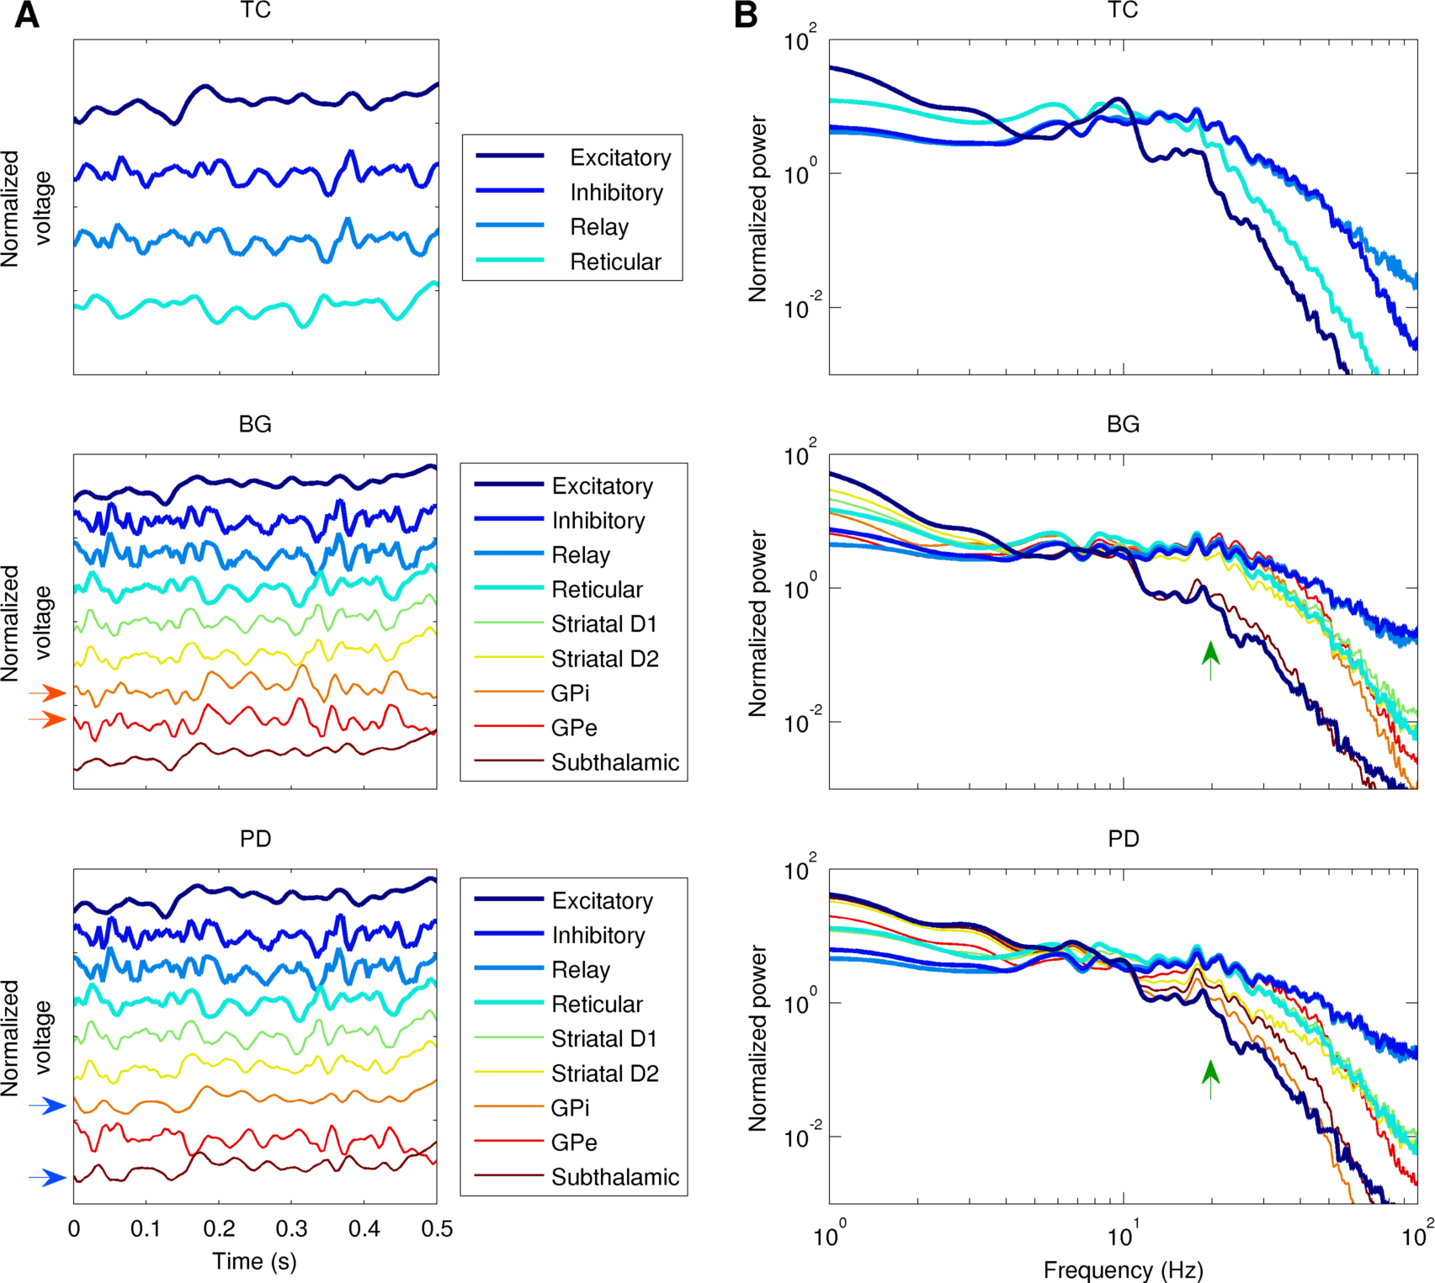
Field model dynamics
PD disrupts coherence between basal ganglia nuclei
PD changes spectral power in beta/gamma bands

Slide 12
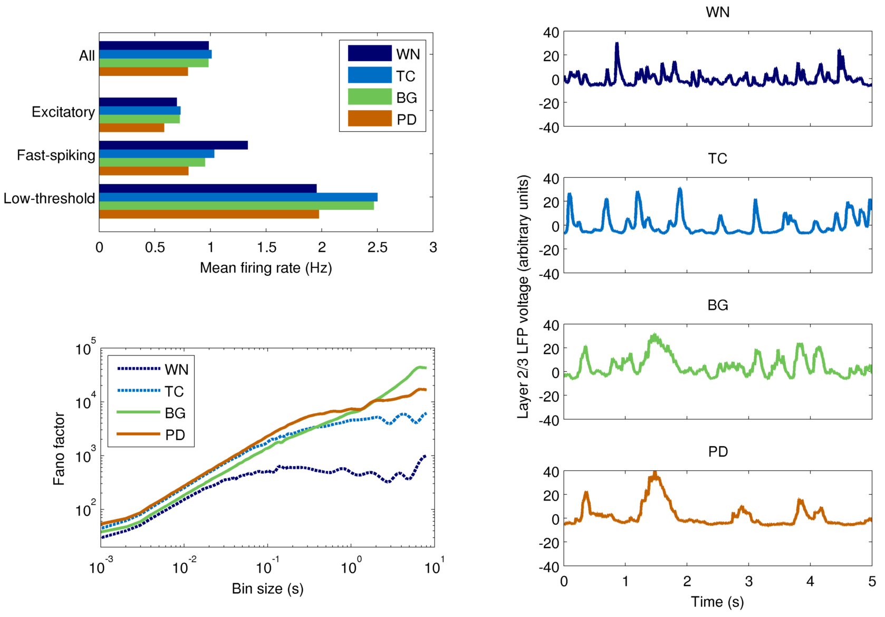
Network model dynamics

Slide 13
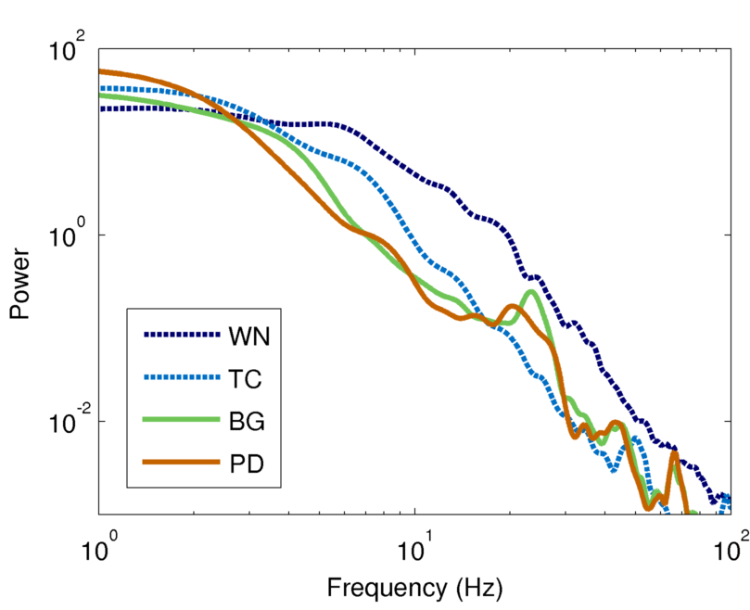
Network spectra

Slide 14
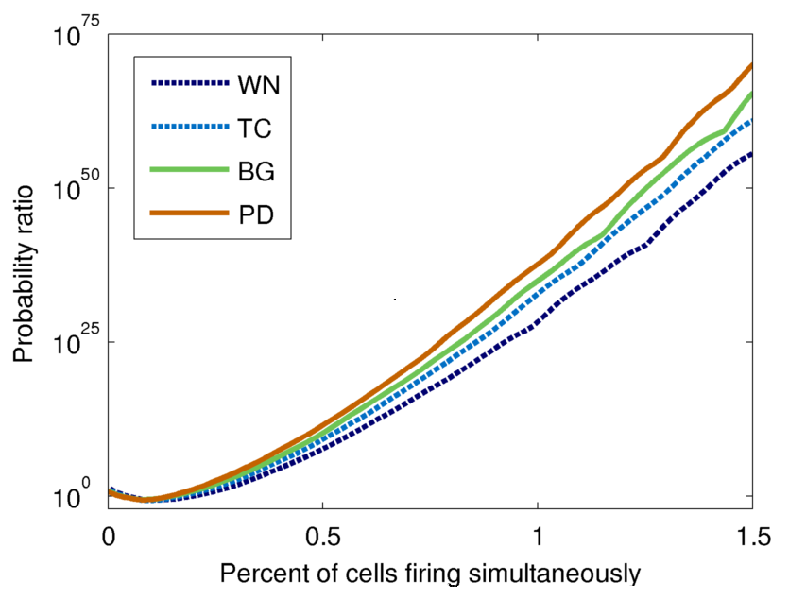
Burst probability

Slide 15
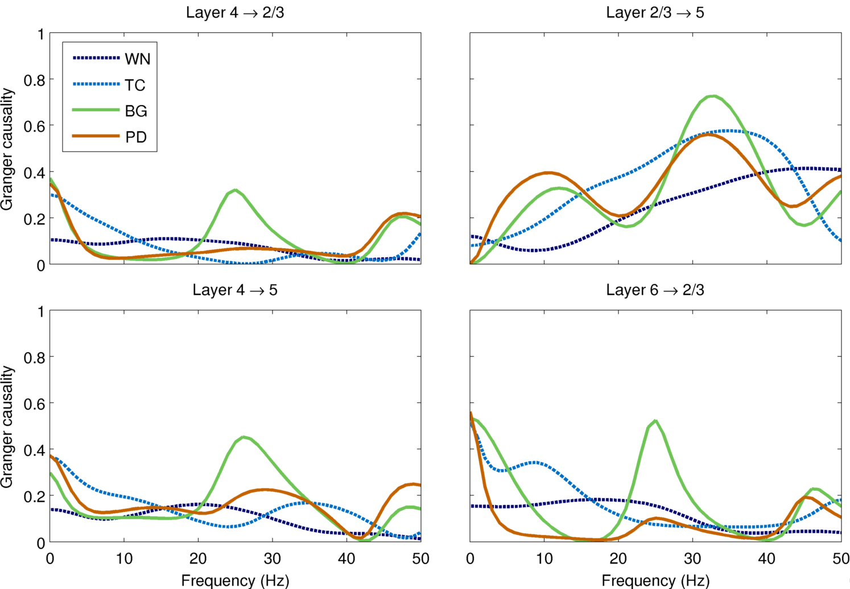
Granger causality

Slide 16
Summary
Model can reproduce many biomarkers of Parkinson’s disease (e.g. reduced cortical firing, increased coherence)
Granger causality between cortical layers was markedly reduced in PD – possible explanation of cognitive/motor deficits?
Different input drives had a major effect on the model dynamics
Realistic inputs are preferable to white noise for driving spiking network models

Slide 17
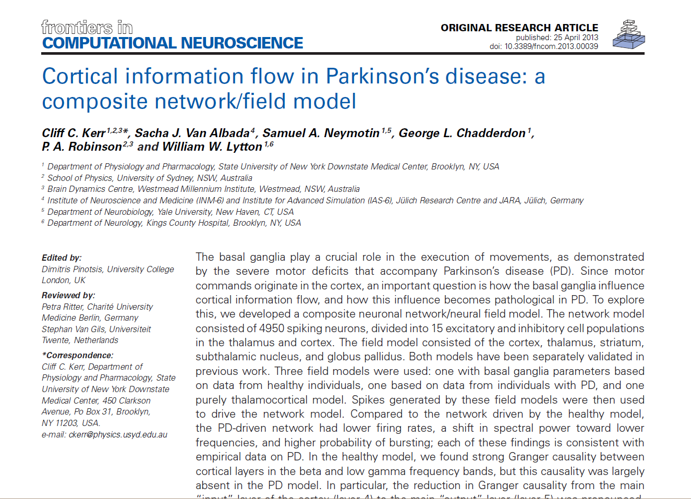

Slide 18

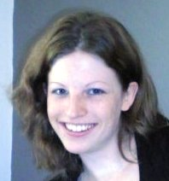
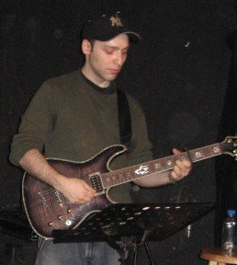
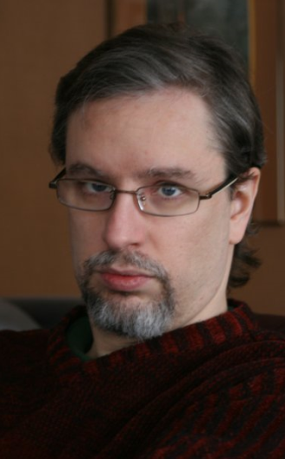

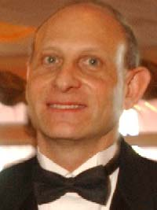
Acknowledgements
Sacha van Albada
Sam Neymotin
George Chadderdon
Peter Robinson
Bill Lytton
Notes:
.

