Slide 1
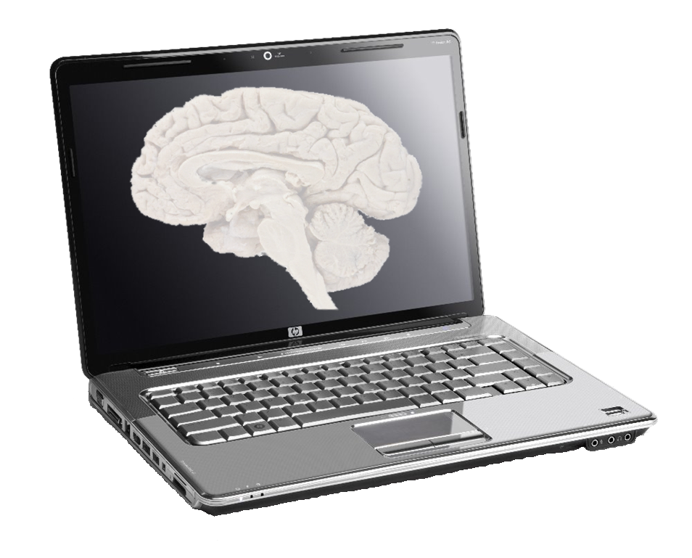
How Parkinson’s disease affects cortical information flow: A multiscale model
Cliff Kerr
Neurosimulation Laboratory
State University of New York
Complex Systems Group
University of Sydney

Slide 2
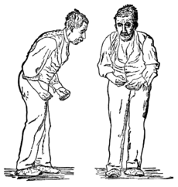
Parkinson’s disease
Tremor (typically 3-6 Hz)
Bradykinesia (slowness of movement)
Bradyphrenia (slowness of thought)

Slide 3
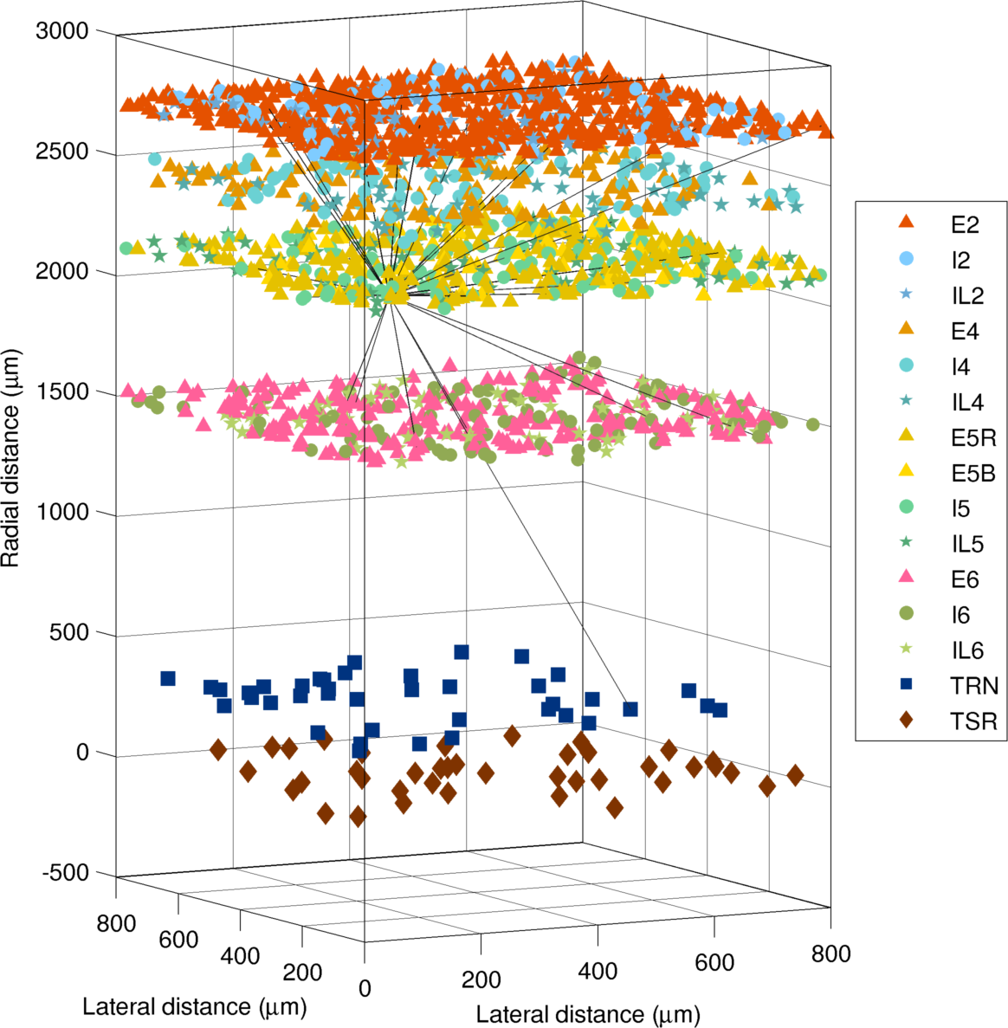
Spiking network model
Event-driven integrate-and-fire model
6-layered cortex, 2 thalamic nuclei
15 cell types
≥5000 neurons

Slide 4
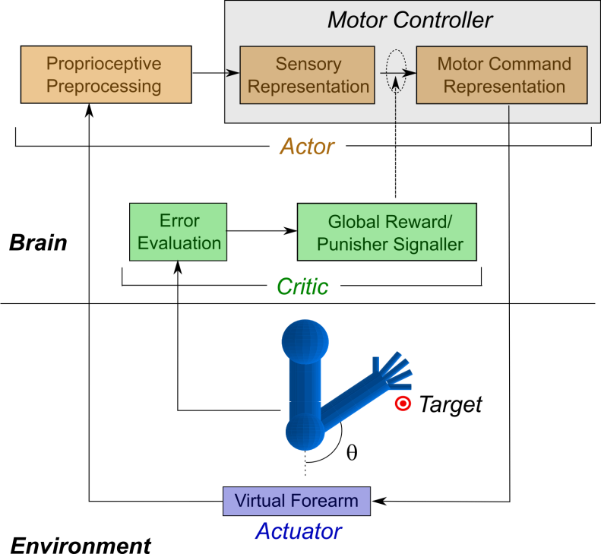
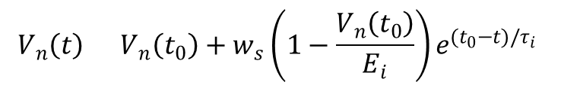

Spiking network model
Anatomy & physiology based on experimental data
Adaptable to different brain regions based on cell populations/ connectivities
Model generates realistic neuronal dynamics; demonstrated control of virtual arm
Synaptic input:
Synaptic plasticity:
$$V_{n}\left(t\right)=V_{n}\left(t_{0}\right)+w_{s}\left(1−\frac{V_{n}\left(t_{0}\right)}{E_{i}}\right)e^{(t_{0}−t)/τ_{i}}$$
$$w_{s}^{f}=w_{s}^{i} +αs\left(Δt\right)e^{−|Δt|/τ_{L}}$$

Slide 5
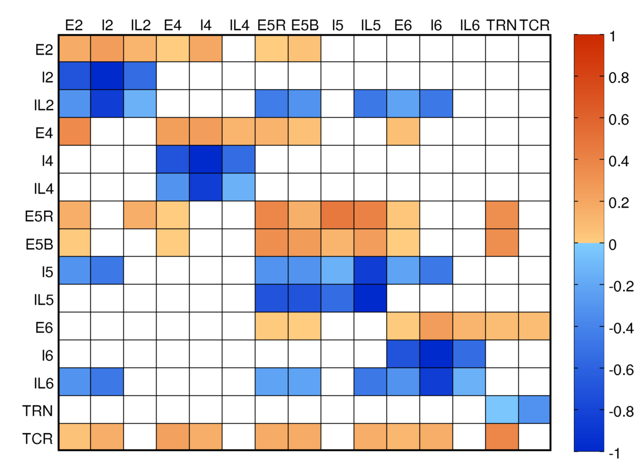
Spiking network model
Connectivity matrix based on rat, cat, and macaque data
Strong intralaminar and thalamocortical connectivity

Slide 6
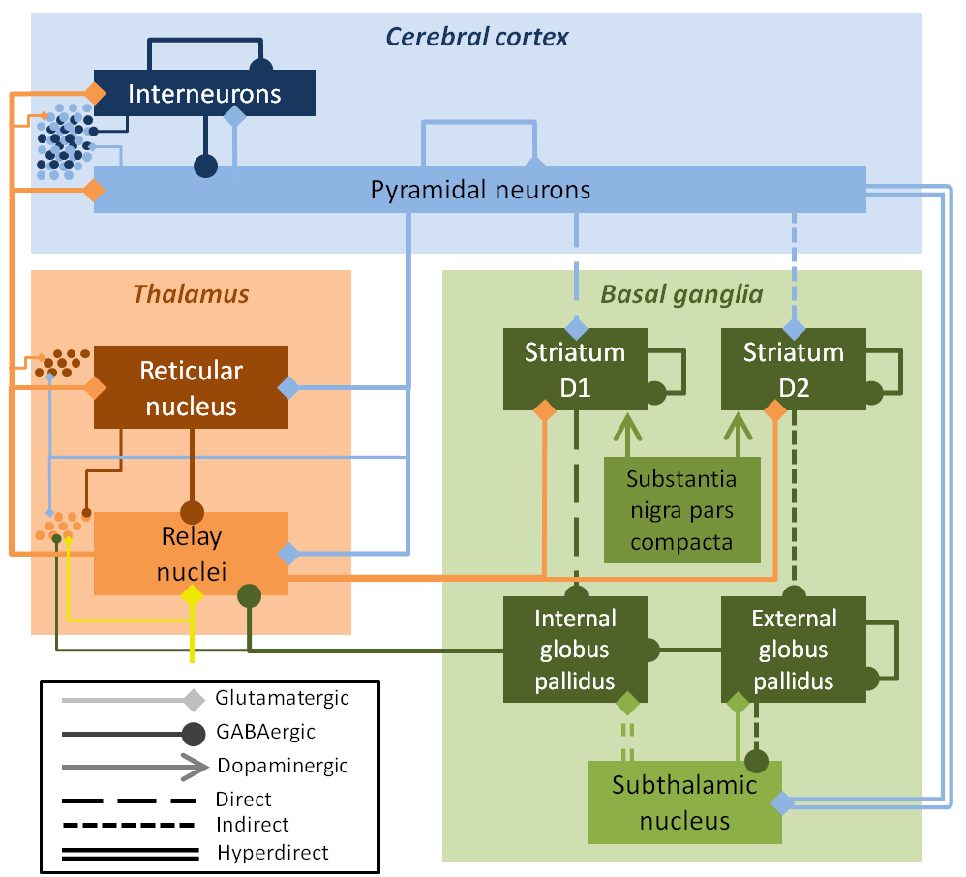
Neural field model
Continuous firing rate model
9 neuronal populations
26 connections
Field model activity drives network model

Slide 7
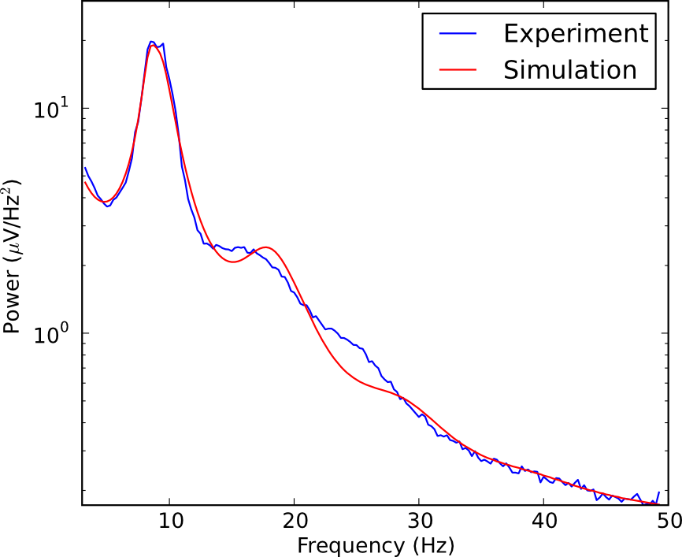
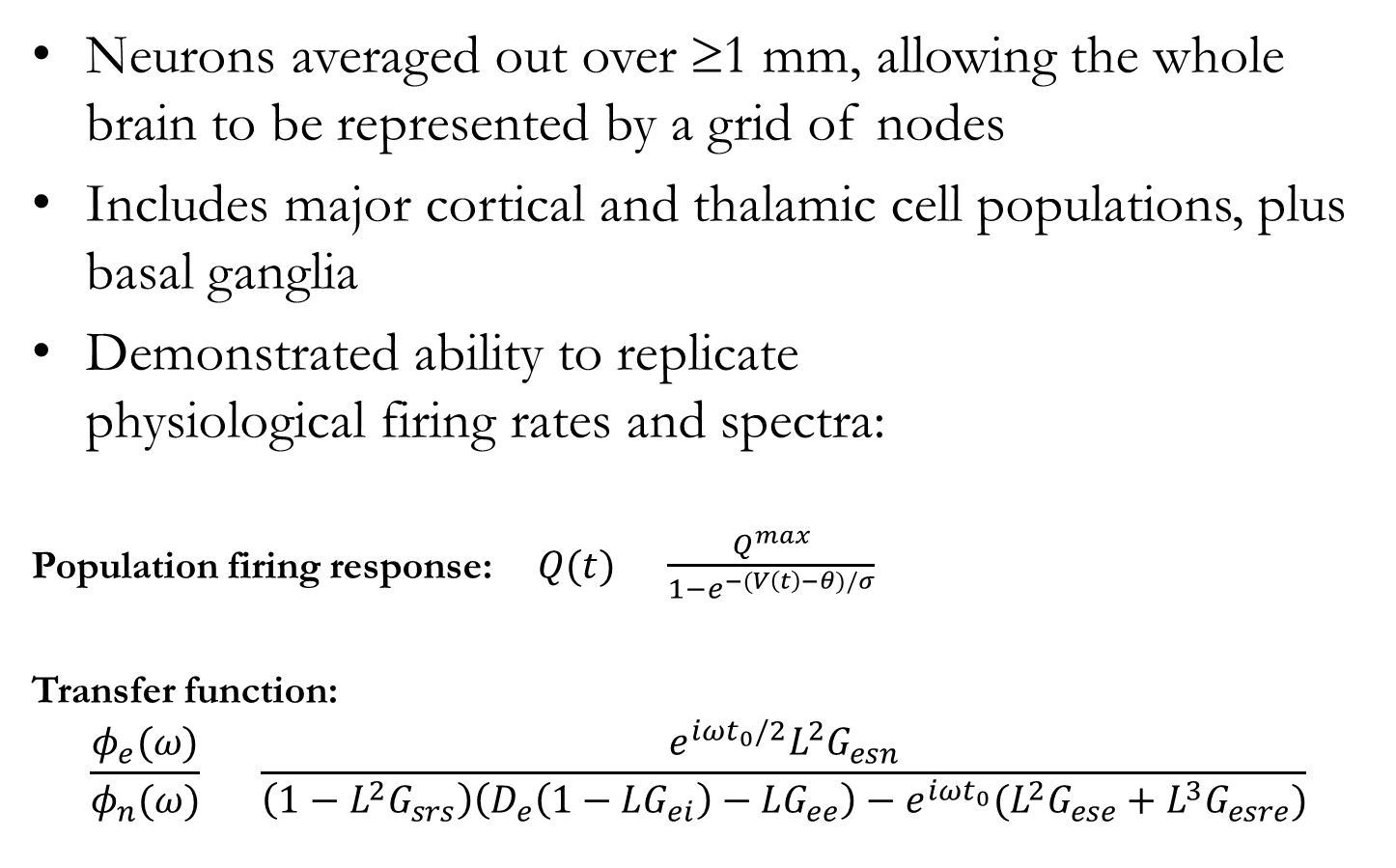
Neural field model
Neurons averaged out over ≥1 mm, allowing the whole brain to be represented by a grid of nodes
Includes major cortical and thalamic cell populations, plus basal ganglia
Demonstrated ability to replicate physiological firing rates and spectra:
Population firing response:$Q(t)=\frac{Q^{max}}{1−e^{−(V\left(t\right)−θ)/σ}}$
Transfer function:
$$\frac{φ_{e}(ω)}{φ_{n}(ω)} =\frac{e^{iωt_{0}/2}L^{2}G_{esn}}{\left(1−L^{2}G_{srs}\right)\left(D_{e}\left(1−LG_{ei}\right)−LG_{ee}\right)−e^{iωt_{0}}(L^{2}G_{ese}+L^{3}G_{esre})}$$

Slide 8
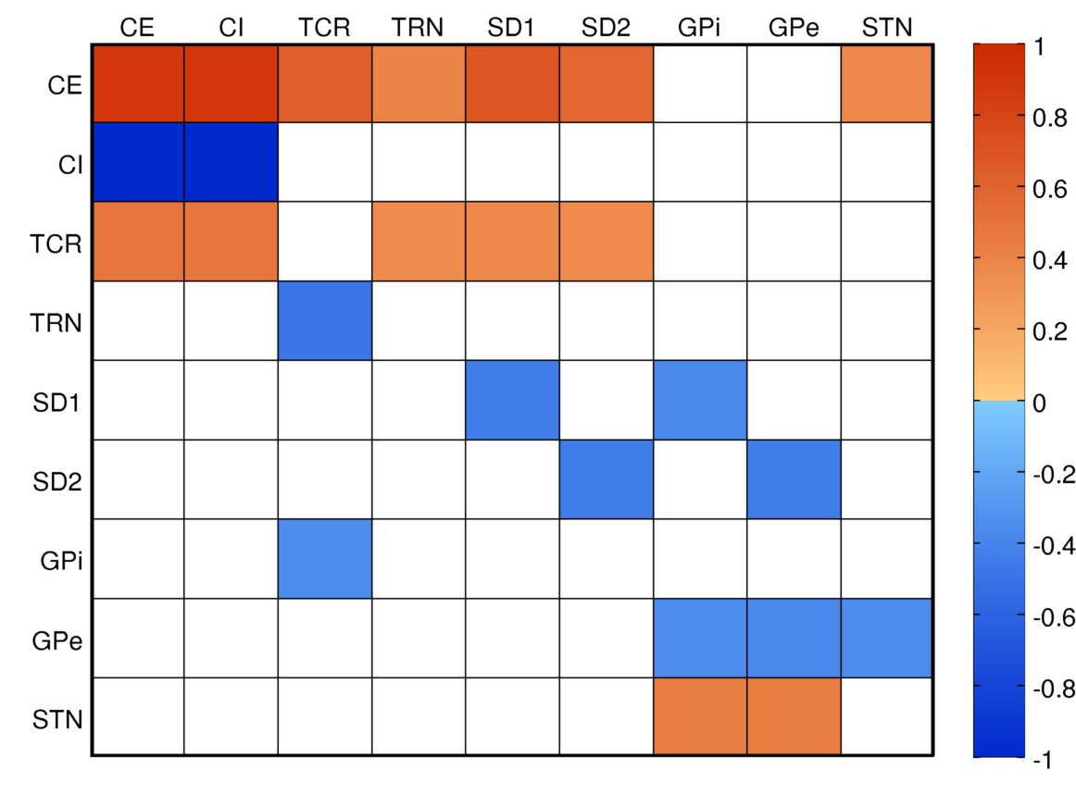
Neural field model
GPi links basal ganglia to rest of brain:

Slide 9
From field to network
Firing rates in the field model drive an ensemble of Poisson processes, which then drive the network
Poisson
Network
Field
p₁
p₂
p₃

Slide 10
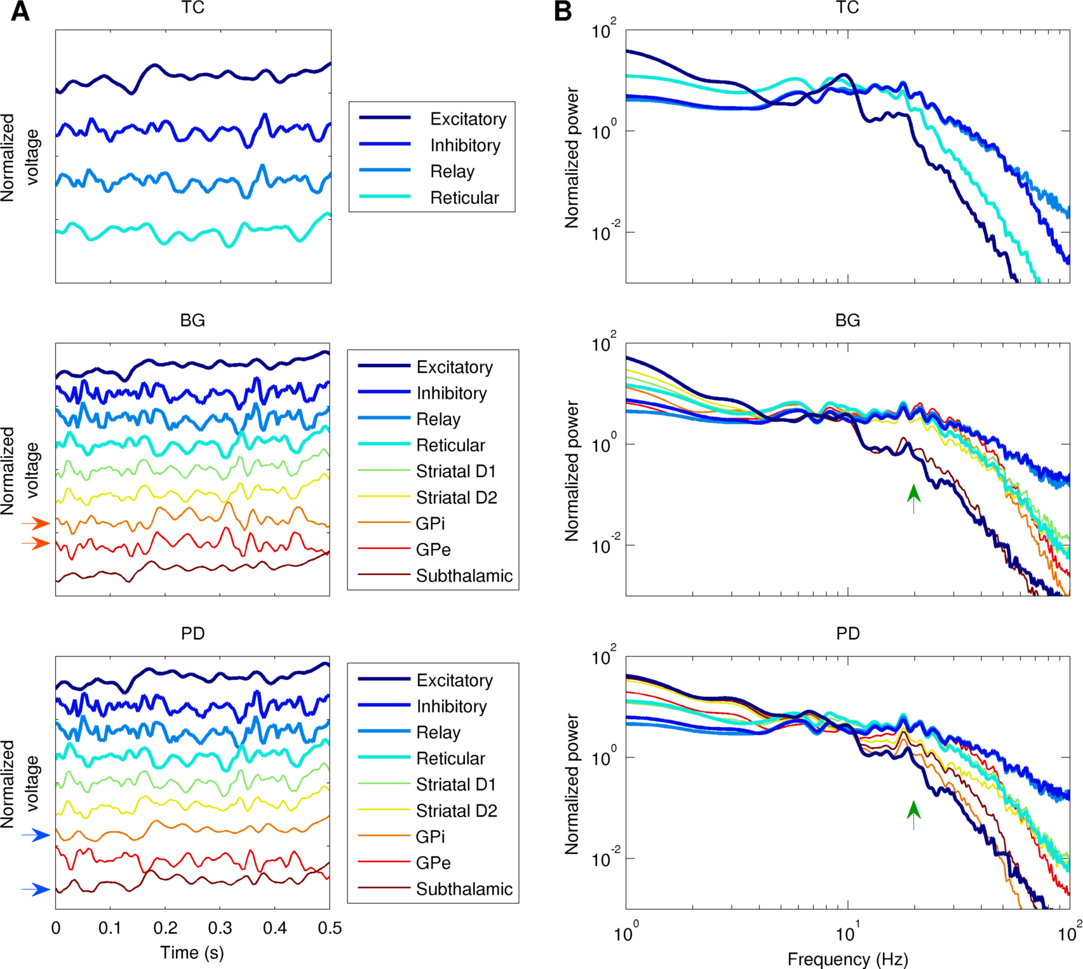
Field model dynamics
PD disrupts coherence between basal ganglia nuclei
PD changes spectral power in beta/gamma bands

Slide 11
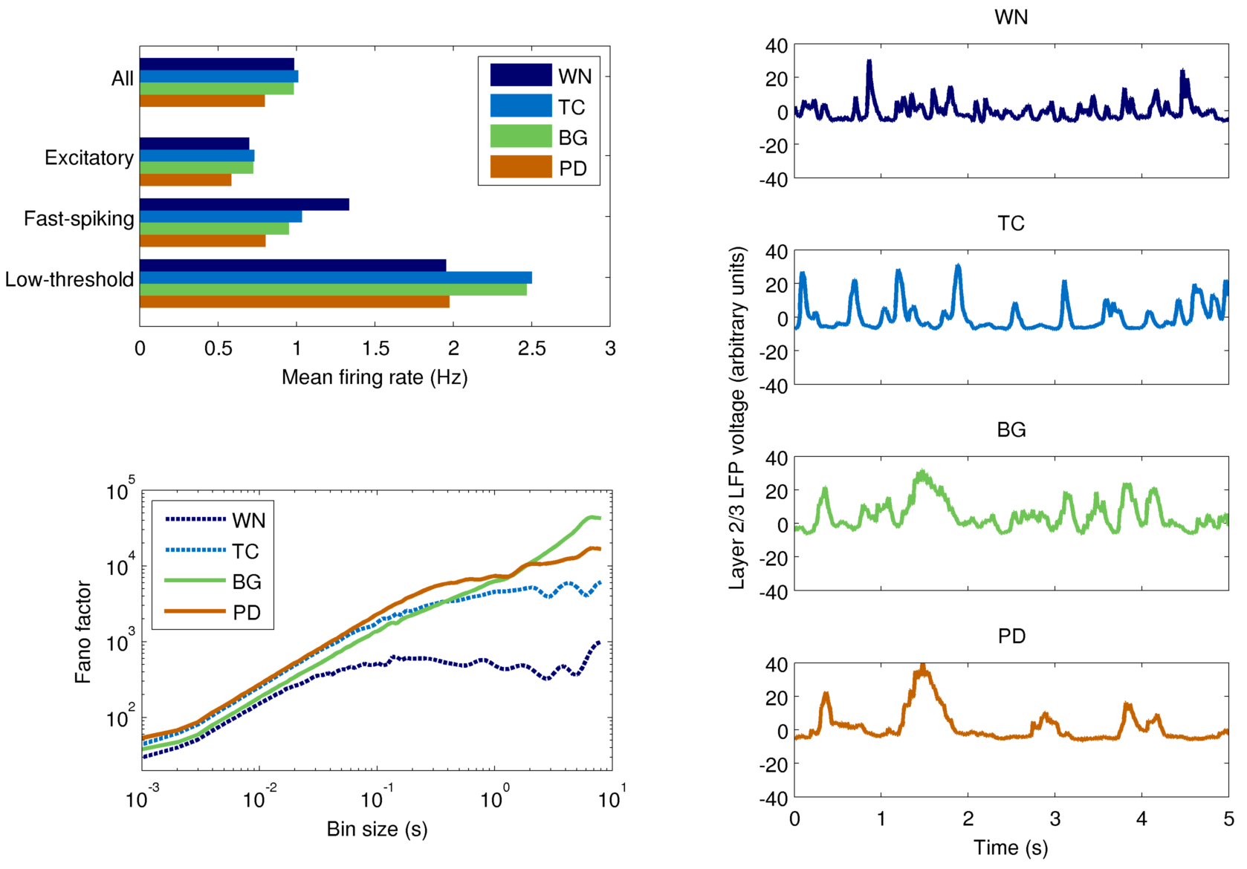
Network model dynamics

Slide 12
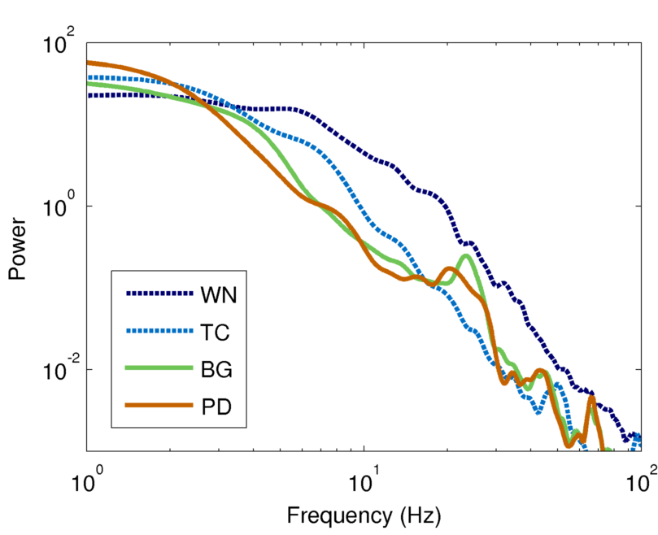
Network spectra

Slide 13
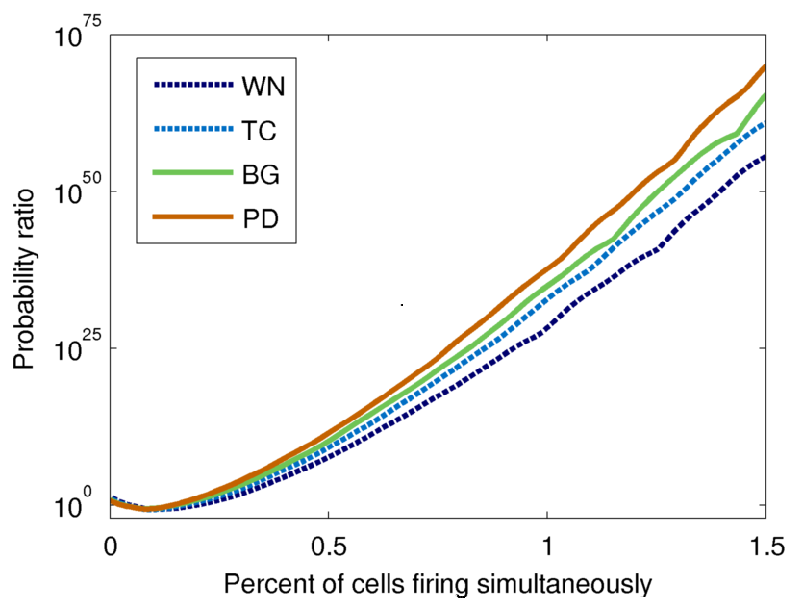
Burst probability

Slide 14
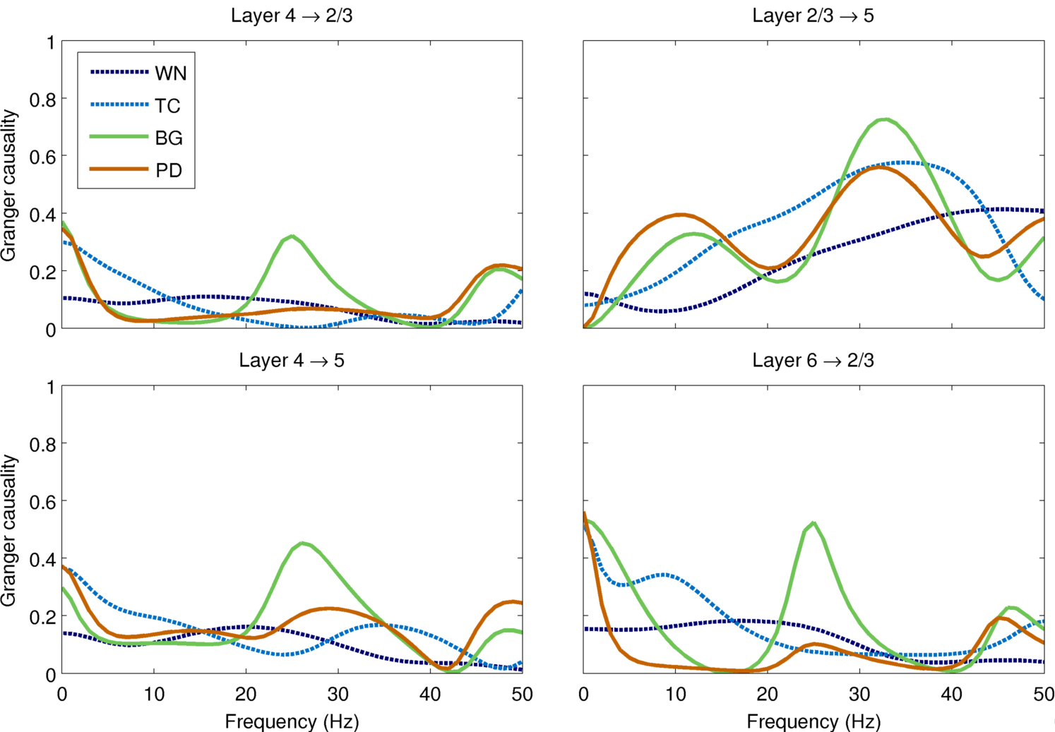
Granger causality

Slide 15
Summary
Model can reproduce many features of Parkinson’s disease (e.g. reduced cortical firing, increased coherence)
Granger causality between cortical layers was markedly reduced in PD – possible explanation of bradyphrenia (…and bradykinesia?)
Different input drives had a major effect on the model dynamics
Where possible, realistic inputs should be used instead of white noise for driving network models

Slide 16

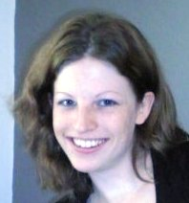
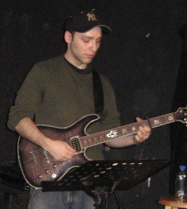
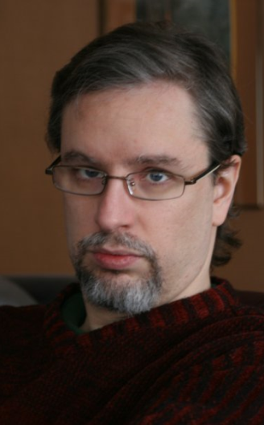
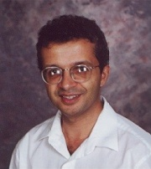
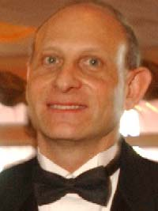
Acknowledgements
Sacha J. van Albada
Samuel A. Neymotin
George L. Chadderdon III
Peter A. Robinson
William W. Lytton
Notes:
.

