Slide 1


Using Optima to optimize resource allocations
Cliff C. Kerr, David P. Wilson

Slide 2
Outline
Background
How Optima works
Data requirements for Optima
Using Optima in practice
Optima vs. Spectrum

Slide 3
Outline
Background
How Optima works
Data requirements for Optima
Using Optima in practice
Optima vs. Spectrum

Slide 4
Public health evaluation process
Know your epidemic
Epidemiological surveillance
Know your response
Program monitoring
Costing and spending assessments
Monitoring & evaluation strategy
Impact evaluation Modeling Health economics
Evaluate response
Development of national strategies
Determining resource needs
Technical efficiency
Allocative efficiency
Sustainable Financing
Refine response

Slide 5
Public health evaluation process
Know your epidemic
Epidemiological surveillance
Know your response
Program monitoring
Costing and spending assessments
Monitoring & evaluation strategy
Impact evaluation Modeling Health economics
Evaluate response
Development of national strategies
Determining resource needs
Technical efficiency
Allocative efficiency
Sustainable Financing
Refine response

Slide 6
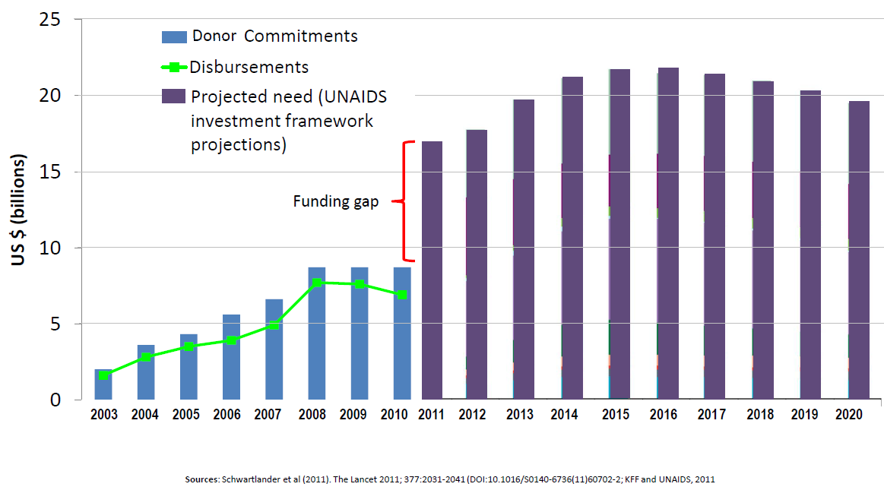
Difficult time for global response to HIV

Slide 7
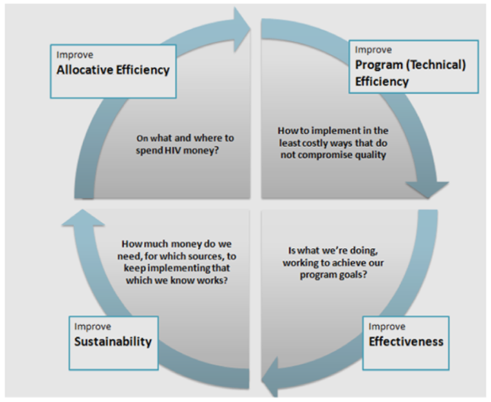
HIV responses need to be done smarter

Slide 8
What should we spend money on?
Understand your epidemic
Where is the epidemic? Among whom? Where is it going?
Is money being allocated to the groups most in need?
Design your response
How well is the response matched to the epidemic?
How many more infections could be averted with an optimized response?
Determine the cost
How much will the response cost? How can it be financed? What are the fiscal space implications?

Slide 9
What should we spend money on?
Understand your epidemic
Where is the epidemic? Among whom? Where is it going?
Is money being allocated to the groups most in need?
Design your response
How well is the response matched to the epidemic?
How many more infections could be averted with an optimized response?
Determine the cost
How much will the response cost? How can it be financed? What are the fiscal space implications?

Slide 10
Smart resource allocation
Resources should be allocated towards interventions that have evidence of being the most cost-effective
Allocation decisions should be done strategically to have the greatest chance of meeting the desired objectives

Slide 11
What is the overall objective?
Necessary to define the objective, e.g.:
Minimizing new infections: all funding would go to the most effective prevention
Minimizing AIDS-related deaths: all funding would go to treatment
Minimizing spending: could lead to a combination of prevention and treatment (depending on timeframe)
Other possible objectives:
Minimize overall disease burden
Provide equal access or impact across groups

Slide 12
Three separate objectives considered
With the current available budget, how should funding be allocated across HIV programs to minimize the number of new infections over the next 5 years?
With the current budget, how should funding be allocated to minimize DALYs over the next 5 years?
What is the minimum amount of money required to reduce population incidence by 50% by 2020?

Slide 13
Outline
Background
How Optima works
Data requirements for Optima
Using Optima in practice
Optima vs. Spectrum

Slide 14
Mathematical optimization
The “best” allocation can be formally determined via mathematical optimization
Each objective can be described mathematically
All of the variables that influence the objective function are included in the mathematical model

Slide 15
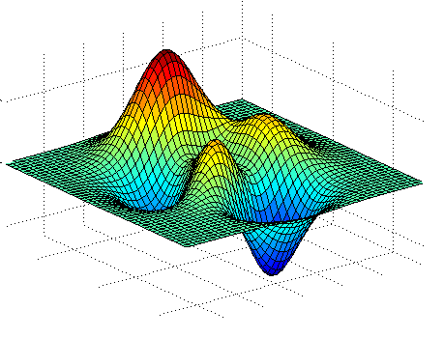
Mathematical objective function
Schematic shown below
Vertical dimension is the objective – to find the maximum or minimum
Horizontal axes represent input variables (e.g. program spending)
In reality, 8-12 dimensional space (cannot be visualized)

Slide 16
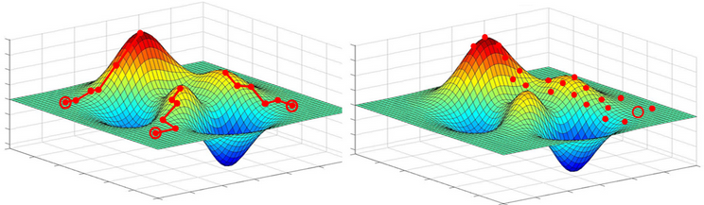
Mathematical objective function
Formal mathematical approach taken to find the optimal solution to meet the objective according to the underlying assumptions

Slide 17
Mathematical epidemiological models
The mountains and valleys in the objective function plot are based on:
How money spent on each program effects behavior or clinical outcomes
How important those behaviors/clinical outcomes are for the epidemic

Slide 18
Mathematical epidemiological models
Mathematical models are analytical tools
attempt to link individual behaviors (such as type of contact and exposure)
to population-level measures (such as prevalence and incidence)
Models attempt to track
transmission between people or the number of events in a population and
natural history of disease progression, initiation of treatment, including morbidity and mortality

Slide 19
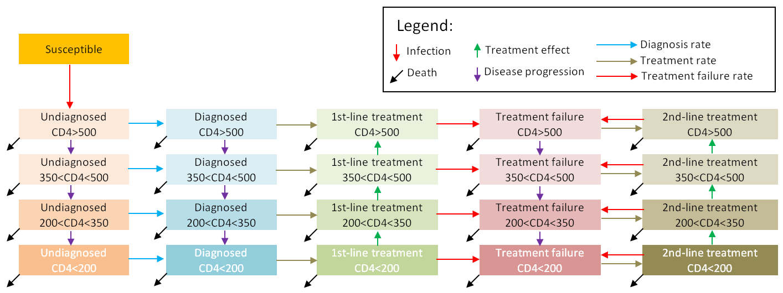
Optima: model structure
Describes transmission, diagnosis, initiation of treatment and treatment failure
Prevention (circumcision, condoms etc.) influences transmission rate
Tracks people by population group (e.g., MSM, FSW) and CD4 count

Slide 20
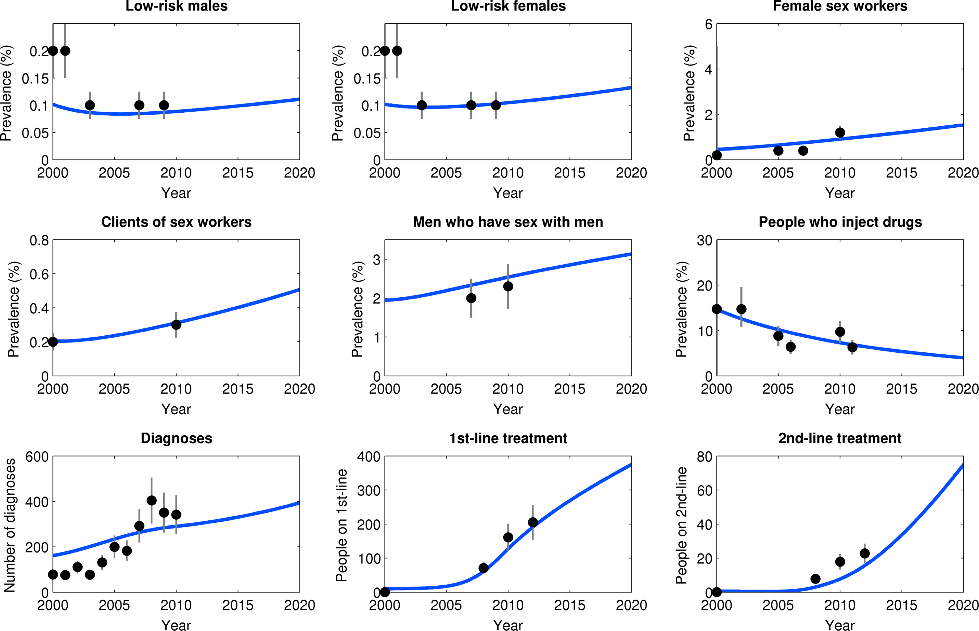
Model calibration to epidemiological data
(e.g. Armenia)

Slide 21
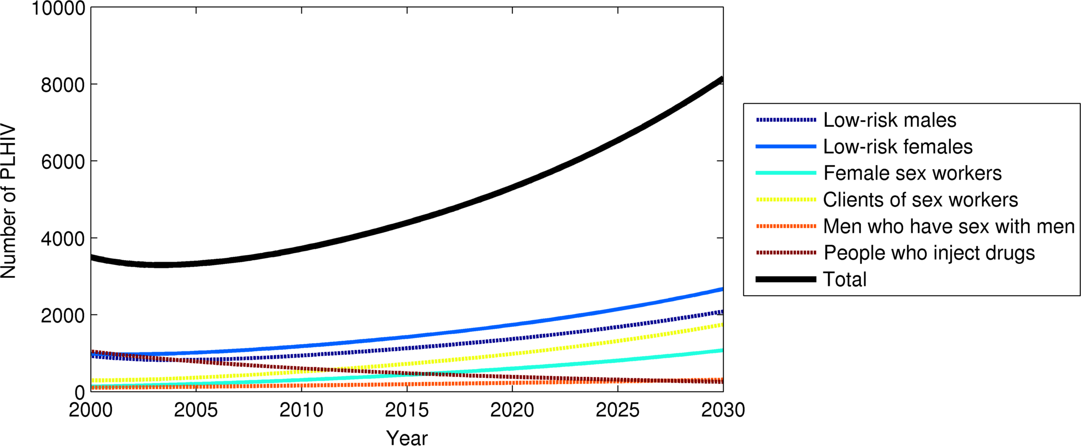
Example projection of epidemic trends (Armenia)

Slide 22
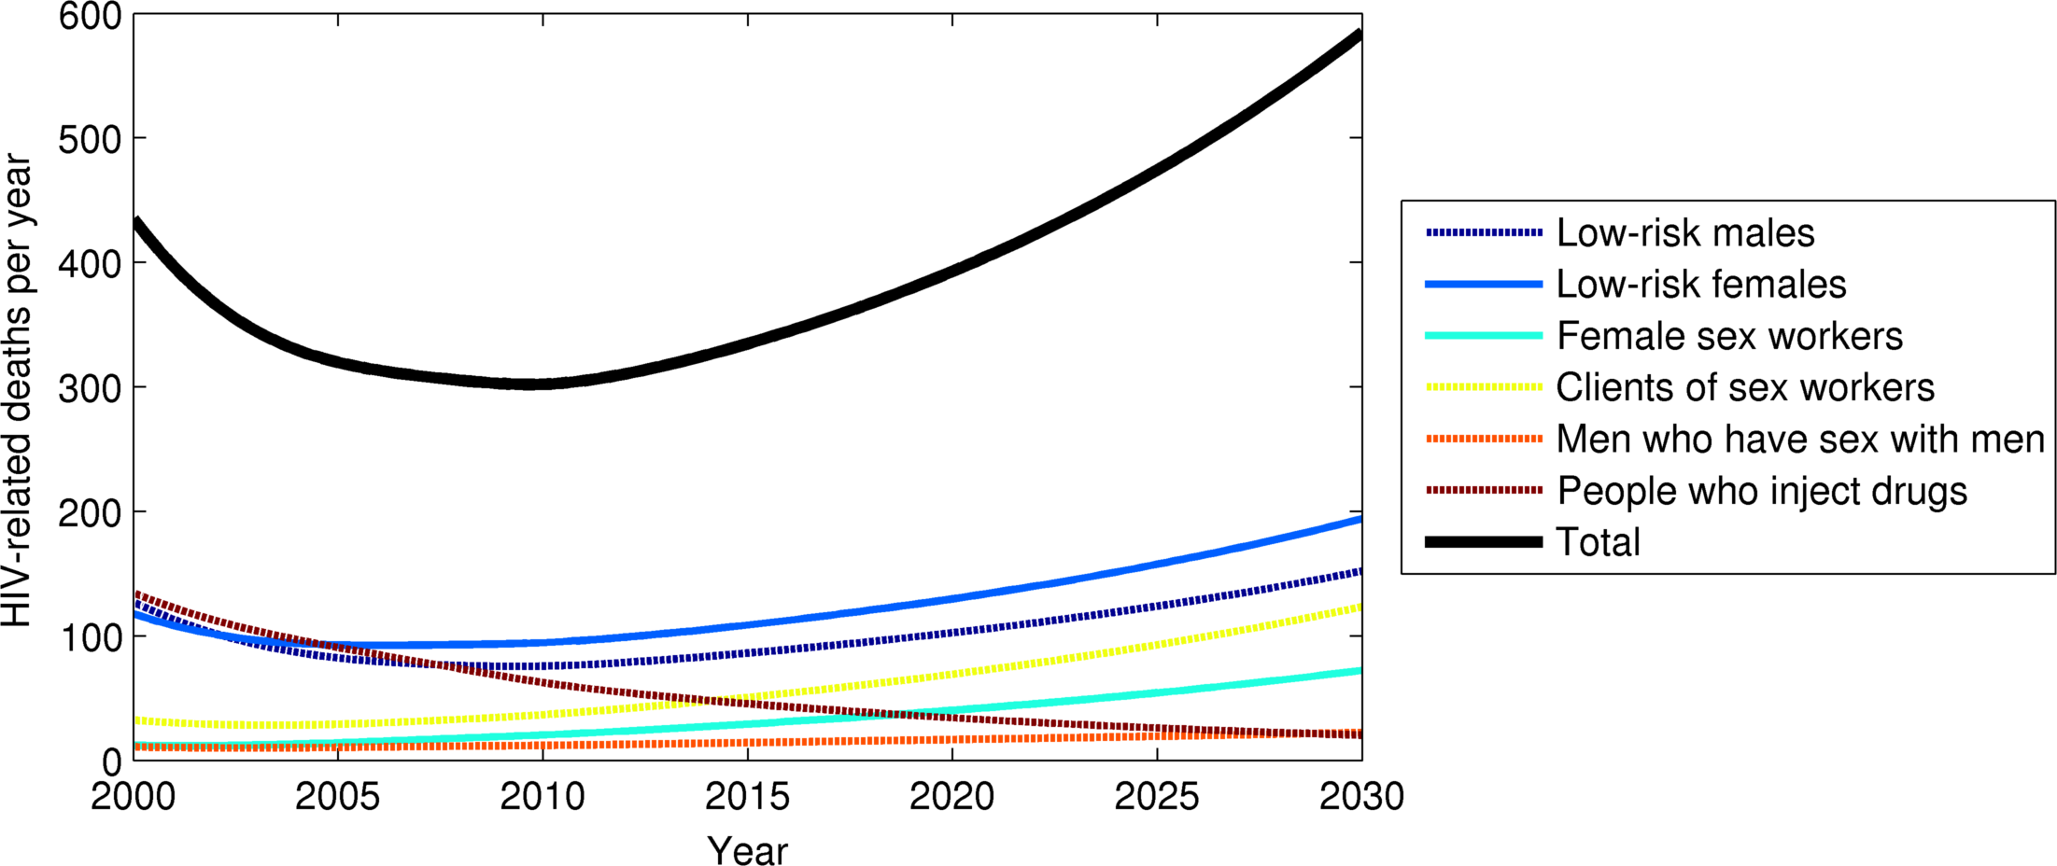
Example projection of epidemic trends (Armenia)

Slide 23
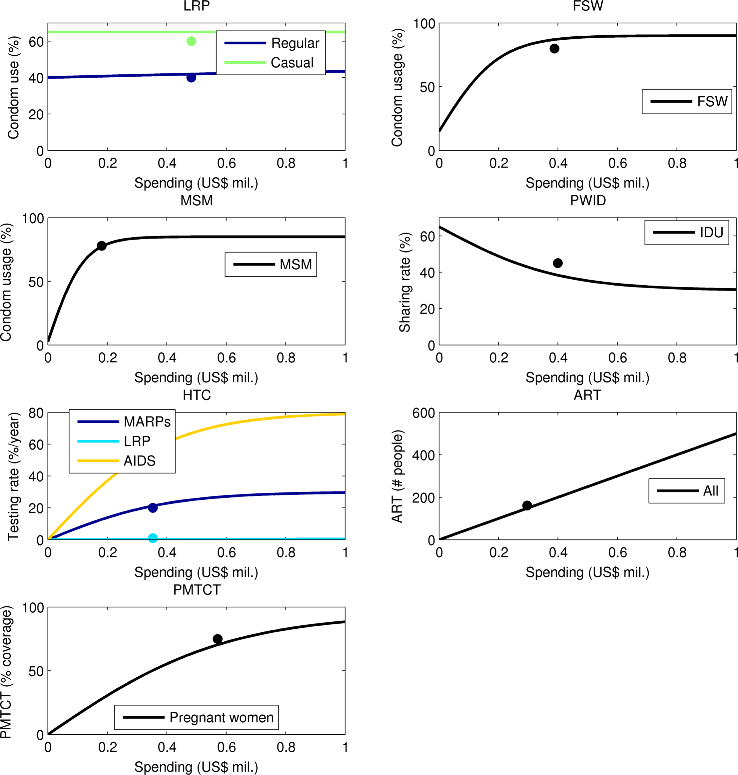
Assumed cost-outcome curves (Armenia)

Slide 24
Assumed cost-outcome curves (Armenia)

Slide 25
Outline
Background
How Optima works
Data requirements for Optima
Using Optima in practice
Optima vs. Spectrum

Slide 26
Data requirements
Optima models can be made more or less complex depending on data availability
e.g. IDUs can be split into males and females if there is data to distinguish them
Critical data requirements: population size and prevalence for each population
Other parameters can be estimated from similar settings if required
Optima allows uncertainties to be entered (if available)

Slide 27
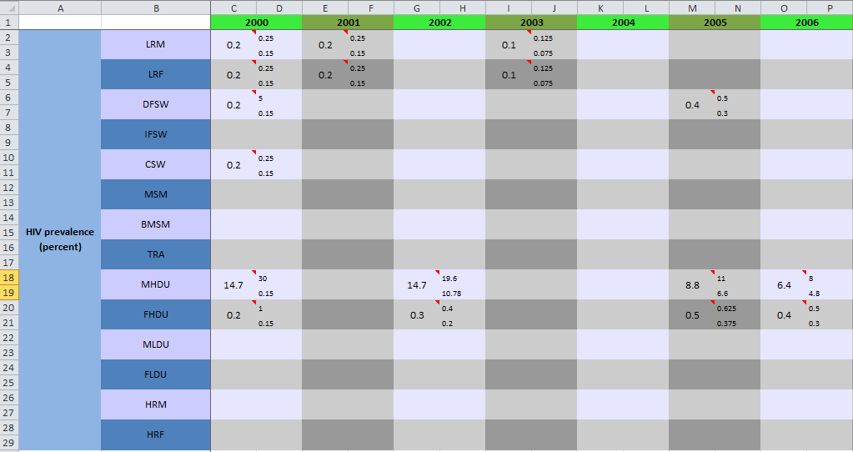
Example data entry

Slide 28
Parameters of the model
 | Biological parameters | Behavioral parameters | Epidemiological parameters
Population parameters | Background death rate |  | Population sizes (TP)
HIV-related parameters | Sexual HIV transmissibilities* (H) STI-related transmissibility increase* Condom efficacy* Circumcision efficacy* HIV health state progression rates (H) HIV-related death rates (H) | Number of sexual partners* (TPS) Number of acts per partner* (S) Condom usage probability* (TP) Circumcision probability* (T) | HIV prevalence (TP) STI prevalence (TP)
MTCT parameters | Mother-to-child transmission probability | Birth rate PMTCT access rate (T)
Injection-related parameters | Injecting HIV transmissibility* Syringe cleaning efficacy* Drug-related death rate | Number of injections* (T) Syringe sharing probability* (T) Syringe cleaning probability* Methadone treatment probability (T)
Treatment parameters | ART efficacy* ART failure rates | HIV testing rates (TPH) | Number of people on ART (T)
T = parameter value changes over time; P = parameter value depends on population group; H = parameter depends on health state; S = parameter depends on sexual partnership type; * = parameter is used to calculate the force-of-infection.

Slide 29
Demographic/prevalence data
Population size
Critical for determining PLHIV, incidence, etc.
For some high-risk populations, can be estimated (e.g. MSM = 1-3% of male population)
HIV prevalence
Most critical parameter for entire modeling approach
A single time point can be used, but multiple time points (e.g. 2006, 2011) necessary to understand epidemic trends
(Ulcerative) STI prevalence
Less important; can be estimated from comparable settings if required

Slide 30
Testing & treatment
Number of people on treatment, PMTCT
Usually known exactly
Number of diagnoses per year
Usually also known exactly
Testing & treatment rates
Usually not known, but Optima can estimate them from diagnoses & treatment data

Slide 31
Behavior
Number of regular, casual, commercial sex acts
Typically estimated from surveys
Very uncertain, but regional estimates can be used
Condom use for regular, casual, and commercial sex
Also uncertain, also usually estimated from surveys
Circumcision
Usually fairly constant with time, so easily estimated

Slide 32
Drug use
Only relevant for countries in which IDUs are important to the epidemic
Number of injections
Hard to estimate
Depends on heroin availability
Syringe sharing rate
Very difficult to estimate, but the critical parameter for this population
Multiple data points important to understand IDU trends

Slide 33
Partnerships & transitions
Important to understand who forms partnerships with whom
e.g. do male IDUs preferentially have sexual relationships with female IDUs?
Default assumption: all male populations (except MSM) partner with all female
Optima also allows transitions between populations
e.g. FSW can return to the low-risk population and vice versa
Rates are usually not measured, but can be estimated

Slide 34
Economic data
Most important economic data is program spend
Usually obtained from NASA (National AIDS Spending Assessment) reports
Multiple years of comparison between NASA & behavioral data are required to accurately produce cost-outcome curves
If not available, can be estimated from regional sources
For calculating program cost-effectiveness and return-on-investment, cost of treating PLHIV per CD4 count is required

Slide 35
Other data
For calculating quality- or disability-adjusted life years (QALYs & DALYs), the health utilities for each state (e.g. untreated HIV, CD4<200) are required
Similar across all countries
Biological data (e.g. infectiousness per unprotected act) not needed on a per-country basis
Except in special circumstances, e.g. more/less virulent strains of HIV in some countries

Slide 36
Outline
Background
How Optima works
Data requirements for Optima
Using Optima in practice
Optima vs. Spectrum

Slide 37
How is Optima used?
Step 1: collect data and fill out spreadsheet
Unknown data can be left blank
If any essential quantities are unknown, they are best estimated in collaboration with key stakeholders
Prevalence data is essential to fill out as accurately & completely as possible
Step 2: calibrate model
Model is calibrated to match all available: prevalence, diagnoses, numbers on treatment, and all behavioral data

Slide 38
How is Optima used?
Step 3: choose objectives & optimize
Choose between minimizing incidence, DALYs, deaths, or a combination
Perform optimization on program allocation
Step 4: reconciliation
Liaise with key stakeholders about interpretation of optimization results
Revise assumptions if required
Interpret findings in broader context (e.g. non-HIV DALYs)

Slide 39
Outline
Background
How Optima works
Data requirements for Optima
Using Optima in practice
Optima vs. Spectrum

Slide 40
Optima vs. Spectrum
Both Goals and Optima aim to model HIV epidemics and assess the effectiveness of HIV prevention programs in the future
Both models need detailed demographic, epidemiological, behavioral and clinical data
Goals models epidemics from their beginning; Optima focuses on recent years with default starting from the year 2000

Slide 41
Optima & Spectrum
If Spectrum analysis has already been performed, Optima can be calibrated to match its output
Alternatively, Optima can be used to give a “second opinion”, since it is based on a different set of assumptions

Slide 42
Optima vs. Spectrum
Spectrum | Optima
Costing of interventions based on detailed unit cost breakdowns Infected children and AIDS deaths in children by age | Diagnoses Number on 1st and 2nd line ART Number with treatment failure Infections in children Lifetime gains Evaluation of past programs Return on investment Optimal resource allocations across interventions for defined objective
Both Models
Similar demographic, epidemiological and clinical outputs for the adult population Infections and AIDS deaths averted for interventions. Both produce CD4 count distributions so QALYs gained and DALYs averted can be calculated Both produce uncertainty estimates in all results

Slide 43
Summary
Optima is a powerful tool for mathematical resource optimization
Critical requirement is for prevalence data, but the more data, the more accurate the projections will be
Program spending & matching behavioral data required for most reliable cost-outcome relationships and thus optimizations
Optima can be used instead of Spectrum or in complement to it

