Slide 1


HIV resource needs case studies: Belarus and Armenia
Cliff C. Kerr, David P. Wilson,
Anna Yakusik, Carlos Avila
Notes:
Hello everyone, Здравствуйте коллеги, it is a pleasure to be here today and to be speaking about our experiences in Belarus and Armenia with all of you. The overall aim of what I want to talk about is how you can use formal mathematical approaches to find optimal allocation of resources. In this talk I won’t go into the mathematical details. I will cover that tomorrow. Here, I will be explaining the results of our studies, that is, the difference between how resources are currently allocated in Belarus and Armenia, and how they could best be allocated.

Slide 2
Background
Belarus and Armenia have been heavily reliant on international aid to fund HIV/AIDS responses
~50% of funding is from international sources, predominantly the Global Fund in 2011
These sources are withdrawing
GFATM resources will not be available beyond 2015
There is need to establish transitional funding mechanisms
Leadership over national response
Including innovative financing systems
Sustainable financing
Notes:
One of the most important things to understand about these countries is that the majority of their HIV responses have been funded by international sources. The main source of funding for these countries has been the Global Fund. However, this funding cannot be counted on continuing. By 2015, Global Fund funding will be withdrawing from these middle- and lower-middle-income countries. As a result, they need to come up with new funding mechanisms to avoid a serious drop in HIV funding. This requires leadership at the national level to coordinate the response, innovative financing systems to raise additional money for the HIV response, and mechanisms to ensure funding for this in future.

Slide 3
Objectives
UNAIDS “Getting to zero”:
Calculate the costs of HIV prevention and treatment interventions and activities
Assess modes of transmission and project future epidemic trajectories for the period 2015-2020 and beyond
Identify specific strategies that are likely to have greatest potential for achieving the “getting to zero” goal
Calculate the resources required to implement these strategies
Including optimization of allocations so that resources are not wasted
Develop recommendations and a framework for resource mobilization
How can we best strive to achieve the “getting to zero” goal without many of the current sources of funding?
Notes:
Getting to zero is an aspirational goal of zero new infections, zero deaths from HIV/AIDS, and zero discrimination against people who live with HIV. This is obviously a difficult goal to reach, especially given the limited funding available for HIV responses in middle- and low-income countries. However, we can still ask what approach would best help us move towards that goal. There are several steps required to do that. First, we need to calculate the costs of HIV prevention and treatment. Without understanding the costs, we cannot understand how best to allocate funds. Second, we need to assess the modes of transmission and the likely future of the epidemic. This is also essential, for, as other speakers have mentioned, it is important to devote funds to the areas where they will have the most impact. This will be where the most infections are occurring. Next, it is important to combine the cost data and modes of transmission projections to come up with specific strategies that will move towards the goal of zero infections, zero deaths, and zero discrimination. Once these strategies are in place, we will be in a position to calculate the resources required to meet different targets. Obviously it is difficult to actually reach zero, but we can still set goals, such as a 50% reduction in infections, and discuss how many resources are required to achieve that goal. Finally, once we understand how many resources are required, we can think of strategies and recommendations for coming up with those resources.

Slide 4
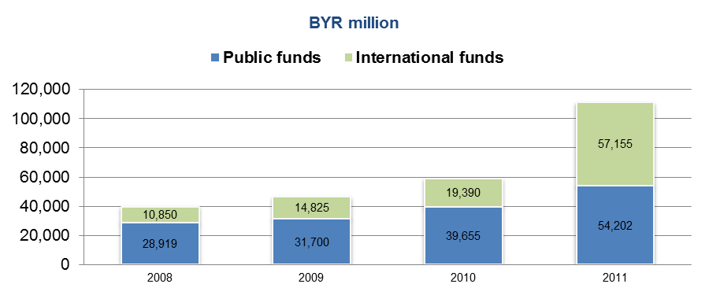
Calculating HIV/AIDS spending
NASAs 2007-2011
Belarus:
Armenia:
Notes:
As you can see here, most funding, especially in Armenia, has come from international sources. However, this is not sustainable. So the questions we are asking are, how can we replace as much of this funding as possible with domestic funding, and what’s the best way to allocate the funds that are available. Ideally we would like to increase spending, but if this is not possible, then we would like to at least sustain coverage of key prevention and treatment programs.

Slide 5
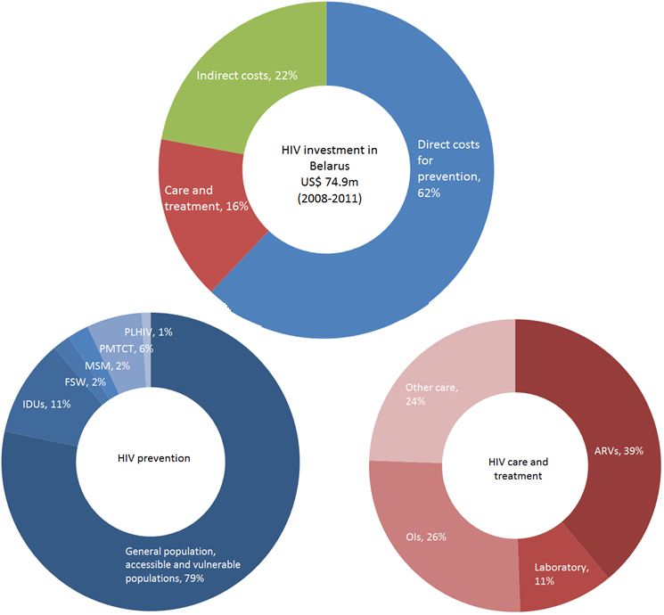
HIV spending in Belarus
Notes:
Here, for example, is the current funding breakdown for Belarus. The overall breakdown does not look too bad: 62% for prevention, 16% for treatment, and 22% for indirect costs. Obviously it would be nice to reduce indirect costs, but 22% is in line with most other countries in the region. However, when you look at the breakdown of prevention, most of th efunding goes towards the general or low-risk population, and only a relatively small proportion goes towards key affected populations, including injecting drug users, female sex workers, and men who have sex with men. This might make sense for a country that has a heterosexually driven generalized epidemic, but does it make sense for Belarus? This is one of the questions we wanted to address. Similarly, when we look at care and treatment, only 40% of the funding goes towards antiretroviral drugs. Thus out of the total HIV budget, only 6% actually goes towards antiretroviral drugs. This seems relatively small.

Slide 6
HIV spending in Armenia
Notes:
If we look at Armenia, we can see that it has slightly higher indirect costs, spends more on treatment, and spends far less on the low-risk population – about 10% of the total HIV budget, compared with 40% for Belarus. Thus, on the face of it, it seems that Armania may be spending its money more effectively than Belarus. However, we need to use mathematical modeling to say for sure, since it depends on the modes of transmission – where the infections are actually occurring in the population, and how spending affects behavior.

Slide 7
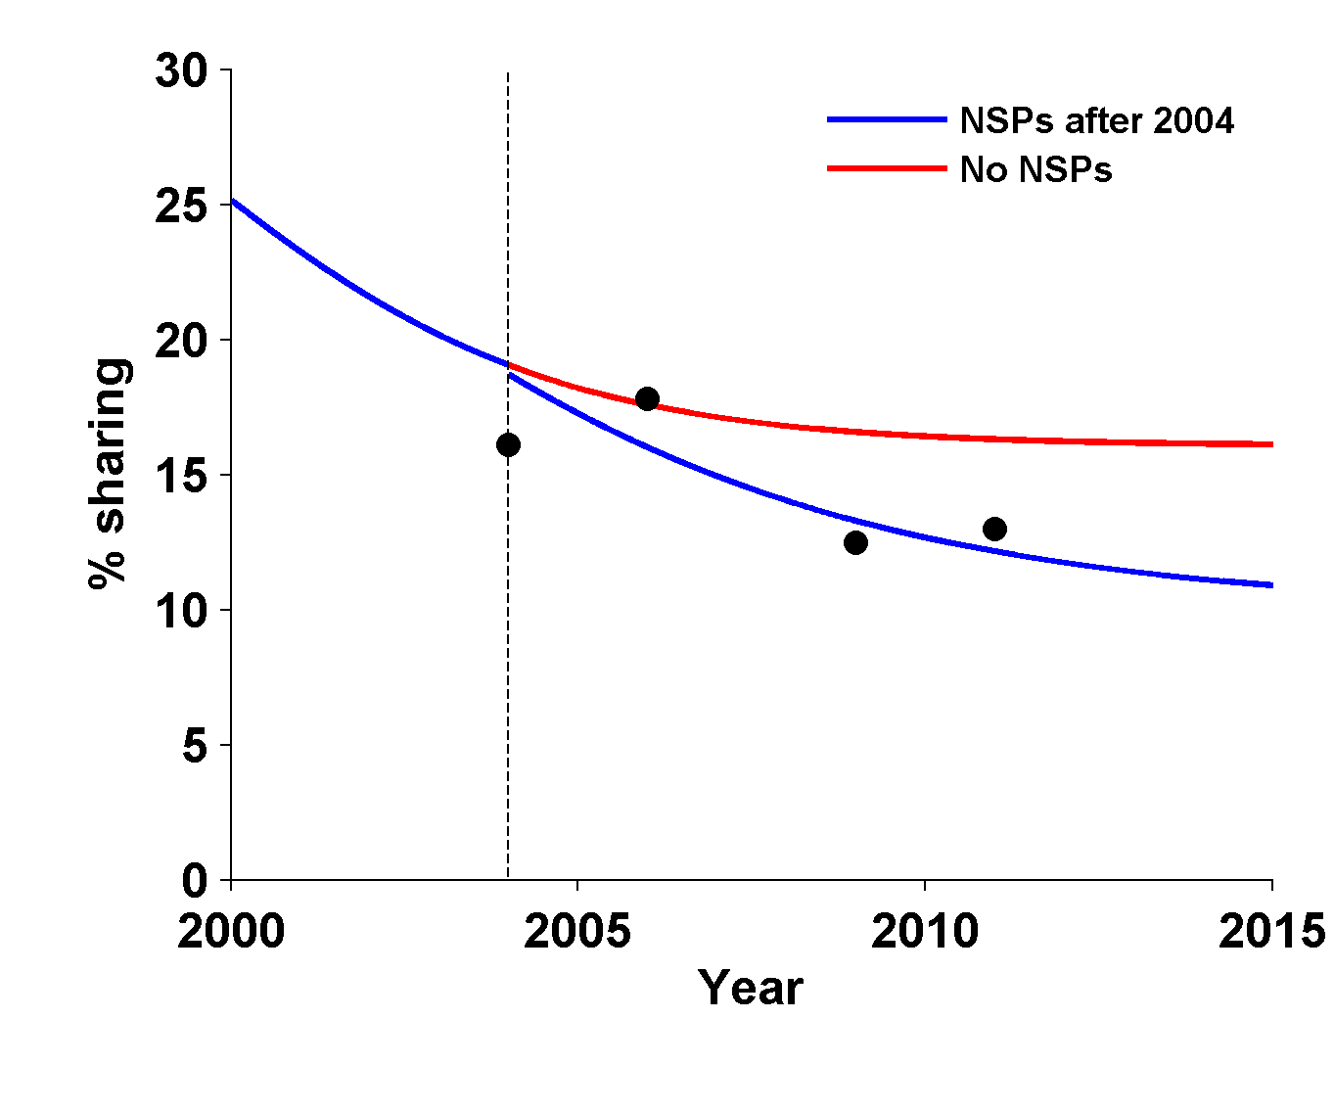
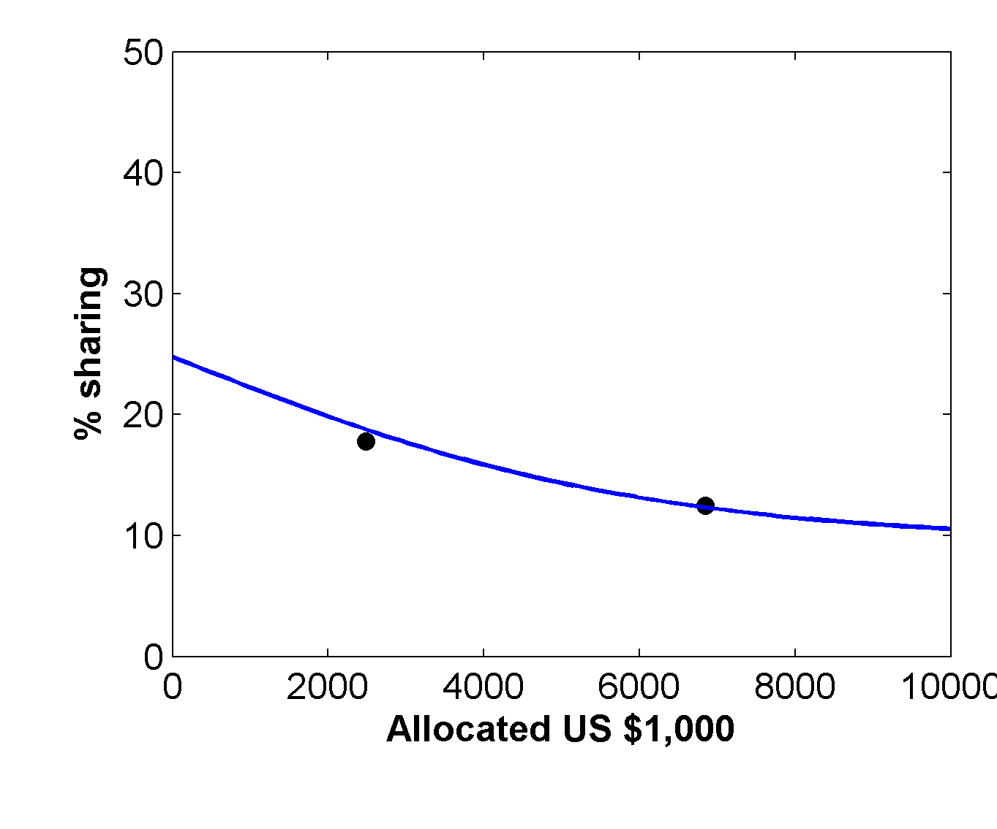
Key assumption: relationship between change in behavior and spending
Example: Syringe sharing rate among IDUs in Belarus
Risk over time
Risk vs. investment
Notes:
The key assumption for deciding how to spend money is how that money affects behavior. For some things, the relationship is quite clear. For example, the cost of antiretroviral drugs per person is fairly well known, so if a certain amount of money is spent on ARVs, then it is fairly well known how many people can be put on treatment. However, most relationships are not so clear. For example, if you spend money on needle-syringe programs for injecting drug users, then it may be clear how many needles will be distributed. But what is not so clear is how these distributed syringes will result in a change in the syringe sharing rate, which is what actually impacts the epidemic. Here, we have to make assumptions, informed by data, as to what these relationships will be. Here, we show an example of what impact a needle-syringe program in Belarus would have. Obviously we do not have data on what would’ve happened if the needle-syringe program did not exist. However, we can estimate what the trend would likely have been in the absence of the needle-syringe program. From these data, we can come up with a relationship between spending on NSPs and the syringe sharing rate. These kinds of relationships are the key foundation on which we decide how to invest money across programs.

Slide 8
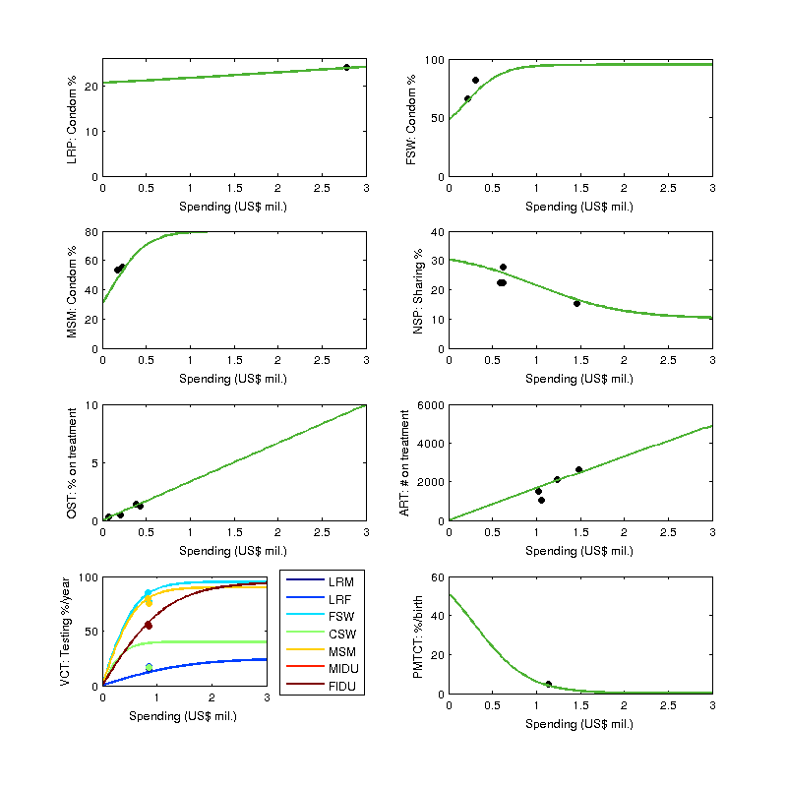
Other relationships for Belarus
Notes:
Here are the example relationships between spending and behavior for Belarus. As you can see, there are typically few data points to constrain most of these curves. However, we can get more reliable estimates if we use international data as well, for example, on the relationship between spending on female sex workers and condom use.

Slide 9
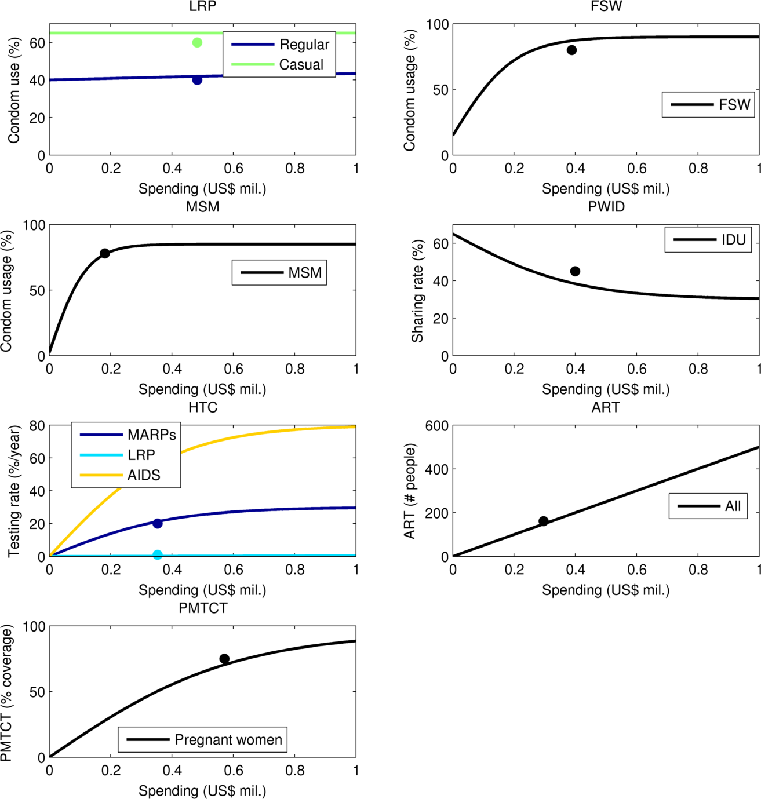
Relationships for Armenia
Notes:
Here are the relationships for Armenia. Here, there is even less data. In fact there is not more than a single data point for each curve. With a single point, we cannot really form a relationship at all. This is where the assumptions become critically important. Here, we assume what will happen if there is no spending and if there is a very large amount of spending. For example, for injecting drug users, we assume that with no spending, the sharing rate would be slightly higher than 60%. With a very large amount of spending, we assume it would be difficult to get sharing rates below 30%. As you can see, the one data point that does exist is close to this line. However, the estimates of 60% with zero spending at 30% with a large amount of spending cannot be obtained from Armenia itself, but instead are based on international data.

Slide 10
Formalized and calculations conducted with epidemiological mathematical model
Optima: The HIV Optimization and Analysis Toolbox
Best-practice HIV epidemic modeling
Realistic biological transmission processes, infection progression, sexual mixing patterns and drug injection behaviors
Simultaneously calibrated to reflect available HIV surveillance data across 7 population groups
Notes:
To formally calculate optimal allocative efficiency, we have developed a software package called Optima that combines all of these different sources of data. It uses realistic and detailed modeling of biological transmission, the progression of HIV in terms of health states, and includes a very detailed model of sexual and injecting behaviors. All of these are based on in-country data, or if in-country data are not available, from regional estimates. In some cases, such as the transmission risk from a single act of unprotected sex, the numbers are known very precisely. In other cases, such as condom usage in the general population, there may be a great deal of uncertainty. Thus, although there is not enough behavioral data to fully constrain the epidemic, we are able to use additional surveillance data to properly reflect the epidemic. This additional data includes prevalence, number of diagnoses, number of people on treatment, and so on. The model can then be calibrated to match these additional sources of data, to make up for gaps in the behavioral data.

Slide 11
Formalized and calculations conducted with epidemiological mathematical model
Population groups
Male and female injecting drug users (IDU)
Direct and indirect female sex workers (FSWs)
Clients of FSWs
Men who have sex with men (MSM)
Low-risk males and females in the general population
Flexible to Belarus-specific characteristics and data
Full health economic analyses
Uncertainty bounds
Resource optimization
Notes:
In Belarus, we modeled seven populations, including injecting drug users, female sex workers, clients of female sex workers, men who have sex with men, and low-risk males and females. These population groups were chosen specifically for Belarus. Obviously if we were modeling an epidemic in a country with a generalized epidemic, such as Swaziland, other population groups would be more important – for example, there age is extremely important. We also calibrated the rest of the model to match the Belarussian epidemic.

Slide 12
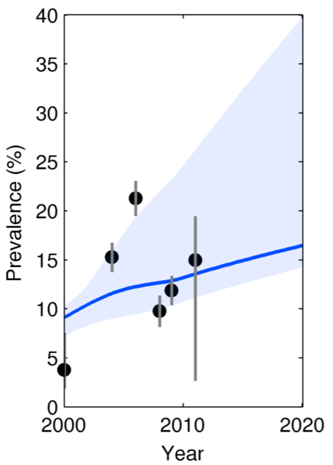
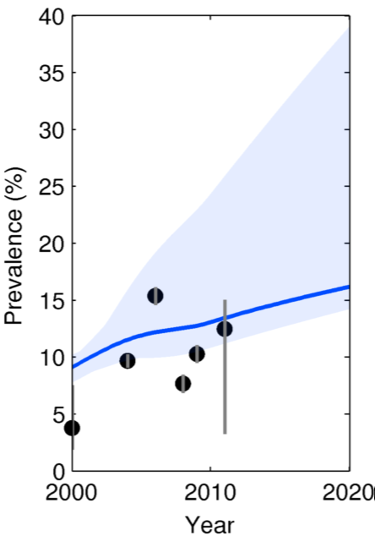
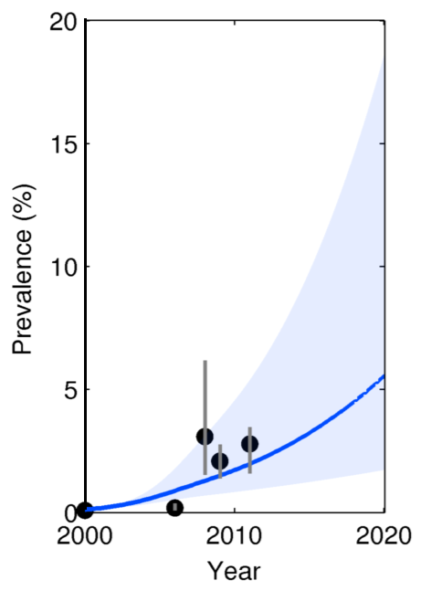
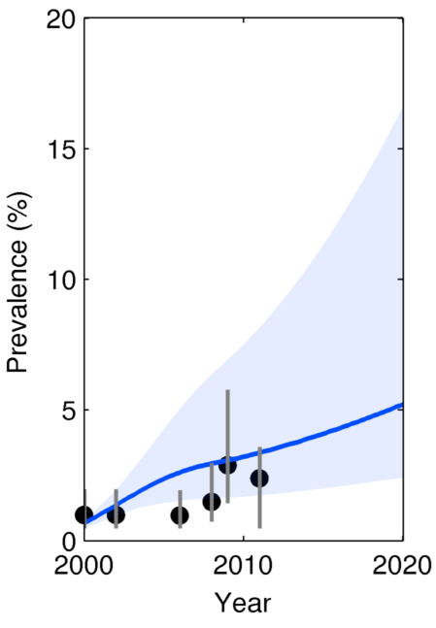
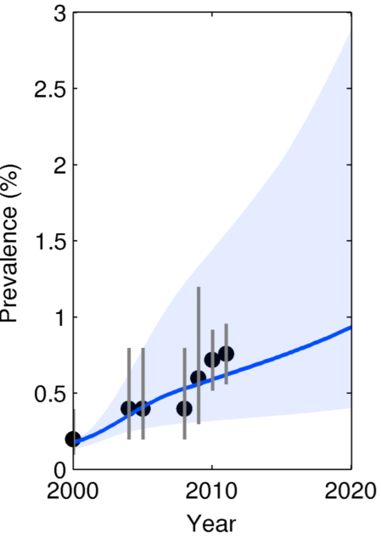
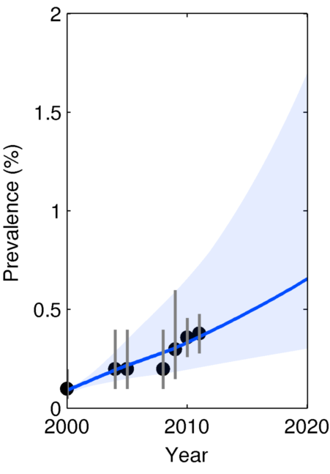
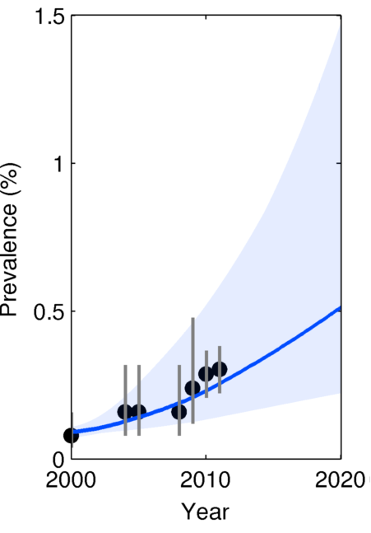
Calibration to HIV prevalence (Belarus)
Male IDU
Female IDU
MSM
FSW
Clients of FSW
Low-risk female
Low-risk male
Notes:
Here is an example of the calibration. The black dots are the surveillance data in Belarus of prevalence in each population group. As you can see prevalence is highest among male and female injecting drug users, but that there are significant epidemics among all populations, including low-risk males and females.

Slide 13
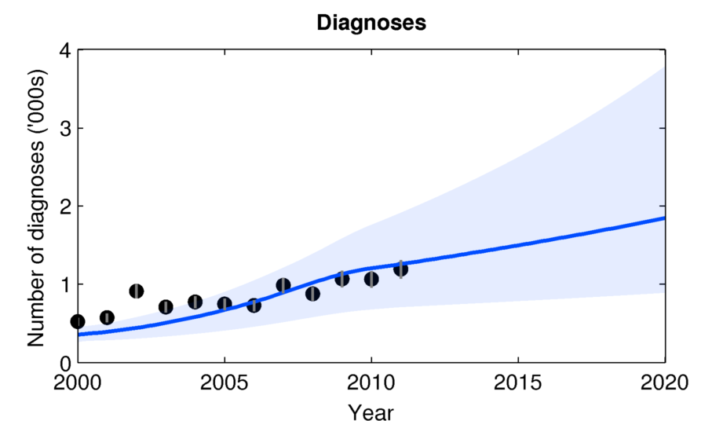
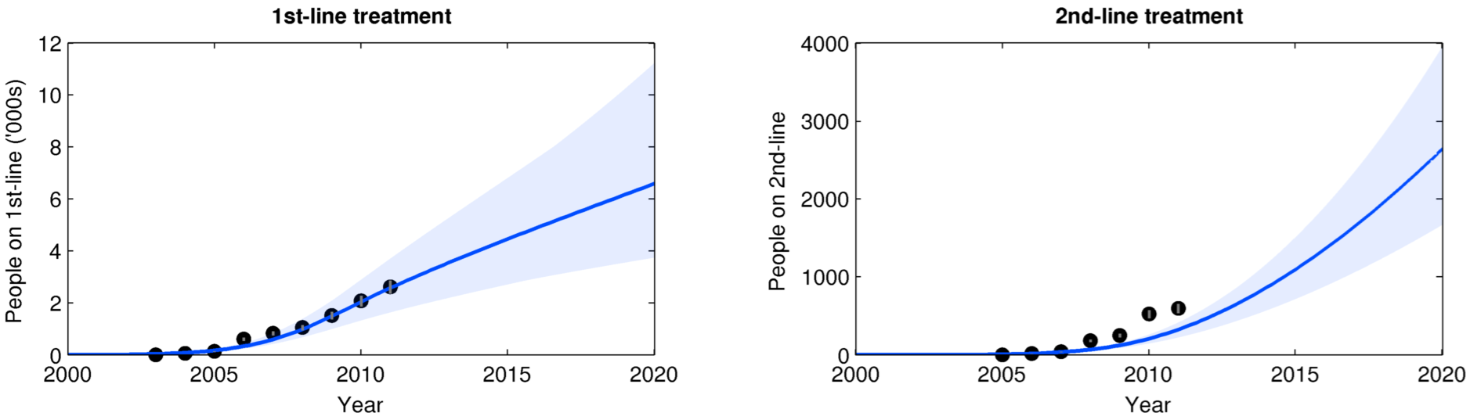
Model also calibrated to diagnosis and treatment
Notes:
Here, we show how the model was calibrated to match other surveillance data, including diagnoses and the number of people on treatment. As you can see, Belarus has very good data on these things – most countries have basically perfect data. Countries generally have less data on prevalence, and even less data on behavior.

Slide 14
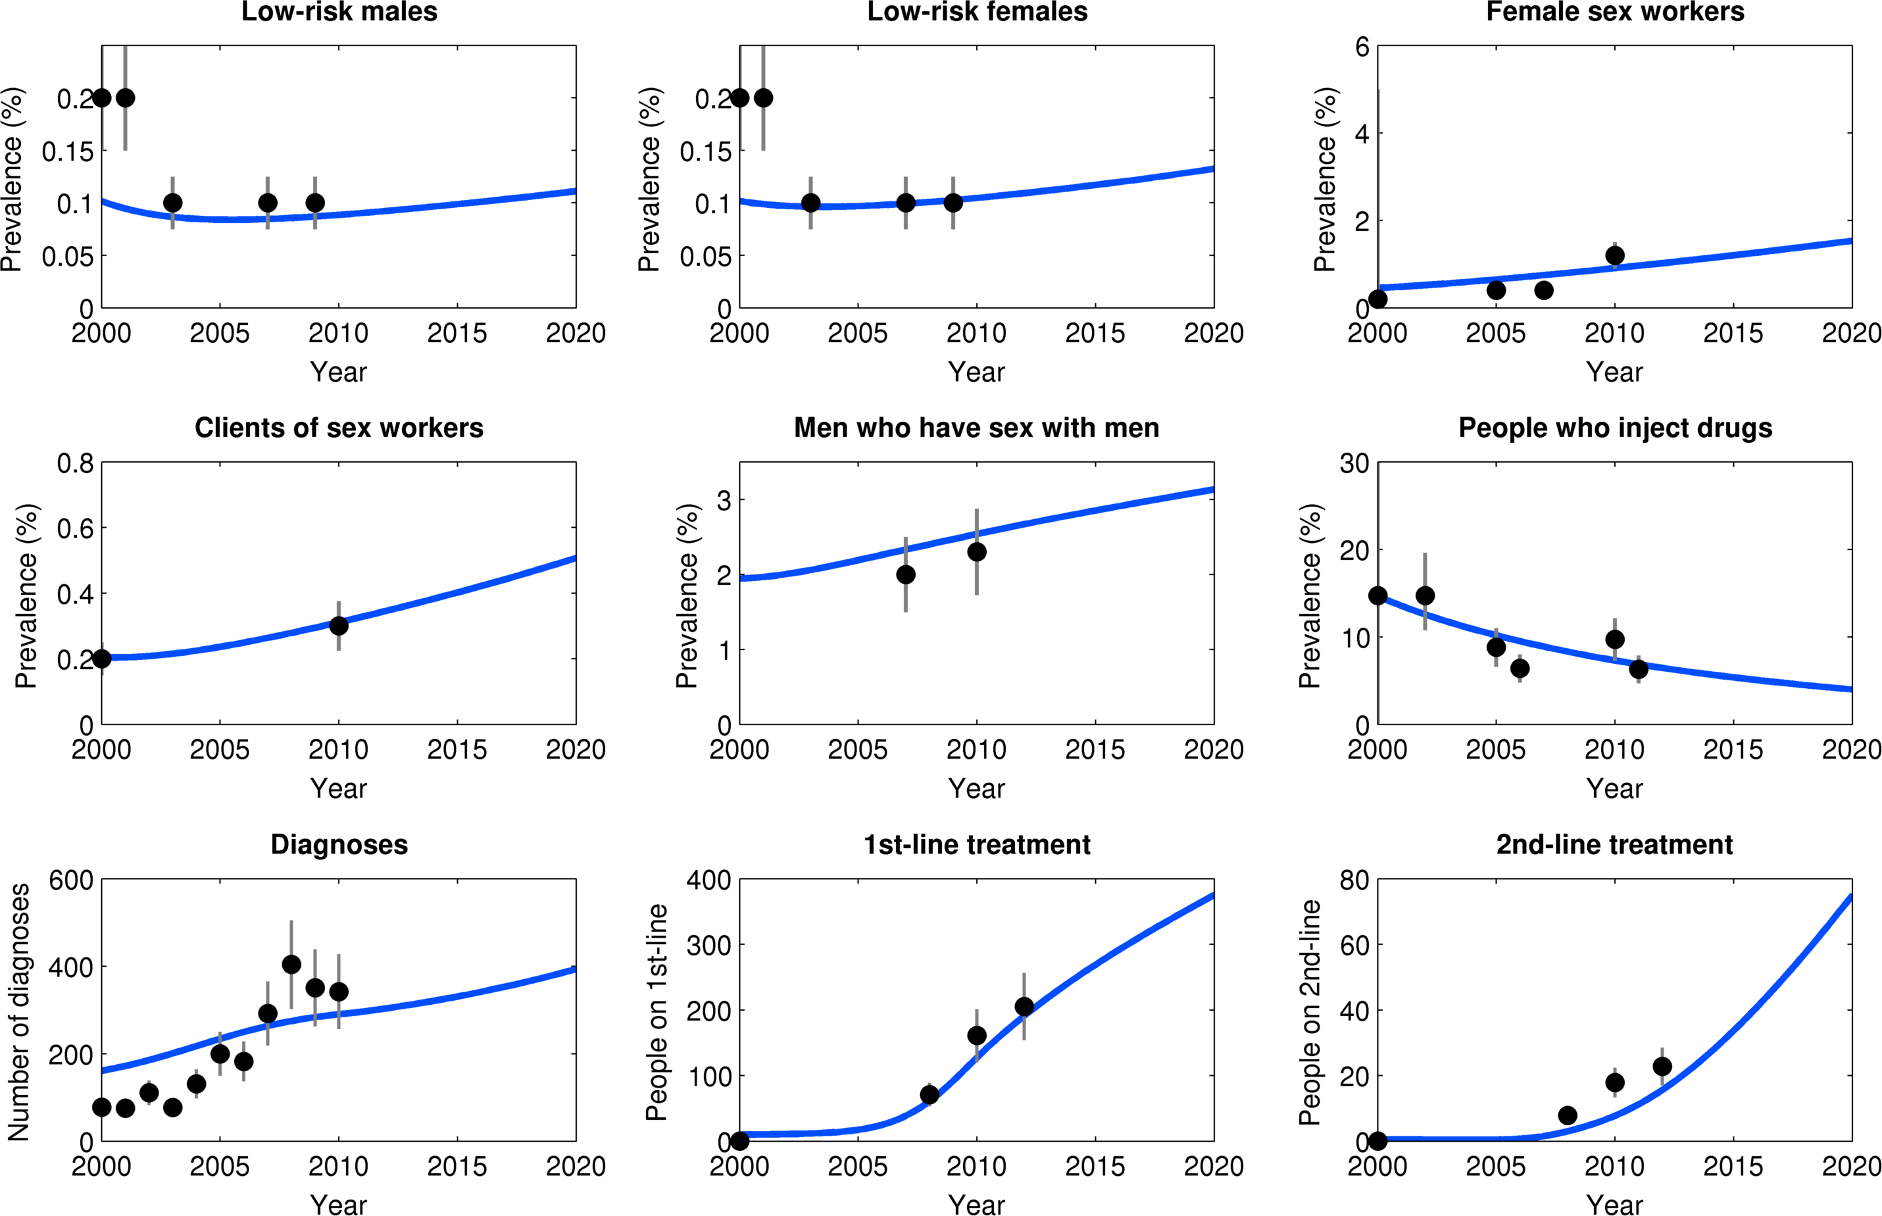
Calibration (Armenia)
Notes:
For comparison, here is the model calibrated to Armenia. Here, prevalence is still highest among injecting drug users, but prevalence seems to be decreasing, whereas it appears to be increasing among other key affected populations, including men who have sex with men. Also of interest here is that some of the prevalence data cannot be taken at face value. For example, if you look at the low-risk population, the prevalence estimate was changed from 0.2% in 2002 to 0.1% in 2003. As we can see from the graphs, this change is unlikely to reflect an actual change in the epidemic, and is more likely to be a sampling error, which is why when we were calibrating the model, we calibrated it to the more recent estimates.

Slide 15
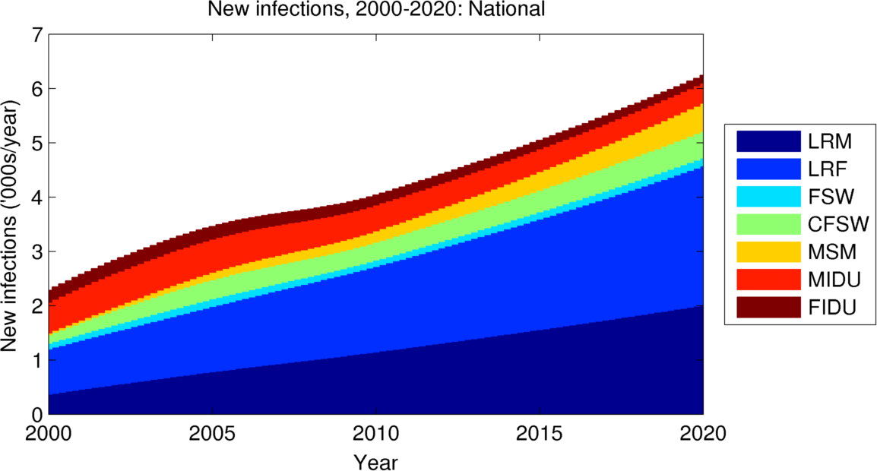
Inferred new HIV infections from 2000 to 2020 in Belarus by population group
Notes:
This graph shows the modes of transmission of HIV in Belarus according to our model. The red lines show infections among injecting drug users. Pale colors show key affected populations, and blue and dark blue show infections in the low-risk population. In 2000, the epidemic was strongly driven by key affected populations, especially injecting drug users. However, since then, both the number and proportion of infections among injecting drug users have been decreasing, and they have been increasing among the low-risk population, so that by now, a majority of injections actually appear to be in the low-risk population.

Slide 16
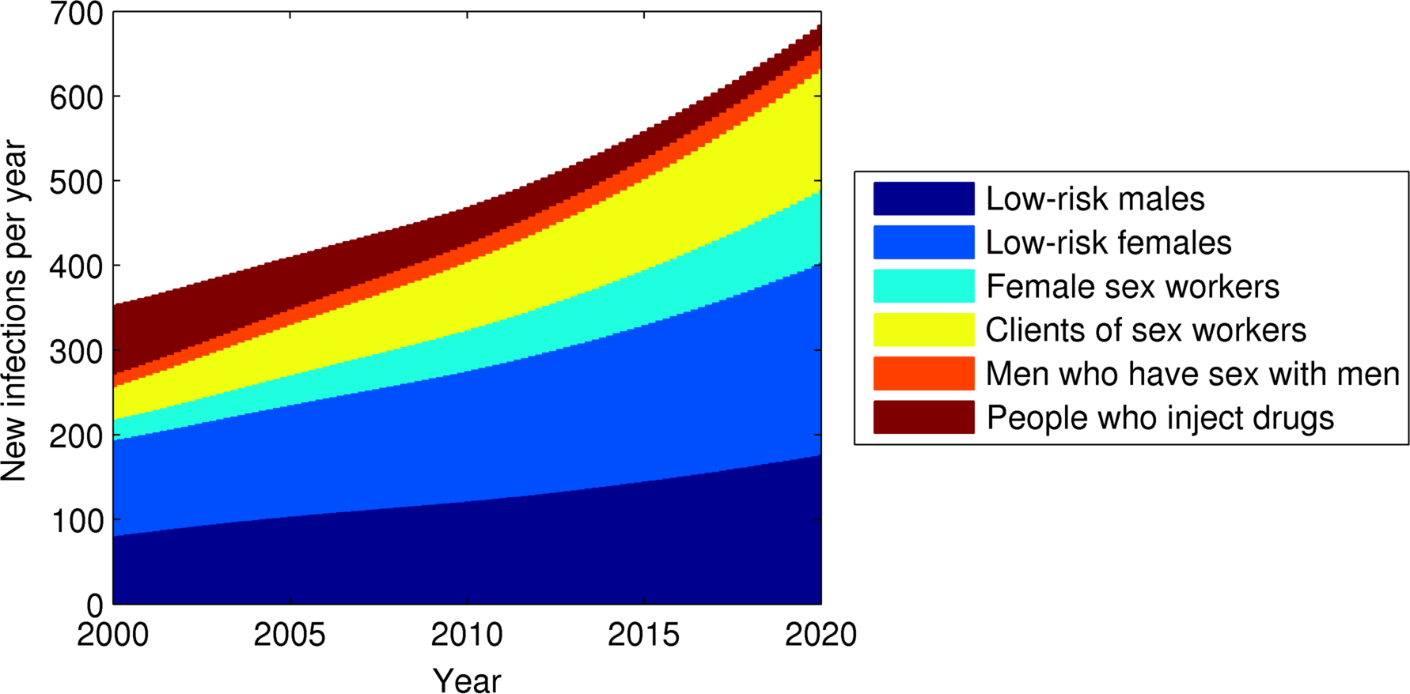
Inferred new HIV infections from 2000 to 2020 in Armenia by population group
Notes:
Here is the same result, but for Armenia. There is a similar story here – the epidemic used to be concentrated among injecting drug users, shown in red, but that this population has been getting less and less important, and now, the vast majority of new infections are due to sexual transmission. I should point out that these are model-based estimates, not empirical data. These estimates are based strongly on prevalence data, and slight changes in the estimated prevalence can have significant impact on the predicted proportions of new infections among each population. Thus, from a surveillance perspective, getting good prevalence data among different population groups is absolutely essential to ensure good and reliable modeling.

Slide 17
What have investments in Belarus bought?
HIV investment, 2008-2012,
Averted 3 800 new HIV infections and averted 1 860 deaths
But incidence is not declining
Late diagnosis means late initiation of ART
Poorer clinical outcomes
Greater potential to transmit to others
Treatment has trebled
1200 on ART in 2008, 3 500 in 2012
But treatment coverage can/should be increased
60-70% of diagnosed treatment eligible are treated
1 in 3 are being treated (including undiagnosed who would be eligible)
Notes:
Before we analyze the best way to spend funds currently, it’s useful to look at how effective past investments have been. According to our model, investments have averted almost 4000 infections and almost 2000 deaths. However, this has not yet been enough to reverse the trend of increasing incidence. Treatment has also increased substantially, from 1200 in 2008 to 3500 in 2012, but this too could be increased substantially. According to our model-based estimates, only 1 in 3 people who would benefit from treatment are actually being treated.

Slide 18
What is the future of the Belarus epidemic?
Is it concentrated?
Male IDU
Female IDU
MSM
FSW
Clients of FSW
Low-risk female
Low-risk male
Notes:
Another thing we can look at in Belarus is the extent to which key affected populations contribute to the epidemic, compared to the low-risk population. Using the model, we can ask what would happen in the low-risk population if transmission in key affected populations would cease. In a concentrated epidemic, we would expect that there would be too few PLHIV in the low-risk population to sustain the HIV epidemic. But is that the case in Belarus?

Slide 19
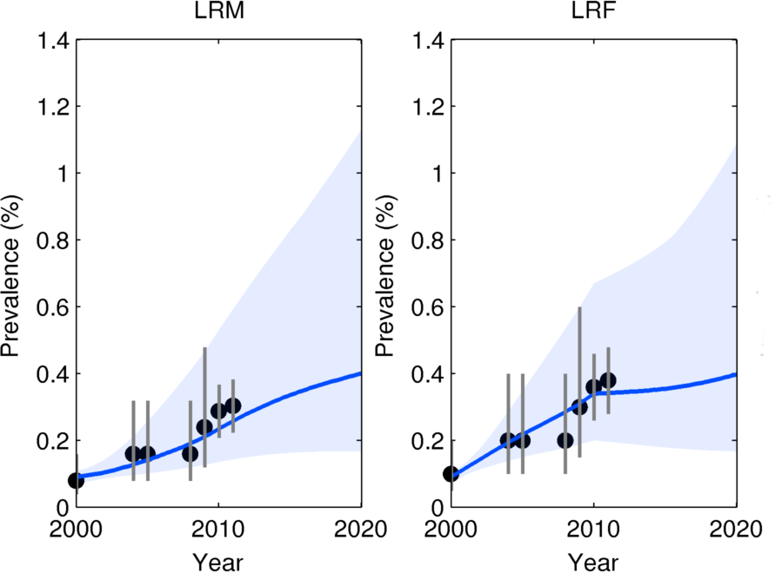
Even without MARPs, prevalence will continue to increase: generalized epidemic?
Males
Females
Notes:
As this graph shows, even if we remove the key affected populations, prevalence continues to increase in the low-risk population. This indicates that, troublingly, the epidemic in Belarus may be transitioning from a concentrated epidemic to a generalized epidemic. This requires a great deal of vigilance, and if true, it will require a substantial and smart investment of resources in order to reverse this worrying trend.

Slide 20
Belarus: projections of current conditions
HIV prevalence is expected to increase by 50% in the general population
HIV has stabilized to high levels (15%) among IDUs
7500 people are expected to be on ART by 2020 with current treatment uptake rates
A further 5800 people will be ready for treatment by 2020
Notes:
So to summarize for Belarus, by 2020, we expect that HIV prevalence might increase by up to 50% in the general population. HIV is stable in IDUs, and we predict they will form a smaller proportion of new infections. With current treatment rates, 7500 people will be on ART, with a further 6000 people needing treatment.

Slide 21
What needs to be improved in Belarus?
Current resources are not allocated towards greatest disease burden and potential for impact
Currently, greatest funding is towards low-risk populations
A formal mathematical optimization procedure was combined with the epidemiological transmission model to find the allocation that minimized new infections
Not enough money is targeted to MARP programs with proven effectiveness
Notes:
So we can finally ask how best resources can be allocated in Belarus, and how the HIV response can be improved. Fundamentally, current resources are not allocated towards those populations that contribute the most to the HIV epidemic. Not enough money is being devoted to key affected populations, where a small amount of funding can go a long way. Note that this is the case even though a large fraction of infections are among the low-risk population: these populations are still the hardest to target, so money spent on them are still very difficult to spend well. To find out exactly how to allocate money optimally, we used a formal mathematical optimization method using our software Optima.

Slide 22
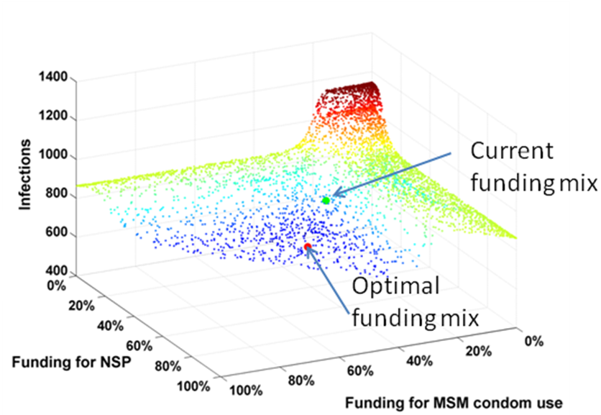
Illustration of methodology
Notes:
To illustrate how the method works, we use the model to run different scenarios with different amounts of money going to different HIV programs, including MSM condom use and needle-syringe programs. The outcome is the number of infections. We run the model many times with many different funding allocations, and look for the mix with the lowest number of infections. In this example, it shows that increases in spending on both MSM and NSP programs will result in fewer infections. Not shown is spending on the low-risk population, which is where the remainder of the spending goes. So this is saying that money should be diverted from the low-risk population towards MSM and IDU populations.

Slide 23
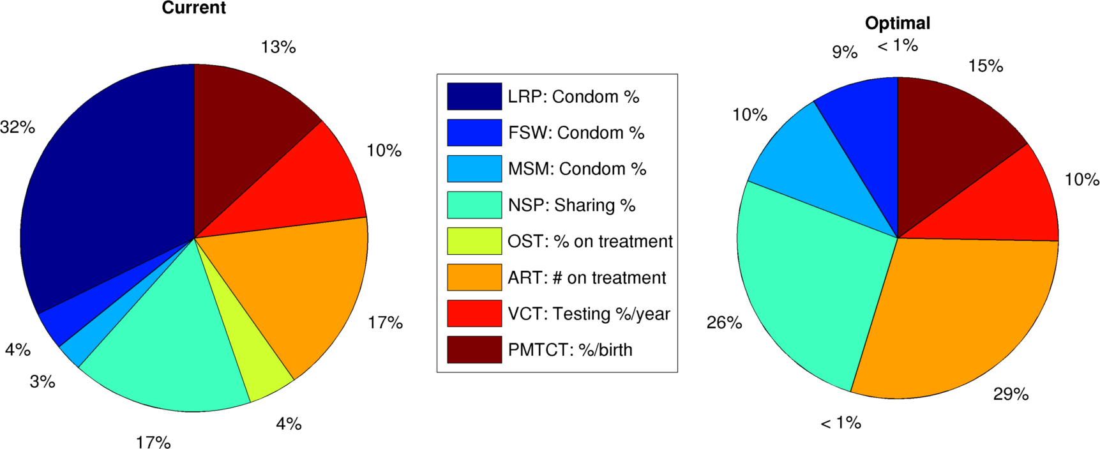
Belarus: current vs. optimal allocations
Programs targeting MARPs are much more effective & cost-effective than general population programs
Notes:
By applying this methodology, here is the result we got with Belarus. As you can see, the biggest change is a shift in funding from the low-risk population towards key affected populations. This includes a significant increase in spending on treatment, as well as tripling spending on MSM and female sex workers. Also, note that this result suggests that money should be shifted from opioid substitution therapy towards needle-syringe programs. This result requires some interpretation. Keep in mind that this is just to reduce HIV incidence, and does not take into account the full health implications of these measures. I’ll come back to this point later.

Slide 24
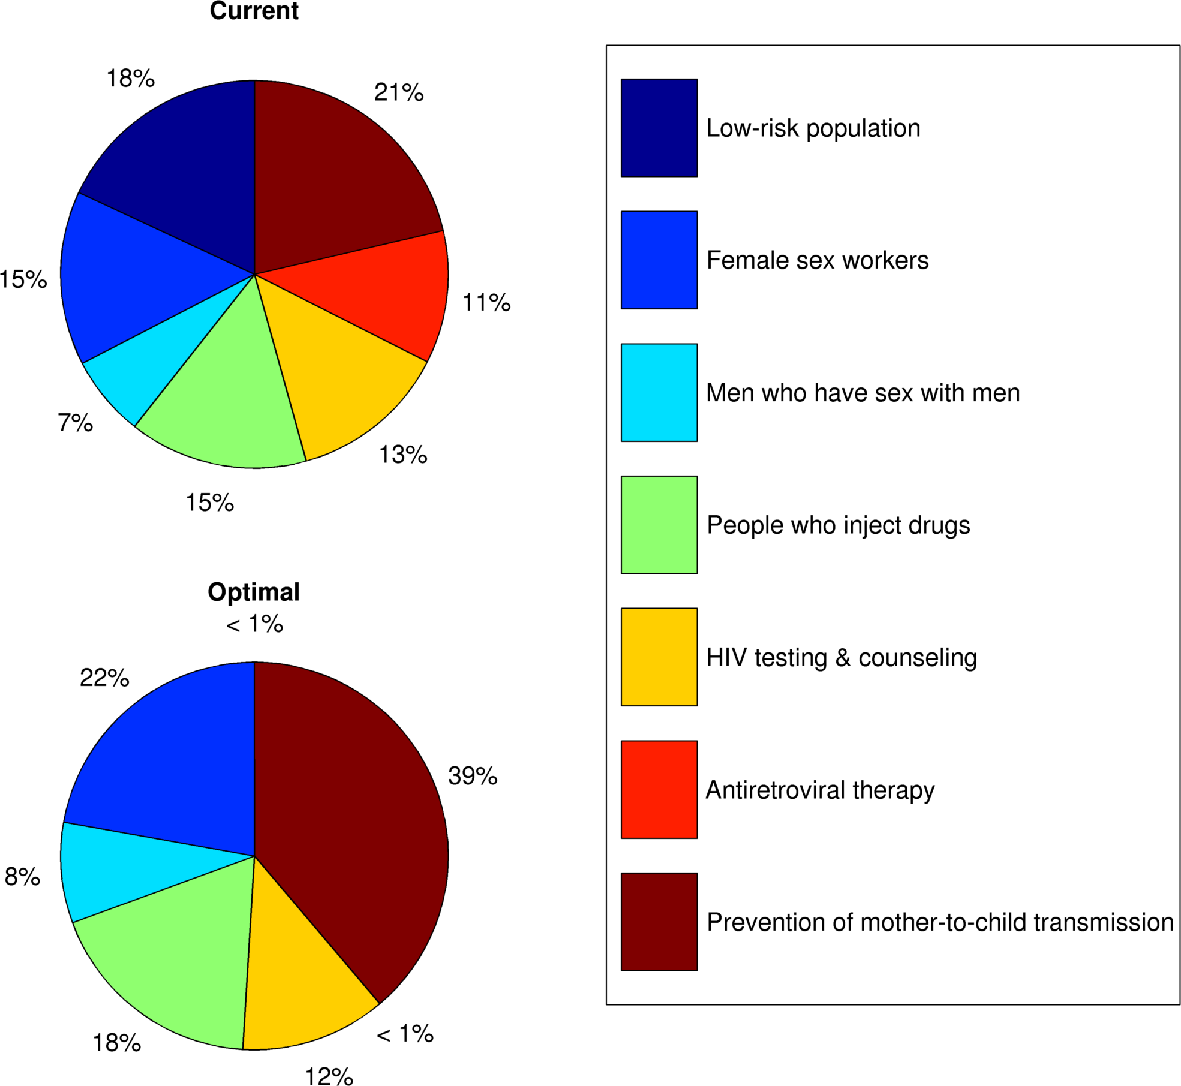
Armenia: current vs. optimal allocations
With limited funds, PMTCT is more cost-effective than untargeted ART
Notes:
Here is the example for Armenia. Again, it suggests that funds should be shifted away from the low-risk population and towards more targeted programs. For example, given the relatively low coverage of prevention of mother-to-child transmission, we find that funds should be shifted towards prevention of mother-to-child transmission. As before, this result needs to be interpreted with a great deal of caution. Based on the costing data we have received, and the coverage levels that have been indicated to us, our model suggests that top priority for Armenia is increasing coverage of prevention of mother-to-child transmission, as well as increasing spending on high-risk sexual populations, most notably female sex workers. However, these results are also in the context of optimizing the current limited budget. Ideally, of course, prevention of mother-to-child transmission funding would be increased without any cuts to other programs.

Slide 25
What needs to be improved?
In both Belarus and Armenia, shift funds away from the general population and towards programs targeted to the MARPs
Facility-based funding model may require additional resources for MARPs
Increase spending on needle-syringe programs
OST programs are not cost-effective for HIV alone, but are when all health implications are considered
Increase spending on MSM programs
Double spending on FSW programs.
Increase total spending on ART + PMTCT, prioritizing latter if not at saturation
Spending the same amount of money smarter can reduce the number of new infections by 15-30%
Notes:
So in summary, in both Belarus and Armenia, our results suggest that funds should be shifted away from the general population and towards programs targeted to most at risk or key affected populations. Our second recommendation is that, despite the fact that injecting drug users are a declining part of the epidemic, a major shift of funds away from them may result in a resurgence, and thus we cannot recommend a major reduction in funding for this population. However, our model does indicate that needle-syringe programs are more cost-effective than opioid substution therapy for prevention new HIV infections. But even this result needs to be interpreted with a grain of salt, since opioid substution therapy has other health benefits that needle-syringe programs don’t, and thus narrowly focusing on HIV prevention may miss the broader health picture. But the main outcome of our study was that funding should be increased for preventing sexual transmission among key affected populations, as this money tends to have much more impact than in the low-risk population, due to the much smaller population sizes. We found that spending the same amount of money smarter can avert up to 30% more infections.

Slide 26
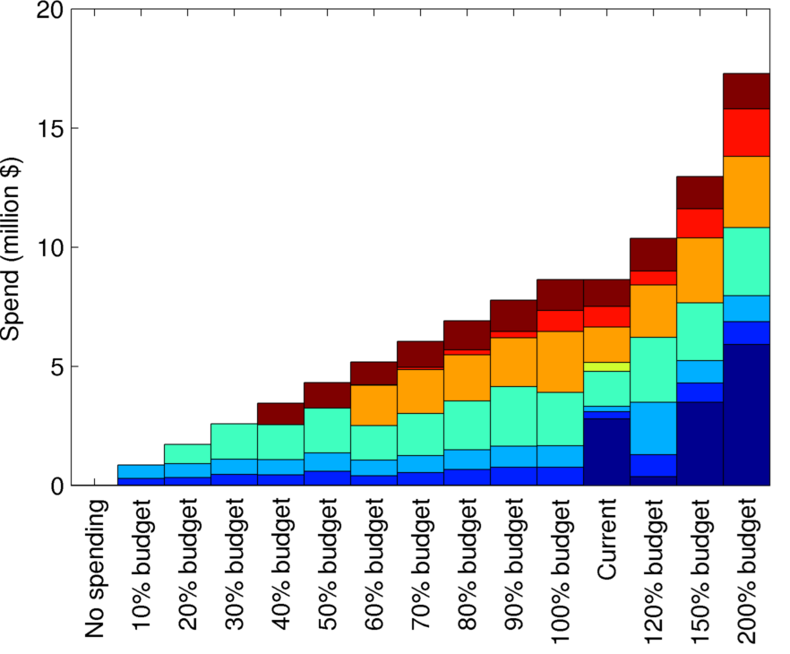
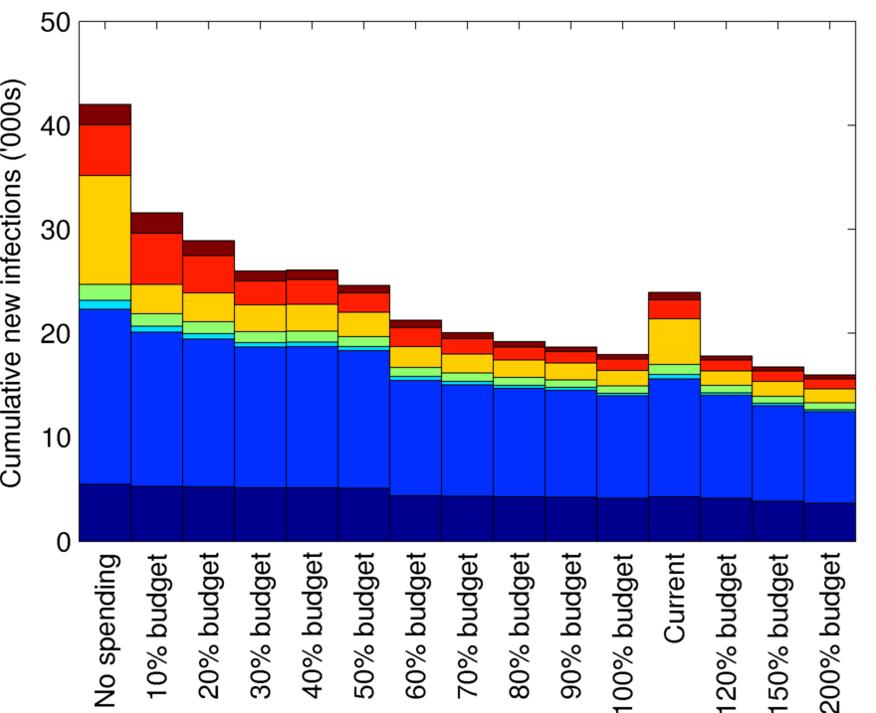
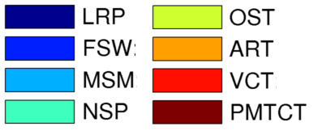
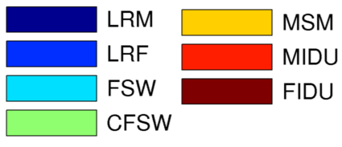
Prioritization of scale-up (Belarus)
Notes:
But what should a country do if, instead of having more money to spend, it actually has its HIV budget cut? Here the aim will not be to meet an aspirational goal such as Getting to Zero, but rather, to try to contain the epidemic and ensure that at the very least, things don’t get worse than they currently are. This example shows what happens in Belarus with different funding levels. The graph on the left shows the budget allocations. The graph on the right shows the infections. Note that the two color schemes are different in the two graphs. The current budget is shown here. For comparison, we found that if resources are optimally allocated, just 60% of the current budget is enough to maintain the epidemic at the same level as 100% funding with the current allocation. This basically corresponds to removing funding to the low-risk population, which is about 40% of the budget, and very slightly increasing funding for other populations. In this way, countries that find themselves in a very tight financial situation can still hope to maintain their HIV responses.

Slide 27
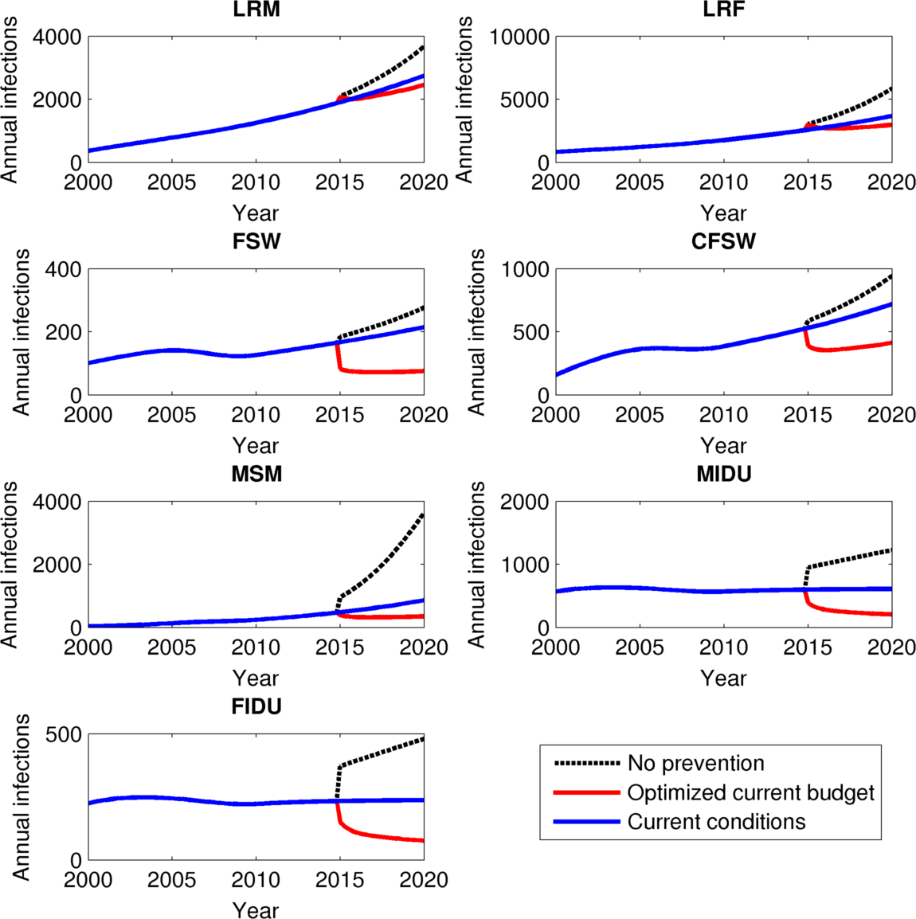
Defunding investment (Belarus)
Notes:
This graph shows what would happen if Belarus completely stopped funding its HIV investment in 2015. In short, the epidemic would take off among virtually all populations. In particular, injecting drug users, who currently have a fairly stable epidemic, would more than double the number of new infections by 2020. This is why, although we find that the epidemic among drug users is currently well controlled, it would be extremely dangerous to remove funding from needle-syringe programs. Similarly, men who have sex with men would see huge increases in prevalence, becoming one of the major populations affected by the epidemic. Conversely, by optimizing current funding, significant drops in incidence could be achieved, particularly among key affected populations, which are still important drivers of the epidemic.

Slide 28
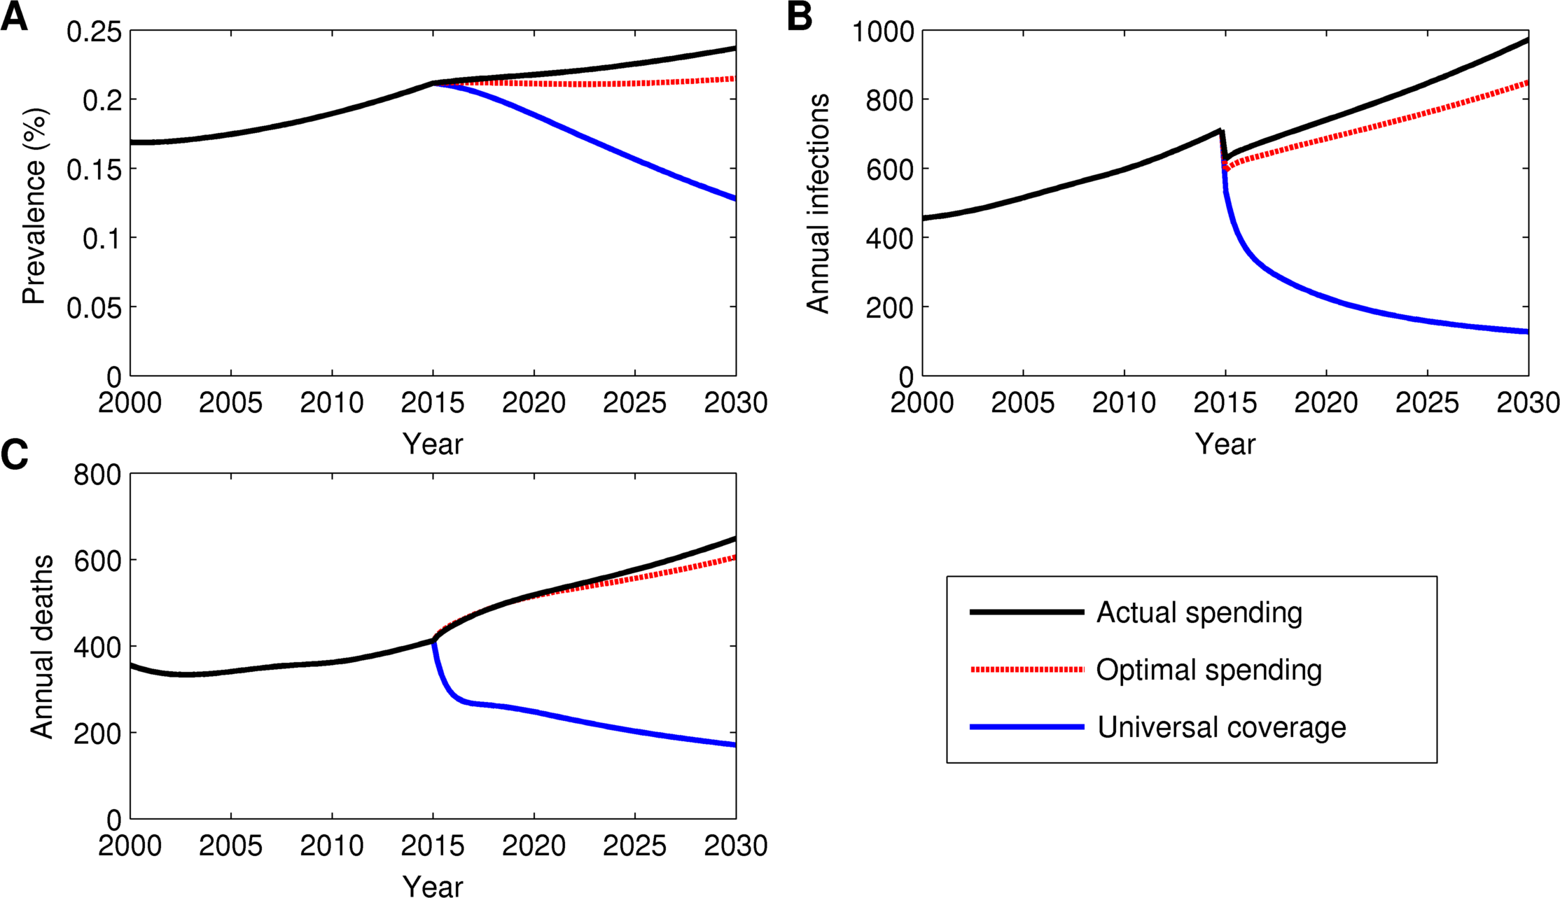
Increasing investment (Armenia)
Notes:
In contrast, this example with Armenia shows what would be possible if funding could be increased enough to allow universal coverage. This would require roughly quadrupling the HIV budget from $5 million to $20 million. However, doing so would more than meet the goal of reducing new infections by 50% -- in fact, it would reduce new infections by almost 80% by 2020, and would half HIV-related deaths.

Slide 29
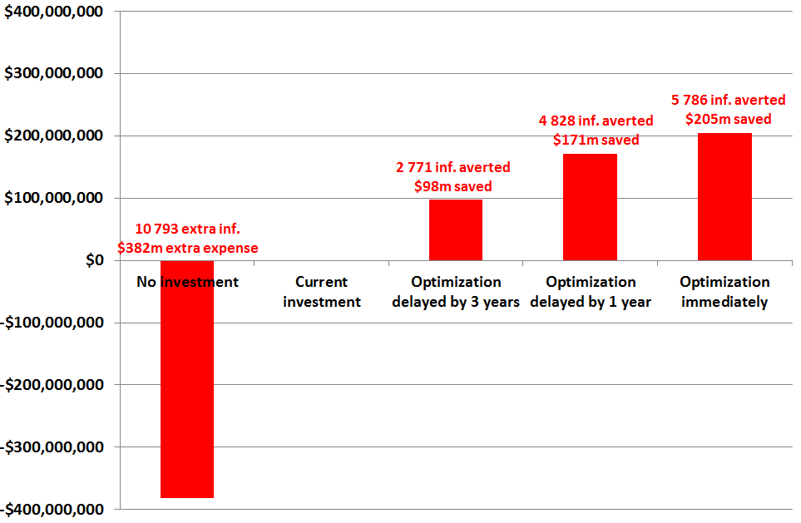
Economic rationale not to delay smart decisions (Belarus, 2015-2020)
Notes:
In addition to these epidemiological benefits, there are considerable cost-savings associated with investing in HIV prevention now. In Belarus, for example, removng funding for HIV will lead to almost 11,000 new infections by 2020, and will incur health care and other costs of $382 million. Conversely, optimizing resources immediately will avert almost 6000 infections by 2020, and will result in lifetime cost savings of $205 million. Clearly, there are huge benefits to substantial and optimal investment in HIV prevention and treatment.

Slide 30
How much money is needed for the future?
Depends on what one wants to achieve
Fill in the gap from international aid withdrawals
Maintain status quo
Getting to zero
Actually zero
WHO definition (<1 per 1000 per year)
UN political declaration (50% reduction)
Reverse increasing trend to attain stabilization
Notes:
So one could ask, how much money is enough? The answer depends on exactly what the goal is. The most modest goal is to simply fill the gap from international aid withdrawals, and maintain the status quo. As we have seen, this is not a desirable situation, since prevalence and incidence are both increasing among Armenia and Belarus. A loftier goal is Getting to Zero. Even this can be interpreted in several ways. The literal goal of zero infections cannot obviously be achieved in the near future, even with unrealistically large resource investments. Another possibility is the WHO definition, which is less than 1 new infection per 1000 people per year. However, note that some countries, such as Australia, already have lower infection rates than this, yet cannot yet be said to have overcome their HIV epidemics. A third possibility is to achieve a 50% reduction in incidence compared to a target year. For many countries, this is the most reasonable goal, and we have investigated how much this would cost in various scenarios. Finally, another modest goal is to simply stop the epidemic from getting worse.

Slide 31
How much money is needed for the future?
Depends on what one wants to achieve
Fill in the gap from international aid withdrawals
Maintain status quo
Getting to zero
Actually zero
WHO definition (<1 per 1000 per year)
UN political declaration (50% reduction)
Reverse increasing trend to attain stabilization

Slide 32
How much money is needed for the future?
Among MARPs
Possible with increased investment
Almost there with reallocation of resources
50% increase overall will accomplish this
Transition from international to domestic program of MARP interventions
Among the general population
Only target after MARP programs at saturation
Not foreseeable with realistic assumptions according to current environments and infrastructure.
Large socio-cultural shifts (e.g. large increases to consistent condom use among heterosexual regular sexual partners) is unrealistic
Increased testing and early treatment most viable
Notes:
Among most-at-risk populations or key affected populations, a 50% decrease in incidence is possible with increased investment and reallocation of resources. Since in many cases key affected populations are only a small part of the total budget, this is actually feasible in many cases without significant increases in total funding. In contrast, it is very difficultto achieve directly in the low-risk population. We have seen that the low risk population should only be funded once programs for key affected populations have reached saturation coverage. Thus, the best approach for achieveing a 50% reducing in incidence among the low-risk population is to prevent infections among key affected populations and wait for the benefits to flow forward, and to put people infected with HIV on treatment, and thus use treatmen-as-prevention in the low-risk population.

Slide 33
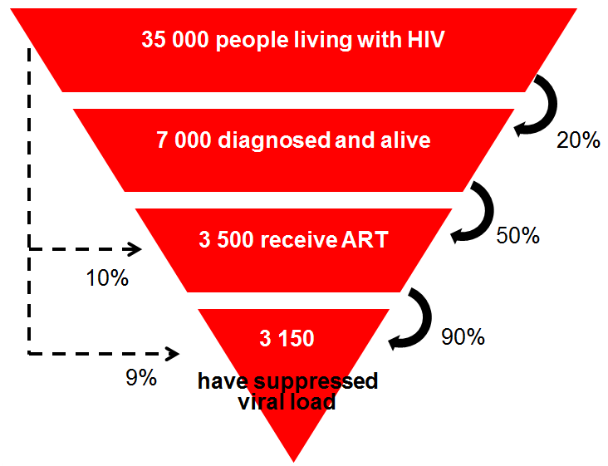
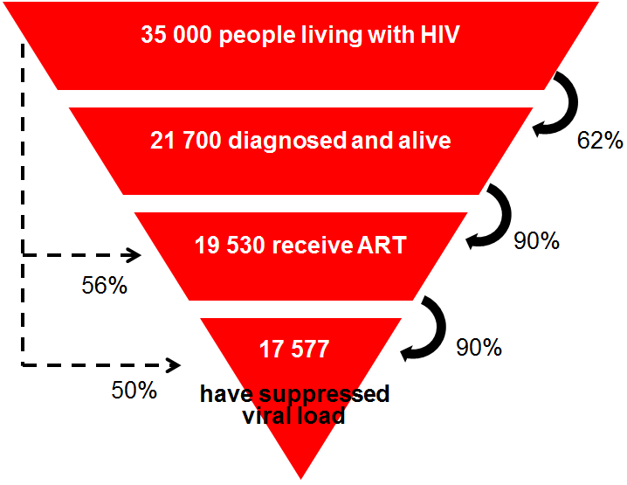
Required cascade for 50% reduction in incidence in Belarus
Notes:
Here, for example, is what would be required to achieve a 50% reduction in incidence in Belarus. The maind ifference is that instead of 10% of people being on treatment, 56% would need to be.

Slide 34
How much money is needed for the future for Belarus?
US$20 million will be needed per year, allocated optimally among MARPs, and at least an additional $10.8 million for the general population
= $30.8 million per year to achieve 50% reduction in overall incidence
Recommended
Maintain current programs
Expand MARP interventions
Ensure universal ART coverage (80%) for those diagnosed and in need
= $25.9 million per year
Notes:
This can be achieved with about $31 million per year.

Slide 35
What is the funding gap in Belarus?
The Belarusian central government is committed to take over 100% funding of ART by the end of 2015.
In 2013, it is funding 40% of ART costs.
The government is committed to take over funding of current prevention programs through revenue of local governments (i.e. regional/municipal budgets) in collaboration with local NGOs.
If current investment in prevention and treatment is covered and any further treatment burdens that arise, the funding gap would then be an extra $3.2 million per year, along with optimal allocation of all resources

Slide 36
What is the funding gap in Armenia?
Universal coverage can be achieved with total spending of US$23 million per year (incl. overhead costs)
Current HIV spending is ~US$5 million per year
Funding gap is US$18 million per year

Slide 37
Conclusions
HIV epidemics are getting worse in both Belarus and Armenia
By spending the same money smarter, 15-30% of infections can be averted
But this is not enough to halt the epidemics: more money is needed

