Slide 1
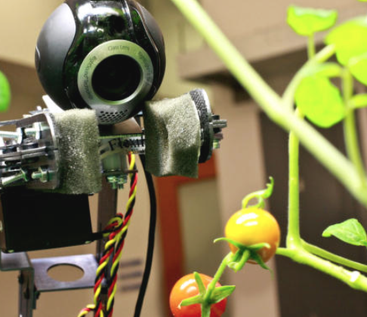
Blossom Bot
IoT Challenge Fall 2014

Slide 2
BlossomBot - Overview
Automated robot(s) to aid in horticulture environments.
Dynamic data gathering of on-board sensors.
Realtime low latency data analysis.
Systemic diagnostics across all robots.
Horticulture resource management.

Slide 3
BlossomBot – Problem Statement
Automate resources in horticulture environments.
Use sensor data to maximize collection and distribution of natural resources (Solar, Hydro etc.)
Use regional measurements to pre-load default settings depending on location.

Slide 4



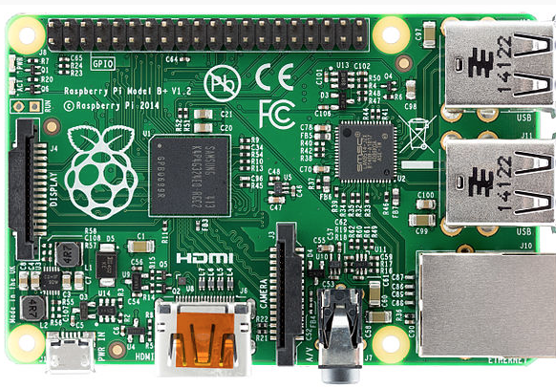
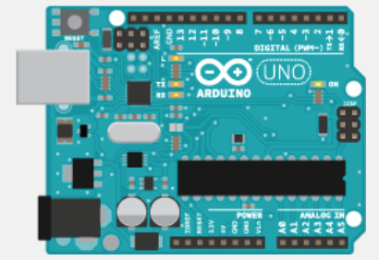
BlossomBot – IoT Devices
Raspberry Pi
Arduino UNO / Firmata sketch
Node Red – Toggle, Arduino, Log

Slide 5
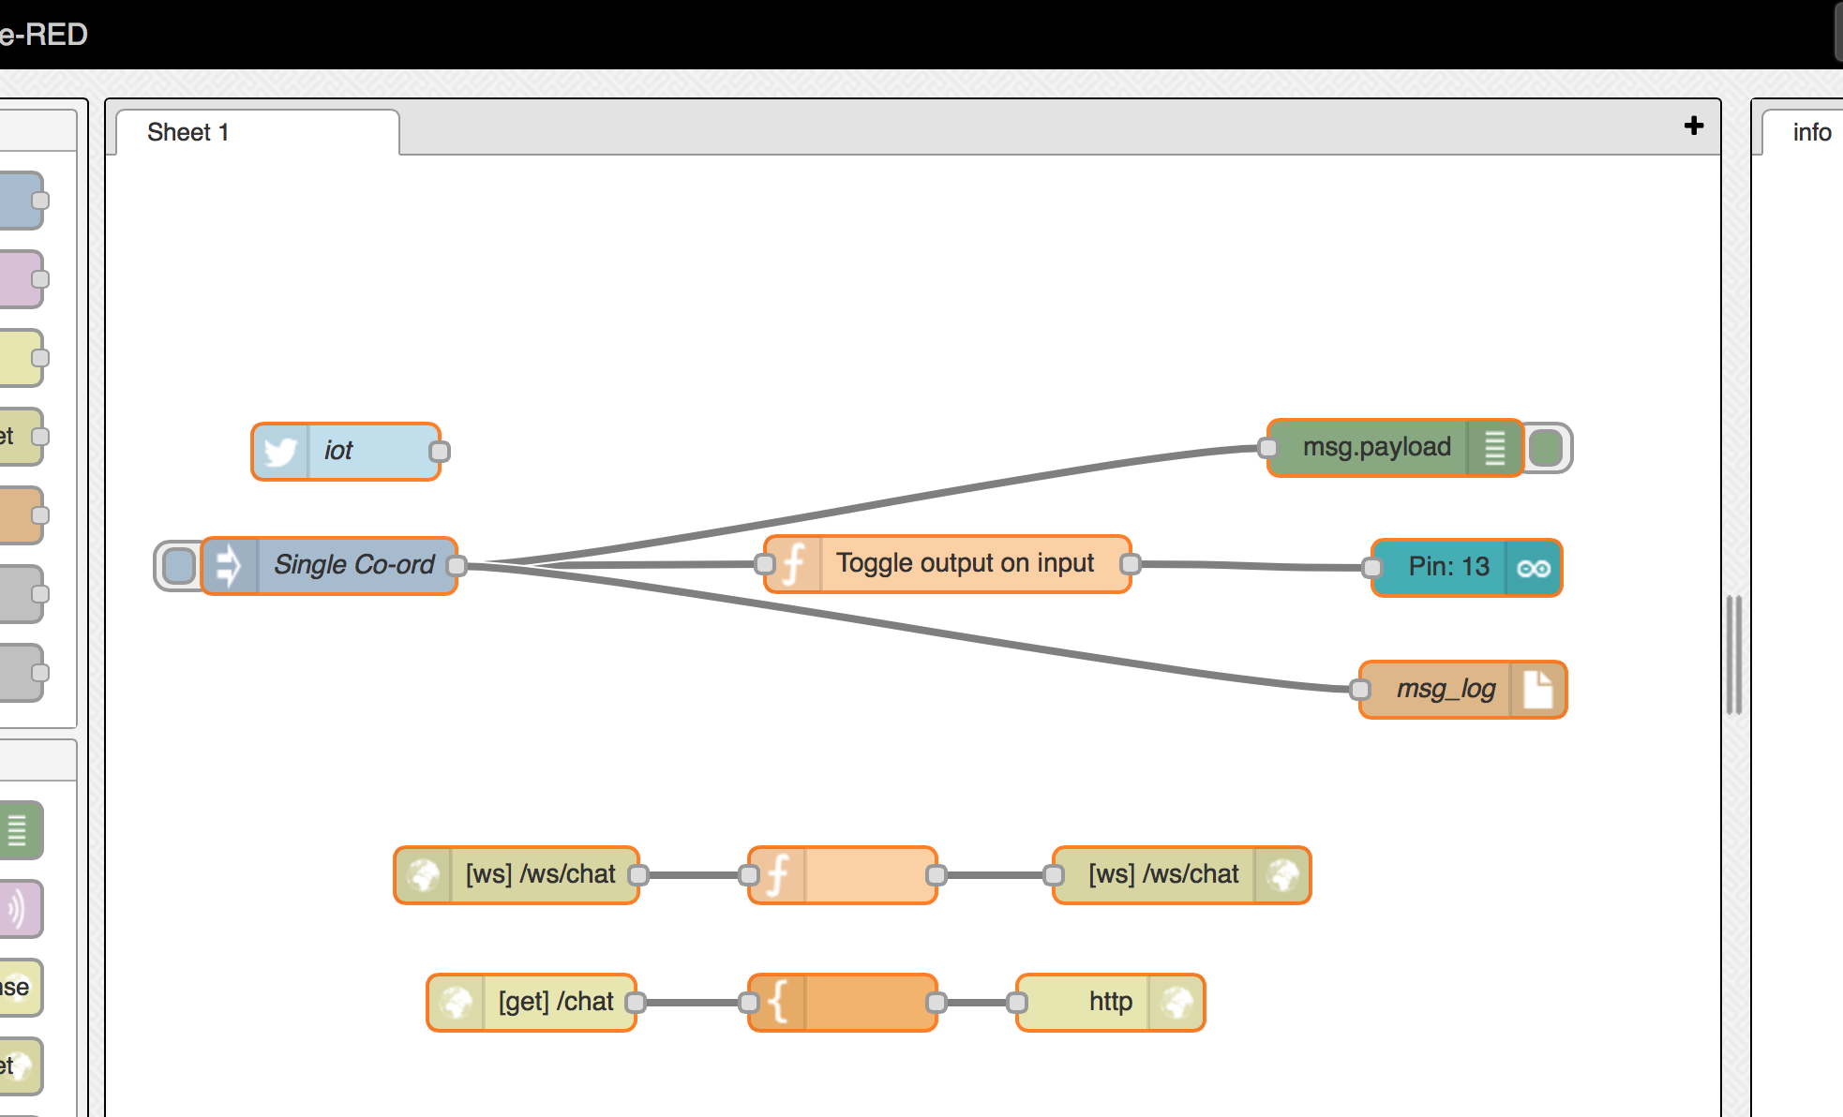
BlossomBot – The Flow

Slide 6
BlossomBot - Users
Farmers – Maximize crops.
Greenhouse - Plants
University Research - Horticulture
Governmental -

Slide 7
BlossomBot – To Market
Develop wireless rechargeable robots.
Investors to use beta-bots.
Universities to use beta-bots.
IoT community.

Slide 8
BlossomBot – Standing Out
Ability to use natural resources when available (Solar, Hydro, Wind).
Use weather forecast to pre-plan resource requirements.
Use photo-synthesis measurements to tune resources deployment.
Use GPS to determine current location of Bot.

