Slide 1
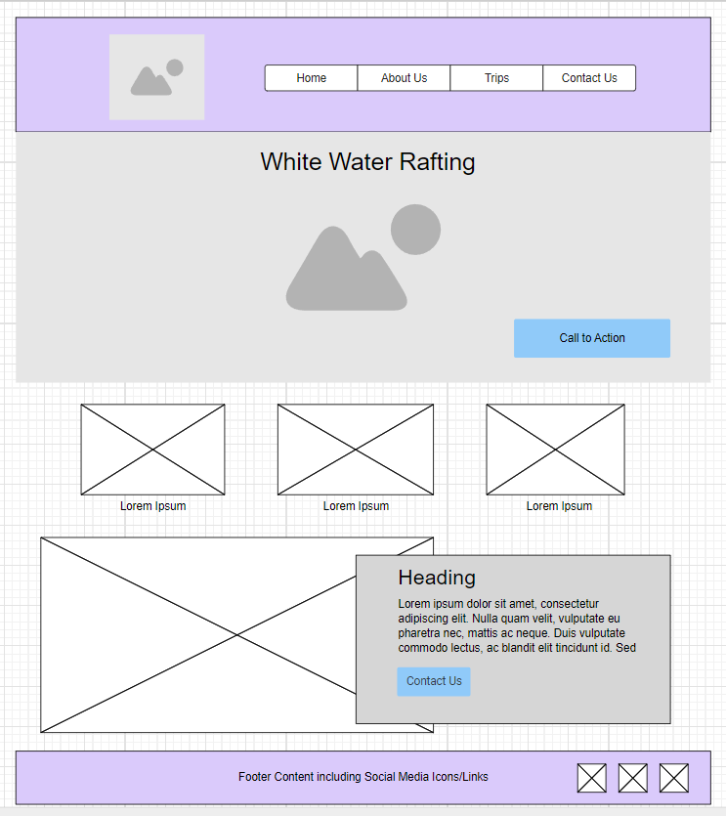
White Water Rafting
Large Rafting Photo
Callout
Rafting Photo
History
Adventure Awaits You
Rafters Photo
Rafters Photo
Rafters Photo
Rafters Photo
Rafters Photo

