Slide 1
AUTONOMOUS VEHICLES
A LOOK INTO THE AI OF SELF DRIVING TECHNOLOGY
WITH WILFRED GITHUKA

Slide 2
Definition: Driverless, Self Driving, Automomous Vehicles (AVs) & Connected Vehicles(CVs)
Vehicle: a thing used for transporting people or goods, especially on land
Connected Vehicles (CVs): A vehicle which can communicate with other cars and also the environment around it. GPS, 4G, 5G
Autonomous Vehicles (AVs): A fully autonomous vehicle does not require a human driver. Self parking, auto-collision avoidance
Self Driving Vehicles: A vague term with a vague meaning. SAE Level 4 and 5
Driverless Vehicles:

Slide 3
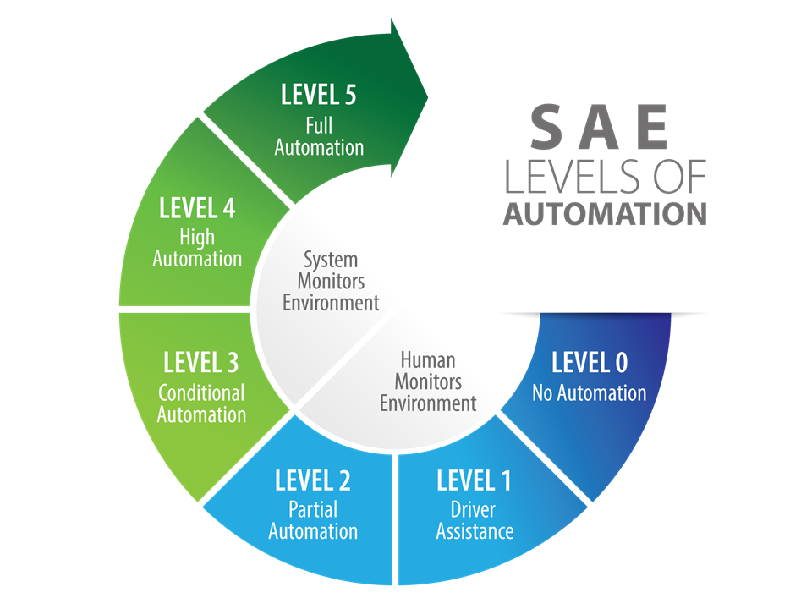
SAE Levels of Automation
Level 0 - No Automation
Level 1 - Driver Assistance Tech.
Level 2 - Partial Automation, Driver Expected to Complete Task
Level 3 - Human Driver Expected to Intervene
Level 4 - Driving task done without expectation of human driver to intervene
Level 5 - Human driver not required at all

Slide 4
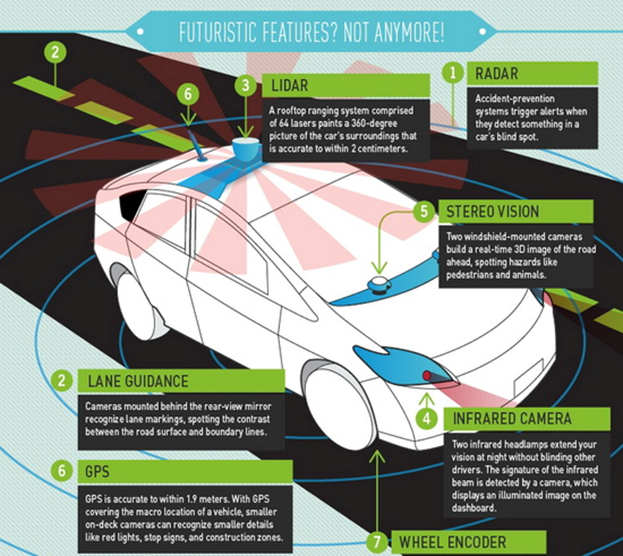
The Technology of the Car
Anti-Lock Brakes
Electronic Stability control
Adaptive cruise control
Lane-departure warning system
Self parking
Automated guided vehicle systems
Lidar-Systems(with google cars) or Cruise Automated Systems(Audi)
Infrared cameras.

Slide 5
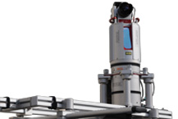
The Lidar System
Features:
Vertical and horizontal setup of the system possible
Image acquisition with fully integrated NIKON DSLR camera.
3D mode of the VZ scanner with continuous rotation of the scanning head for highly efficient mobile data acquisition.
360 degree static scanning.
Mainly used by Google Inc. for detecting the surroundings of the vehicle

Slide 6
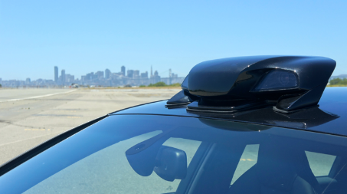
Camera Systems(Computer Vision)
Features:
Cameras and Radars to map out surroundings(including other vehicles)
Used mainly for highway scenarios.
Steering wheel motor mounted to steering column.
Adaptive speed control.
Collision avoidance
RP-1 sensors
Will be made in future for other vehicles.

Slide 7
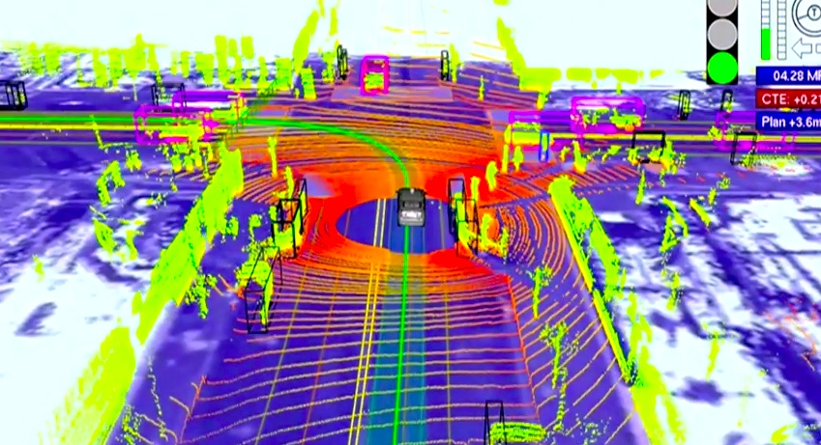
Types of Algorithms
The combination of:
3-D imaging with multiple 1064 nm lasers.
Edge-Detection Algorithm
Motion-Detection algorithm
Tracking algorithm

Slide 8
Apples and Oranges
Lidar System:
$70k system
Can be used in basically anywhere.
Design is very bulky and heavy
Fully autonomous
Camera System:
$10k system(installed)
Mainly for highway scenarios
Design is small and lightweight
Not fully autonomous

Slide 9
Current Adoption of the Technology
Google, as mentioned previously
Cruise Automation
Tesla Model D announced in 2014
Car will be able to autonomously pick owners up (on private property)
Cadillac Super Cruise announced in 2014 for 2017 models
Hands-free driving in certain conditions
Vehicle to vehicle communication
Ford Traffic Jam Assist announced in 2012 gives similar features

Slide 10
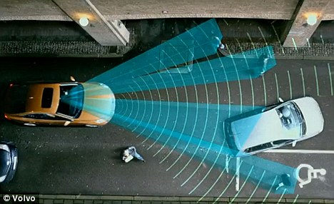
Components
Lane departure warning
Lazy or inattentive drivers can automatically be moved
Blind spot monitoring
Warn if cars are in blind spots
Pedestrian detection
Automatic brake or warning
Adaptive cruise control + forward collision warning
Car stays a safe distance behind cars ahead of it
Warns or takes action in case of danger

Slide 11
Statistical and Professional Support
32,719 people were killed in car accidents in the US alone in 2013
The Institute for Highway Safety reported the following in 2014
7% reduction in crashes for vehicles with forward collision warning systems.
14-15% reduction for vehicles with automatic braking.
In 2012 pedestrian deaths were 14% of all crash fatalities
Insurance Institute for Highway Safety found 72% of people who try the technology want them in their own vehicle.
Automatic braking lowers severity of unavoidable crashes according to an IIHS official.

Slide 12
Drawbacks
Although there are people who want the technology in their cars, it can cost:
$2,000 on average for safety-related tech (not automation)
$10,000 for Cruise in Audi S4s, as mentioned.
Poor performance in adverse weather conditions
Who is to blame?
The car manufacturer? The programmer?
The driver?

Slide 13
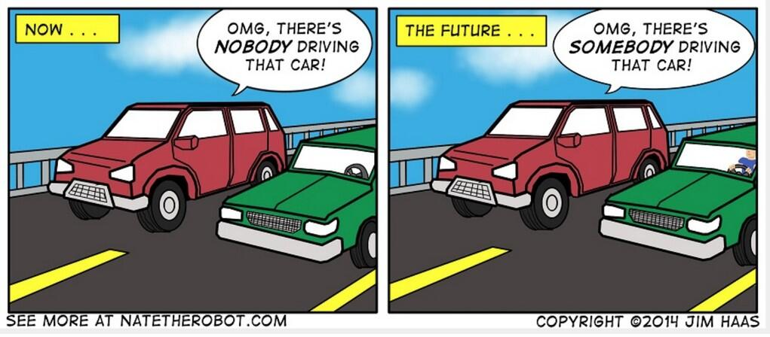
Public Acceptance and Adoption
Vehicle to vehicle technology cannot function ideally without adoption across the board.
Minority vs majority
Few legal precedents
Legal in NV, CA, FL, MI, and the District of Columbia.
Failed legislation in TX, OK, CO, AZ, OR, WI, and NH.

Slide 14
Ethical Considerations
“Human drivers may be forgiven for making an instinctive but nonetheless bad split-second decision, such as swerving into incoming traffic rather than the other way into a field. But programmers and designers of automated cars don’t have that luxury, since they do have the time to get it right and therefore bear more responsibility for bad outcomes.”
- Patrick Lin, The Atlantic

Slide 15
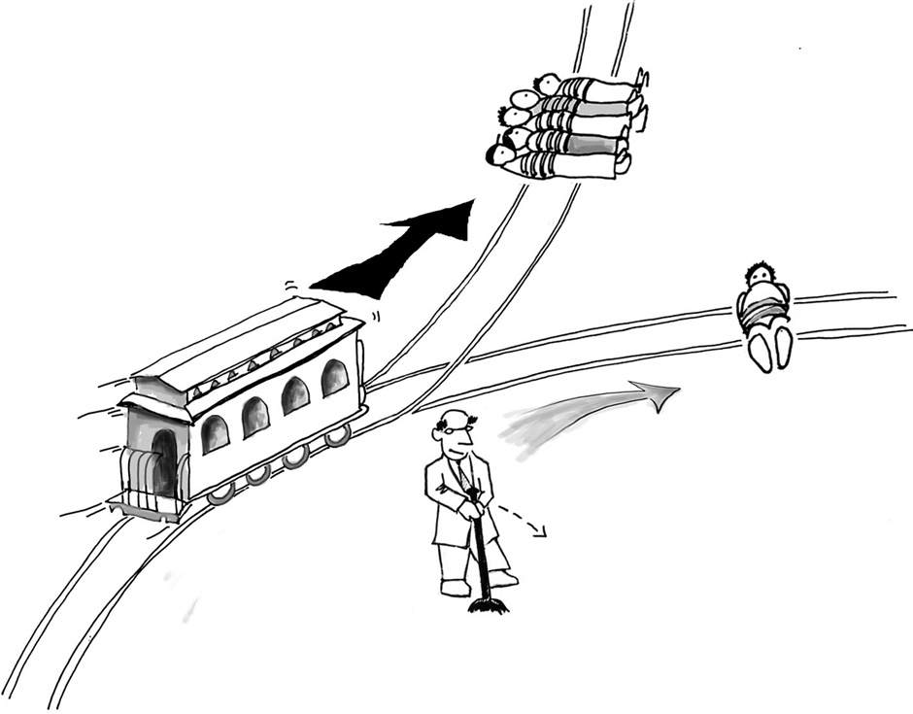
The Trolley Problem
A classic thought-exercise in ethics
A trolley’s brakes have failed.
You are controlling the signal switch.
If you do nothing, five people will be killed.
If you activate the switch, only one person will be killed.
What do you choose to do?
Critical distinction: Allowing death versus causing death?

Slide 16

Utilitarian Analysis
A quick refresher
Weigh the pros and cons of each potential outcome to determine the net change in overall welfare.
Pick the outcome with greatest net increase (or least decrease) in welfare.
Due to its objectiveness, it is theoretically possible to implement in a computer system.

Slide 17
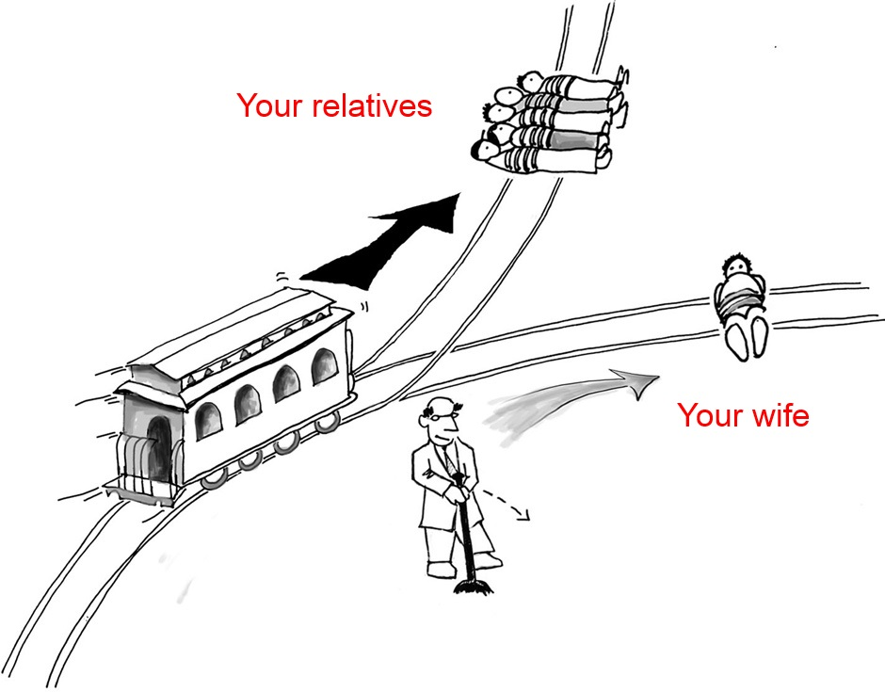
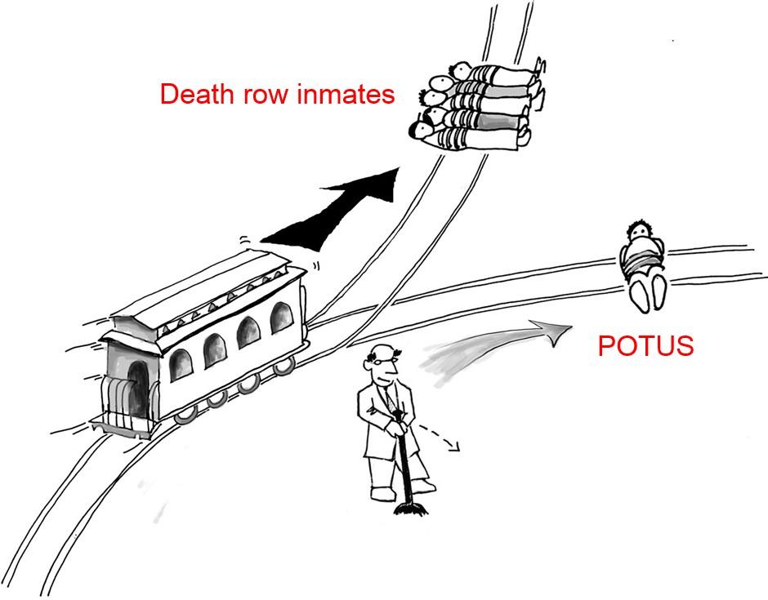
The Trolley Problem
When the identities of the actors change

Slide 18
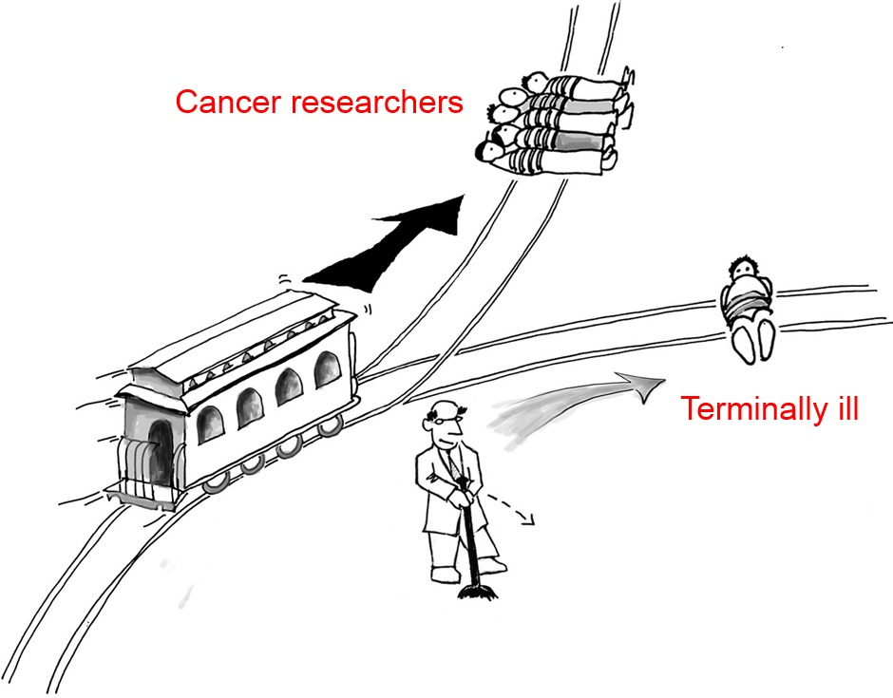
Problems with Utilitarian Analysis
Ineffective when information is omitted.
A truly accurate analysis may require valuing one human life over another.
The “least bad” outcome may still result in the loss of life.

Slide 19
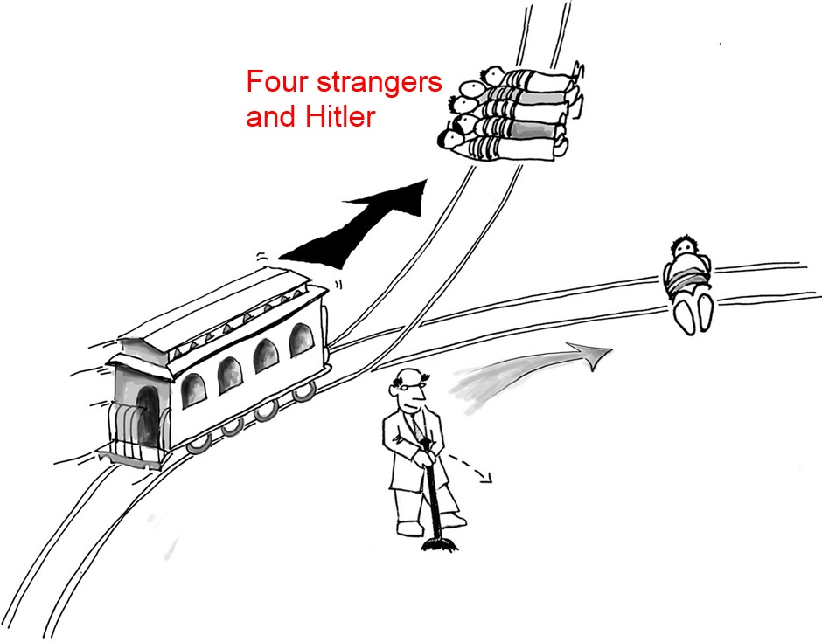
Another Problem: Consequentialism
While we are free to choose our actions, we are not free to choose the consequences of our actions.
– Stephen R. Covey
Without complete information and the gift of hindsight, a decision that results in a net gain of welfare in the short run may turn out to be a very poor decision in the long run.

Slide 20
A New Class of Victims
There will be an inherent shift in the makeup of automobile accident victims.
Likely a decrease in driver deaths and an increase in pedestrian and cyclist deaths.
Great news for some people, bad news for others.
An ethical conundrum: Can we accept an increase in the death rate of certain groups of people if it means a decrease in the overall death rate?

Slide 21

Random Outcome Generator
A “fair” solution
Generate a list of potential outcomes, then roll the die:
Swerve to the right, potentially killing a cyclist.
Swerve to the left, potentially killing two pedestrians.
Continue forward into the path of an oncoming vehicle, potentially killing yourself and its occupant(s).

Slide 22
Easing Public Apprehensions
How many more lives per year must be saved for the public to embrace a driverless revolution?
Manufacturers will need to be upfront with the details of the decision-making systems piloting the vehicles.
Will there be override capabilities?
Delayed Feedback Problem: There will be a significant period of time before we’ve collected enough data to determine the effectiveness of a driverless initiative.

Slide 23
References
BRANDON, JOHN. "The New Cruise Control." Inc 37.1 (2015): 88-94. Academic Search Complete. Web. 1 Apr. 2015.
PULTAROVA, TEREZA. "Self-Driving Self-charging Electric Cars Ready to Roll." Engineering & Technology (17509637) 9.12 (2015): 10. Academic Search Complete. Web. 1 Apr. 2015.
"The Road To Self-Driving Cars." Consumer Reports 79.4 (2014): 16-20. Academic Search Complete. Web. 1 Apr. 2015.
http://www.fool.com/investing/general/2014/10/26/self-driving-cars-what-will-it-take-to-make-automa.aspx
http://www.autoinsurancecenter.com/top-20-pros-and-cons-associated-with-self-driving-cars.htm
http://www.wired.com/2013/07/the-surprising-ethics-of-robot-cars/
http://www.consumerreports.org/cro/magazine/2014/04/the-road-to-self-driving-cars/index.htm

