Slide 1
How to manage your django settings
Jockeying the Pony
Tareque Hossain
Notes:
Yesterday we had a question on the panel regarding settings management.
Many of us have already found out that putting all your settings in a single file can be messy because you are forced to put all your configurations in one place and then have to be able to change them for various reasons.
In Pony terms, this is equivalent to trying to tame a pony that’s growing really fast.

Slide 2
Why?
You find the single file settings management to be too restrictive
You have different development, staging and production servers and edit your settings often
You have a large team and need developers to use different settings
You have exclusive settings for testing environment
You are a pony jockey & you want your own saddle

Slide 3
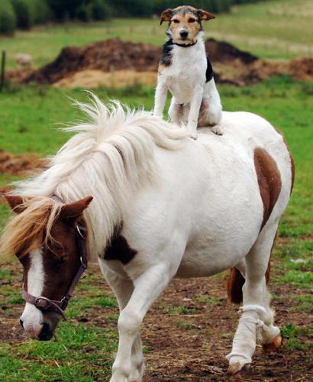
How?
Notes:
You don’t want to be sad like this puppy who doesn’t have a saddle

Slide 4

How?
Notes:
You don’t want to be pushed around while riding your pony

Slide 5
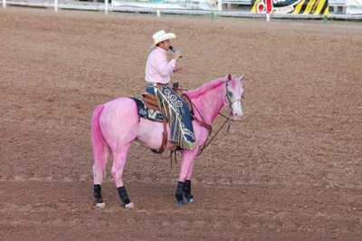
How?
Notes:
That’s right. You need your own saddle.

Slide 6
But really, how?
Maintain a global settings file which everyone shares
Maintain individual settings:
Different developer settings (e.g. dev1, dev2)
Different server settings (e.g. local, staging, production)
Notes:
At PBS we have been successfully using multiple settings files to distribute and customize our diverse configuration needs.

Slide 7
But really, how?
Define defaults in a base settings file
Override base settings in individual settings profile to suit developer/ server need
Define new settings without affecting others
Protect your settings using a password (e.g. production settings)
Share your settings or keep it private
Notes:
Enable password when you don’t want people to accidentally edit your settings (e.g. production settings)

Slide 8
But really, how?

Slide 9
Jockey Perks
Maintain and work on your own database
Work with multiple databases
Switch between databases on the fly. Experiment with your models without messing up the db
Work with different application sets
Create & test all deployment circumstances

Slide 10
Demo
Now an awesome demo of django-config in action

Slide 11
Who?
Tareque Hossain, PBS TeacherLine Tech
Details: http://bit.ly/django-config

