Slide 1
How to manage your django settings
Jockeying the Pony
Notes:
Yesterday we had a question on the panel regarding settings management.
Many of us have already found out that putting all your settings in a single file can be messy because you are forced to put all your configurations in one place and then have to be able to change them for various reasons.
In Pony terms, this is equivalent to trying to tame a pony that’s growing really fast.

Slide 2
Why?
You hate the “one file” Django offers for settings management
You are a jockey and you want your own saddle to ride the pony.
You have different development, staging and production servers and edit your db settings often
You have a large team and everyone is trying to use the same database

Slide 3
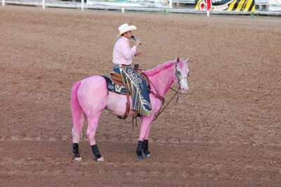
How?

Slide 4
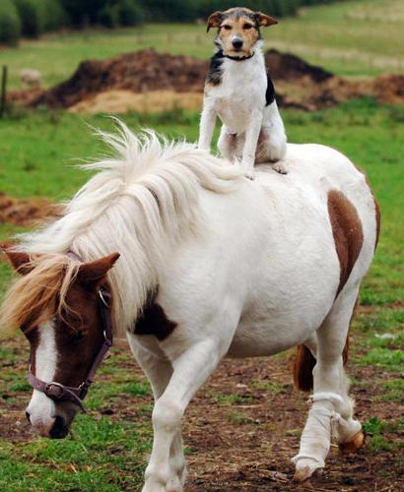
How?

Slide 5

How?

Slide 6
But really, how?
Maintain a global settings file which everyone shares
Maintain individual settings:
Different developer settings (e.g. monty, silly)
Different server settings (e.g. local, staging, production)
Override manage.py & combine global settings with your server/ developer settings
Notes:
At PBS we have been successfully using multiple settings files to distribute and customize our diverse configuration needs.

Slide 7
But really, how?
Define defaults in a base settings file
Override base settings in individual settings profile to suit developer/ server need
Define new settings without affecting others
Option to protect your settings using a password (e.g. production settings)
Share your settings or keep it private

Slide 8
But really, how?

Slide 9
Jockey Perks
Maintain and work on your own database
Work with multiple databases
Switch between databases on the fly. Experiment with your models without messing up the db
Work with different application sets
Create & test unlimited number of profile for your application and test all possible deployment circumstances

Slide 10
Demo
Now an awesome demo of django-config in action

Slide 11
Who?
Tareque Hossain, PBS Tech Team

