Slide 1


ASANA
Asana Custom Fields & Filters
Custom Fields are for
Filters are for
TRACKING
FOCUS
RULE 1
RULE 2
Every task gets a status
custom field
Use filters to see only
what's relevant
RULE 3
RULE 4
Save your most-used
filters as bookmarks
Update fields before
every status meeting
Notes:
Hey team! Welcome to Asana Tip of the Week number 2. Last week we covered turning Slack messages into Asana tasks. This week we are leveling up with Custom Fields and Filters.
Think of Custom Fields as labels you put on every task so you always know the status, the priority, and which channel it belongs to. Filters let you cut through the noise and only see what matters to you right now.
Here are the four rules:
Rule 1: Every task gets a status custom field. No more guessing where things stand. Is it Not Started, In Progress, Blocked, or Done? Tag it.
Rule 2: Use filters to see only what is relevant. You do not need to scroll through 200 tasks. Filter by your name, by priority, by status, whatever helps you focus.
Rule 3: Save your most-used filters as bookmarks. If you check "My high priority tasks" every morning, save that view so it is one click away.
Rule 4: Update your fields before every status meeting. This is the big one. If everyone updates their task fields before we meet, we spend less time on "what is the status of X" and more time on actual strategy.

Slide 2
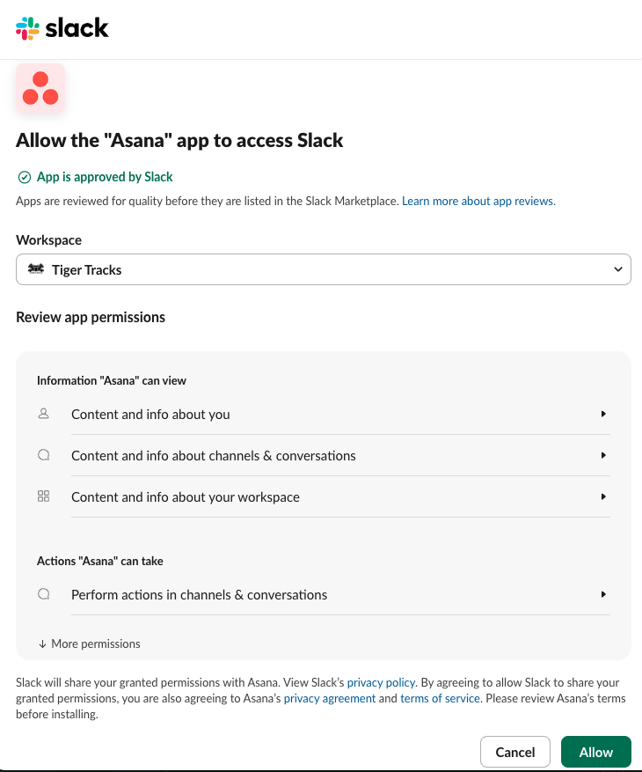
ASANA
Asana Custom Fields & Filters
STEP ONE
ADD CUSTOM FIELDS
Open any Asana project
Click "Customize" (top right)
Select "Add Field"
Add: Status, Priority, Channel
These fields appear on every task
Notes:
Step One is adding custom fields to your projects.
Open any client project in Asana. In the top right corner you will see a Customize button. Click that, then select Add Field.
The three fields every project needs are Status, Priority, and Channel. Status tells us where the task is: Not Started, In Progress, Blocked, Complete. Priority is High, Medium, or Low. Channel tells us if this is Paid Search, Paid Social, SEO, or whatever applies.
Once you add these fields to a project, they show up on every single task in that project. It takes two minutes to set up and saves hours of confusion later.
If you are not sure which fields to add, just start with Status and Priority. You can always add more later.

Slide 3
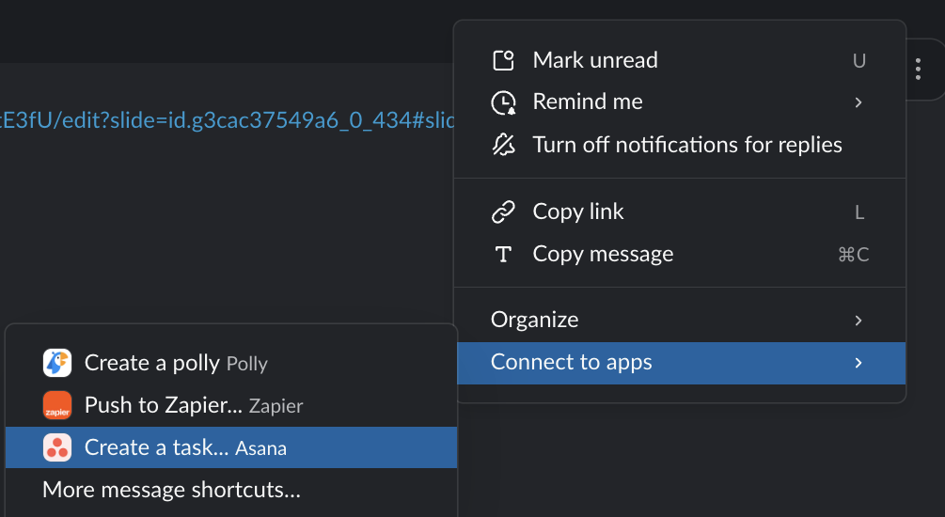
ASANA
Asana Custom Fields & Filters
STEP TWO
USE FILTERS TO FOCUS
Click "Filter" at the top of any project
Choose a field (e.g. Priority = High)
Stack multiple filters to narrow further
Click "Save as default" for your view
Notes:
Step Two is using filters to focus your view.
At the top of any project, you will see a Filter button. Click it and choose which field you want to filter by. For example, Priority equals High. Now you only see high priority tasks.
The power move is stacking filters. Priority equals High AND Status equals In Progress. Now you see exactly what is actively being worked on that matters most.
Once you have a filter combination you like, click Save as Default for your view. That means every time you open this project, it automatically shows you what you care about. Your teammates will still see their own default view.
Pro tip: Try this on your My Tasks view. Filter by Due This Week plus High Priority. That is your daily game plan right there.

Slide 4
ASANA
Asana Custom Fields & Filters
TT STANDARDS:
TEAM CHALLENGE:
Add custom fields to one client project
Filter your "My Tasks" by priority
Update all task statuses before Friday
Every client project must have Status, Priority, and Channel custom fields.
Every task must have its Status and Priority fields set before weekly syncs.
Use "My Tasks" with filters to prep for standups and client calls.
Save filtered views so you can jump to your focus areas instantly.
★ Share your favorite filter with the team
Notes:
Here are the Tiger Tracks standards going forward:
Every client project must have Status, Priority, and Channel custom fields. No exceptions. If your project does not have them, add them today.
Every task must have its Status and Priority fields updated before our weekly syncs. This way when we get on a call, we are not wasting time asking for updates. We can see everything at a glance.
Use My Tasks with filters to prep for standups and client calls. Filter by the client project, sort by priority, and you have your talking points ready.
Save your filtered views so you can jump to your focus areas instantly. One click, you are there.
Here is this week's team challenge: Add custom fields to at least one client project. Filter your My Tasks by priority. Update all your task statuses before Friday. And share your favorite filter setup with the team so we can all learn from each other.
Let me know if you have any questions. Go make your Asana work for you!

