Slide 1
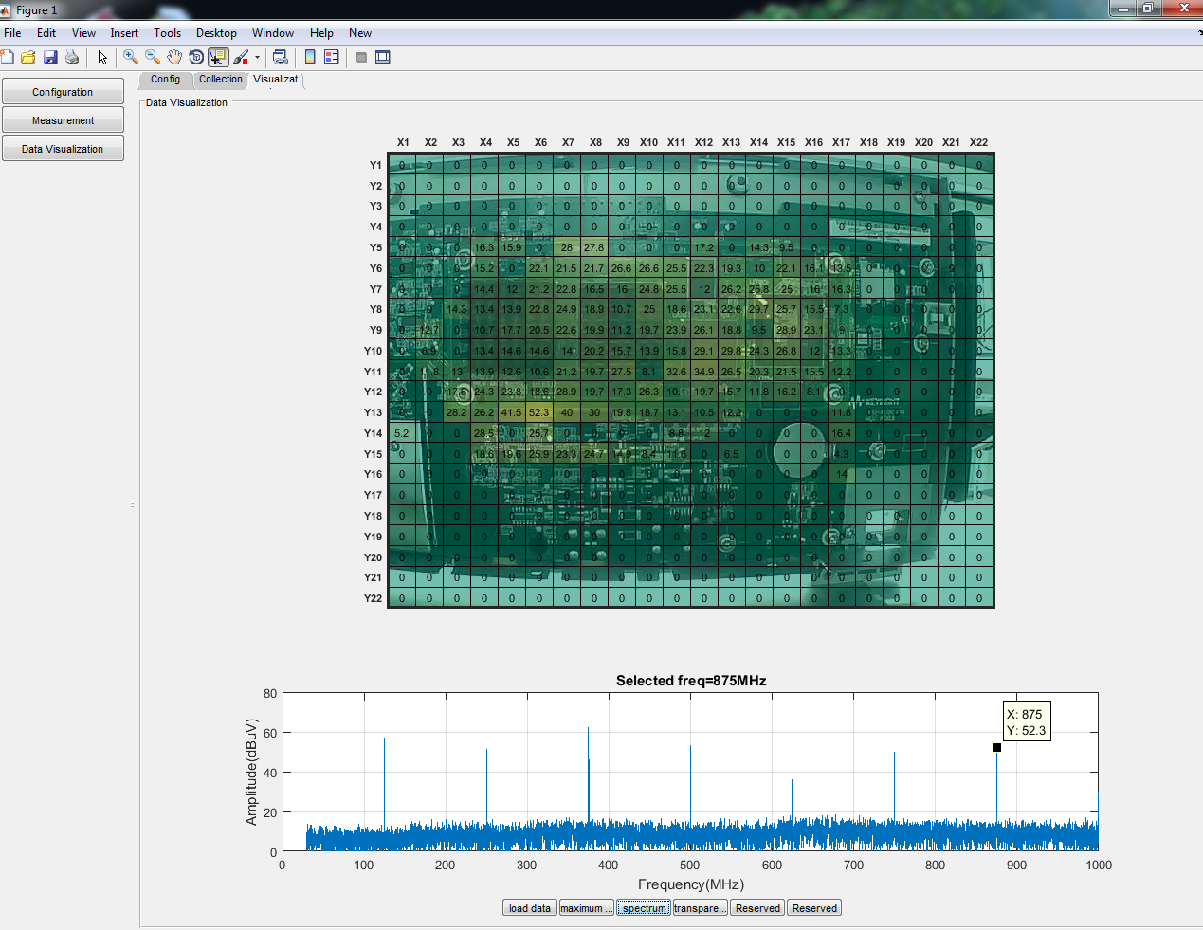
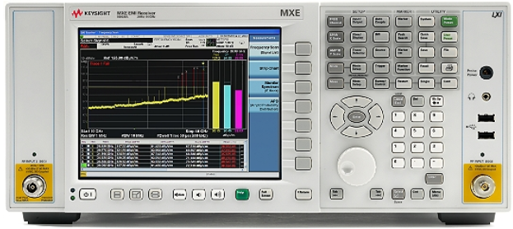
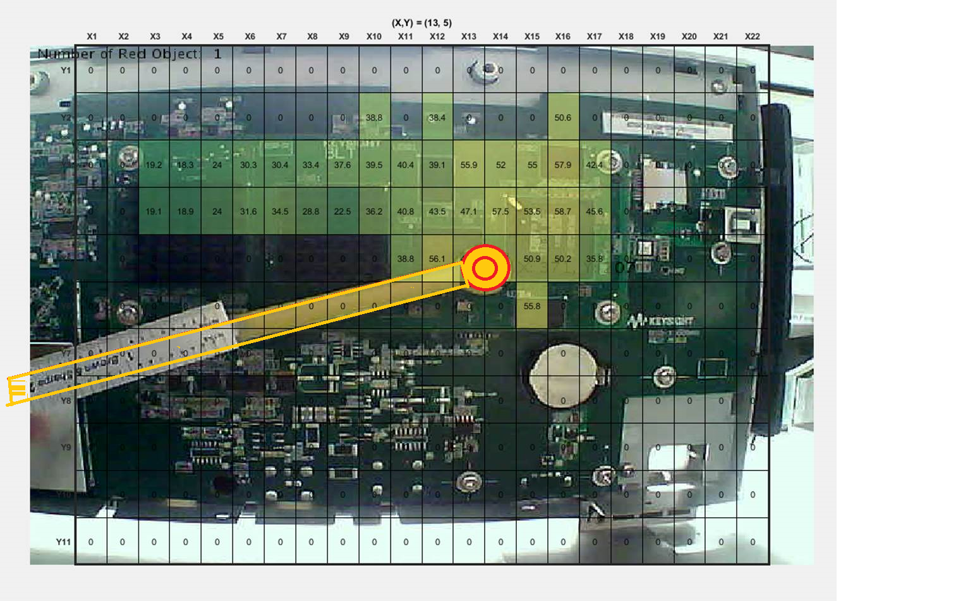
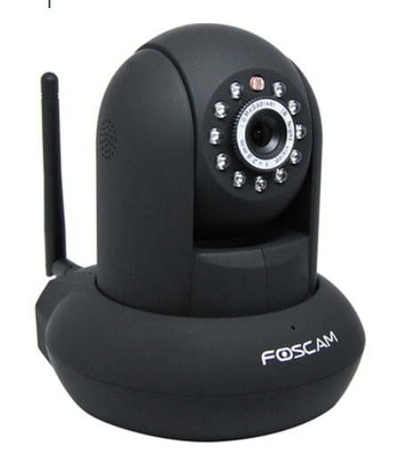
Near Field Scanner enabled by Computer Vision Tracking
Running on the windows based Spectrum Analyzer
Device Under Test
Spectrum Analyzer
Sniffer Probe with
Red color at the tip
IP Camera

Slide 2
Connect Camera, SA
Filter noise using median filter
Save data into indexed matrix
Setup Mesh Grid
Convert red into white binary img
Overlay the maximum value to mesh grid
Overlay Mesh Grid
Calculate centroids and bounding box of white blobs
Overlay the Heat map to frame
If stop?
Convert centroid location to mesh index
Acquire single frame
Collect data from SA
Get Red Component
Maximum hold the existing data with new data

