Slide 1
Detecting Machine-Generated Text
50.007 Machine Learning | COLING 2026 GenAI Content Detection
Public leaderboard Macro F1 0.80143
LightGBM on 40,385 features built from raw text,
with the two test populations thresholded separately.
Cliffton, Brian, Jovyan, Koko, Vincent
Notes:
One sentence: we got most of our gain from what the model sees and from how we turn its scores into labels, not from the model.

Slide 2
The task, and the trap inside it
- Binary: is this document machine-generated? Scored on Macro F1.
- 20,000 labelled training documents, 6,999 to predict. 62.52% machine.
- Train is HC3 + M4GT + MAGE. Test is CUDRT + IELTS + NLPeer + PeerSum + MixSet.
- Zero corpus overlap. The shift is by design, and the brief says so.
- Public leaderboard noise floor: 0.0084. Everything smaller is a tie.
Notes:
The shift is deliberate. High training F1 and low test F1 is the designed behaviour, so a large gap is not evidence of a bug. What it does mean is that same-domain validation will mislead you.

Slide 3
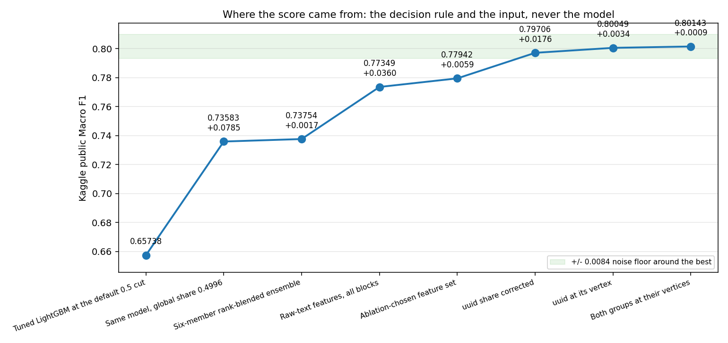
The journey, in seven milestone submissions
Representation, then calibration. The model itself contributed almost nothing.
Notes:
Point at the two steep steps. Everything flat is a round we spent on tuning or ensembling. We report those as nulls.

Slide 4
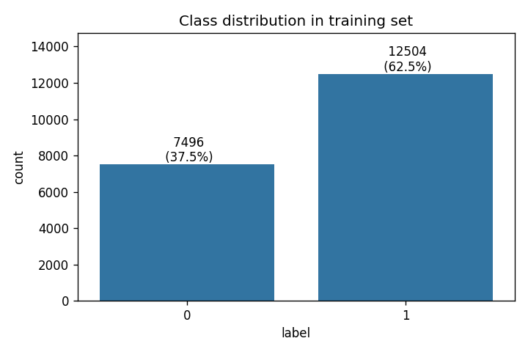
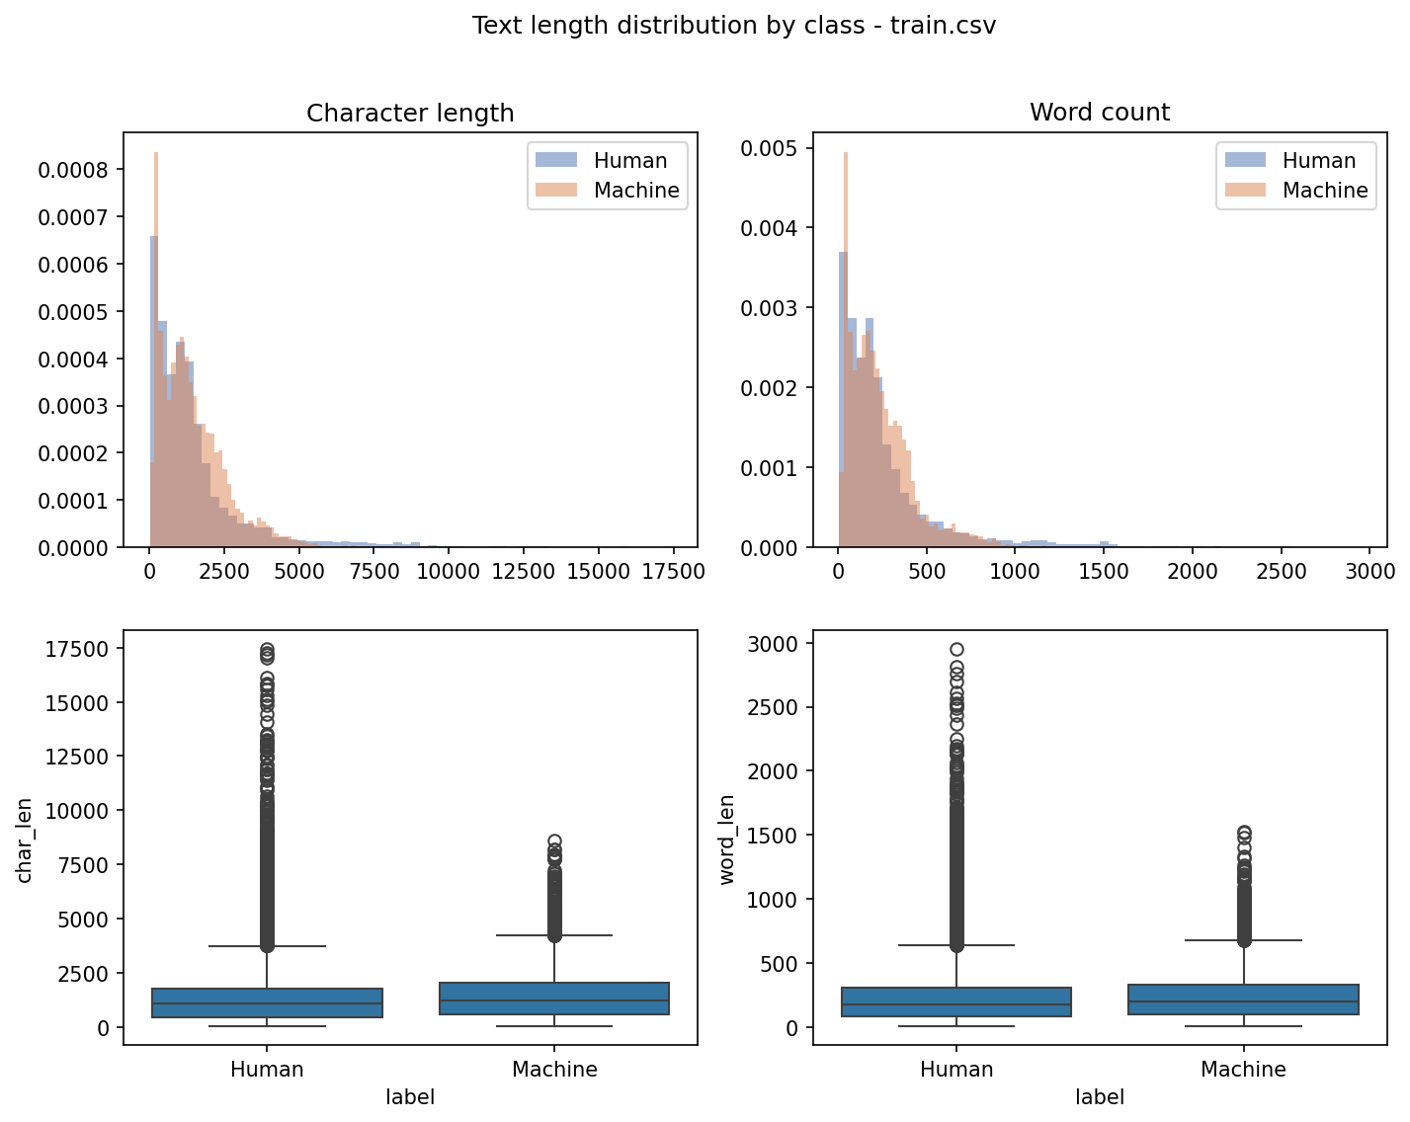
What the data looked like
Notes:
Class imbalance forced stratification and class weighting everywhere. Length correlates with the label, which later became our validation protocol.

Slide 5
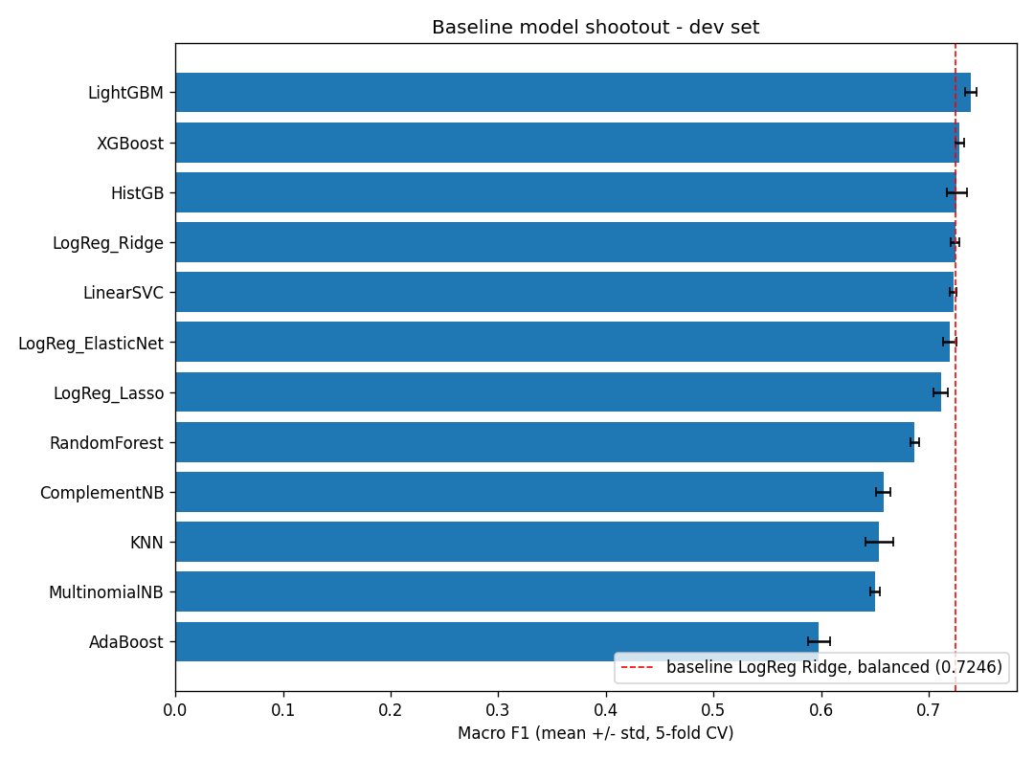
Where we started: twelve models on the supplied features
LightGBM led, and kept leading once we compared fairly.
Notes:
Chose LightGBM. Tried XGBoost, HistGB, three linear models, naive Bayes, KNN, RandomForest, AdaBoost. Drawback of a single model is no diversity. Acceptable because we later measured what ensembling was worth and it was inside the noise floor.

Slide 6
Wrong turn 1: we compared models along an axis we had not fixed
- For three notebooks we believed local validation was anti-correlated with Kaggle.
- LightGBM had the best CV and holdout of anything, and the worst leaderboard score. So we wrote it off.
- The cause: each model was submitted at whatever class balance its own default threshold produced.
- At a matched share, LightGBM beat ElasticNet by 0.0189, matching its local lead.
- Local validation had never been broken. We had been asking two questions as one.
Notes:
This is the difficulties question. We wrote down a conclusion, designed a test that could overturn it, and it did. Keep that habit visible.

Slide 7
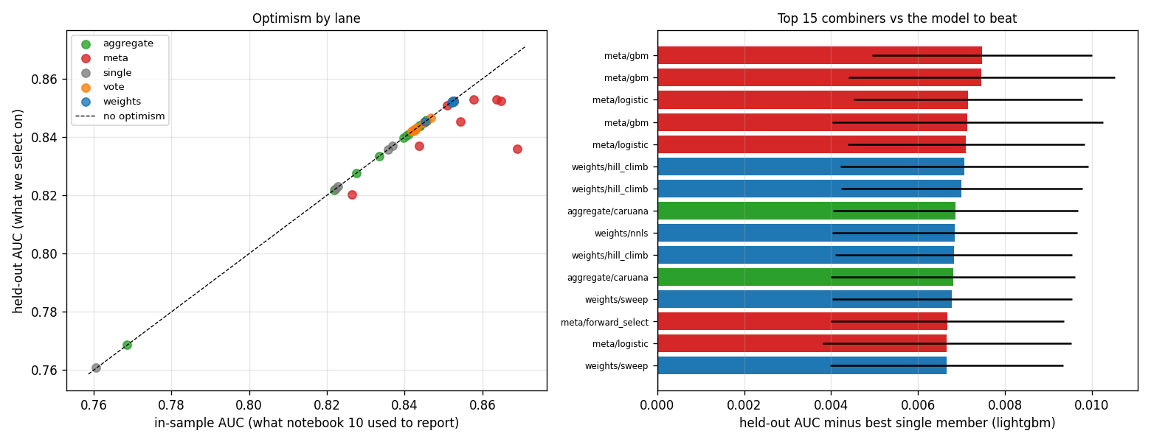
Rounds 3 and 4: ensembling, and an honest null
Four combiner families, 48 configurations, +0.0017 on Kaggle.
Notes:
A fifth of the noise floor. The diagnosis was that we had been optimising the model while holding the representation fixed.

Slide 8
The diagnosis: we were tuning the wrong thing
- The supplied features are top-5,000 TF-IDF over lemmas, stop words removed.
- That is a pure content signal, and content is what differs between corpora.
- Raw text was fully available and essentially untouched: one length summary in seven notebooks.
- So we rebuilt the representation from the text: function words, punctuation, casing, layout, length, diversity, and character and word n-grams.
Notes:
The supplied features are lemmatised with stop words removed, so they are pure content. Content vocabulary is exactly what changes between corpora. Function words, punctuation and layout survive.

Slide 9
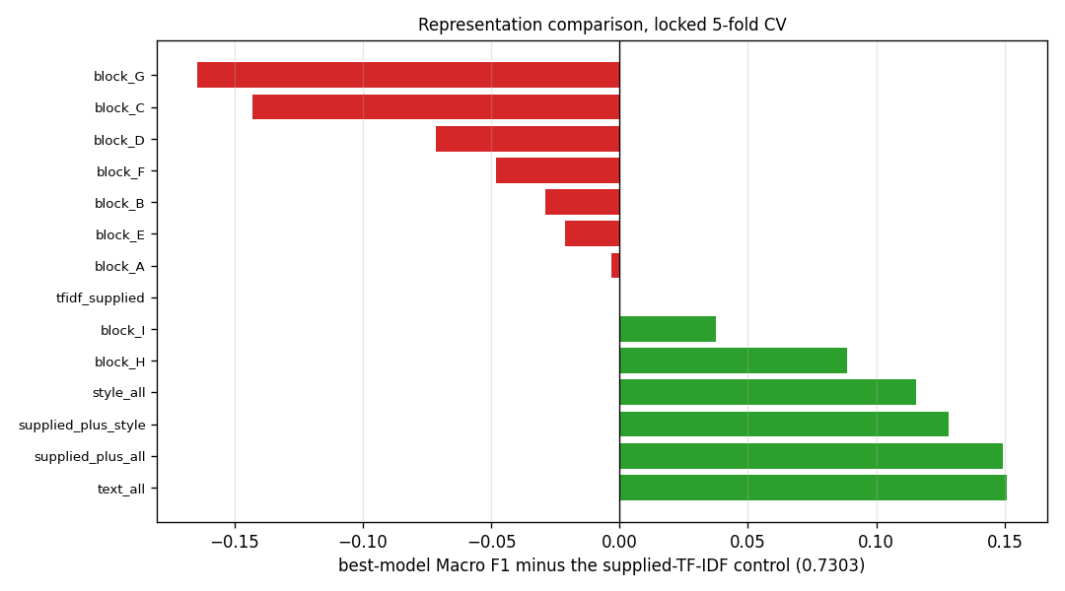
Changing the representation: +0.036 on the leaderboard
Every dense block alone scores below the supplied control. Together they beat it by 0.115.
Notes:
Chose all raw-text blocks. Tried supplied alone 0.7303, style only 0.8458, char n-grams alone 0.8188, supplied plus everything 0.8795 which ties raw text alone with 5,000 more columns. Drawback: 40,385 hand-built features. Acceptable because the supplied ones delete the signal that transfers.

Slide 10
Wrong turn 2: we predicted the formatting features were artifacts
- Hypothesis: layout and punctuation features are dataset fingerprints and will not survive the corpus change.
- Test: ship a stripped-down feature set with only function words and character n-grams.
- Result: it lost 0.04944, six times the noise floor, in the opposite direction.
- We would rather report a falsified prediction than a roadmap where every idea worked.
Notes:
Machine text in training carries markdown bold at ten times the human rate, and the peer-review test rows carry it at five times the machine rate. Sounded like a domain marker. We built the test so it could fail, and it did.

Slide 11
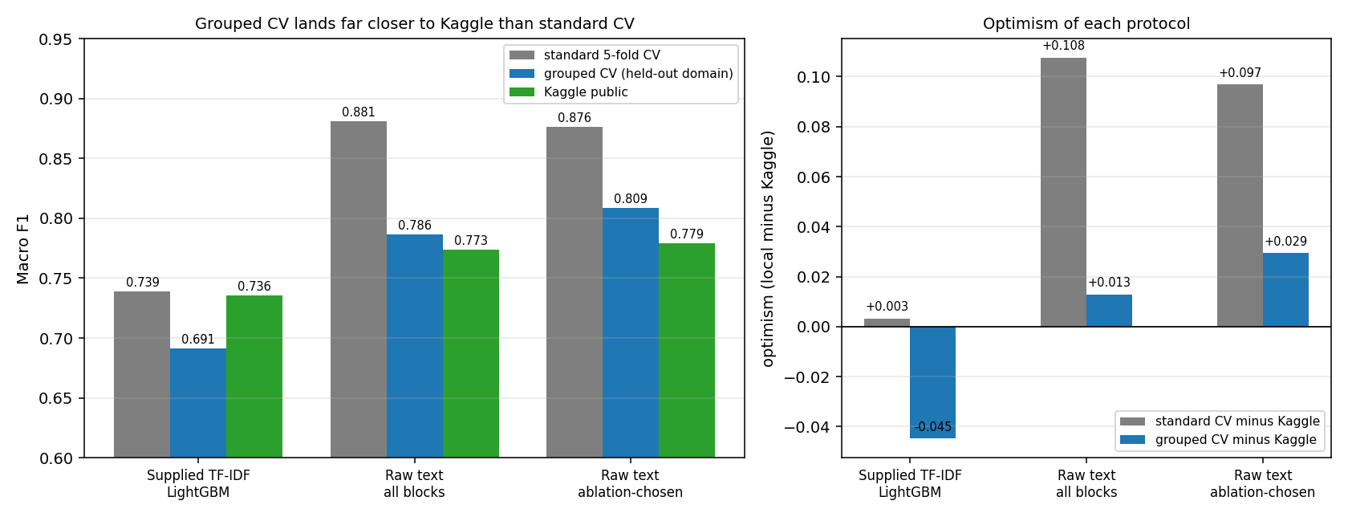
Which local number should we trust?
Standard CV overstates the leaderboard by ~0.10. Grouped CV gets within ~0.03.
Notes:
Chose leave-one-length-band-out. Tried standard 5-fold, k-means domain clusters which would not reproduce across machines, and a random grouping as a control. The control is the point: it reproduced standard CV, so the gap comes from structure and not from training on fewer rows.

Slide 12
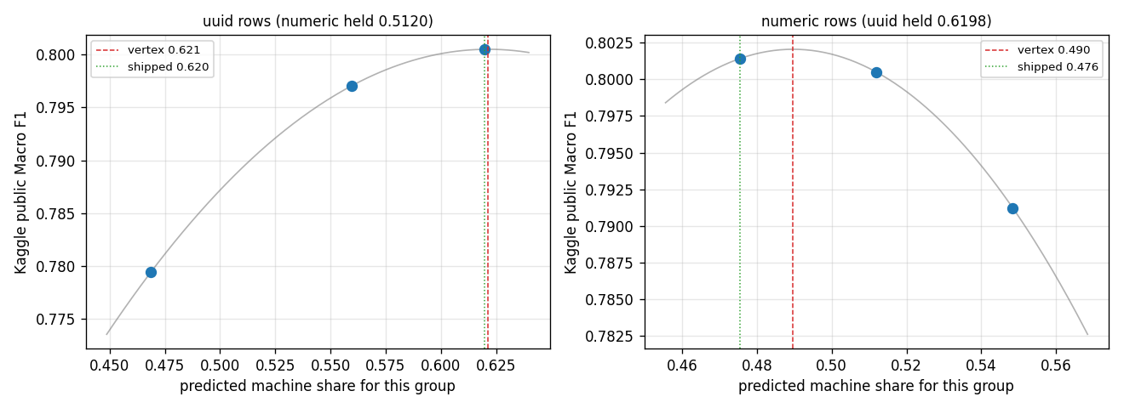
The biggest single finding: threshold the two populations separately
A global cut moves both groups the same way. They need opposite corrections.
Notes:
We swept global share twice, on two models, and it was flat both times. Both measurements were correct and both conclusions were wrong. A +0.019 effect and a -0.019 effect were cancelling.

Slide 13
Why the global sweep looked flat
When one global threshold is applied to a population that is a mixture,
the optimum for the mixture can be flat while the component optima are
far apart and moving in opposite directions.
- UUID rows wanted a higher predicted machine share. Numeric rows wanted a lower one.
- Correcting them separately: +0.022 on the leaderboard, no model change at all.
- Confirmed independently on a second, unrelated model to within 0.001.
Notes:
This is the idea that generalises furthest beyond this project. Say it slowly.

Slide 14
What did not work, and we report it
Four feature ideas, all inside the selection bar.
- extended diversity (J, 14 cols): -0.0022 on held-out-domain Macro F1
- variability (K, 12 cols): +0.0049 on held-out-domain Macro F1
- J and K together: +0.0011 on held-out-domain Macro F1
- char n-grams at 5x capacity: +0.0023 on held-out-domain Macro F1
- K-means domain clusters: passed the stability gate on one machine at ARI 0.9703 and failed on another at 0.5991.
- Ensembling on the supplied features: +0.0017, a fifth of the noise floor.
Notes:
Extended diversity actually made transfer worse while improving same-domain fit, which is the exact memorisation signature. Selecting on standard CV alone would have shipped it.

Slide 15
Where the gain actually came from
0.73583
+0.044
+0.022
supplied TF-IDF, global threshold
raw-text representation
per-group thresholding
Final: 0.80143 Local: 0.8764 standard CV, 0.8089 held-out domain
Hyperparameter tuning contributed nothing so far: the shipped model runs on LightGBM defaults.
Notes:
Two thirds representation, one third calibration, essentially nothing from the model. That is not the split we expected when we started.

Slide 16
What we learned, and what is still open
- Read the dataset paper first. It produced both changes that moved our score.
- When folds differ by design, compare paired differences, not means.
- A leaderboard has a precision. Compute it once, then hold every claim to it.
- Averaging can hide two large effects that cancel.
- Open: hyperparameter search on this representation, a second model family, and final pick selection.
- Final picks pair the best public point with a more central one, because our share coordinates are fitted to a noisy leaderboard.
Notes:
Close on the methodology, not the score. The paired-comparison point and the mixture point are the two we would defend hardest.

