Slide 1
Detecting Machine-Generated Text
50.007 Machine Learning | COLING 2026 GenAI Content Detection
Public leaderboard Macro F1 0.80143
LightGBM on 40,385 features built from raw text,
with the two test populations thresholded separately.
Cliffton, Brian, Jovyan, Koko, Vincent
Notes:
Open with the method, not the score. We ran nine phases in order and each one is presented the same way: what we considered, what we chose, and the tradeoff we accepted. Two of the nine returned nothing, and we will say so.

Slide 2
The task, and the trap inside it
- Binary: is this document machine-generated? Scored on Macro F1.
- 20,000 labelled training documents, 6,999 to predict. 62.52% machine.
- Train is HC3 + M4GT + MAGE. Test is CUDRT + IELTS + NLPeer + PeerSum + MixSet.
- Zero corpus overlap. The shift is by design and the brief says so.
- Public leaderboard noise floor: 0.0084. Anything smaller is a tie.
Notes:
The shift is deliberate, so a large train-to-test gap is the designed behaviour rather than a bug. What it does mean is that same-domain validation will mislead you, and that is the thread running through the whole deck.

Slide 3
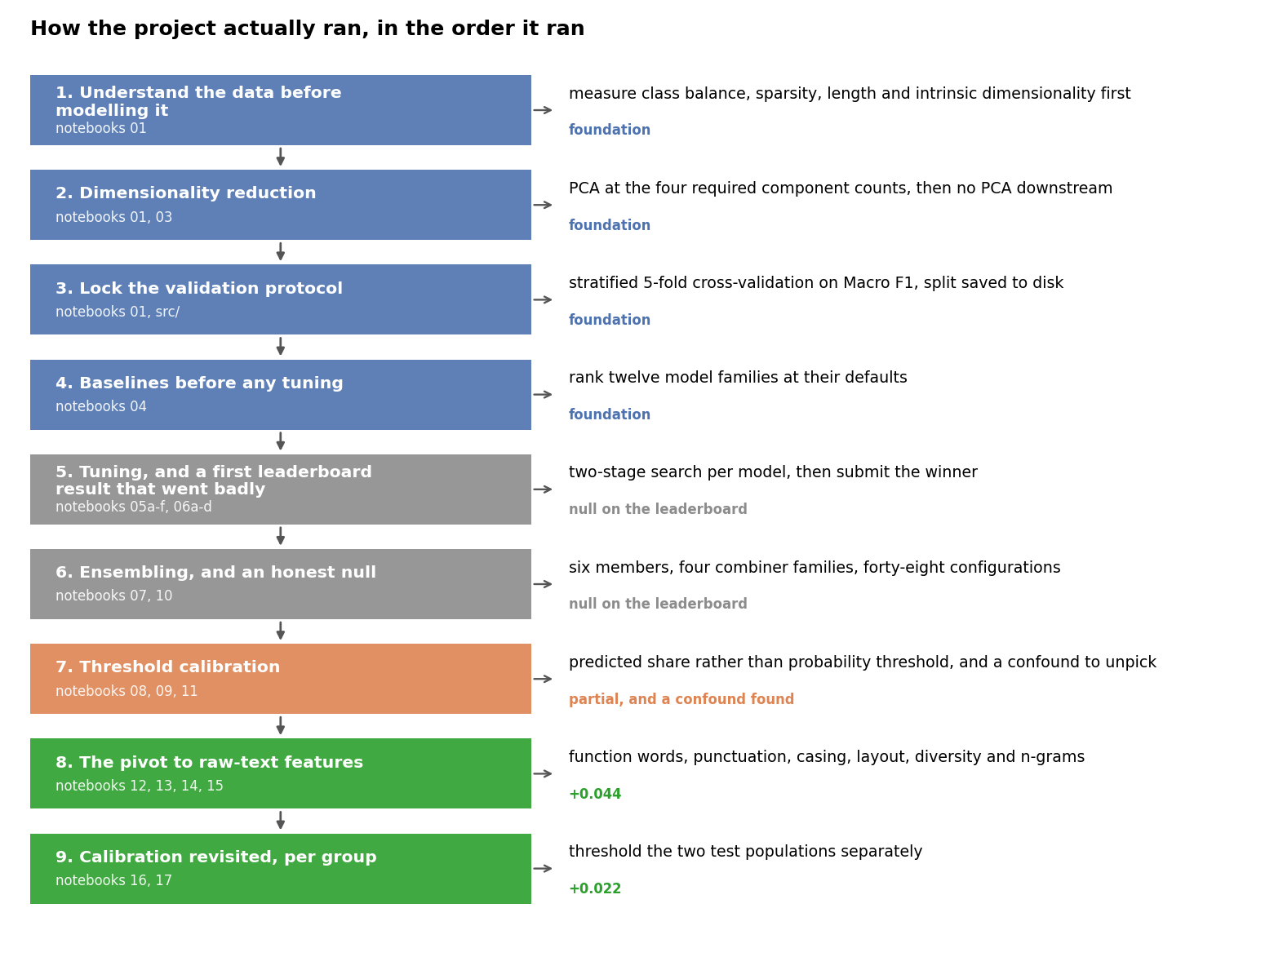
Our method, in the order we ran it
Four foundation phases, two that returned nothing, three that moved the score.
Notes:
This slide is the spine of the talk. Point out that phases 5 and 6 are grey on purpose: tuning and ensembling both came back inside the noise floor, and that null is what redirected us to phase 8.

Slide 4
PHASE 1 | NOTEBOOK 01
Measure the data before modelling it
- 62.52% machine, 37.48% human. Predict-majority scores 62.5% accuracy and 0.385 Macro F1.
- So: Macro F1 not accuracy, stratify every split, class_weight balanced everywhere.
- The matrix is 98.64% zero. About 68 of 5,000 columns active per document.
- The test file holds two populations: 1,999 UUID ids and 5,000 numeric ids.
- The numeric rows are peer reviews. Longer, heavier markdown, 15.8% contain "reviewer" against 0.2%.
We chose: a full exploratory pass before training anything.
Notes:
Considered: start modelling immediately, versus full EDA first, versus both in parallel. For EDA-first: stratification, class weighting and metric choice all become measured decisions. Against: a whole notebook with no score at the end. Acceptable because three of four measurements became constraints we never revisited, and the fourth was worth more than any model.

Slide 5
PHASE 2 | NOTEBOOKS 01 AND 03 | TASKS 1 AND 2
Dimensionality reduction, and why we stopped using it
PCA where the task requires it. Nowhere else.
- Task 2 fixes PCA at 2,000 / 1,000 / 500 / 100 components with KNN, n_neighbors = 2.
Variance retained: 2,000 keeps 77.0%, 1,000 keeps 56.4%, 500 keeps 39.0%, 100 keeps 15.8%.
No canonical threshold is reached within 2,000 components. The knee sits at 638 components and keeps only 44.5%.
- Why: 98.64% zeros and ~68 active columns per document leaves little shared linear structure to absorb.
- That also predicts KNN finishing tenth of twelve: distances are weak in a sparse space, and worse after discarding 84% of the variance.
We chose: no dimensionality reduction for any Task 3 model.
Notes:
This slide carries Task 2 and the component analysis its top band asks for. Considered: PCA everywhere, TruncatedSVD, feature selection, or nothing. Against PCA downstream: it is lossy rather than efficient here. Acceptable because boosted trees take sparse input directly and select features as they split.

Slide 6
PHASE 3 | NOTEBOOK 01
Lock the validation protocol
The class balance from phase 1 decides this, not preference.
Considered
For
Against
Single random split
Cheapest, one number per model
Too noisy to separate adjacent candidates
Plain k-fold
Uses all the data
Fold balance drifts, and Macro F1 is sensitive to that
Stratified 5-fold
Every fold matches the population; gives a spread too
Five fits per candidate; same-corpus only
Stratified 10-fold
Lower variance still
Twice the compute for a decimal we could not use
We chose: stratified 5-fold, seed 42, Macro F1, plus a 4,000-row holdout saved to disk so all five of us evaluate identical rows.
Notes:
At 62.5 against 37.5, an unstratified fold drifts from the population by several points, and Macro F1 is sensitive to exactly that drift. Tradeoff: it trains and tests inside the same corpora, so it overstates the leaderboard by about 0.10 and can say nothing about the test set's class balance. Acceptable because we needed a ranking instrument, not a forecasting one, and it ranked correctly every time we checked.

Slide 7
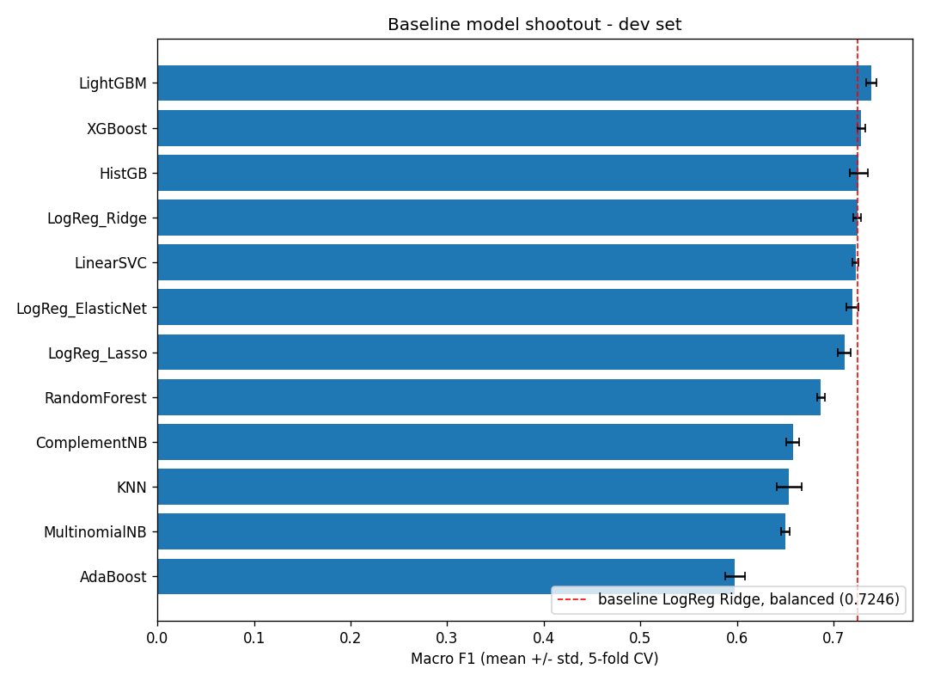
PHASE 4 | NOTEBOOK 04
Baselines before a single hyperparameter moved
Twelve families at library defaults. Only then did we tune.
Notes:
The spread is the finding. Twelve families span 0.14 and the top four sit within 0.015, which told us in advance that model choice was worth less than we hoped. That is the evidence we used later to stop tuning and stop ensembling rather than grinding at them.

Slide 8
PHASE 5 | NOTEBOOKS 05 AND 06
Tuning worked locally, and then went badly
- LightGBM cross-validation 0.7391 to 0.7443 after the search.
- Untouched holdout confirmed it at 0.7437. Gap of 0.0006, so no search overfitting.
- Threshold tuned on the holdout added a further 0.003 locally.
- Kaggle: 0.65738 at the default cut, 0.66502 with the tuned one.
- A gap of roughly 0.079, and our carefully tuned threshold moved the leaderboard by under 0.01.
Notes:
Two-stage search: coarse randomised, then a focused grid. Every local diagnostic said the model was healthy. The holdout agreed with CV to 0.0006, so we were not overfitting the search. Then the leaderboard came back 0.079 lower.

Slide 9
PHASE 5 | THE DECISION
How we reacted to a 0.079 gap
Considered
For
Against
Trust local, keep tuning
Local validation was clean and reproducible
Local and Kaggle disagreed by 0.079
Assume a bug, audit
Cheap to check, severe if real
The brief predicts this gap by design
Tune against the leaderboard
It is the graded surface
~3,570 rows, rationed submissions: this is how leaderboard overfitting starts
Keep both, measure the leaderboard
Makes the two instruments comparable
Spends submissions on measurement, not candidates
We chose: keep local validation for ranking, audit for leakage once, and compute the leaderboard noise floor at 0.0084.
Notes:
This is the most reusable decision in the project. Computing the noise floor cost one submission and paid for itself three times: it stopped the ensembling phase, it stopped the share search inside a flat region, and it made us disbelieve two of our own gains.

Slide 10
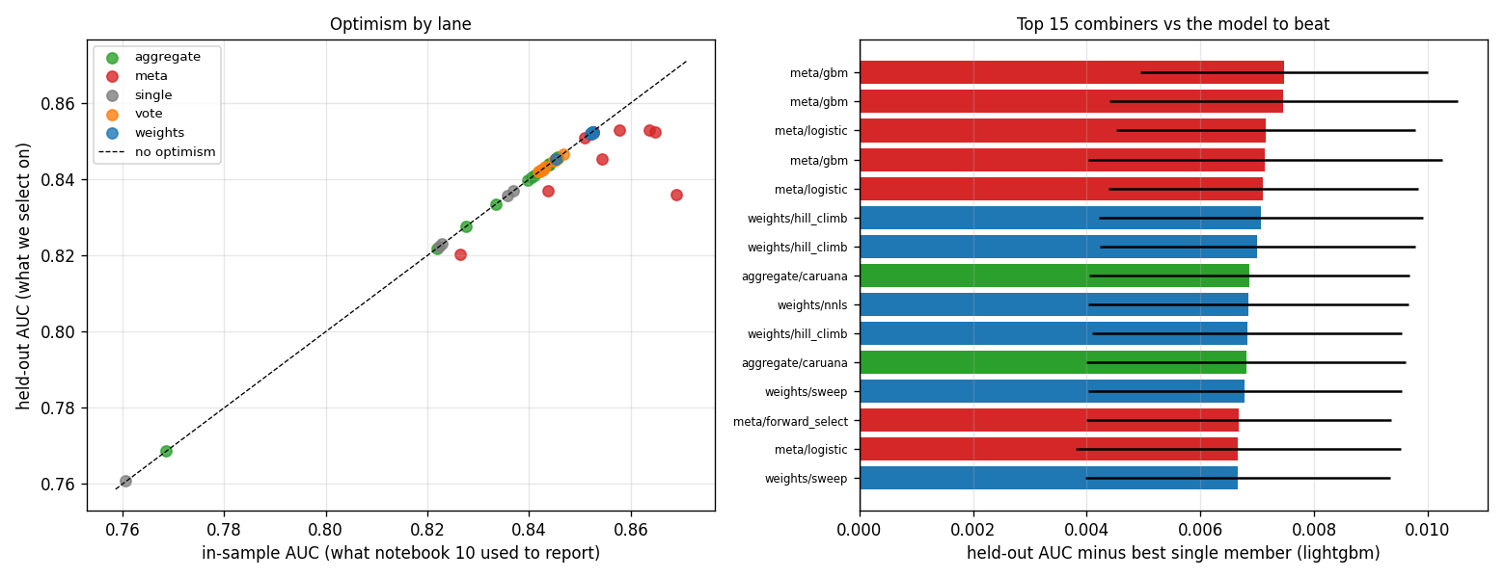
PHASE 6 | NOTEBOOKS 07 AND 10
Ensembling, and an honest null
Six members, four combiner families, forty-eight configurations.
Notes:
Out-of-fold AUC improved 0.0075. Kaggle moved +0.00171, under a fifth of the noise floor. Without the noise floor we would have read that as a small win and added more members. With it, the correct reading was that two consecutive phases of model work had returned nothing, so the constraint was somewhere else.

Slide 11
PHASE 7 | NOTEBOOKS 08, 09 AND 11
Threshold calibration, and a confound we had been carrying
- A 0.5 cut silently assumes the test balance equals the training balance of 62.5%. The brief says it does not.
- Tuning the threshold on our holdout moved it the wrong way: 0.66502.
- No local data can estimate the test class balance. Dev and holdout are both carved from training.
- So we reparameterised: sort by score, label a fixed share machine. Comparable across models, and sweepable.
- That exposed the confound: every model had been submitted at whatever share its own default threshold produced.
- At a matched share, LightGBM beat ElasticNet by 0.0189, matching its local lead. Local validation had never been broken.
- Moving the tuned LightGBM off the default cut: 0.65738 to 0.73583. The largest single gain of the project, from one line of code.
Notes:
Considered: keep 0.5, tune on the holdout, sweep predicted share, or set share from the paper. The holdout inherits the training balance, so it optimises for the wrong distribution: measured at 0.66502. Tradeoff of sweeping share is that it fits the public rows. Acceptable because every alternative is simply wrong, and we manage the risk against the noise floor.

Slide 12
PHASE 8 | READING THE PAPER PROPERLY
The pivot: we had never questioned the input
- The paper: train is HC3 + M4GT + MAGE, test is CUDRT + IELTS + NLPeer + PeerSum + MixSet, no overlap.
- It also gives the balances: 62.6% machine in train against 53.1% in test. Both matched what we had measured.
- The supplied features are top-5,000 TF-IDF over lemmas with stop words removed.
- That is a pure content signal, and content vocabulary is exactly what changes when the corpus changes.
- Function words, punctuation, casing and layout survive a corpus change. The course preprocessing deletes precisely those.
- The raw text had been sitting in train.csv, untouched for seven notebooks.
Notes:
This is the turning point of the talk. Three phases had changed the model or the decision rule while holding the input fixed. What changed our minds was the shared-task paper's data section, which we had skimmed the first time.

Slide 13
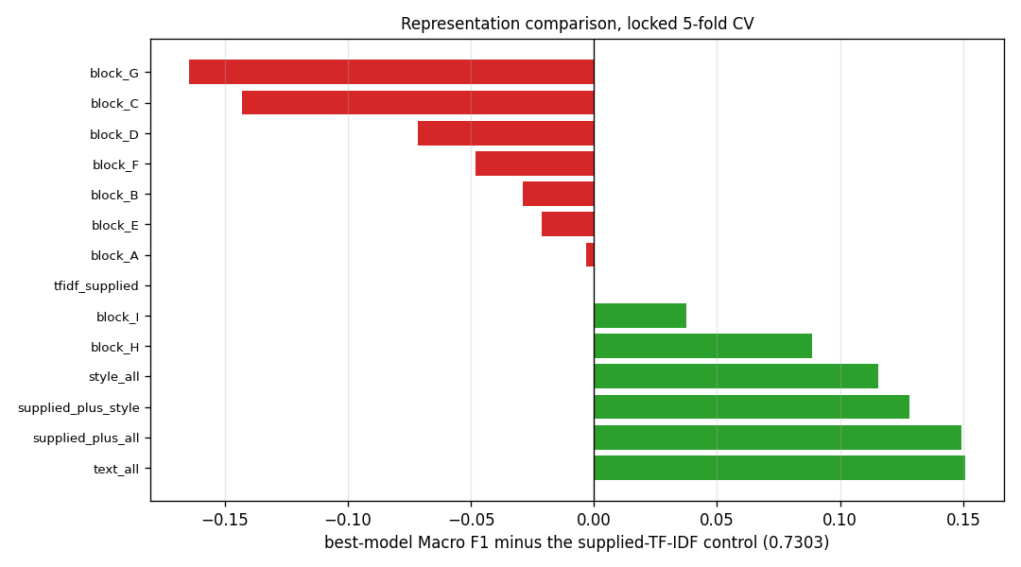
PHASE 8 | NOTEBOOKS 12 TO 15
Rebuilding the representation: +0.044 on the leaderboard
Every dense block alone scores below the supplied control. Together they beat it by 0.115.
Notes:
Considered: keep the supplied features, add a few style features, rebuild n-grams only, or rebuild fully. Tradeoff: 40,385 hand-built columns against 5,000 supplied, far more code, and the brief awards no extra marks for own preprocessing. Acceptable because it was worth +0.044 on the graded surface, which is more than everything else we did to the model combined.

Slide 14
PHASE 8 | A TEST BUILT TO BE ABLE TO FAIL
We predicted the formatting features were artifacts. They were not.
- Hypothesis: layout and punctuation are dataset fingerprints and will not survive the corpus change.
- Test: ship a stripped set of function words and character n-grams only.
- Result: it lost 0.04944, six times the noise floor, in the opposite direction.
- Second falsified prediction: extending the diversity block made transfer worse while improving same-domain fit, which is the memorisation signature.
- We would rather report two falsified predictions than a roadmap where every idea worked.
Notes:
Machine text in training carries markdown bold at ten times the human rate, and the peer-review test rows carry it at five times the machine rate. That sounded exactly like a dataset fingerprint. We built the stripped-down set specifically so the prediction could be falsified, and it was.

Slide 15
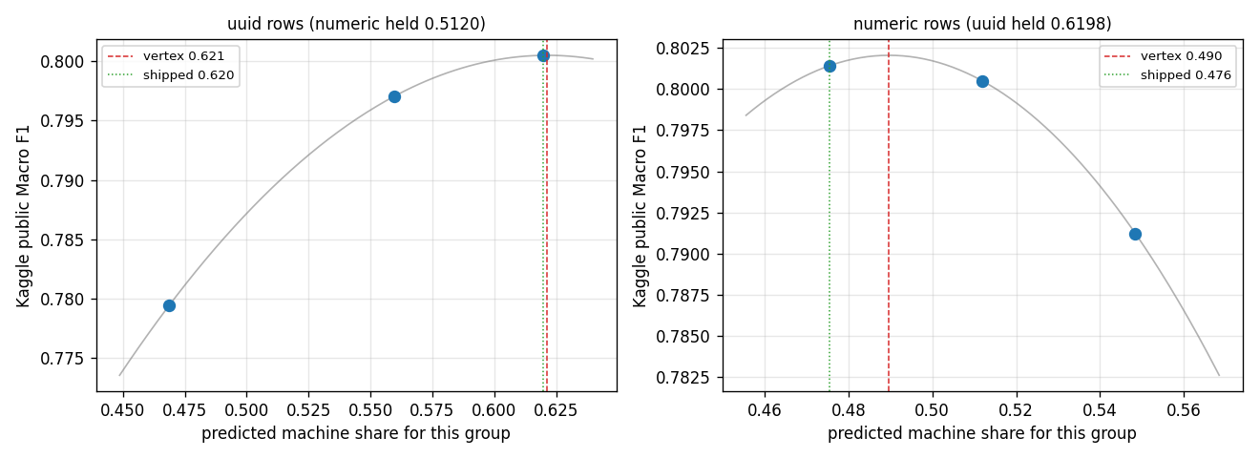
PHASE 9 | NOTEBOOK 16
Calibration revisited, one share per population
uuid 0.6198, numeric 0.4756. No change to the model at all.
Notes:
Considered: one global share, separate shares per group, a model per group, or domain adaptation. A model per group is impossible: 1,999 unlabelled UUID test rows. Tradeoff: both coordinates are fitted to the public leaderboard over seven submissions. Acceptable because the first correction gained 0.01764, a deliberate wrong-direction probe lost 0.00926, and the same correction reproduced on a different model.

Slide 16
THE IDEA THAT GENERALISES
Why the global sweep looked flat
When one global threshold is applied to a population that is a mixture,
the optimum for the mixture can be flat while the component optima are
far apart and moving in opposite directions.
- UUID rows wanted a higher predicted machine share. Numeric rows wanted a lower one.
- Roughly +0.019 and roughly -0.019, cancelling in the average.
- Correcting them separately: +0.022 on the leaderboard, with no model change.
- Confirmed independently on a second, unrelated model to within 0.001.
Notes:
Say this one slowly. We measured the flat curve twice, correctly both times, and drew the wrong conclusion on both occasions. The only way to see it was to stop averaging.

Slide 17
Where the gain actually came from
+0.078
+0.044
+0.022
global share, off the default cut (phase 7)
raw-text representation (phase 8)
per-group thresholding (phase 9)
0.65738 to 0.80143. About 70% from how scores become labels, 30% from what the model sees.
Nothing measurable from the model itself. Ensembling returned +0.0017 and the shipped model runs on LightGBM defaults.
This is not the split any of us expected when we started.
Notes:
The single cheapest change we made was also the biggest: one line moving off the default 0.5 cut, worth +0.078, nearly twice what rebuilding the whole representation returned. If a marker asks one question, expect it to be this one.

Slide 18
Limitations, and what is still open
- Predicted share cannot be validated locally. Every share decision rests on leaderboard feedback, and we managed that risk rather than solving it.
- The grouped protocol is trustworthy to about 0.03 in level. It ranks candidates; it does not forecast a score.
- A ~0.075 standard-CV to leaderboard gap remains. The brief says to expect it.
- Open: hyperparameter search on this representation, designed and split five ways, not yet run. A second model family, specified but unmeasured.
- Final picks pair the best public point with a more central one, because our share coordinates are fitted to a leaderboard with a known noise floor.
Notes:
Close on the limitations rather than the score. The two we would defend hardest are that share cannot be validated locally at all, and that our grouped protocol ranks but does not forecast. Finish on the final-pick rule.

