Slide 1
Neobi Data Pipeline
By: Cliford Rojas

Slide 2
Background
Legalization of Cannabis in the US has been a slow adaptation. Marijuana has be legalized in 10 states for medical use (Market Insider) and 33 states have approved the use for medicinal purposes.
As this industry gets approval from more states and there a greater widespread use the data we can gather from similar markets can greatly improve the sales goals of US based companies.
Europe and Canada already have large companies that provide cannabis needs to their citizens.

Slide 3
Why data pipeline?
The purpose of this pipeline is to gather key information that can benefit US companies like price, brands, and producers that best provide serve Canada’s needs. This information can then be paired with other analytics to determine the best pricing practices and sourcing needs.

Slide 4
Pipeline Tools
Automation:
Airflow
Ingestion:
Python Script
Data lake:
HDFS
Processing:
Spark
Data Warehouse
Hive

Slide 5
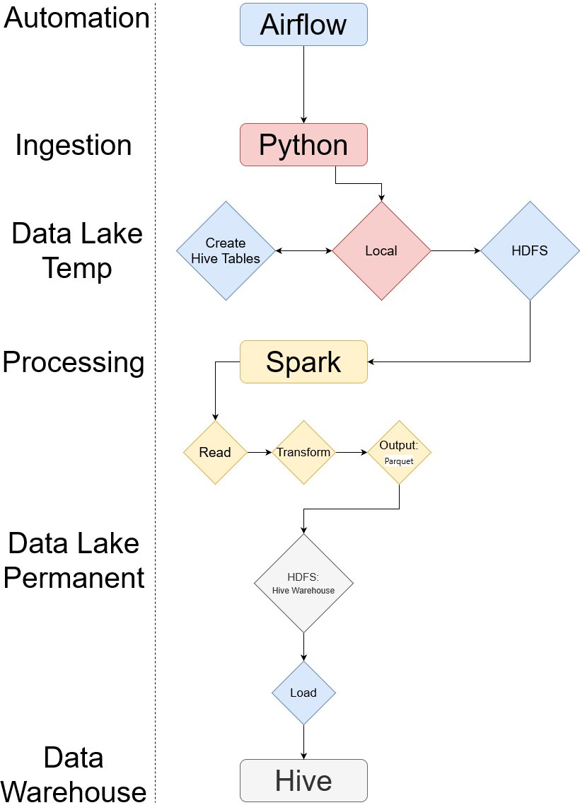
Pipeline Flow

Slide 6
Purpose Behind the pipeline tools
Pipeline is a batch process. Information isn’t update constantly.
Only new records need to be loaded into HDFS.
Spark allows easy manipulation of the JSON format and easily convert DataFrame objects into Hive table using Spark-Hive.
I chose the data warehouse hive because it works well with the Spark system and can be read back in using spark.

Slide 7
Demonstration
Created an airflow Directed Acyclic Graph for scheduling purposes.
Created a Bash Script (Immediate pull)

