Slide 1

Neobi Data Pipeline
By: Cliford Rojas

Slide 2
Background
Legalization of Cannabis in the US has been a slow adaptation. Marijuana has be legalized in 10 states for medical use (Market Insider) and 33 states have approved the use for medicinal purposes.
As this industry gets approval from more states and there a greater widespread use the data we can gather from similar markets can greatly improve the sales goals of US based companies.
Europe and Canada already have large companies that provide cannabis needs to their citizens.
Lets use that INFORMATION!

Slide 3
Why data pipeline?
The purpose of this pipeline is to gather key information that can benefit US companies like price, brands, and producers that best provide serve Canada’s needs.
This information can then be paired with other analytics to determine the best pricing practices and sourcing needs.

Slide 4
Pipeline Tools Overview
Automation:
Airflow
Ingestion:
Python Script
Data lake:
HDFS
Processing:
Spark
Data Warehouse
Hive

Slide 5

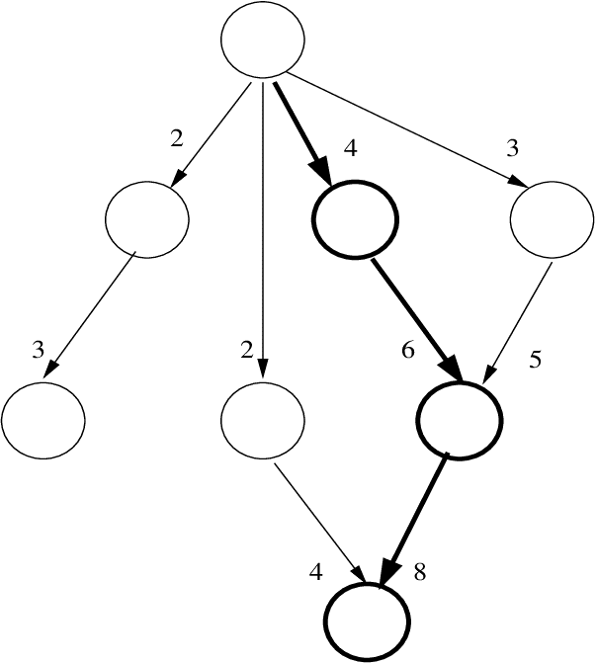
Workflow Manager
Uses python to set up DAG
Schedules Tasks (Time Interval)
Easier than Oozie doesn’t need different configuration files.
Built-In operator support like:
Hive
Bash
Hive_to_mysql
Etc.

Slide 6

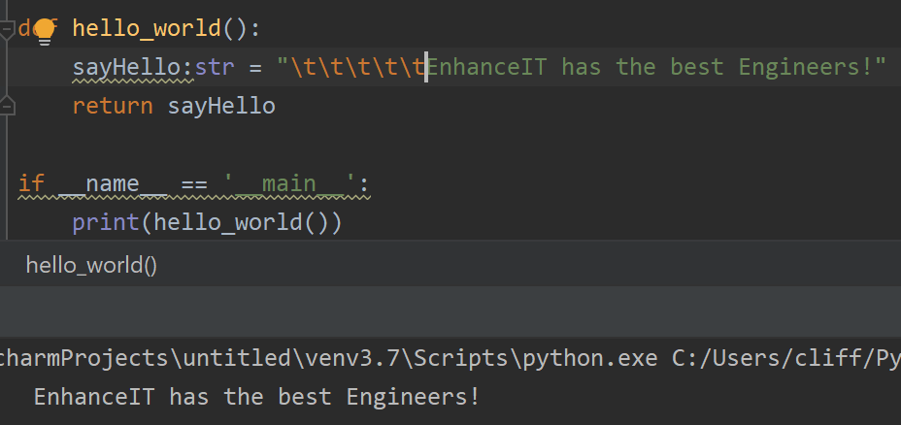
Why python?
-User Friendly Data Structures (List & Dict)
-Speed (coding syntax is easy)
-Open Source
-Extensive Support Libraries
Notable Library
-requests
-nltk
-Machine Learning
-pyspark

Slide 7
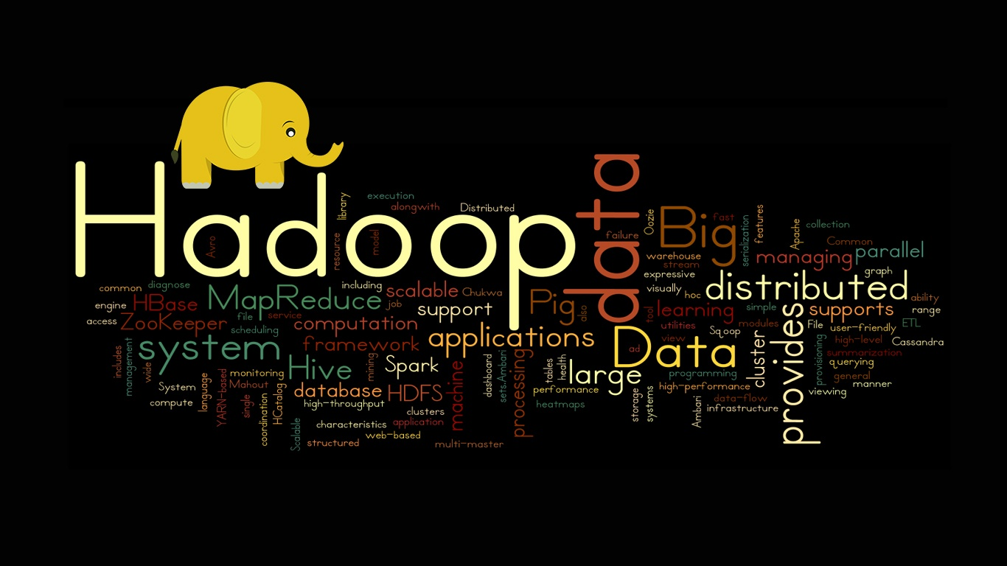

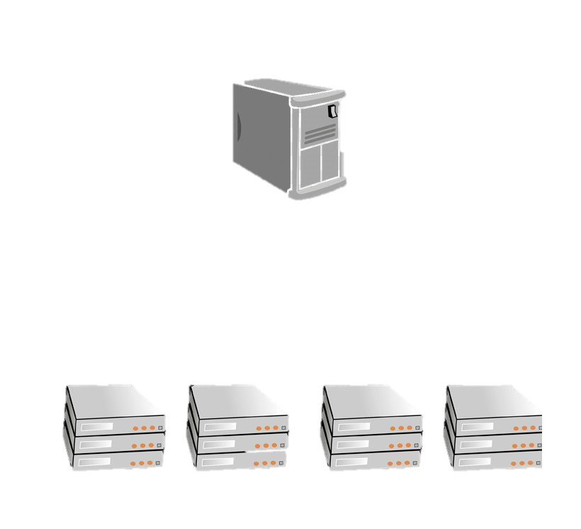
HDFS:
-Runs on commodity hardware
-Master/Slave architecture (Consistency)
-Horizontal Scaling
-Data parallelization
Name Node
Data Nodes

Slide 8


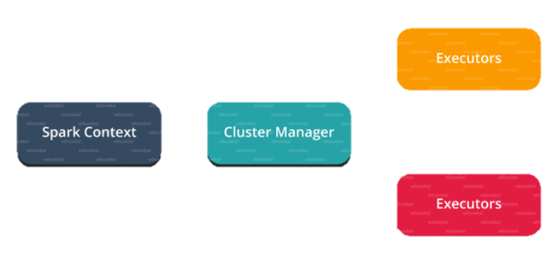
Powerful Processing tool
-Query Language tools
-Fault Tolerant (Immutable Data sets)
-Lazy Evaluation
-Real Time Processing
In memory computing
Works with other tools
-Apache NiFi
-AWS
Workers
Driver
Resource Negotiator

Slide 9

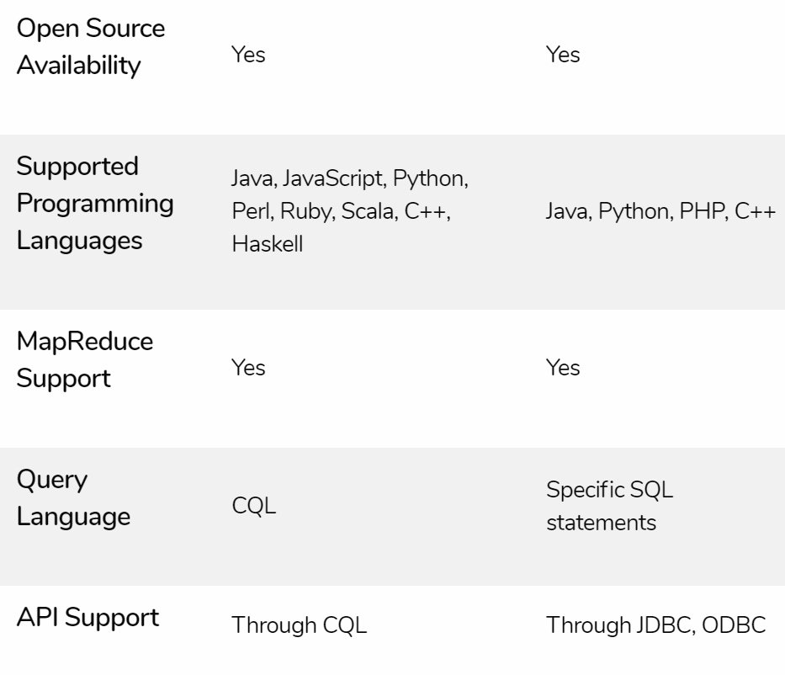
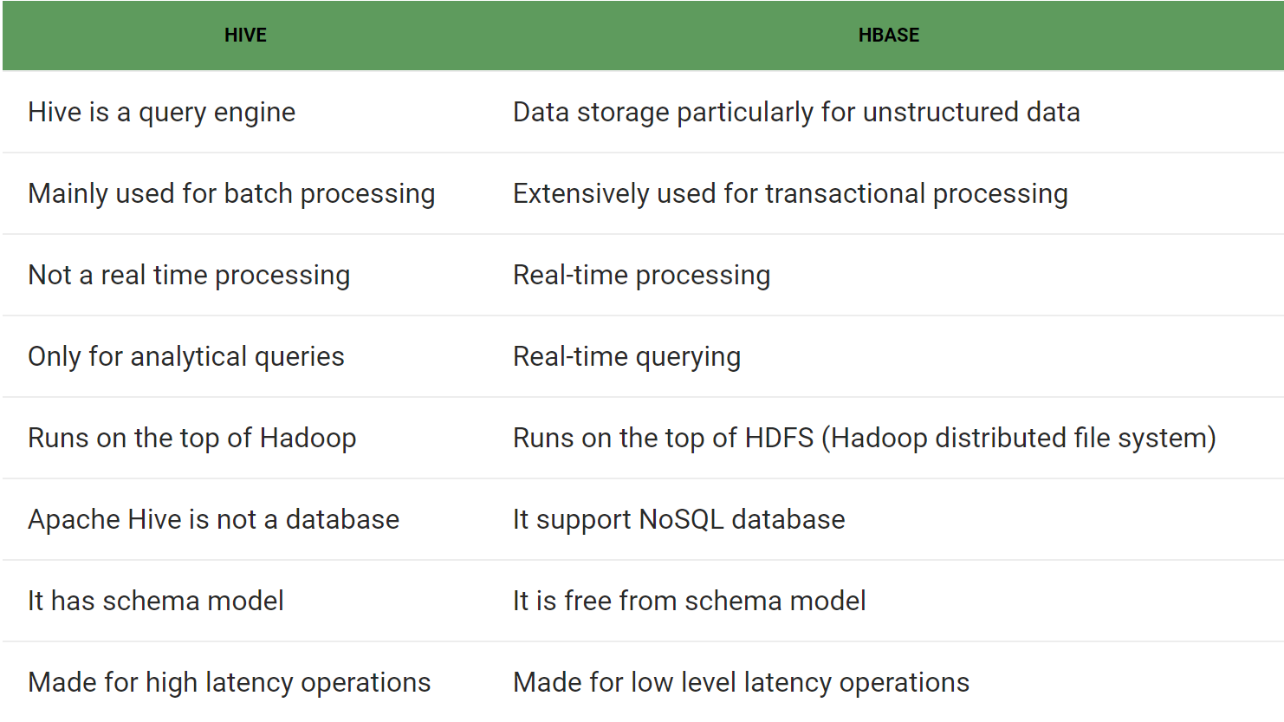
Uses HDFS:
-Benefits from all of HDFS strengths
-Allows for SQL like queries
-MapReduce Jobs
-Lower learning
-External Table support
HIVE vs. Cassandra
HIVE vs. HBase

Slide 10
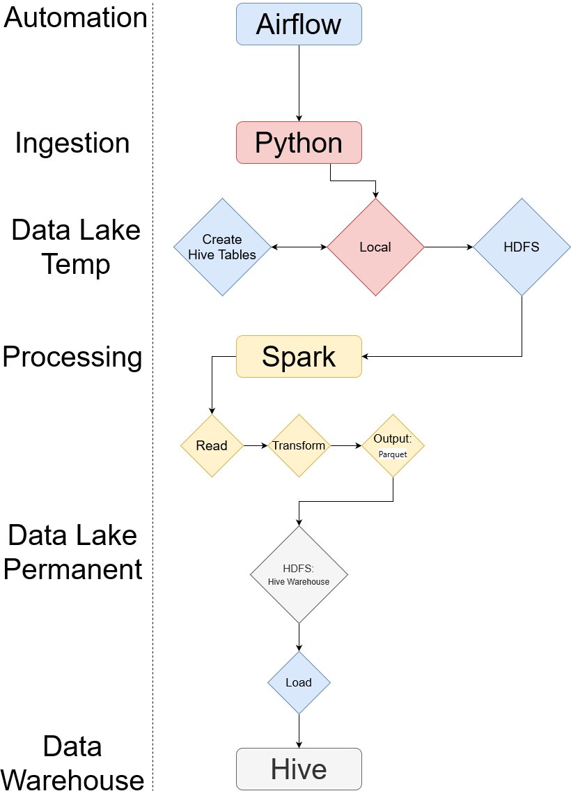
Pipeline Flow

Slide 11
Purpose Behind the pipeline tools
Pipeline is a batch process. Information isn’t update constantly.
Only new records need to be loaded into HDFS.
Spark allows easy manipulation of the JSON format and easily convert DataFrame objects into Hive table using Spark-Hive.
I chose the data warehouse hive because it works well with the Spark system and can be read back in using spark.

Slide 12
Demonstration
Created an airflow Directed Acyclic Graph for scheduling purposes.
Created a Bash Script (Immediate pull)

