Slide 1
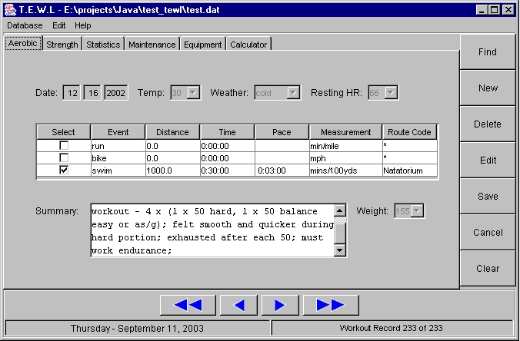
Menu Bar
Tabs
Record
Edit
Buttons
Navigation Buttons

