Slide 1


Central Pressure – Maximum Wind Relationships in Tropical Cyclones using operationally available information
John Knaff, NOAA/NESDIS/StAR, RAMMB, Fort Collins, CO, USA
Joe Courtney, Australian BoM, Perth, WA, Australia
Ray Zehr, NOAA/NESDIS/StAR, RAMMB, Fort Collins, CO, USA (retired)

Slide 2
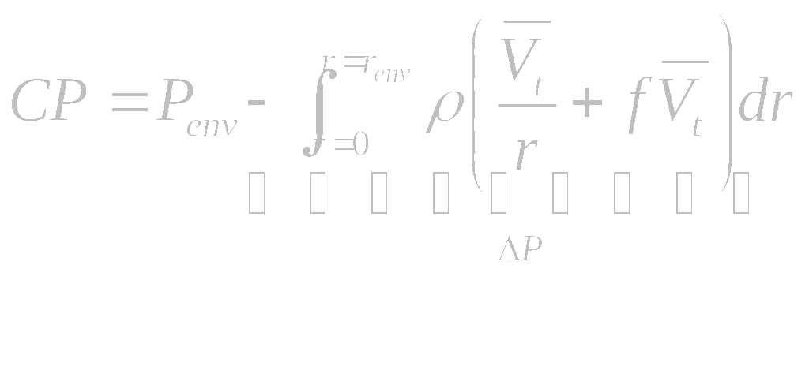
Determining Central Pressure (CP)
Environmental Pressure (P_{env}; i.e., Boundary Condition)
Pressure Deficit
  Determined by the integral of the wind field
, where
r is the radius
ρ is the density
V_{t} is the tangential wind
̅ represents azimuthal averaging

Slide 3
Some Implications
Larger storms when other variables are held constant (wovhc) have lower CP
Smaller (Larger) radius of maximum wind wovhc implies lower (higher) CP
Lower P_{env} wovhc implies lower CP
Higher latitude wovhc implies lower CP

Slide 4
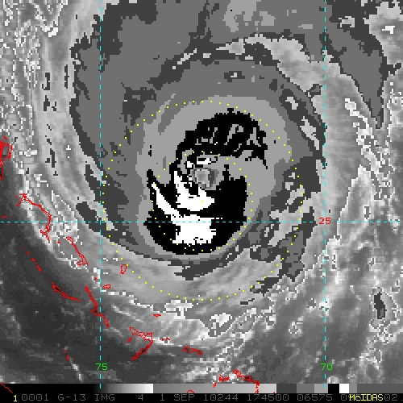
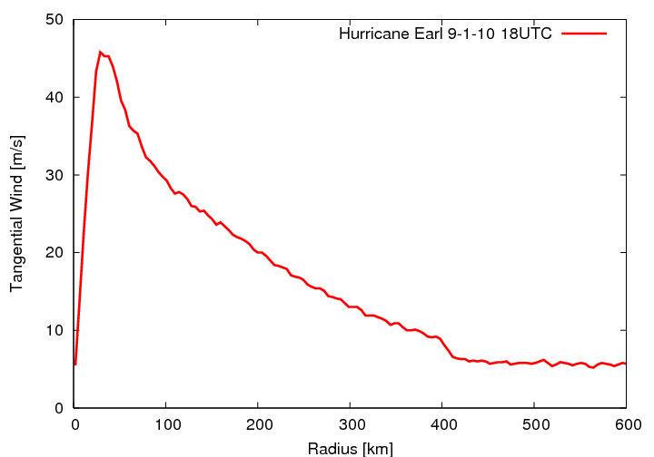
Examples (Earl Sept 1 18UTC
IR image
Azimuthally averaged V_{t}
P_{600km} = 1012.1 hPa
ΔP = -68.6 hPa
CP = 943.5
V_{t} = 45.8 ms⁻¹, 89 kt

Slide 5
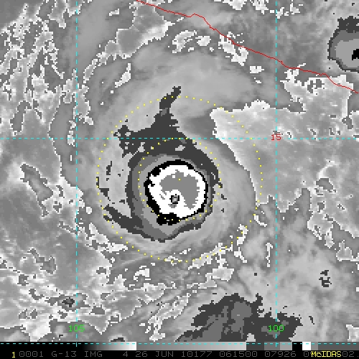
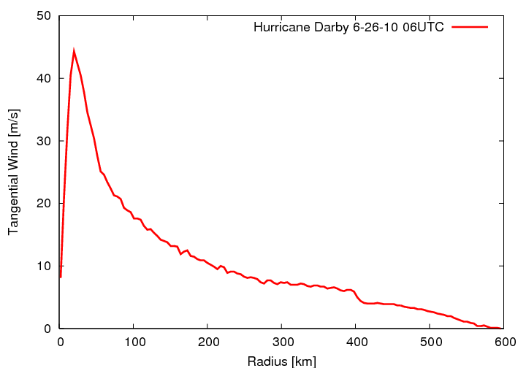
Examples (Darby June 26 06 UTC)
IR image
Azimuthally averaged V_{t}
P_{600km} = 1011.7 hPa
ΔP = -52.9 hPa
CP = 958.8
V_{t} = 44.3 ms⁻¹, 86.1 kt

Slide 6
Operational Challenges
Historical wind-pressure relationships target the mean relationship and don’t account for different…
  Environments
  Steering
  Sizes
  Latitudes
Intensification rates vary
Observational data are limited, sparse, & latent.
CP is often required for advisories and forecasts

Slide 7
New Methods
Use operationally available information to quantify
  Environmental Pressure (P_{env})
  TC size (S)
  Intensification rate
  Maximim winds, 1-minute max sustained (V_{max})
  Latitude (φ)
  Translation Speed (c)
Determined the most important factors (i.e., P_{env,} V_{max,} φ,c, S)
Develop universal techniques to estimate CP from maximum wind and vise versa.
More reading:
Knaff, J.A., and R.M. Zehr, 2007: Reexamination of Tropical Cyclone Wind-Pressure Relationships. Wea Forecasting, 22:1, 71–88.
Knaff, J.A. and R.M. Zehr, 2008: Reply to Comments on "Reexamination of Tropical Cyclone Wind-Pressure Relationship." Weather and Forecasting, 23:4, 762-770.
Courtney, J., and J.A. Knaff, 2009: Adapting the Knaff and Zehr Wind-Pressure Relationship for operational use in Tropical Cyclone Warning Centres. Australian Meteorological and Oceanographic Journal, 58:3, 167-179.

Slide 8
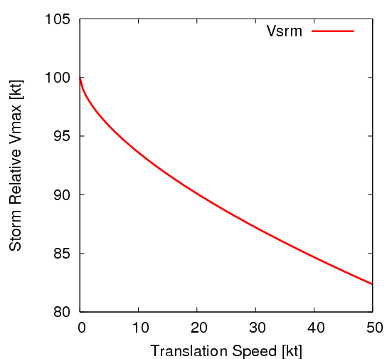

Factor #1: Storm relative intensity (i.e., combining V_{max} and c)
Accounting for translation
Example (V_{max} =100kt TC)
Use Schwerdt et al. (1979) asymmetry factor (a)
  1.50c^{0.63} [kt]
  1.26c^{0.63} [ms⁻¹]
  1.88c^{0.63} [kmh⁻¹]
  Define: storm relative intensity

Slide 9

Factor #2: Environmental Pressure (P_{env})
Estimating P_{env}
Comments
Knaff and Zehr (2007): Azimuthally averaged MSLP at r=900 km (10 degrees) from global analyses
Courtney and Knaff (2009): Pressure of outer closed isobar method.
Cumulative term so…This is a factor that just needs to be representative of the environment.
Standardizes seasonal and inter basin differences
  ranged from 1004 to 1026 hPa with an average of 1014 in the Atlantic dataset
  1002 to 1016 with a 1009 average in the West Pacific.

Slide 10
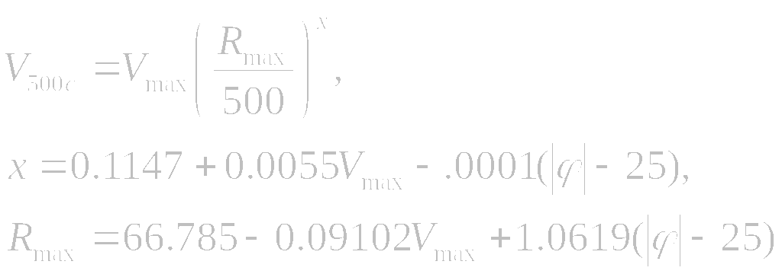
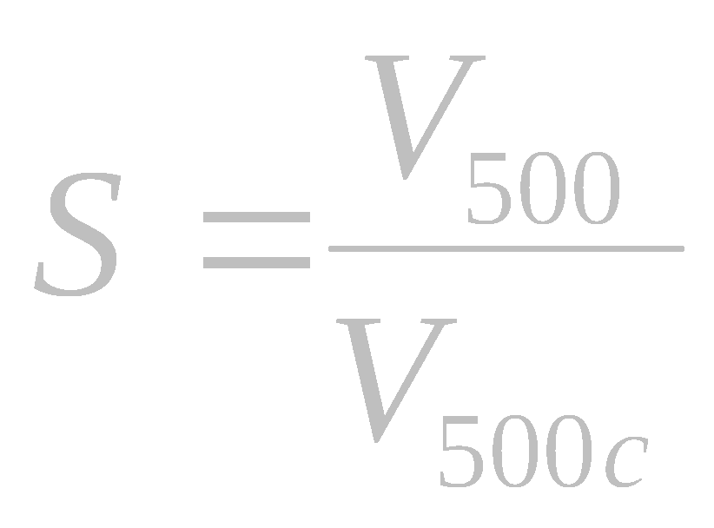
Factor #3: TC Size (S)
Quantifying TC Size
Climatology of Size
Knaff & Zehr: Calculate the tangential wind at r=500km (V₅₀₀) from global analyses
Courtney & Knaff: Estimate V₅₀₀ from the non-zero average of the gale radii, where V₅₀₀= R34/9 – 3
Must account for climatological size variations (V_{500c}) due to
  Intensity
  Latitude
R_{max} is valid just for the wind profile estimation
and is generally too large when compared to
observations (i.e., not a good estimate for RMW)
More reading:
Knaff, J.A., C. R. Sampson, M. DeMaria, T. P. Marchok, J. M. Gross, and C. J. McAdie, 2007: Statistical Tropical Cyclone Wind Radii Prediction Using Climatology and Persistence, Wea. Forecasting, 22:4, 781–791.

Slide 11
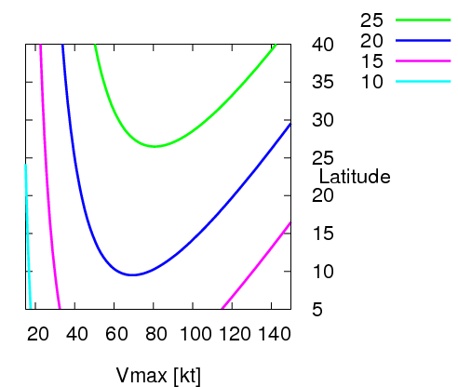
V_{500c}

Slide 12
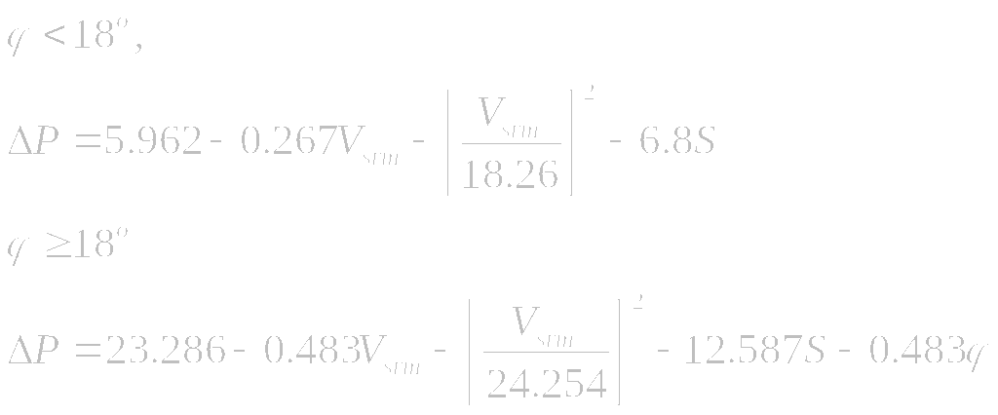
Putting it all together
Courtney & Knaff:
Caveats:
the minimum value of S should be limited to a value between 0.4 and 0.1
estimates are sensitive most to poor estimates of S (i.e. R34) and V_{srm}

Slide 13
Simple Example
Penv: POCI=1009, Penv=1011 hPa
Latitude: φ=20
Translation: c=10 kt
Intensity: V_{max} = 75 kt
V_{srm} = 75 – 6.40 = 68.6 kt
Size climo: x=.528,Rmax=54.65,V500c=23.3
Size: R34= 170, 120, 130, 180
averaged R34=150
V500=13.66
S=13.66/23.3=0.586
ΔP: ΔP=-35 hPa
CP: CP=976 hPa

Slide 14
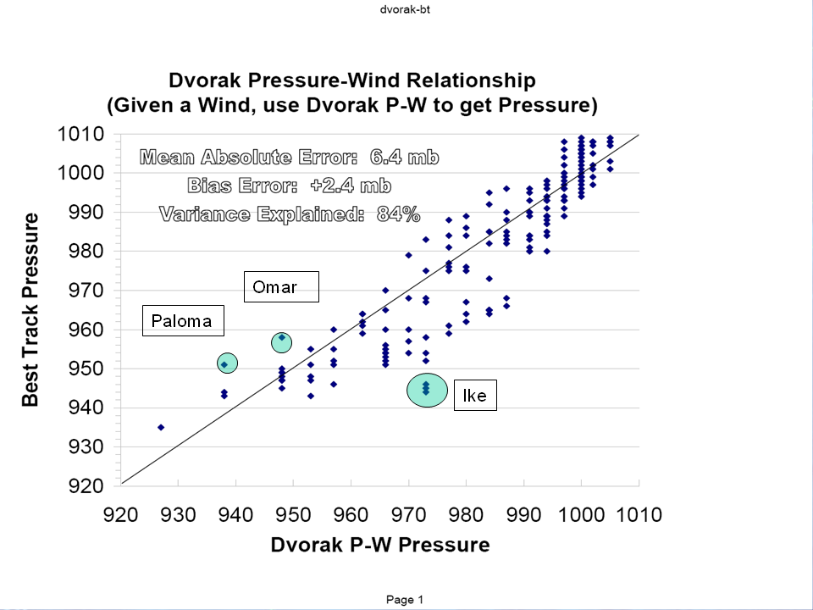
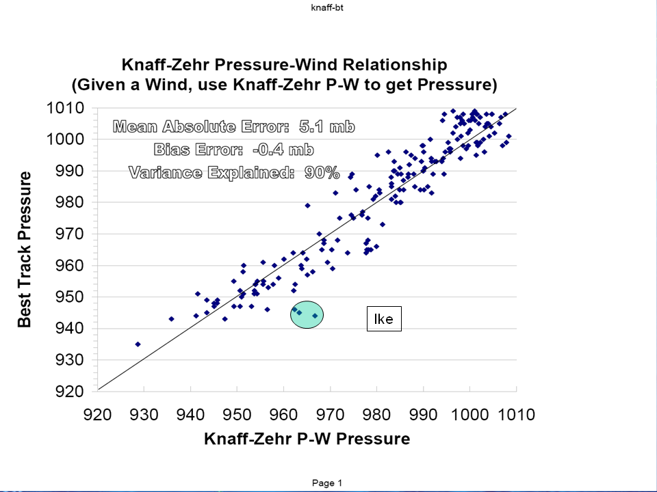
Validation
Dvorak Atantic
Using Courtney & Knaff
Courtesy of C. Landsea (NHC)

Slide 15
Sensitivities
 | Standard Deviation | Values used for calculations | Response
34-knot wind radii | 49 n. mi | 50 n. mi. | -3.0 hPa
Latitude | 5.5º | 5 º | -2.5 hPa
POCI | 2.4 hPa | 2 hPa | 2.0 hPa
Translation speed | 4.7 knots | 5 knots | 1.0 hPa
Input sensitivities associated with the CZ09 WPR. (C. Landsea personal communication)

Slide 16
Shortcomings
Large errors (10-30 hPa) can occur when small or multiple radii of maximum winds occur
  Currently lack a reliable estimate for all intensities
  Currently lack an empirical correction
Pressure estimates only as good as the input
  R34
  Intensity from Dvorak, SATCON, AMSU etc each with it’s biases
  Translation speed (tough for multiple centers and weaker poorly defined TCs

Slide 17
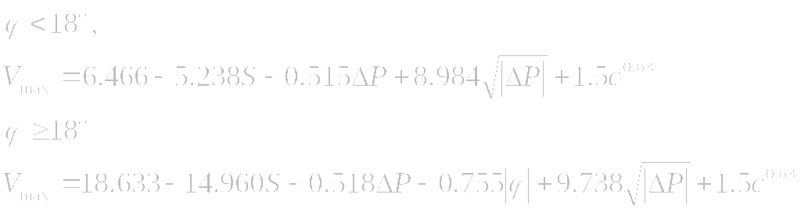
Estimating V_{max}
All values here are valid for 1-minute winds in units of knots
We recommend a factor between 0.88 and 0.93 for 1-minute
to 10-minute conversion
Also note that iteration is required to accurately solve since S is a function of Vmax

Slide 18
Additional Reading References
Courtney, J., and J.A. Knaff, 2009: Adapting the Knaff and Zehr Wind-Pressure Relationship for operational use in Tropical Cyclone Warning Centres. Australian Meteorological and Oceanographic Journal, 58:3, 167-179.
Harper, B. A., J. Kepert and J. Ginger, 2008a: Wind speed time averaging conversions for tropical cyclone conditions. AMS 28th Conf Hurricanes and Tropical Meteorology, Orlando, 4B.1, April.
Harper, B. A., J. D. Kepert, and J. D. Ginger, 2010: Guidelines for converting between various wind averaging periods in tropical cyclone conditions. World Meteorological Organization, TCP Sub-Project Report, WMO/TD-No. 1555.
Knaff, J.A., and B.A. Harper, 2010: Tropical cyclone surface wind structure and wind-pressure relationships. Keynote #3, WMO International Workshop on Tropical Cyclones – VII, La Reunion, France, 15-20 November, 35pp.
Knaff, J.A. and R.M. Zehr, 2008: Reply to Comments on "Reexamination of Tropical Cyclone Wind-Pressure Relationship." Weather and Forecasting, 23:4, 762-770.
Knaff, J.A., and R.M. Zehr, 2007: Reexamination of Tropical Cyclone Wind-Pressure Relationships. Wea Forecasting, 22:1, 71–88.
Knaff J. A., C. R. Sampson, M. DeMaria, T. P. Marchok, J. M. Gross, and C. J. McAdie, 2007: Statistical tropical cyclone wind radii prediction using climatology and persistence, Wea. Forecasting, 22:4, 781–791.
Knaff J. A., D.P. Brown, J. Courtney, G. M. Gallina, and J. L. Beven, II, 2010: An evaluation of Dvorak technique-based tropical cyclone intensity estimates. Wea. Forecasting, in press. ; e-View doi: 10.1175/2010WAF2222375.1
Schwerdt,R. W., F. P. Ho, and R. R. Watkins, 1979: Meteorological criteria for standard project hurricane and probable maximum hurricane wind fields, Gulf and East Coasts of the United States. NOAA Tech. Rep. NWS 23, 317 pp. [Available from National Hurricane Center Library, 11691 SW 117 St., Miami, FL 33165-2149.]
Many of these are available at http://rammb.cira.colostate.edu/resources/publications.asp or upon request.

