Slide 1
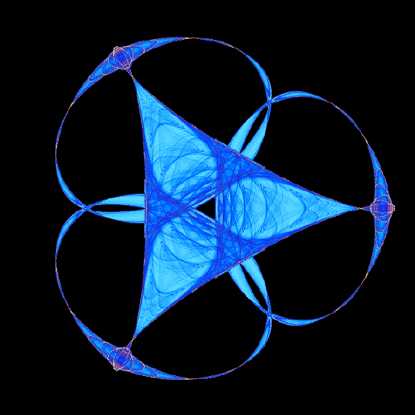
Report on the IMA Special Workshop on Careers and Opportunities in Industry for Mathematical Scientists
Cody Clifton
KU GSO/AWM joint meeting
April 29, 2014

Slide 2
Workshop overview
Outline
How does a program place students in industry?
What are industry employers looking for?
How to network and communicate?
How do mathematicians find careers in industry?
What is the hiring process?
What are the emerging opportunities?
What is a mathematical entrepreneur?
Industry vs. Academia: the right choice for you?

Slide 3
Why mathematicians in industry?
Because mathematicians are good at…*
Looking up answers
Abstracting and generalizing
Solving math problems
Sorting out confused logic
* Thomas A. Grandine, Senior Technical Fellow, The Boeing Company

Slide 4
Industry employers are looking for…
Taken from the SIAM Report on Mathematics in Industry (MII 2012)
Taken from the SIAM Report on Mathematics in Industry (MII 2012)

Slide 5
Ready to find a career in industry?
Advice on preparing for industrial careers*
Develop excellence in area of expertise
Have broad knowledge of relevant math / computational science
Get acquainted with a field of application
Computer skills
Programming in a relevant language
Other computer science (e.g. Data)
“Soft” skills
Communication, listening, and collaboration skills
Enthusiasm and self motivation
Desire and ability to stretch your knowledge base
Identify industries/companies you would like to work for and learn as much as you can about them
Find faculty members who are collaborating with industrial scientists and arrange to work with them
Get an internship
* William Kolata, Technical Director, SIAM

Slide 6
Know your weaknesses
Good mathematicians aren’t always good at…*
Tolerating bad ideas (i.e. other people’s)
Leaving things alone when working (e.g. ugly code)
Focusing on the business problem
Communicating with The Others
Saying “yes” when the situation requires
Collaborating with other mathematicians
* Thomas A. Grandine, Senior Technical Fellow, The Boeing Company

Slide 7
So, what’s this about programming?
Most mathematicians in industry need to be very good at programming!
Learn a “relevant” language (C++, Java, etc.)
Practice, practice, practice
projecteuler.net
topcoder.com
kaggle.com

Slide 8

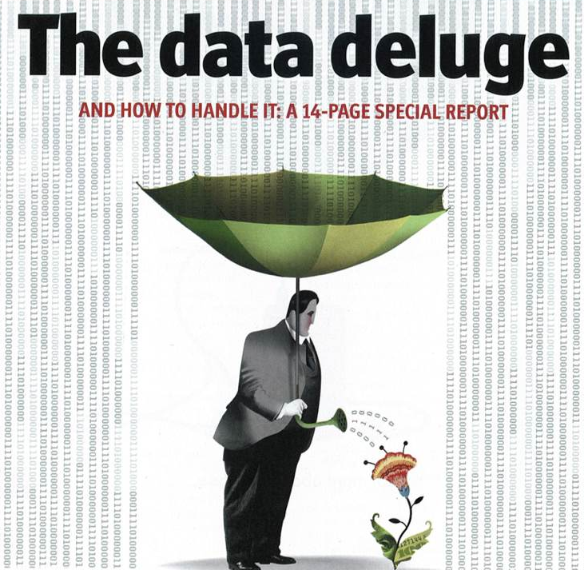
Emerging opportunities
Big Data
Big Data and Predictive Analytics
Financial Mathematics
Systems Biology
Energy
Manufacturing
Communications and Transportation
Design and Optimization of Complex Engineered Systems
Applications of High Performance Computing and Information Technology
Big Data
… is a Big Deal
4 industry speakers at the workshop had started new jobs as data scientists in the past few months
Interested? Learn programming in R, Hadoop, etc.
* William Kolata, Technical Director, SIAM

Slide 9
Industry vs. Academia
Taken from the SIAM Report on Mathematics in Industry (MII 2012)
“PhDs tend to underestimate the quality of science done
in industry. You will get to solve challenging problems.”
Taken from the SIAM Report on Mathematics in Industry (MII 2012)

Slide 10
What kind of rectangle are you?
Distinction within the Discipline
Impact through Teaching
What matters is the area of your rectangle*
* Robert Calderbank, Director, Information Initiative, Duke University
Impact on Technology

Slide 11
Summary
Industry needs problem solvers who can grasp abstract concepts while interfacing with engineers in the real world
What does it take to land a job?
Mathematical expertise
Programming ability
Communication skills
Internships
…
Big data is a big deal
What kind of rectangle are you?

Slide 12
For more information…
IMA Special Workshop on Careers and Opportunities in Industry for Mathematical Scientists
presentations
videos
Ten Simple Rules for Choosing between Industry and Academia
SIAM Report on Mathematics in Industry (MII 2012)
SIAM Careers in Applied Mathematics brochure

