Slide 1
Why Strong UX is Key to Materialize our Strategy
November, 2023
Iris Cremers
UX Design Director

Slide 2
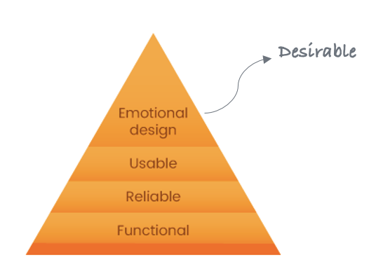
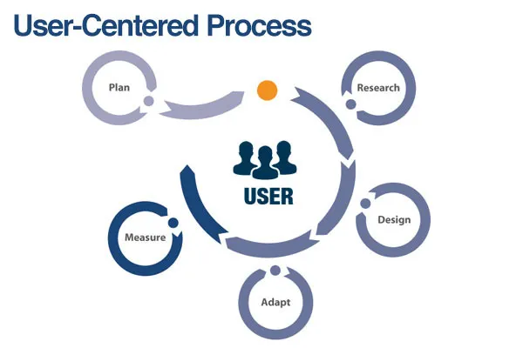
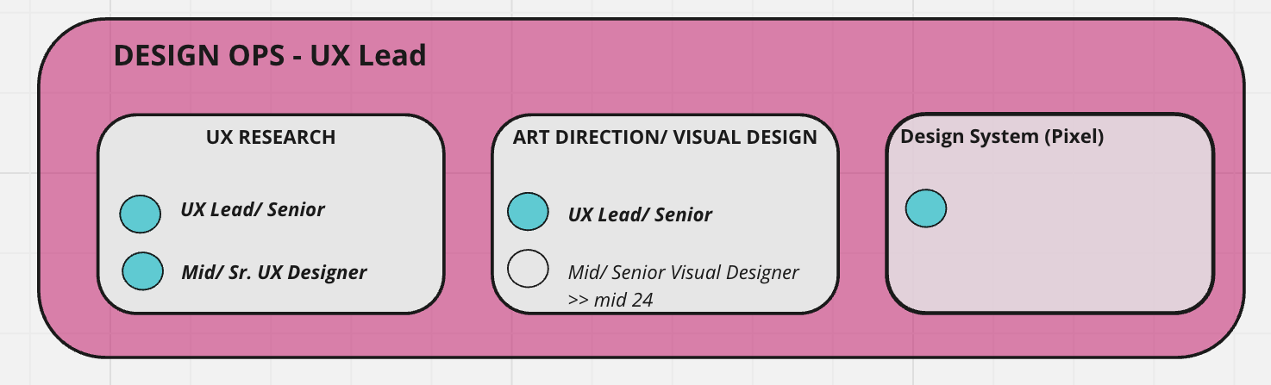
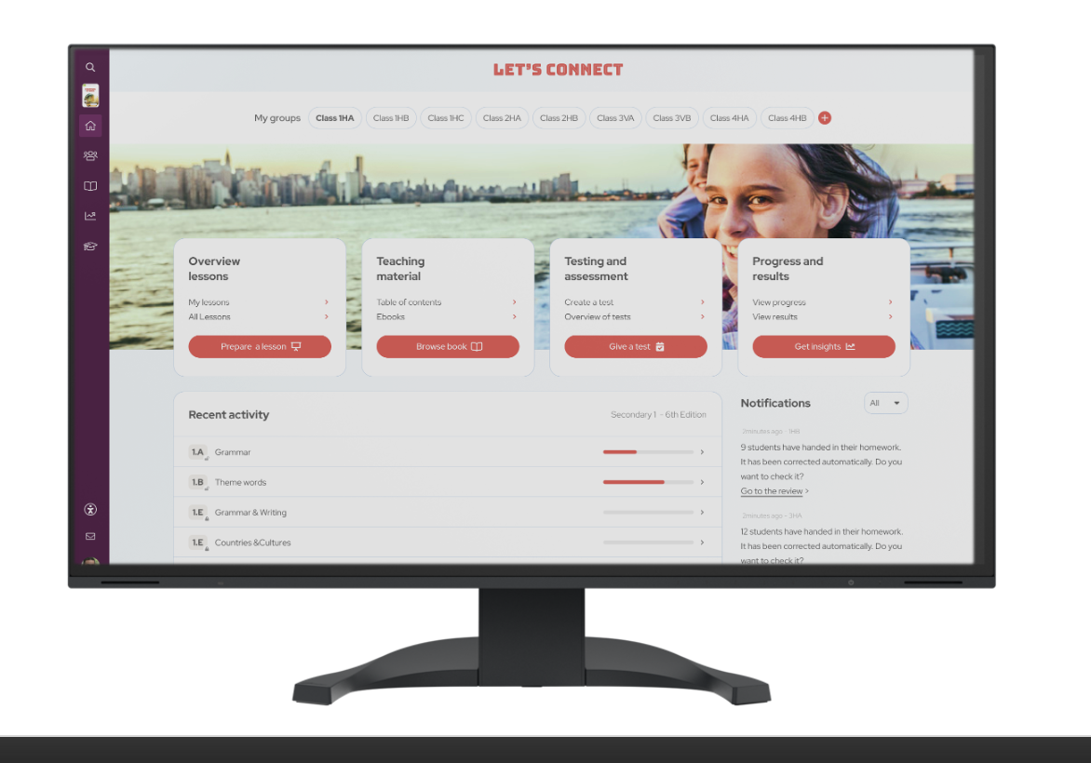
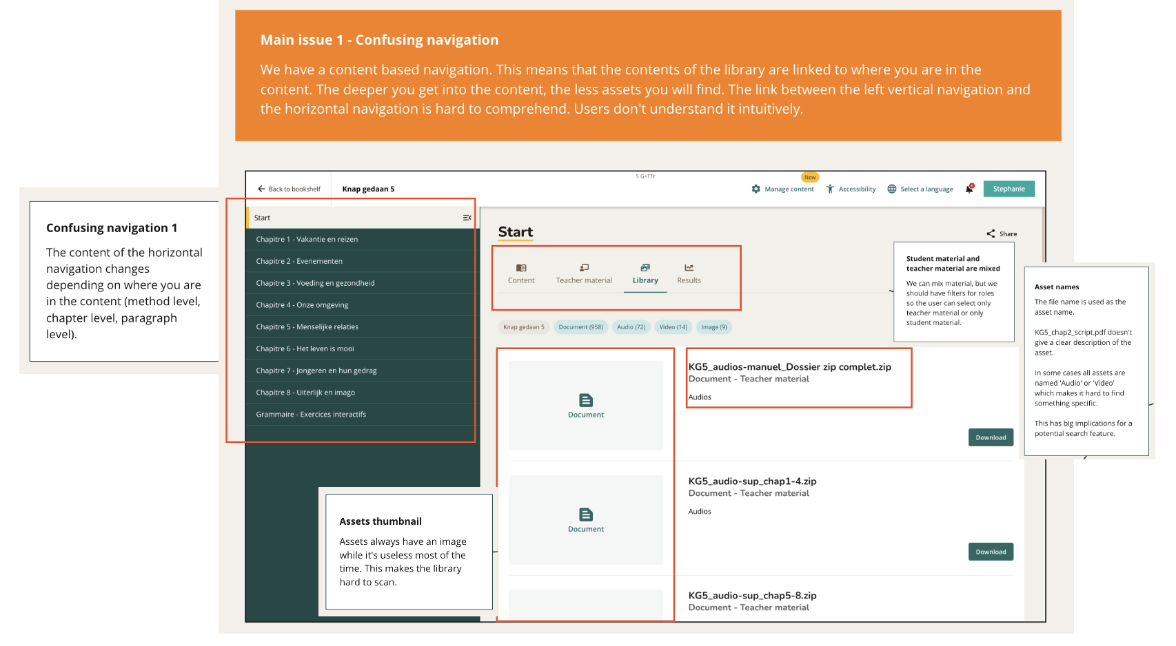
Conclusion: Strengthened UX design&research capability and leadership to take our platforms to the next level
D
Focus on Customer Intimacy and A Continuous Feedback Loop
Challenge
Solution
New operating model
Impact for our users
We need to become better in offering a great end-2-end user experience
Ease of use and usability of digital
Recognizability between folio and digital
Desirability and look and feel of digital
Smooth transition between folio and digital touchpoints
Use strength of digital (design) possibilities (not just copy the book)
By understanding our end user better and basing our designs on more facts not assumptions
User centered: Be close to the end users much more to see actual behavior in context and work on continuous improvements
Data driven: Having tagged our products better and dashboarding in place to see (live) behavior
Feedback loop: Conduct surveys and make better use of and mature feedback tools to improve products; introduce UX score (i.e. success rate, add questions on statements related to vision (“saves me time, feeling of control”)
Start a Design Ops Team: creating operational efficiency across everything that touches the design process, including:
User Centered Design Process: Follow a common, user focused, way of working
Set up a User/UX Research practice: Making it easy to connect to teachers and learners on a regular basis, set up new research methods (i.e. AB testing) and get daily, actionable insights
Desirability: Uplift look&feel by hiring Visual Design/ UI/ Art Direction skills
Increasing engagement and user satisfaction of both teachers and learners, by
Understanding, documenting & sharing, and prioritizing the needs and behavior of different types of end-users better
Start getting more insights in learners
Introducing additional metrics on user satisfaction (combining behavioral and attitudinal)
Creating fast feedback loops

Slide 3
Agenda
Why strong UX is key to materialize our Strategy
Reflections: Where we are now
Recommendations: What & how to improve
Conclusion
Questions/ Discussion/ Next Steps

Slide 4
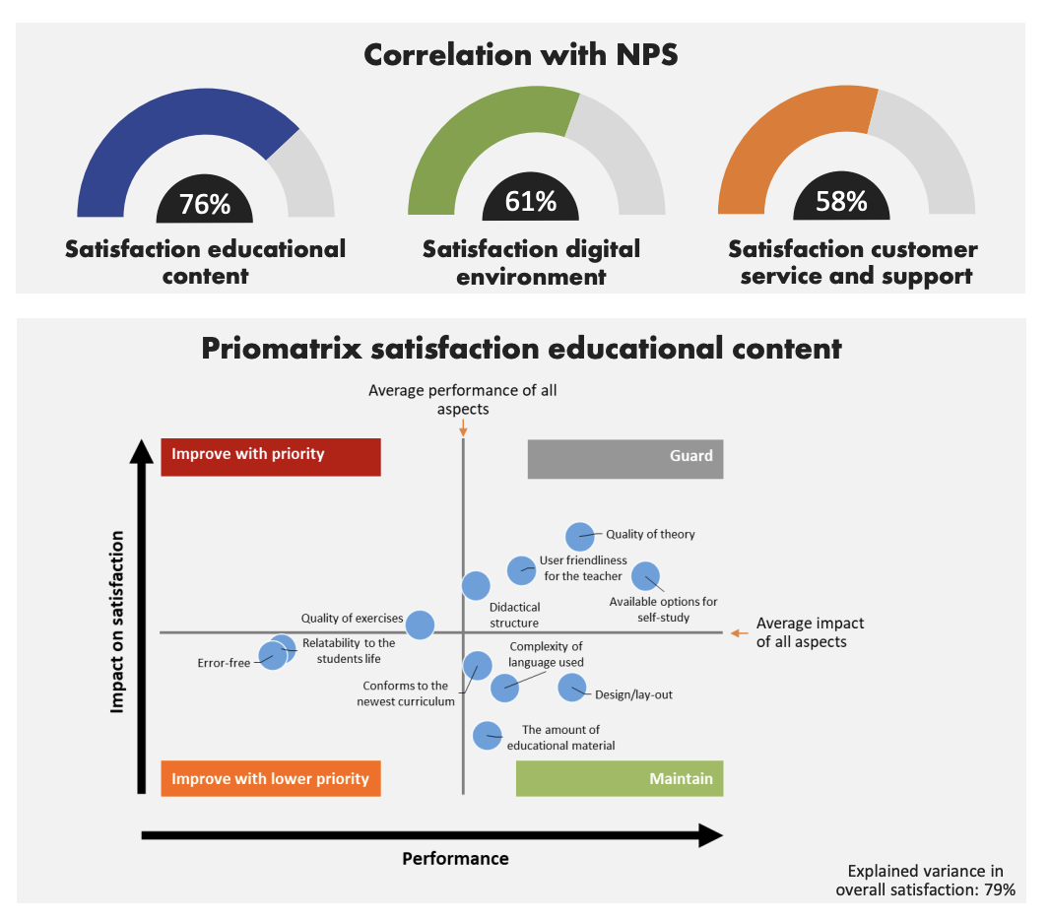
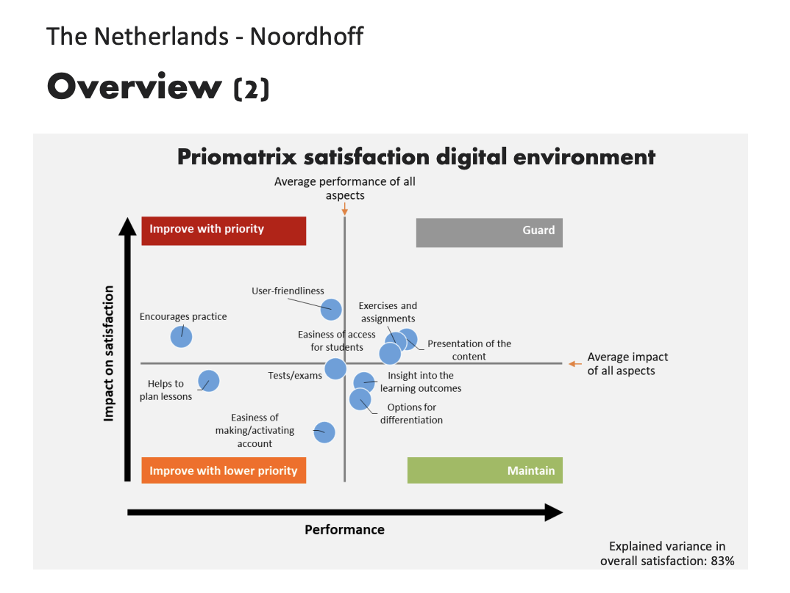
Why strong UX is key to materialize our Strategy
NPS data shows that, overall UX needs improvement:
Satisfaction of educational content and the digital environment has a medium to strong correlation with NPS
We have to guard and sometimes improve our user friendliness with priority, across all OpCos -- for both the educational content and the digital environment
At Plantyn, Liber* and Leya the digital environment are perceived quite positive, but so is the competition
There is still room for improvement: i.e. almost 3 out of 10 teachers are dissatisfied at Plantyn
In the Netherlands, the digital environment accounts for quite some negativity, although this is the same for the competition
We need to fill in hygiene-needs in ease-of-use in order to ensure digital adoption and user satisfaction
Notes:
NPS is low, of as good as the competition
A lot of this related to mediocre UX
We need to act

Slide 5
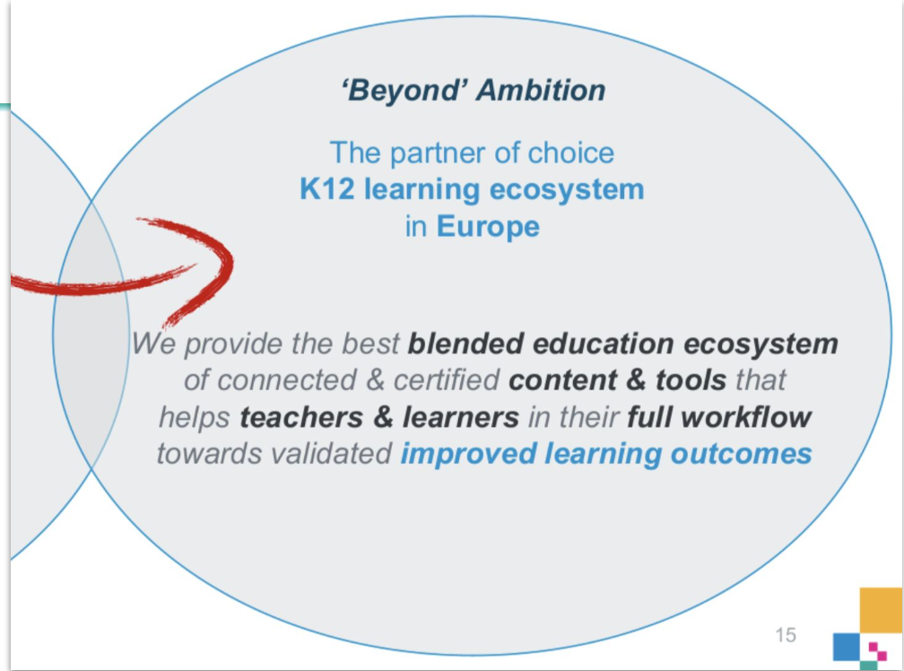
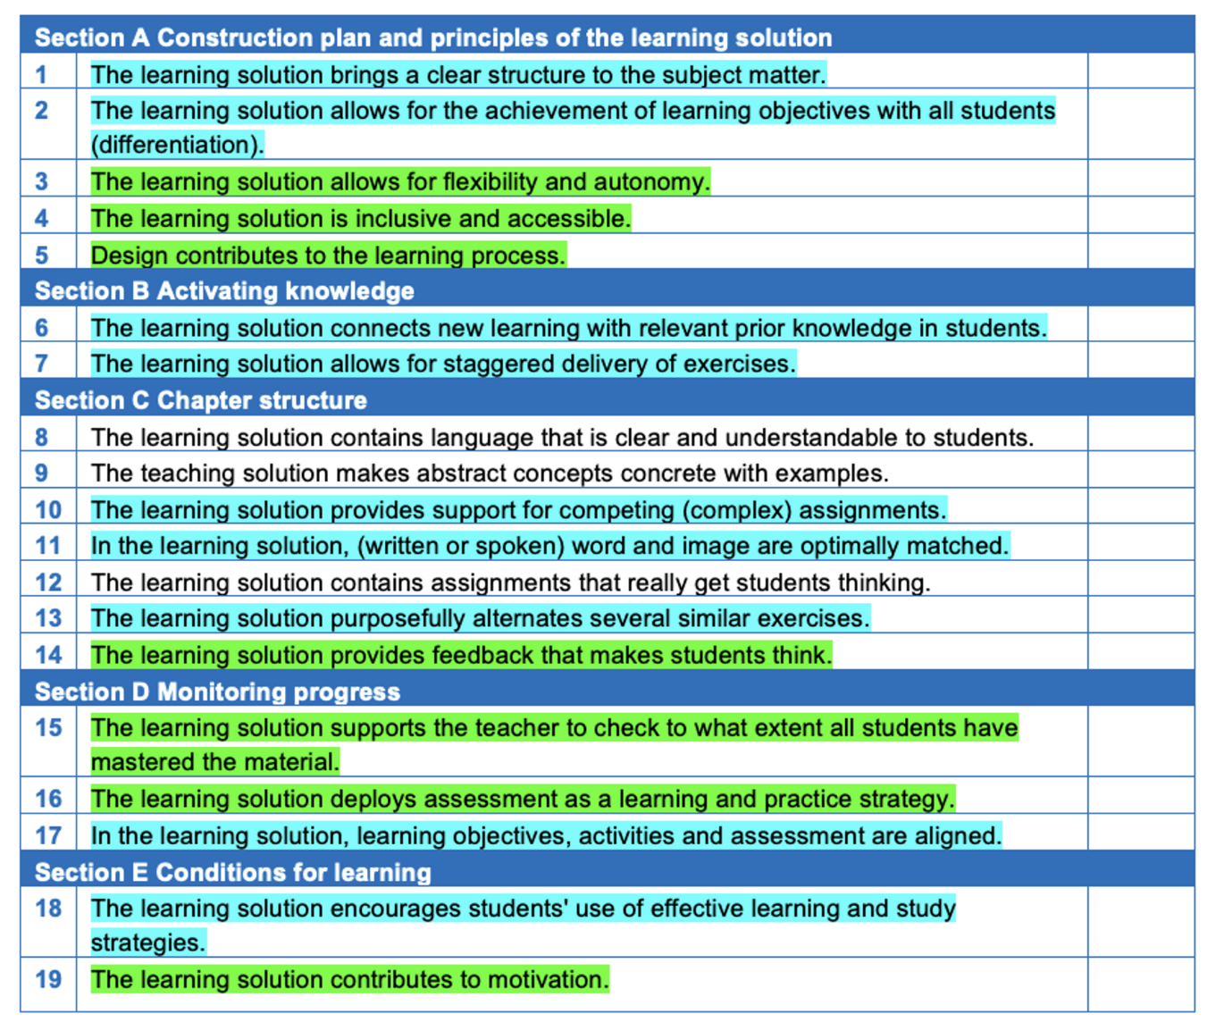
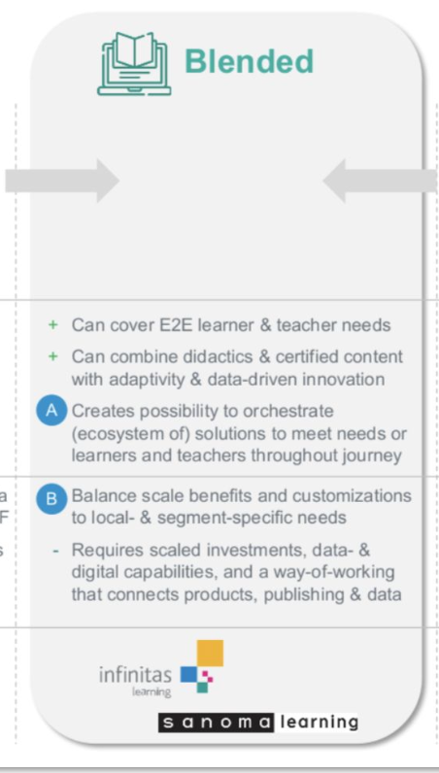
Why strong UX is key to materialize our Strategy
IL(PT) Strategies
Become an ecosystem that supports the full workflow of teachers and learners and integrates with third party tools
To improve learning outcomes, our platform should enable publishers to create content in line with the didactics checklist
Data is essential to address teachers and learners needs, to improve our products and secure business growth
Blended learning, the perfect mix between folio and digital gives us the competitive advantage
Products should be easy to use and navigate, recognizable between folio and digital and appealing (SEP vision)
Our products should be re-usable, so we can sell our product as white label product to publishers who can’t afford to develop a good platform themselves and support our M&A strategy
Our strategies tell us that our products should be easy to use, enjoyable and scalable and that design contributes to the learning process. A lot of this has to do with good interaction and visual design and insights in our users needs, wishes and problems.
Notes:
Our strategies tell us that our products should be easy to find, easy to use, enjoyable to use, etc
A lot of this has to do with good interaction and visual design and insights in our users needs, wishes and problems.
.
Improving learning outcomes and engagement of learners through an integrated use of physical & digital learning
Offer an integral solution to foster teacher efficiency, student comprehensibility, quality of content & an integral data-view
❖ Through a scalable framework that allows for local adaptation to differences

Slide 6
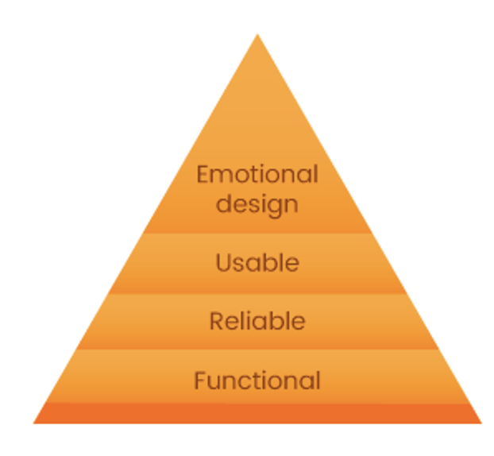
Why strong UX is key to materialize our Strategy
We want to offer blended products and services that
fulfill the teachers and learners needs
are easy to use
are attractive and fun to use for both teachers and learners from different age groups
thereby supporting didactical goals in a motivational way that keeps them coming back and speak highly of its educational value, ease of use and look and feel
In order to do so, we need to become user centered:
understand exactly who our end users are
what their needs and problems are in what context
by being in continuous dialogue with them
and by gathering continuous feedback (through qualitative and quantitative data/insights) so we know we
solve the rights problems
and solve them in the right way
Desirable
Notes:
If we want to reach a simple, intuitive and fun product, we need work user centered.
And at the moment, we are not doing enough of that.
We need to fill in hygiene-needs in ease-of-use & flexibility in order to ensure digital adoption
Improving learning outcomes and engagement of learners through an integrated use of physical & digital learning

Slide 7
User Centered Design refers to an iterative design process in which we focus on the users and their needs in each phase of the design and product development process
Notes:
In sum, this is what UCD is

Slide 8
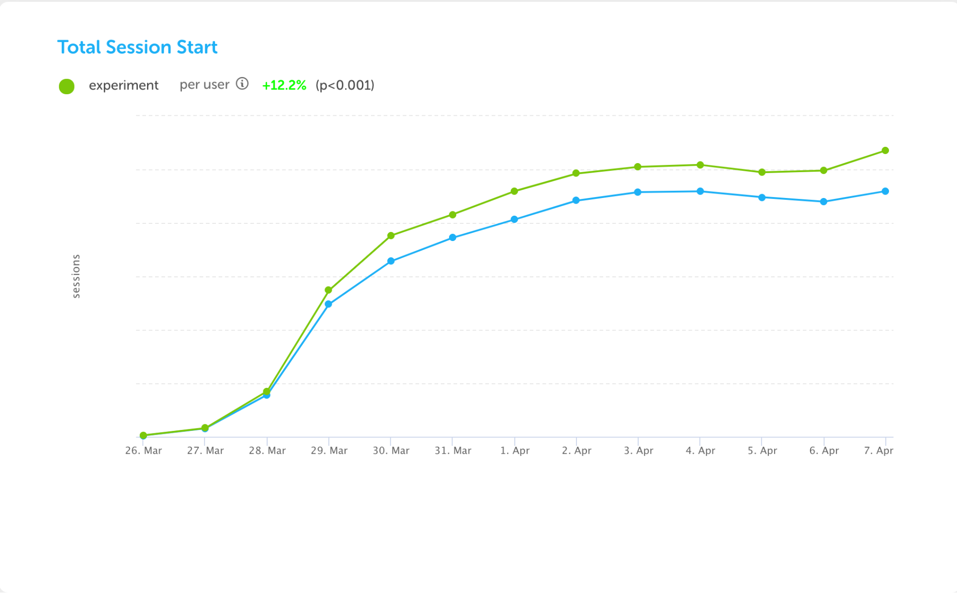
Strategy
Company who is doing this really well: DuoLingo
“Test everything”. This is one of the key operating principles followed at DuoLingo in order to improve the learning experience of their users.
It means they rely heavily on experiments and data to help make informed decisions about any updates and new features they launch.
At DuoLingo, it is not uncommon to have a few hundred experiments running simulteously.
They conduct experiments for any changes they want to make – from seemingly small ones like a single button to rolling out a major feature like Leaderboards.
Notes:
Examples of companies doing this really well: Duo Lingoo is not only easy to use, but alsoo looks great and: it’s visual design, movements, and stimulation in copy and tone of voice.
Next to that: theu contiunally test everything design they make, from user interviews, tot AB testing.
https://design.duolingo.com/

Slide 9
Strong UX Design & UX Research is key to materialize our Strategy

Slide 10
Reflections: Where we are now
A lot has been happening over the years to improve our UX, user insights and horizontal focus
Creation of focus teams
(Live) NPS score
Gathering as much user research and insights as we can
Started with vision work for SE and PE soon to be followed
Way of working with double diamond model and opportunity and solution cards
Creation of a design system (Pixel)
UX Director role
….
but in order to reach our strategic goals, more maturity is needed

Slide 11
Agenda
About me ☺
Why strong UX is key to materialize our Strategy
Reflections: Where we are now
Recommendations: What & how to improve
Conclusion
Questions/ Discussion/ Next Steps

