Slide 1
Lab8

Slide 2
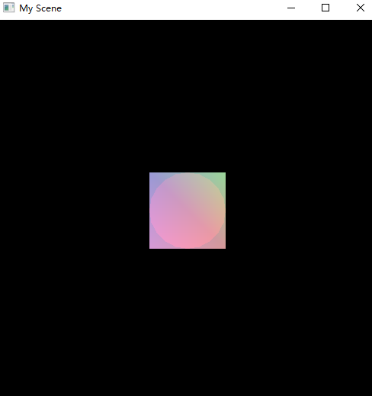
8.1 New Transparency Example
Try:
Different order of the objects
Different color, transparency of the objects
Different position of the objects

Slide 3
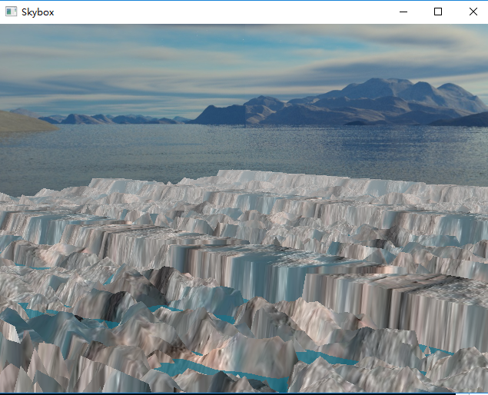
8.2 Skybox
This is the solution of a question
in Lab Session 7, say last week.
Learn the structure of the code

Slide 4
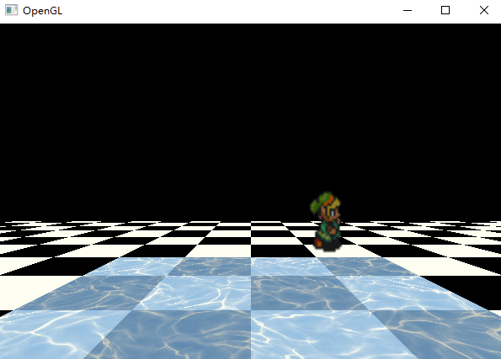
8.3 Animated texture
Water control
Try:
time += deltaTime
time += 0.001
time += 0.01
radius = sqrtf((1.0f / xGridDims)*(1.0f / xGridDims) + (1.0f / zGridDims)*(1.0f / zGridDims));
radius = sqrtf((2.0f / xGridDims)*(2.0f / xGridDims) + (2.0f / zGridDims)*(2.0f / zGridDims));
radius = sqrtf((3.0f / xGridDims)*(3.0f / xGridDims) + (3.0f / zGridDims)*(3.0f / zGridDims));

Slide 5
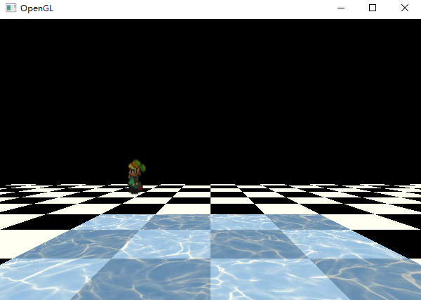
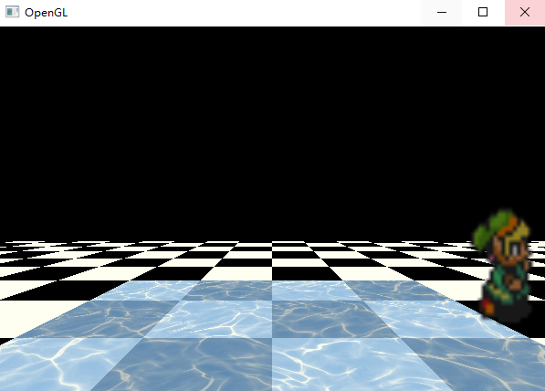
8.4 Animated texture
Try to implement a diagonal walking man
Going back and forth between point A and point B
A
B

