Slide 1
Lab4
Viewing, camera and keyboard control

Slide 2
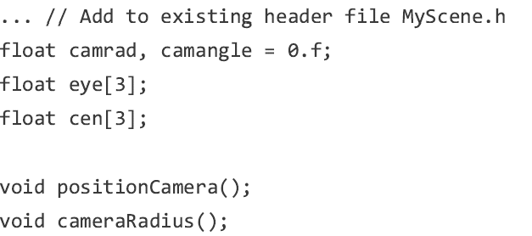
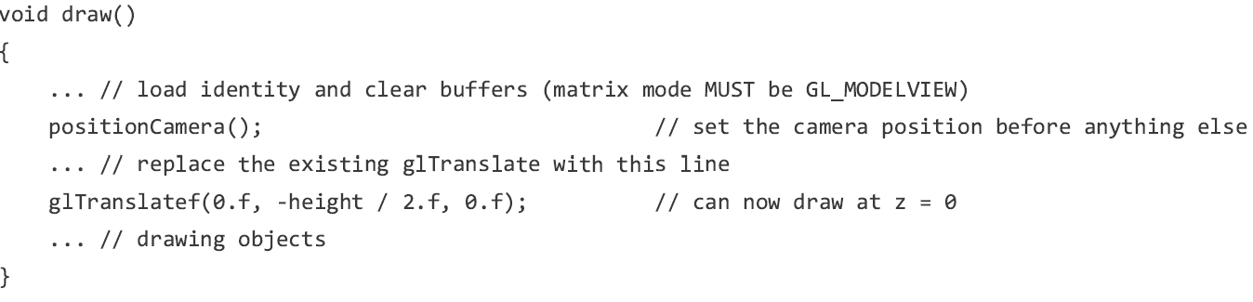
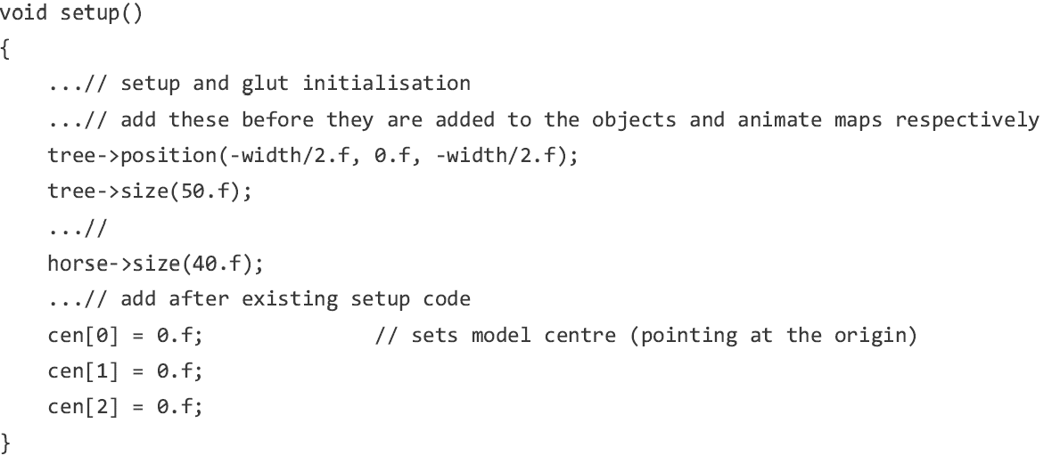
1. Viewing your scene
Based on the animated horse
The following code has been added:

Slide 3

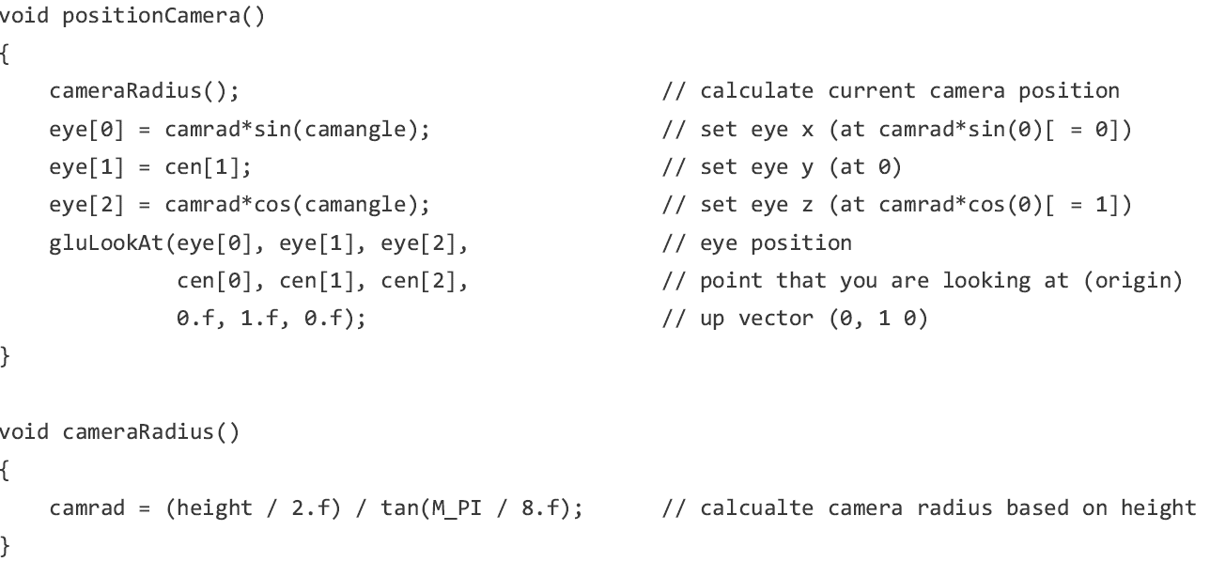
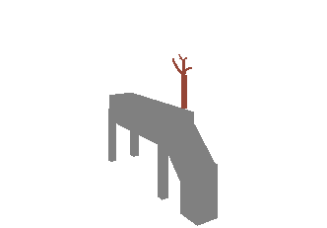
1. Viewing your scene
Try to modify the code to get the lower figure.
“float camangle=0.f;” in “MyScene.h”
Try to understand the structure of the code

Slide 4
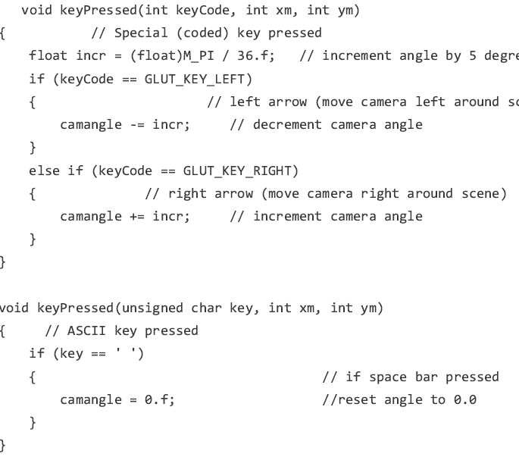
2. Using keyboard input
The following code has been added:

Slide 5
2. Using keyboard input
Try:
→ , ← and space

Slide 6




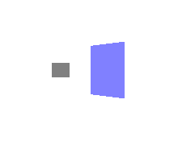

3. Back-face culling
Try to understand the idea of:
glEnable(GL_DEPTH_TEST)
glEnable(GL_CULL_FACE)
glFrontFace(GL_CCW)

Slide 7
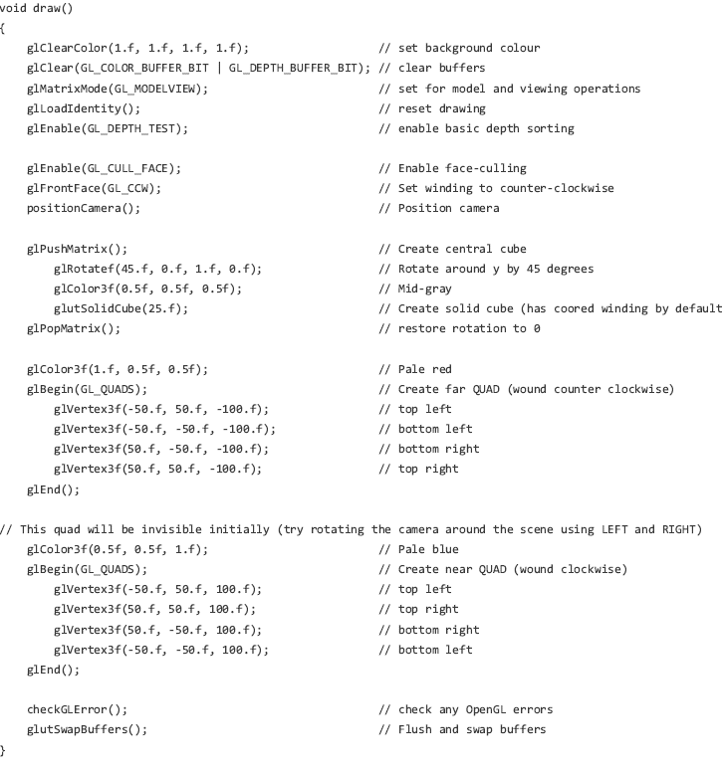
3. Back-face culling

