Slide 1
CHEM 101 · ELEMENTS OF GENERAL CHEMISTRY I
Topic 9: Stoichiometry Calculations
Using a balanced equation to predict exactly how much reacts and forms
Asynchronous Online Lecture

Slide 2




What's covered in this lecture
Mole↔mole calculations — Using a balanced equation’s coefficients as a direct mole-to-mole conversion
Mole↔mass calculations — Combining molar mass and mole ratios into a full gram-to-gram roadmap
Molar solution calculations — Bringing molarity into stoichiometry, to work with reactants dissolved in solution
Percent yield — Comparing what a reaction actually produced to what it should have produced based on the chemical reaction equation
CHEM 101 · Topic 9: Stoichiometry Calculations
2

Slide 3



Why Stoichiometry Matters in Healthcare
IV Drip Rate Calculations
Compounding Pharmacy
Converting an ordered dose into the correct infusion volume relies on the same mole-ratio thinking used throughout this lecture
Scaling a recipe up or down to make a specific batch size uses the same proportional reasoning as a mole-ratio conversion
Yield in Drug Manufacturing
Oxygen & Metabolic Calculations
Percent yield tells manufacturers how much usable medication a batch actually produced, compared to the theoretical amount especially in multi-step syntheses.
Calculating how much oxygen a reaction — or the body — consumes uses the exact same mole-ratio math covered here
CHEM 101 · Topic 9: Stoichiometry Calculations
3

Slide 4
Mole-Mole Calculations
The simplest form of stoichiometry — moles straight in, moles straight out
CHEM 101 · Topic 9: Stoichiometry Calculations
4

Slide 5

The Mole Ratio
Where It Comes From — the coefficients in a balanced chemical equation (Topic 7) show the exact ratio in which substances react and form.
As a Conversion Factor — that ratio becomes a fraction you multiply by, just like any unit conversion (Topic 2) — moles of chemical A in the reaction convert directly to moles of chemical B in the reaction.
$\frac{\# moles of A}{\# moles of B} = \frac{\# moles of B}{\# moles of A}$ These are equivalent just like the earlier conversions to go A ↔ B or B ↔ A
Always From a Balanced Equation — never guess a mole ratio. It must come from a correctly balanced equation, or the whole calculation is wrong.
CHEM 101 · Topic 9: Stoichiometry Calculations
5

Slide 6
Applied Example: Mole-Mole Calculation
N₂ + 3H₂ → 2NH₃ Reaction of Nitrogen gas with Hydrogen gas to produce Ammonia (NH₃)
5.00 mol of N₂ reacts with excess H₂, following N₂ + 3H₂ → 2NH₃.
Given
The coefficients show 1 mol N₂ produces OR equals 2 mol NH₃.
Identify the Ratio
5.00 mol N₂ × $\frac{\text{(}\text{2 mol NH₃}\text{)}}{\text{(}\text{1 }\text{mol N₂}\text{)}}$ = 10.0 mol NH₃.
Set Up & Calculate
5.00 moles of N₂ produces 10.0 moles of NH₃.
Result
CHEM 101 · Topic 9: Stoichiometry Calculations
6

Slide 7
Mole-Mass Calculations
Combining molar mass and mole ratios into one complete roadmap
CHEM 101 · Topic 9: Stoichiometry Calculations
7

Slide 8
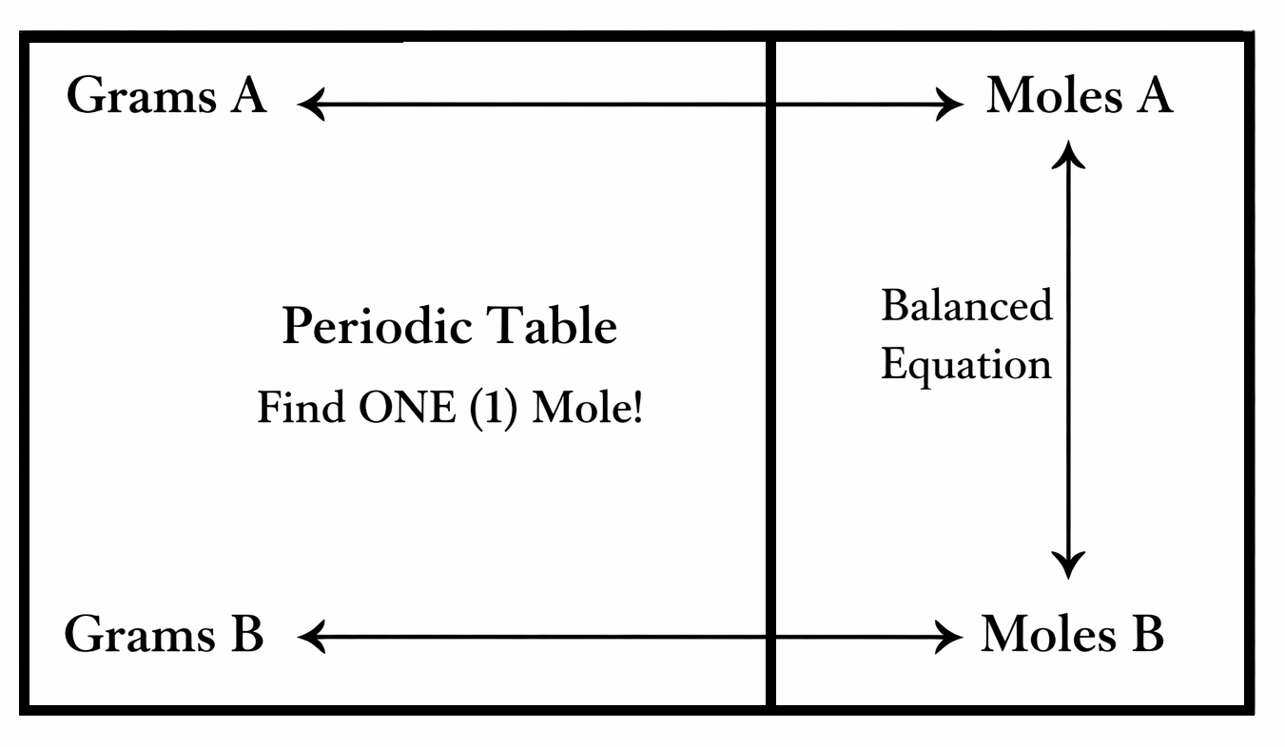

The Mole↔Mass Roadmap
Three conversion relationships, chained together, to get from grams of A to grams of B using the Balanced Reaction and Periodic Table
Step 1: Grams A → Moles A — convert the given mass of substance A into moles, using its molar mass (Topic 8).
Step 2: Moles A → Moles B — convert moles of A into moles of B using the mole ratio from the balanced equation.
Step 3: Moles B → Grams B — convert moles of B into grams, using B’s molar mass.
CHEM 101 · Topic 9: Stoichiometry Calculations
8

Slide 9
Mole-Mass Calculation – Same reaction with the roadmap
N₂ + 3H₂ → 2NH₃
10.0 g of N₂ reacts and excess H₂. Molar masses: N₂ = 28.02 g/mol and NH₃ = 17.03 g/mol.
Given
10.0 g ÷ 28.02 g/mol = 0.357 mol N₂.
Grams → Moles
0.357 mol N₂ × $\frac{\text{2 mol NH₃}}{\text{1 }\text{mol N₂}}$ = 0.714 mol NH₃.
Mole Ratio
0.714 mol NH₃ × 17.03 g/mol ≈ 12.2 g NH₃.
Moles → Grams
CHEM 101 · Topic 9: Stoichiometry Calculations
9

Slide 10
Molar Solutions & Percent Yield
Bringing concentration into the roadmap, and checking a reaction’s real-world performance
CHEM 101 · Topic 9: Stoichiometry Calculations
10

Slide 11

Stoichiometry with Solutions
Molarity as a Bridge — when a reactant is dissolved in solution, molarity (Topic 8) becomes another way to find moles: moles = molarity × liters.
Same Roadmap Applies — once you have moles of the reactant, the mole-ratio and molar-mass conversions work exactly the same as any other stoichiometry example problems.
Reading the Question — a volume and a molarity given together (like "25.0 mL of 0.500 M HCl") is your signal to start with moles = M × V. !!Don’t forget that the molarity is per Liter!!
CHEM 101 · Topic 9: Stoichiometry Calculations
11

Slide 12
Applied Example: Asking for Volume Needed to React in Reaction
Balanced Equation: Mg + 2HCl → MgCl₂ + H₂
2.43 g of Mg reacts completely with 0.500 M HCl solution. Molar mass Mg = 24.3 g/mol.
Given
2.43 g ÷ 24.3 g/mol = 0.100 mol Mg.
Grams → Moles
0.100 mol Mg × ($\frac{\text{2 mol HCl}}{\text{1 }\text{mol Mg}}$) = 0.200 mol HCl.
Mole Ratio
volume = moles ÷ molarity = 0.200 mol ÷ 0.500 mol/L = 0.400 L, or 400. mL.
Moles → Volume
CHEM 101 · Topic 9: Stoichiometry Calculations
12

Slide 13

Percent Yield – Measure of Efficiency and Precision
Theoretical Yield — the maximum amount of product possible, calculated from stoichiometry assuming the reaction goes perfectly. All reactants produce precisely the expected products
Actual Yield — the amount of product actually measured in the lab — always less than or equal to the theoretical yield, due to real-world losses.
The Formula — percent yield = (actual yield ÷ theoretical yield) × 100%.
CHEM 101 · Topic 9: Stoichiometry Calculations
13

Slide 14
Applied Example: Calculating Percent Yield (%)
Stoichiometry predicts a theoretical yield of 12.2 g NH₃ (from the earlier example); the lab actually measured an actual yield of 10.5 g.
Given
Percent (%) yield = (10.5 g ÷ 12.2 g) × 100%.
Apply the Formula
10.5 ÷ 12.2 ≈ 0.861, so 86.1%.
Calculate
The reaction achieved an 86.1% yield.
Result
CHEM 101 · Topic 9: Stoichiometry Calculations
14

Slide 15
The Full Stoichiometry Roadmap
Every problem in this lecture is some version of this same four-step chain
1. Start — grams (or volume and molarity) of substance A, straight from the problem.
2. Convert to Moles A — divide by molar mass, or multiply molarity × volume.
3. Convert to Moles B — multiply by the mole ratio from the balanced equation.
4. Finish — multiply by molar mass for grams of B, or divide by molarity for volume of B.
CHEM 101 · Topic 9: Stoichiometry Calculations
15

Slide 16

Common Pitfalls & Tips
Always Balance First!
Watch Your Units
Round Only at the End
An unbalanced equation gives an incorrect mole ratio, which throws off every step that follows.
Convert mL to L before using molarity and double-check that every conversion factor is right-side-up so that units can cancel in the numerator and denominator of the fraction.
Carry extra digits through intermediate steps and round only your final answer, to avoid compounding small errors.
CHEM 101 · Topic 9: Stoichiometry Calculations
16

Slide 17
Key Terms to Know, Use, and Understand
Stoichiometry: Calculations relating amounts of reactants and products
Mole ratio: The ratio between two substances’ coefficients in an equation
Mole-mass calculation: A conversion chaining moles, mass, and the mole ratio
Molar solution: A solution with a known molarity, used to find moles
Theoretical yield: The maximum product predicted by stoichiometry
Actual yield: The amount of product actually obtained in the lab
Percent yield: Actual yield divided by theoretical yield, times 100%
Molarity: A solution’s concentration, in moles of solute per liter
CHEM 101 · Topic 9: Stoichiometry Calculations
17

Slide 18
Summary & What’s Next
A balanced equation’s coefficients give a mole ratio, usable as a direct conversion factor
Mole-mass problems chain three conversions: mass to moles, moles to moles, moles to mass
Molarity (moles = M × L) is just another way into the same roadmap when reactants are dissolved
Percent yield compares what a reaction actually produced to what stoichiometry predicted
UP NEXT
Topic 10: Chemical Bonds — ionic and covalent bonds, electron dot structures, molecular geometry, and polar vs. non-polar bonds.
CHEM 101 · Topic 9: Stoichiometry Calculations
18

