Slide 1
CHEM 101 · ELEMENTS OF GENERAL CHEMISTRY I
Topic 10: Chemical Bonds
How atoms hold onto each other — and the shapes that creates
Asynchronous Online Lecture

Slide 2




What's covered in this lecture
Ionic and covalent bonds — The two fundamental ways atoms hold onto one another and form molecules or compounds
Electron dot structures — Drawing a molecule’s bonding and lone-pair electrons
Molecular geometry — Predicting the 3D shape a molecule actually takes
Coordinate covalent & polar bonds — A special kind of covalent bond, and why some bonds share electrons unevenly
CHEM 101 · Topic 10: Chemical Bonds
2

Slide 3




Chemical Bonding Concepts are important in Healthcare
Electrolytes & Nerve Function
Water’s Bonds & Polarity
Na⁺, K⁺, and Ca²⁺ are held in ionic bonds until dissolved — then they separate to carry the electrical signals nerves and muscles depend on
Water’s polar covalent bonds are why it dissolves electrolytes and forms the hydrogen bonds that make life as we know it possible
Hemoglobin & Oxygen Binding
Drug Shape & Receptor Binding
Iron in hemoglobin binds oxygen through a coordinate covalent bond — the exact mechanism that lets blood carry oxygen through the body
A drug’s molecular geometry determines whether it fits its target receptor — the "lock and key" model behind how medications and drug specificity work.
CHEM 101 · Topic 10: Chemical Bonds
3

Slide 4
Ionic and Covalent Bonds
The two fundamental strategies atoms use to hold onto each other
CHEM 101 · Topic 10: Chemical Bonds
4

Slide 5

Ionic Bonds, Reviewed from Topic 5 & 6
Electron Transfer — a metal transfers one or more electrons to a nonmetal, creating oppositely charged ions that attract each other (Topics 5 – 6).
A Strong, Rigid Bond — ionic bonds are strong in every direction, which is why ionic compounds form hard crystals with high melting points. The structure they form is called a “lattice” because they sit in a pattern like the common garden structure with the same name.
Conducts When Dissolved — once dissolved in water, the ions separate and move freely — which is exactly what lets an electrolyte solution carry an electrical current which is charges (+/-) moving through solutions.
CHEM 101 · Topic 10: Chemical Bonds
5

Slide 6



Covalent Bonds: Sharing Electrons for Nonmetals (include H)
Sharing, Not Transferring — two nonmetals each contribute an electron to a shared pair, rather than one atom giving an electron away entirely.
Single, Double, and Triple Bonds — atoms can share one pair of electrons (single bond), two pairs (double bond), or three pairs (triple bond).
Molecules, Not Crystals — covalent bonding produces individual molecules (like H₂O or CO₂) rather than the repeating ionic lattices formed by ionic bonds.
CHEM 101 · Topic 10: Chemical Bonds
6

Slide 7
Comparing Ionic and Covalent Bonds
Characteristics | Ionic Bond | Covalent Bond
Electron behavior | Transferred | Shared
Typically forms between | A metal and a nonmetal or polyatomic ions | Two nonmetals
Melting point | High | Low to moderate
Conducts electricity dissolved? | Yes | Usually not
Example | NaCl (table salt) | H₂O (water)
CHEM 101 · Topic 10: Chemical Bonds
7

Slide 8
Electron Dot Structures & Molecular Geometry
Drawing a molecule’s electrons, then predicting the shape they create
CHEM 101 · Topic 10: Chemical Bonds
8

Slide 9

Drawing Electron Dot Structures of Molecules
Step 1 — count the total valence electrons from every atom in the molecule (Topic 5).
Step 2 — arrange the atoms, placing the least electronegative atom (other than hydrogen) in the center.
Step 3 — place one bonding pair of electrons between each pair of connected atoms.
Step 4 — fill in the remaining electrons as lone pairs, giving every atom (except hydrogen) a full octet.
CHEM 101 · Topic 10: Chemical Bonds
9

Slide 10
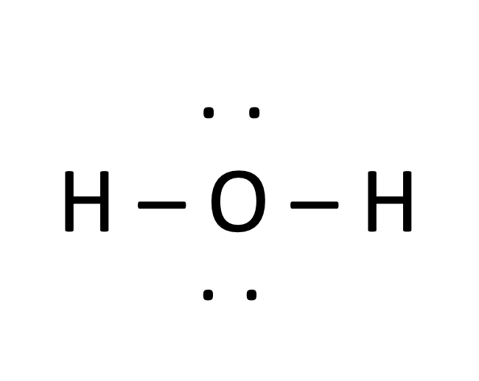
Applying It: Electron Dot Structure of H₂O
Oxygen contributes 6 valence electrons; each hydrogen contributes 1. Total: 6 + 1 + 1 = 8 electrons.
Count
Hydrogen can never be a central atom, so oxygen — the only other atom — goes in the center, with one H bonded on each side.
Arrange
Place one bonding pair between O and each H — that uses 4 of the 8 electrons (2 bonds × 2 electrons each).
Bond
The remaining 4 electrons become two lone pairs on oxygen, giving it a full octet. H₂O is complete.
Fill Octets
CHEM 101 · Topic 10: Chemical Bonds
10

Slide 11

Molecular Geometry: VSEPR Basics
Valence Shell Electron Pair Repulsion — predicting a molecule’s 3D shape
The Core Idea — electron pairs around a central atom repel each other, so they arrange themselves as far apart in space around the central atom as possible. Remember — atoms are spheres!
Bonding and Lone Pairs Both Count — both the electrons in a bond and any unshared lone pairs on the central atom push other electron pairs away.
In practice: that’s why water (2 bonding pairs, 2 lone pairs) is bent, not straight — the lone pairs push the two O–H bonds together.
CHEM 101 · Topic 10: Chemical Bonds
11

Slide 12
Most Common Molecular Shapes
Electron Groups (pairs of electrons) | Shape Name | Example
2 pairs | Linear | CO₂
3 pairs | Trigonal planar | BF₃
4 pairs (all bonding) | Tetrahedral | CH₄
4 pairs (2 bonding, 2 lone) | Bent | H₂O
CHEM 101 · Topic 10: Chemical Bonds
12

Slide 13
Coordinate Covalent Bonds & Polarity
A special kind of sharing, and why sharing isn’t always equal
CHEM 101 · Topic 10: Chemical Bonds
13

Slide 14
Coordinate Covalent Bonds
One-Sided Sharing — in a normal covalent bond, each atom contributes one electron. In a coordinate covalent bond, one atom donates both electrons of the shared pair.
Looks the Same Once Formed — once formed, a coordinate covalent bond behaves exactly like any other covalent bond — only its origin is different.
Example: the Iron atom (Fe) in hemoglobin forms a coordinate covalent bond with oxygen gas molecules — oxygen donates the electron pair which binds O₂ to hemoglobin to carry oxygen in the blood for tissue delivery.
CHEM 101 · Topic 10: Chemical Bonds
14

Slide 15
Polar Bonds vs. Non-Polar Bonds
Electronegativity Decides It — electronegativity (Topic 5) measures how strongly an atom pulls on shared electrons. A bond’s polarity depends on the difference between the two atoms’ values.
Non-Polar Covalent — electrons are shared equally, usually between identical or very similar atoms (like the O=O bond in O₂).
Polar Covalent — electrons are shared unequally, pulled closer to the more electronegative atom — giving that end a slightly negative charge (like O–H in water).
CHEM 101 · Topic 10: Chemical Bonds
15

Slide 16
Applying It: Is the O–H Bond in Water Polar?
Oxygen has a much higher electronegativity than hydrogen — oxygen pulls harder on the shared electrons.
Compare
The shared electron pair sits closer to oxygen than to hydrogen, most of the time.
Electron Position
Oxygen ends up with a slight negative charge (δ−); each hydrogen ends up with a slight positive charge (δ+).
Charge Distribution
The O–H bond is polar covalent — and that unequal sharing is exactly why water dissolves ionic and polar substances so well.
Conclusion
CHEM 101 · Topic 10: Chemical Bonds
16

Slide 17
Key Terms to Know & Understand
Ionic bond: A bond formed by transferring electrons.
Covalent bond: A bond formed by sharing electrons.
Lone pair: A pair of valence electrons not used in bonding.
VSEPR: The model predicting shape from electron-pair repulsion.
Molecular geometry: The 3D shape a molecule actually takes.
Coordinate covalent bond: A covalent bond where one atom donates both electrons.
Electronegativity: An atom’s pull on shared electrons in a bond.
Polar bond: A bond with unequal sharing of electrons.
CHEM 101 · Topic 10: Chemical Bonds
17

Slide 18
Summary & What’s Next
Ionic bonds transfer electrons; covalent bonds share them
Electron dot structures show a molecule’s bonding and lone-pair electrons
VSEPR theory predicts a molecule’s 3D shape from electron-pair repulsion
Coordinate covalent bonds involve one-sided sharing; electronegativity differences make some bonds polar
UP NEXT
Topic 11: Acids and Bases — Arrhenius and Bronsted-Lowry definitions, ionization of water, pH, and strong vs. weak electrolytes.
CHEM 101 · Topic 10: Chemical Bonds
18

