Slide 1
Comment | Assigned to | Edits | Status | Notes
1.1 | Joeri | Response only | Done
1.2 | Joeri | Manuscript; SI | Text to be copied; SI figure TBD | Model spread figure
1.3 | Joeri | Manuscript | In progress | Highlight a couple of measures that can be taken by governments (to make sure that investments are indeed redirected)
1.4 | Marina | Manuscript | Done
1.5 | Carl | Manuscript | Mostly done | See Carl's latest edits
1.6 | David | SI | Done
2.1 | Joeri | SI | Figure TBD | Model spread figure
2.2 | Joeri | Manuscript | Done
2.3 | Marina | Manuscript | Done | Check with Joeri a comment in the manuscript doc
2.4 | Marina | Response only | Done
2.5 | Marina | SI | Done | Discuss Table S3
2.6 | Marina | Manuscript | Done
3.1 | Joeri | Response only | Done
3.2 | Joeri | Response only | Done
3.3 | Marina | Manuscript | Done
3.4 | Joeri | Manuscript | In progress | Green to brown recovery section
3.5 | TBD | TBD | Not done | Comment on incremental vs rupture situation
3.6 | David, Marina | Manuscript | In progress | Time horizon justification
3.7 | David | SI | Done
3.8 | Carl | Manuscript | Done
3.9 | David | Response only | Mostly done | Only numbers missing
3.11 | Joeri, Marina | Figure 1 | Not done
3.12 | Marina | Manuscript; SI | Done

Slide 2
International cooperation
The role of development banks (nationally and internationally):
Guarantee instruments
Loan products
About 50% of the global stimulus is exactly liquidity support

Slide 3
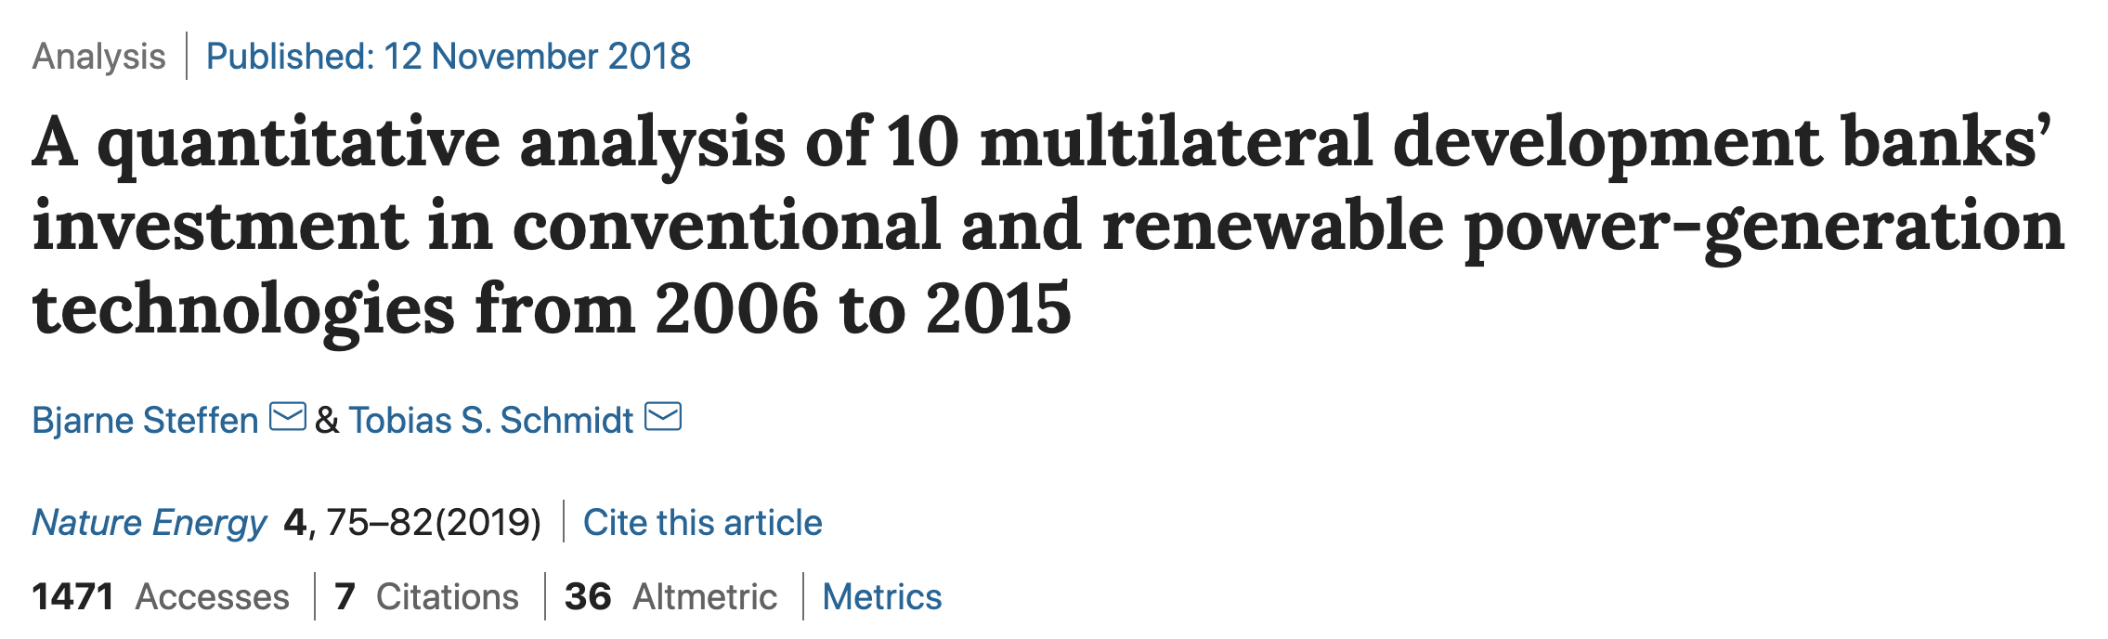
We find that MDBs financed a major portion of all power-generation growth in the developing world, with an increasing share of renewables. However, MDBs have ‘greened’ their portfolios to different extents, and the activities of their public- and private-sector branches differ substantially.

Slide 4
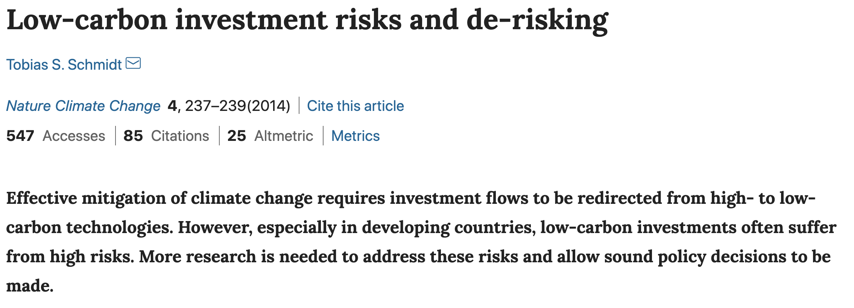

Slide 5
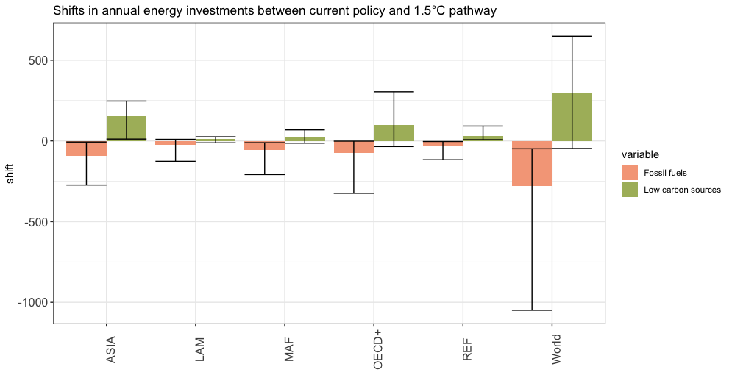
Model spread

Slide 6
