Slide 1
Post-COVID-19 recovery stimulus dwarfs near-term climate change investment needs
Manuscript revision

Slide 2
Narrative
Discuss the risks arising from the stimulus going in the wrong direction
Include a more holistic view on energy investments to account for the aspects of transition that might be difficult to quantify (policy implemetation, training and reorientation of the workforce, changes in norms…)
Justify the time horizon & link it to the lessons from the GFC
Expand on what low-carbon energy investments entail
Rethink our international cooperation narrative
Paraphrase Rev. 2 comment 2.2 ☺
Integrate recent studies (IEA, IRENA, CB)

Slide 3
Numbers
Update stimulus numbers
Change the way we disaggregate them?
Clarify how numbers are derived for where we explicitly compare the packages and the investments

Slide 4
Updates on global numbers
Different estimats of the total stimulus globally (summary by Carbon Brief):
Reuters: >15 trn
Bloomberg: 12 trn (less than 0.2% earmarked for climate)
IEA and IMF: 9 trn
Our updates: IMF database adds up to 10.7 trn (their own reportitng says 11 trn; 5.4 of which is additional spending and forgone revenue, and 5.3 liquidity support)

Slide 5
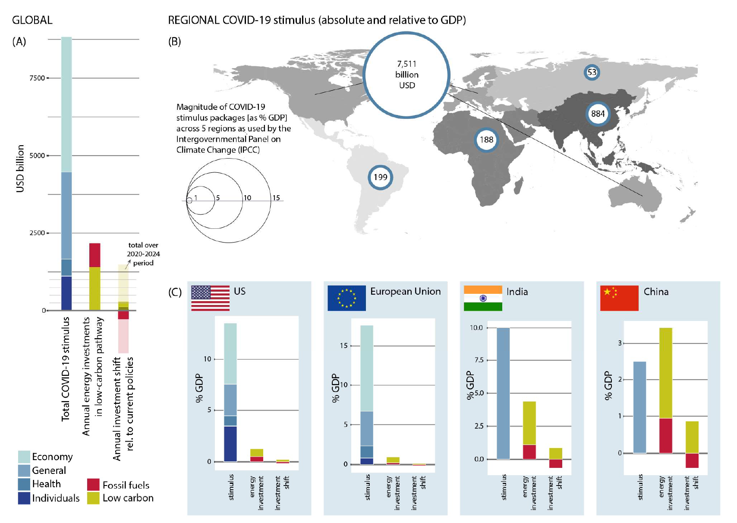
10762 bn
76 bn
8488 bn
1088 bn
188 bn
292 bn
12.5 %
22.5 %
12%
4.5 %

Slide 6
Current classification
Fiscal measures grouped broadly into:
health sector
supporting individuals and households
economy at large (including loans and guarantees)
the remainder we pool into a category of general measures (could also be that the entire package or parts of it remain unspecified)

Slide 7
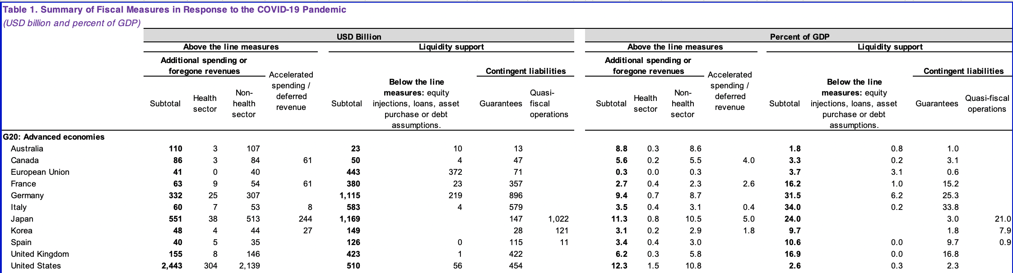
The IMF has their own Excel sheet now
G20 emerging economies
Selected advanced economies
Selected emerging economies
Selecteed low income countries
55 countries in total
Notes:
“Above the line” measures refer to increases in government expenditures and reductions in tax revenues—directly impacting economic activity via fiscal multipliers.
“Below the line” measures refer to liquidity support (loans and equity stakes) and guarantees (to firms and banks)—the economic impact of these measures depends how much they are taken up and spent by the targeted recipients

Slide 9
CB’s tracker of green recovery plans
Country | Amount (USD billion) | Purpose
China | 1.43 | Transport/electric vehicles
Denmark | 5.23 | Largest share to energy efficiency (home insulation)
European Union | 77.92 | Largest share to "green jobs" (almost 50 bn); then agriculture (17 bn); then industry (11 bn)
Germany | 48.38 | Very detailed; largest share goes to cutting the levy on renewable energy (12 bn);then to hydrogen (7 bn); then to public transport (>5 bn)
India | 0.8 | Trees
South Korea | 10.75 | Infrastructure; renewables/hydrogen; industry generally
United Kingdom | 3.8 | Majority for energy efficiency (home insulation); some funds for steel, automotive and negative emissions
TOTAL | 148.31

Slide 10
10762 bn
76 bn
8488 bn
1088 bn
188 bn
292 bn
148 bn
12.5 %
22.5 %
12%
4.5 %
Notes:
Change the regional grouping (split the OECD+ into North America, Europe and Pacific)

Slide 11
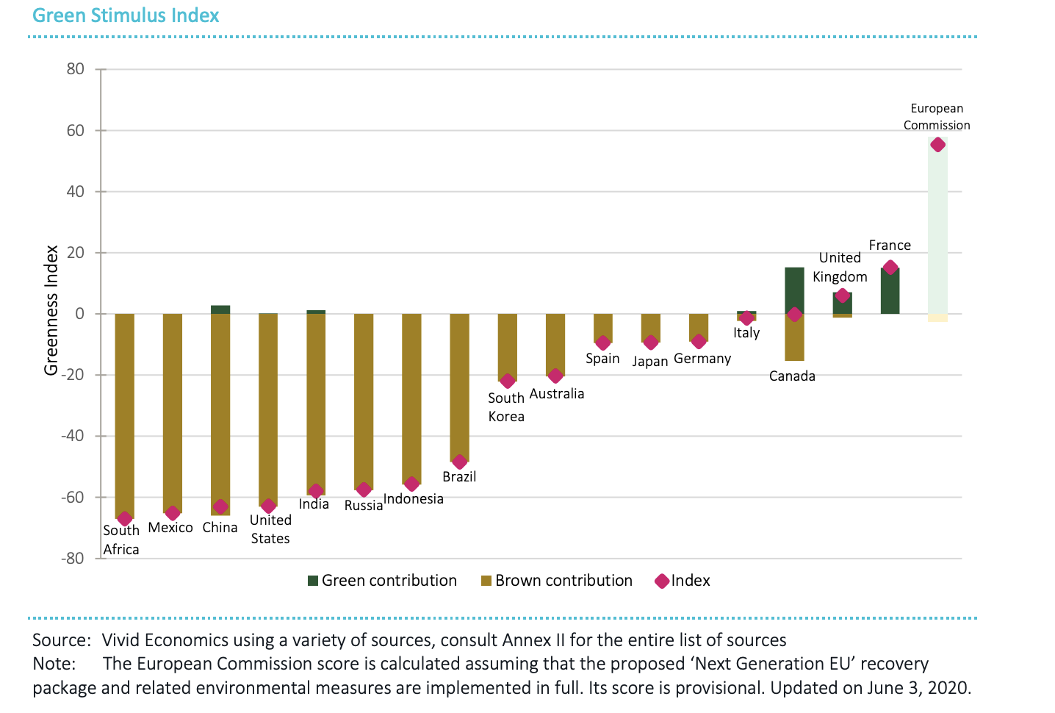

Slide 12
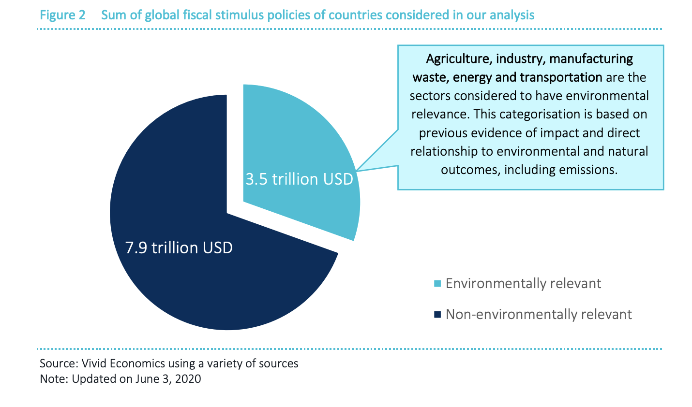

Slide 13
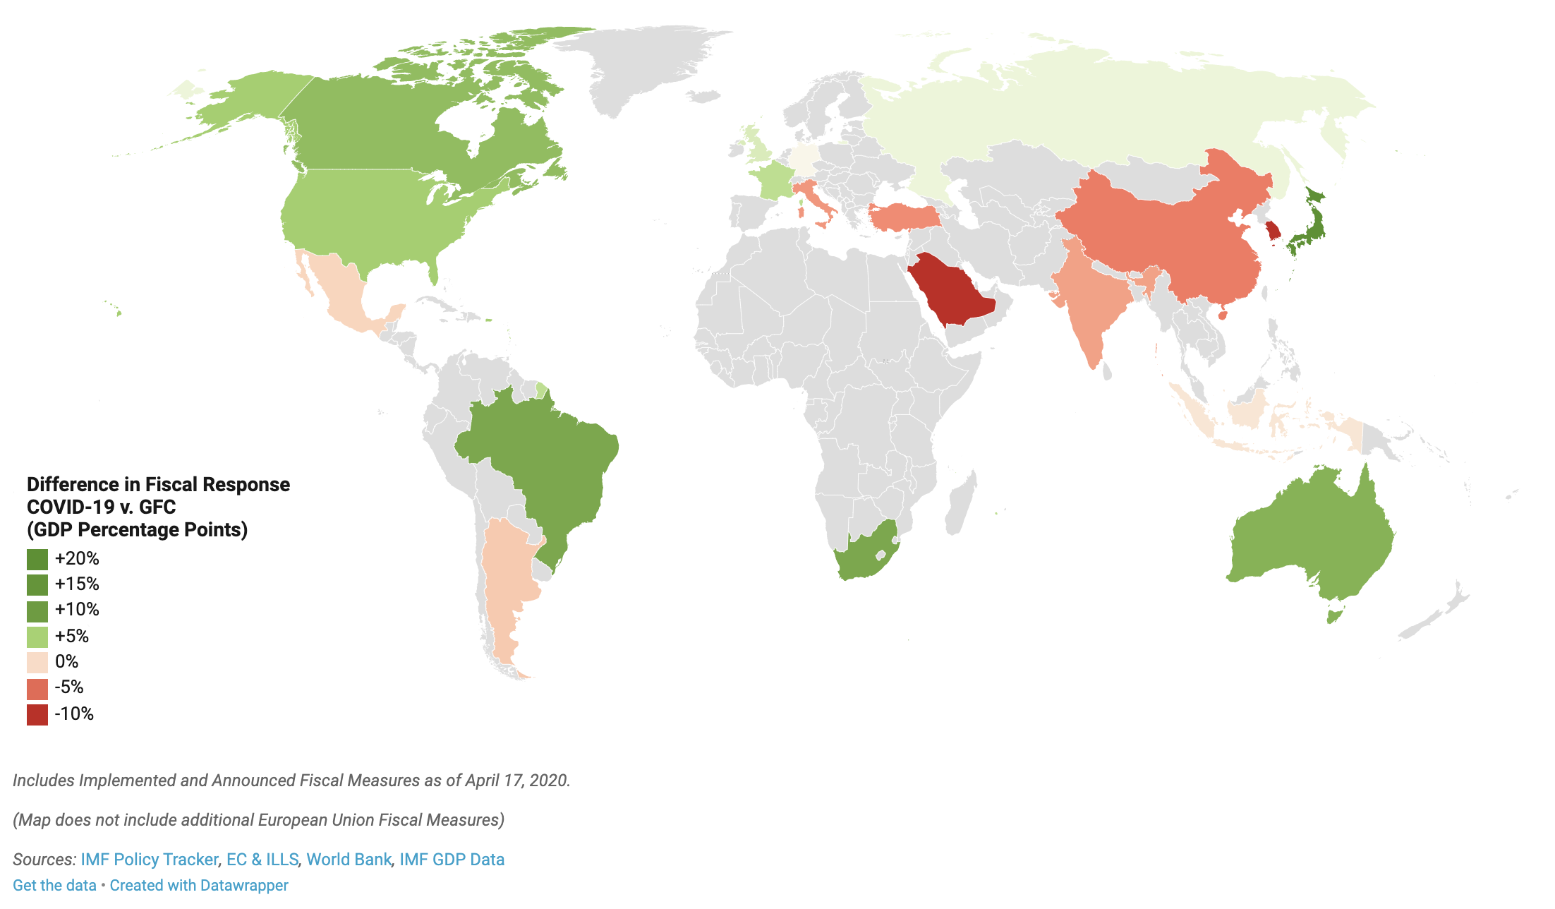
Comparison with the GFC

Slide 14
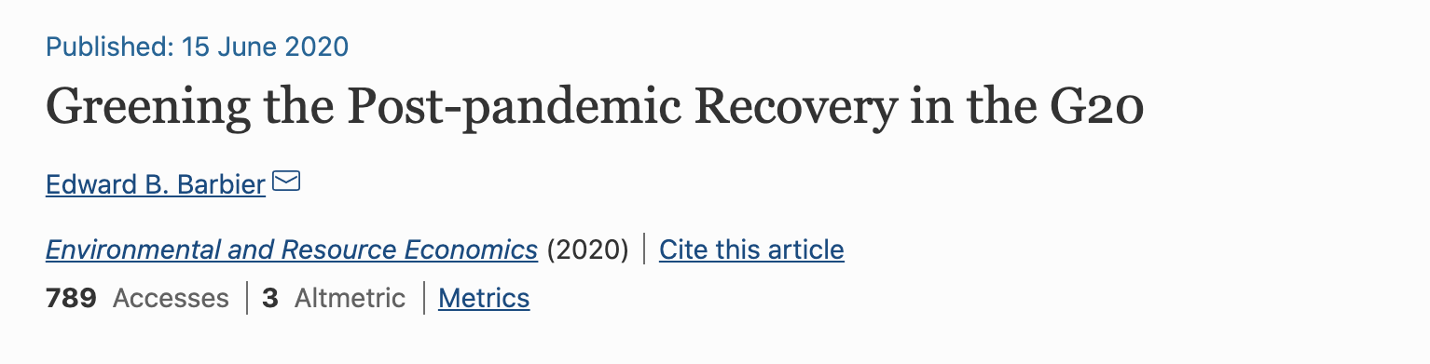
Comparison with the GFC
What worked and what did not from previous efforts to green the economic recovery during the 2008–2009 Great Recession, examining the cases of the United States and South Korea
G20 dedicated 16% of the GFC stimulus to low-carbon energy, energy efficiency, pollution abatement and materials recycling etc.
Emphasis on the longer-term thinking (5-10 years from now)
“High levels of deficit spending cannot continue indefinitely without creating unsustainable levels of national debt, which will be just as dangerous as burdening future generations with an economy that is environmentally unsustainable.”

Slide 15
To do
Categorization of the packages:
Can we tease out some more detail on energy and environmentally-relevant stimulus?
G20 or 90% of the global package to be more detailed
Assign different comments
Marina takes the lead on the analysis
Joeri takes the lead on the narrative ☺

