Slide 1
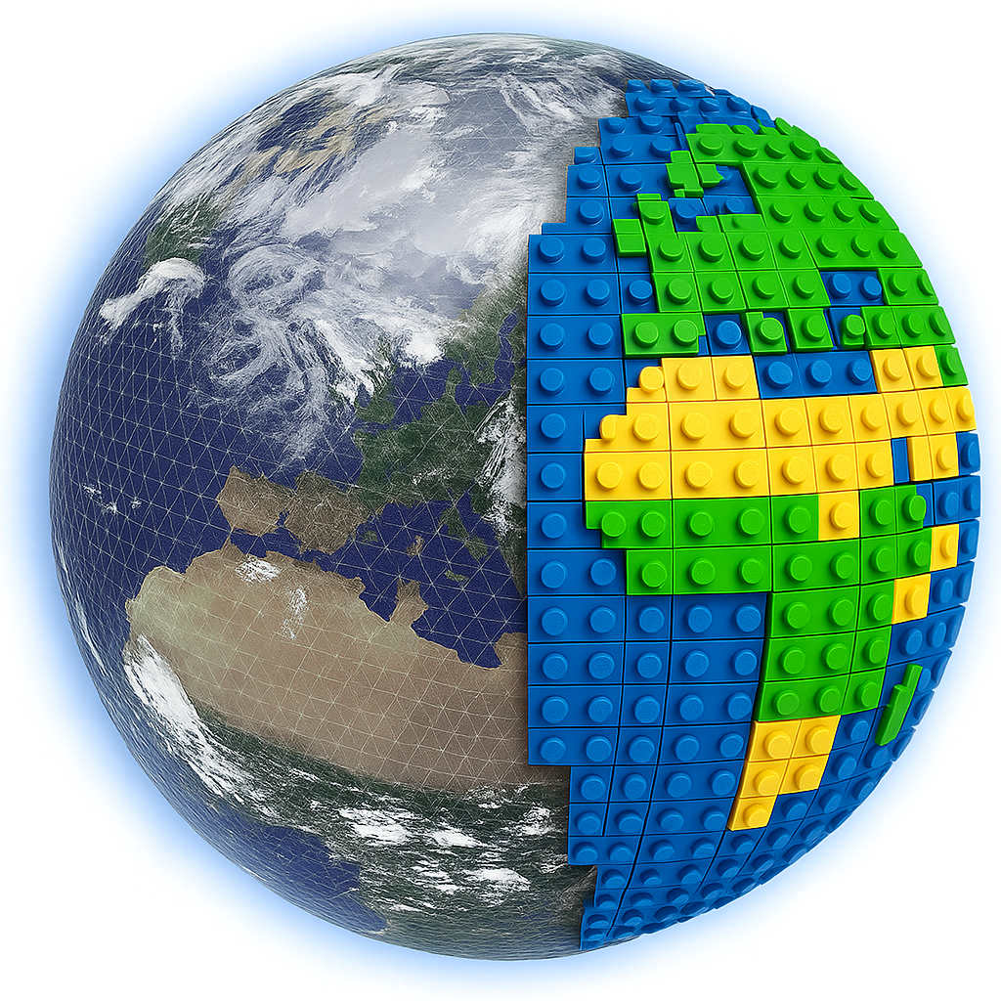
DIFFERENTIABLE EARTH SYSTEM MODELING
legoESM
A fully differentiable, modular
Earth System Model in JAX
Atmosphere · Ocean · Land · Sea ice · Coupler
End-to-end jax.grad through the coupled model
Pierre Gentine and collaborators
github.com/legoESM
Columbia University · 2026

Slide 2
INTRO
Talk outline
01
Why a differentiable ESM
Motivation, design principles, where legoESM sits in the model landscape.
02
Modularity across components
Atmosphere · ocean · land · ice · coupler · grids — interchangeable lego bricks under a common JAX interface.
03
Applications
AMIP / AIMIP differentiable tuning · NeuralGCM + SFNO hybrids · slab-S2S · SCM · RCE / RCEMIP · CRM · ocean experiments.
04
Validation strategy
Dycore progression suite, Williamson + DCMIP + Held-Suarez, conservation diagnostics, ocean fidelity vs Veros.
legoESM · a differentiable Earth System Model in JAX
2 / 33

Slide 3
MOTIVATION
Why a differentiable Earth System Model
Three converging pressures on traditional ESMs
Our hypothesis
▸ Parameter tuning is the bottleneck: cloud / convection / mixing constants are calibrated by hand against scarce observations, with no gradients.
▸ AI weather models (GraphCast, FourCastNet, ACE) are fast and skillful — but pure black boxes, no conservation, no prognostic ocean or land.
▸ Hybrid AI–physics requires differentiating through the dynamics: today this means writing a separate adjoint code (E3SM / MITgcm) or living without one.
▸ Modern accelerators (GPU / TPU) reward array-language ESMs; the Fortran / MPI stack is increasingly off the critical path.
A modern Earth System Model should be:
· written in one differentiable array language
· modular across components, grids, and complexities
· GPU / TPU / CPU / MPI portable
· conservative by construction
· open to both classical physics and ML cores under the same interface
Then parameter estimation, 4D-Var, sensitivity, and hybrid ML become first-class workflows — not retrofits.
legoESM · a differentiable Earth System Model in JAX
3 / 33

Slide 4
PRINCIPLES
Five design principles
1
Differentiable-first
2
Conservation by construction
3
Modular & swappable
End-to-end jax.grad / eqx.filter_value_and_grad through the coupled model — including MPI halo exchange and global reductions.
Mass conserved exactly; energy & momentum tracked diagnostically with explicit budget closure.
Standard tensor-in / tendency-out interfaces; dynamical cores, physics, grids, and time integrators all hot-swappable.
4
Multi-grid native
5
AI-ready
Cubed-sphere C-D · lat-lon C · Gaussian / spectral · MPAS Voronoi — shared FV / spectral operators where numerics permit.
SFNO neural cores and ML parameterizations coexist with classical physics under the same interface. ERA5 ingestion built in.
legoESM · a differentiable Earth System Model in JAX
4 / 33

Slide 5
LANDSCAPE
Where legoESM sits in the modeling landscape
Model
Language
Dynamics
Differentiability
Prognostic components
ML cores
E3SM / CESM / ICON
Fortran + MPI
Multiple, hand-coded
Separate adjoint
Yes
Bolt-on
MOM6 / NEMO
Fortran
Ocean only
Limited
—
—
NeuralGCM
JAX
Spectral PE + NN physics
Yes (built-in)
No prognostic ocean / ice
Native
GraphCast / ACE
PyTorch / JAX
Learned (no dycore)
Training only
No prognostic ocean / ice
Native
legoESM
JAX (single lang.)
4 grids × {SW, hydro, NH, SFNO}
End-to-end jax.grad
Atm + ocean + land + ice + lake
First-class
legoESM is the only stack in this row that combines a full classical-physics + dynamical-core ladder with a prognostic ocean / ice / land and end-to-end differentiability.
legoESM · a differentiable Earth System Model in JAX
5 / 33

Slide 6
ARCHITECTURE
High-level architecture
Atmosphere
Ocean
Land
atmosphere/
ocean/
land/
SW · hydro · NH · SFNO · radiation · convection · turbulence · clouds · microphysics · GWD
PE on lat-lon C · cubed-sphere · MPAS · spectral · KPP · GM-Redi · BGC · barotropic split
slab · multilayer Richards (8L) · soil thermal · stomata · DALEC-990 carbon
ParallelRuntime · compiled_segments (lax.scan) · pytree state · MPI custom_vjp halo + allreduce(SUM)
Sea ice
Coupler
DA · ML · training
ice/
coupler/
da/ · ml/ · training/
thermo · EVP / mEVP rheology · ITD (Lipscomb) · snow · brine · ridging · ponds
tile-based (ocean / ice / land / lake) · COARE 3.0 · L–Y bulk fluxes · surface energy + accumulator
incremental 4D-Var · SFNO · NeuralGCM · S2S slab · ERA5 → state · trainable physics
Every block ships its own configs and validation; cores, schemes and grids are independently swappable.
legoESM · a differentiable Earth System Model in JAX
6 / 33

Slide 7
FOUNDATIONS
JAX foundations: state · scan · autodiff
Model as a pure function over pytrees
training step (sketch)
▸ State as NamedTuple pytrees: SegmentCarry, OceanState, LatLonCGridOceanState, Field…
▸ Time integration is jax.lax.scan over a single-step function — no Python loops on traced values.
▸ Hot loop compiled in segments of length GCD(diagnostic interval, checkpoint interval).
▸ External forcings (SST, solar, ozone) passed as explicit traced args (SegmentForcing) so the kernel is reused, not retraced.
▸ Each segment has a JIT (donate_argnums) variant for production and a .raw non-donating variant for eqx.filter_value_and_grad.
def loss_fn(theta, state0, forcing):
final = run_segment.raw(
theta, state0, forcing,
n_steps=N, dt=dt)
return area_weighted_mse(
final.state, target)
grads = eqx.filter_value_and_grad(
loss_fn)(theta, state0, forcing)
# end-to-end jax.grad — through
# dycore + physics + halo + reductions
legoESM · a differentiable Earth System Model in JAX
7 / 33

Slide 8
DIFFERENTIABILITY
End-to-end differentiability through MPI
state₀
→
halo exchange
(MPI)
→
dynamics
(lax.scan)
→
physics
(scan)
→
global sum
(allreduce)
→
loss
←
←
←
←
←
→ primal trace ← cotangent (jax.grad)
What's non-trivial in this picture
▸ MPI halo exchange has no native VJP. We wrap mpi4jax.sendrecv in a custom_vjp whose backward swaps source / dest endpoints — cotangents flow back to the sender (parallel/halo_exchange.py).
▸ Only allreduce(SUM) is AD-safe among reductions. global_max / global_min stay diagnostic-only; the differentiable path uses sums and softmax surrogates.
▸ Mass / moisture / energy fixers are written as projections — gradients flow through the global reductions used to compute the correction.
▸ JIT donate_argnums conflicts with reverse-mode AD; the training path uses non-donating .raw variants of compiled segments.
legoESM · a differentiable Earth System Model in JAX
8 / 33

Slide 9
CONSERVATION
Conservation as a hard constraint
Built into the time integrator
Diagnostics shipped in diagnostics/
▸ Mass exactly conserved by construction (target-anchored fixer in SegmentCarry).
▸ Moisture conserved via fix_moisture + zero_mean_tendency, with gradient-safe global means.
▸ Energy budget diagnostics (column DSE / MSE / TOA-SFC residual) — never just hidden clipping.
▸ Tracer monotonicity preserved by PPM transport with positive-definite limiter.
▸ ML cores get the same treatment: conservation correctors (dry mass, moisture, ocean volume / heat / salt) act as differentiable projections.
energy_budget.py
EnergyBudget, column DSE / MSE, TOA & SFC net radiation
total_energy_pe.py
Hydrostatic total energy, te_correction, te_drift
angular_momentum.py
Atmospheric angular momentum + corrections
column_integrals.py
column_water_vapor, mass-weighted means
conservation_drift.py
Relative-drift series + tolerance gating
precision_drift.py
Tracer negativity + state diff tools
legoESM · a differentiable Earth System Model in JAX
9 / 33

Slide 10
01
Modularity across Earth components
Every Earth-system block has its own swappable cores and physics schemes — same interfaces, different numerics, from the simplest aquaplanet to coupled CMIP-style runs.
legoESM · Pierre Gentine et al.

Slide 11
MODULARITY · ATM
Atmosphere — dynamical cores
Lat-lon C-grid
Cubed-sphere C-D
Gaussian / spectral
MPAS Voronoi
Shallow water
shallow_water_latlon_cgrid
shallow_water_fv3_cdgrid
spectral_sw
shallow_water_mpas
Hydrostatic PE
primitive_eq_latlon_cgrid
primitive_eq_cdgrid
spectral_pe
primitive_eq_mpas
Non-hydrostatic CE
—
compressible_euler_cdgrid
spectral_nh
compressible_euler_mpas
Neural (SFNO)
sfno_pe (channel-packed)
sfno_pe / sfno_sw
sfno (spherical)
—
4 grid families × 4 complexities. Tracer transport (RK3, 3rd-order PPM) and the physics interface are grid-agnostic; SFNO cores use the same SegmentCarry as the classical ones.
legoESM · a differentiable Earth System Model in JAX
11 / 33

Slide 12
MODULARITY · ATM
Atmosphere — physics zoo
Radiation
Convection
Microphysics
radiation/
convection/
microphysics/
gray (Frierson) · RRTMGP (LW g128 / g256, SW g112 / g224) · ozone_ml · solar (cos-zenith)
Bechtold · Tiedtke · Emanuel · Kain–Fritsch · Zhang–McFarlane · SBM (Frierson BM) · DCA · Kuo · shared mass_flux + plume + smooth triggers
Kessler · Sundqvist · Seifert–Beheng · Morrison · Thompson · ml_emulator (Equinox MLP)
Cloud fraction
Turbulence / PBL
Gravity-wave drag
clouds/
turbulence/
gravity_wave_drag/
Sundqvist · Xu–Randall
YSU · EDMF · TKE (MY2.5) · Louis · CLUBB-lite · Holtslag–Boville · Smagorinsky · MOST surface layer
Rayleigh · Lindzen · McFarlane · Hines · prognostic_spectral · ml_emulator
Every scheme exposes a NamedTuple config → integration.py factory → tendency function — interchangeable across all atmosphere dycores.
legoESM · a differentiable Earth System Model in JAX
12 / 33

Slide 13
MODULARITY · OCEAN
Ocean — dynamical cores
Same prognostic ocean PE across four grids
Vertical & solvers
▸ Lat-lon C-grid (FV, Sadourny EC vector-invariant; MOM6-style slow-forcing split): ocean_pe_latlon_cgrid.py
▸ Cubed-sphere C-D (Boussinesq, Lin 2004 + Griffies 2004): ocean_pe_cdgrid.py
▸ MPAS Voronoi (TRiSK, Ringler 2010): ocean_pe_mpas.py
▸ Spectral + FC-Gram: spectral_ocean_pe.py, ocean_pe_fc.py
▸ Learned ocean (SFNO): sfno_ocean.py — packed PE state ↔ tensors via channel_packing
▸ Shared baroclinic helpers (ocean_tendency_common): EOS-pressure iteration, tracer sponge, freshwater virtual-salt, implicit bottom drag
▸ Shared barotropic helpers (barotropic_common): cosine / box filter, BEBT eta blend, MAXVEL clip
▸ z-star vertical coordinate (ocean/vertical.py)
▸ Wright (1997) EOS + Boussinesq
▸ Pressure gradient: AHH08, SMC03 variants
▸ Implicit + explicit barotropic solvers across all grids
▸ Tridiagonal vertical implicit mixing
▸ Tripolar eORCA1 grid with pole-fold halo
legoESM · a differentiable Earth System Model in JAX
13 / 33

Slide 14
MODULARITY · OCEAN
Ocean — physics & biogeochemistry
Vertical mixing
Lateral mixing
vertical_mixing/
lateral_mixing/
KPP (LMD94, non-local) · Richardson · constant · Jayne–St-Laurent tidal · implicit tridiagonal
Harmonic · biharmonic · GM-Redi (cube / lat-lon / MPAS) with DM95 slope tapering · Visbeck adaptive κ · eddy backscatter
Bottom drag
Surface forcing
bottom_drag/
surface_forcing/
Linear & quadratic + implicit factor in ocean_tendency_common
COARE 3.0 · Large–Yeager 09 · fixed-z0 · restoring · prescribed · wind_profiles
Convection
Shortwave penetration
convection/
shortwave_penetration.py
Plume + enhanced diffusion (gradient-safe sigmoid active mask)
Jerlov optical-water types
Ice-shelf basal melt
Biogeochemistry
ice_shelf_basal_melt.py
biogeochemistry/
Jenkins 1991 / Holland-Jenkins 1999 three-equation (ISOMIP+)
Abiotic DIC + ALK carbonate · NPZD · air–sea CO₂ Schmidt-number gas exchange
Ocean test matrix: 57 / 57 PASS across lat-lon, tripolar eORCA1, cubed-sphere C-D, MPAS Voronoi.
legoESM · a differentiable Earth System Model in JAX
14 / 33

Slide 15
MODULARITY · LAND
Land — slab to multilayer Richards + carbon
Two complexity tiers under one interface
8-layer soil column
▸ Slab land (land/slab_land.py): energy balance + bucket hydrology + snow + stomata (Farquhar / Ball-Berry / Medlyn / Jarvis).
▸ Multilayer land (land/multilayer_land.py): 8-layer soil, Richards equation (mixed-form Picard, Van Genuchten / Clapp-Hornberger / Brooks-Corey / Campbell / PDI / Lu).
▸ Soil thermal: Johansen diffusion · tridiagonal vertical solver.
▸ Snow: accumulation / melt with age-dependent albedo and latitude-varying veg albedo.
▸ Carbon cycle (DALEC-990): 6 pools (labile / foliage / root / wood / litter / SOM), LUE GPP + phenology.
▸ PFT-weighted parameter providers: Constant · PFT · Neural — all differentiable.
L1
0.00 – 0.02 m
L2
0.02 – 0.05 m
L3
0.05 – 0.10 m
L4
0.10 – 0.20 m
L5
0.20 – 0.40 m
L6
0.40 – 0.80 m
L7
0.80 – 1.60 m
L8
1.60 – 3.20 m
legoESM · a differentiable Earth System Model in JAX
15 / 33

Slide 16
MODULARITY · ICE
Sea ice — thermo + EVP/mEVP rheology + ITD
▸ Step function ice/sea_ice.py — modes: slab · free-drift · EVP (Hunke & Dukowicz 1997) · mEVP (Bouillon 2013 / Kimmritz 2015).
▸ Rheology: ice strength, strain rates, delta-deformation, VP stress, EVP / mEVP updates (ice/rheology.py, ice/dynamics.py).
▸ Ice-thickness distribution (ITD): Lipscomb 2001 linear remapping for multi-category ice (ice/itd.py).
▸ Transport: advection + boundary masking. Snow on ice + flooding (ice/snow.py).
▸ Brine pockets + salt flux to ocean (ice/brine.py). Ridging (ice/ridging.py). Melt ponds (ice/ponds.py).
▸ Delta-Eddington shortwave + Maykut–Untersteiner albedo (ice/shortwave.py).
▸ Standalone test matrix: 15 benchmarks across thermo, dynamics, transport, ITD, integration.
Why EVP matters for AD
Sea-ice rheology in CICE-style models is solved implicitly — elliptic problems are awkward to differentiate.
EVP / mEVP recast the implicit problem as a sub-cycled explicit pseudo-time integration. Every sub-step is a pure JAX operation, so the whole rheology solver is naturally inside jax.lax.scan and inside jax.grad.
Trade-off: more sub-steps for the same stiffness — but each is fully GPU-friendly and AD-friendly.
legoESM · a differentiable Earth System Model in JAX
16 / 33

Slide 17
MODULARITY · COUPLER
Coupler and grids
Coupler — tile-based surface exchange
Grids — geometry + halo + regrid
▸ TileFractions (ocean / ice / land / lake) blended area-weighted in coupler/coupler.py
▸ AtmToSurface / SurfaceToAtm / TileResponse typed pytrees
▸ Bulk fluxes (coupler/bulk_flux.py): COARE 3.0 · Large–Yeager · fixed-z0 with AD-safe Monin–Obukhov iteration via lax.fori_loop
▸ Surface energy: zenith-dependent ocean albedo (Briegleb 1992), snow age decay, sea-ice T feedback
▸ FluxAccumulator with conservation-aware accumulation
▸ Two-layer lake model (coupler/lake/) with surface coupling
▸ Cubed-sphere C-D (Putman & Lin 2007): corner-aware halo, FV3 D-grid corner fill, edge blending
▸ Lat-lon C-grid (regular · Mercator · regional), Tripolar eORCA1 with pole-fold halo descriptor
▸ Gaussian + spherical-harmonic transforms (T21 / T42 / …) — pinned to CPU on Apple Silicon
▸ MPAS Voronoi SCVT: recursive bisection + Lloyd; LSQ edge-to-cell + Thuburn kite-area TRiSK
▸ Vertical: hybrid sigma-pressure L20–L60, sinh stretching
▸ Native 4D halo: one MPI message per exchange across all levels
Shared operators (core/)
core/operators_cdgrid.py (FV3 PPM + divergence damping) is reused by both atmosphere and ocean cubed-sphere cores. core/operators_fv_latlon.py / operators_fv_latlon_3d.py serve all lat-lon FV cores. core/operators_voronoi.py serves MPAS atmosphere + ocean. core/fv_tp_2d.py is the canonical PPM transport step. Spectral and FC-Gram operators live in core/spectral.py and core/fc_gram.py.
legoESM · a differentiable Earth System Model in JAX
17 / 33

Slide 18
RUNTIME
Parallel runtime — MPI + SPMD + ensemble
ParallelRuntime.create() — one entry point
AD-safe halo + reductions
serial
1 rank · 1 device — identity ops
▸ custom_vjp wrapper around mpi4jax.sendrecv: backward swaps source / dest endpoints
▸ Differentiable reductions: only allreduce(SUM); max / min / allgather / bcast diagnostic-only
▸ Native 4D halo: one MPI message per exchange — not vmap(pad_halo)
▸ Async halo + compute overlap (parallel/async_halo.py)
▸ Voronoi RCB + METIS partitioning · VoronoiHaloExchange
▸ Ensemble parallelism: vmap over ensemble dim × scan over time + checkpoint
▸ Persistent JAX compile cache via LEGOESM_JAX_CACHE_DIR
multi_device
1 rank · N devices — JAX SPMD halos + local reductions
mpi
N ranks · 1 device each — MPI halos + MPI reductions
hybrid
N ranks × M devices — MPI between ranks + SPMD within rank
legoESM · a differentiable Earth System Model in JAX
18 / 33

Slide 19
02
Applications
Differentiable physics tuning · AIMIP · NeuralGCM-style hybrids · SFNO S2S · SCM · RCE / RCEMIP · CRM · ocean experiments.
legoESM · Pierre Gentine et al.

Slide 20
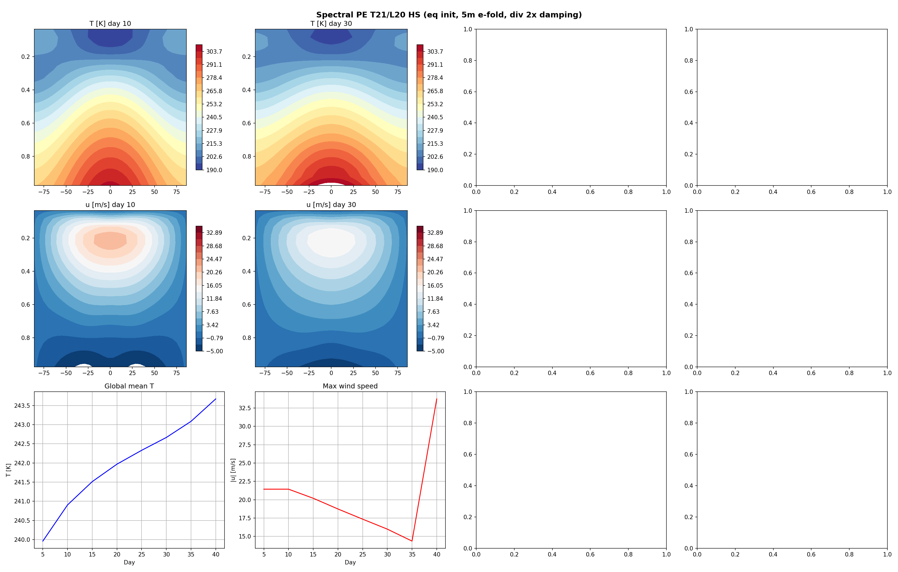
APPLICATIONS · AMIP
AMIP — RRTMGP + Sundqvist + SBM across grids
What's in the production AMIP CMIP6 deck
▸ Cubed-sphere C48 + lat-lon C144 production grids; Gaussian T42 + MPAS ico6 smoke-tested
▸ Radiation: RRTMGP (LW g128, SW g112) with bundled jax-rrtmgp lookup tables
▸ Clouds: Sundqvist large-scale + cloud fraction
▸ Convection: SBM (Frierson Betts-Miller), AIMIP-tunable
▸ Turbulence: Louis surface layer + bulk Ri PBL
▸ Forcing: amip_forcing — SST, sea-ice, GHG, ozone, aerosol, solar
▸ CMOR-compliant output (CF-1.8): Amon · Lmon · Omon · Oyr · Ofx · SImon · SIyr
AMIP-style diagnostic stack — Held-Suarez + gray radiation rollout.
legoESM · a differentiable Earth System Model in JAX
20 / 33

Slide 21
APPLICATIONS · VALIDATION
Held-Suarez aquaplanet across cores
Held-Suarez 1994 forcing — spectral T21 final state showing the developed eddy-driven jet.
▸ Same forcing, three dynamical cores: FV A-grid · FV C-D grid · spectral — all reach the canonical zonal-mean climatology.
▸ Energy budget closure verified; jet latitude, eddy momentum flux, and EKE within published Held-Suarez bands.
▸ Held-Suarez is the workhorse smoke test for any new dycore change before AMIP runs.
legoESM · a differentiable Earth System Model in JAX
21 / 33

Slide 22
APPLICATIONS · SCM
Single-column model — fast offline iteration
atmosphere/scm.py · SingleColumnModel
API · 50-day tropical RCE smoke test
▸ Dycore-free driver on a single (lat, lon) column — no horizontal advection / PGF / Coriolis.
▸ Reuses the same HydrostaticState pytree as the 3-D model, shape (face=1, x=1, y=1, level=nlev) — not a separate SCM-only state.
▸ Calls the canonical hydrostatic physics factory make_physics — every scheme that runs in 3-D runs here unchanged.
▸ Sigma vertical grid via create_sigma_coordinate; tracers (q_c, q_r, q_i, q_s) auto-materialised by physics.
▸ Three time integrators: Forward Euler · Heun RK2 · classical RK4 (TIME_INTEGRATORS registry, register_time_integrator()).
▸ Compatibility validator rejects multi-stage RK with stateful schemes (TKE / EDMF, mass-flux / Tiedtke / Bechtold, prognostic-spectral GWD, diurnal radiation) — never silently lies about order.
▸ Because state + physics factory are shared, the SCM is jax.grad-compatible end-to-end — fastest path for offline gradient-based parameter tuning with TrainablePhysicsParams.
scm = SingleColumnModel.create(
physics_config=...,
nlev=30, dt=300.0,
T_profile=..., q_v_profile=...,
latitude_deg=0.0,
time_integrator="rk4")
state, hist = scm.run(
nsteps=14400, save_every=12)
Use cases
▸ Parameterization integration tests
▸ Timestep & scheme stability sweeps
▸ Idealized process cases (RCE, GABLS, BOMEX)
▸ Fast iteration before 3-D AMIP runs
▸ ML-physics training-data generation
legoESM · a differentiable Earth System Model in JAX
22 / 33

Slide 23
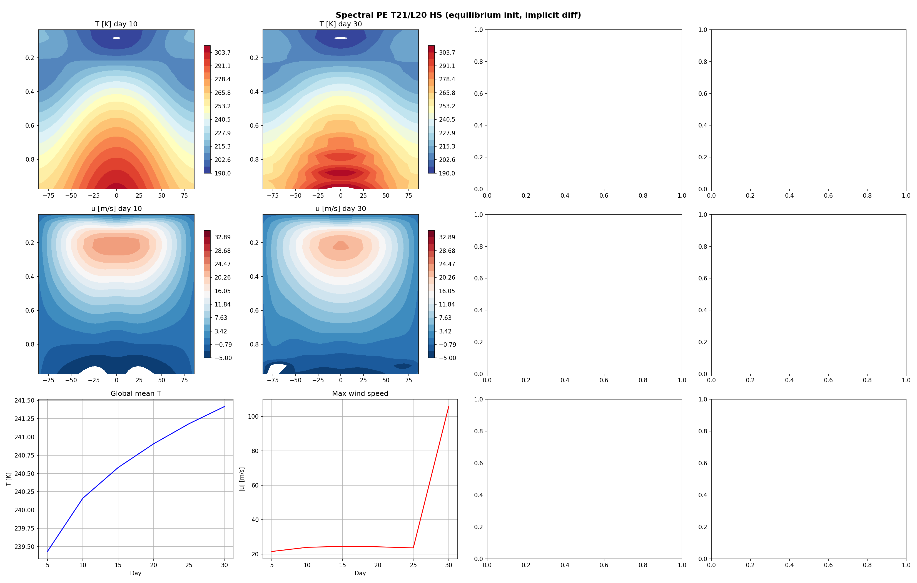
APPLICATIONS · RCE
RCE — radiative-convective equilibrium
▸ Three RCE flavors share one driver: prescribed-SST · slab-ocean · slab-land
▸ Spectral T21 + Gaussian grid · slab cubed-sphere C36 · multi-month rollouts
▸ Used to validate radiation–convection–boundary-layer closure under a clean global-mean budget
▸ Trainable physics modes plug straight into RCE: ideal sandbox for gradient-based parameter calibration
▸ Single-column model (atmosphere/scm.py): same physics factory as 3D runs — for fast offline diagnostics and ML-physics training data
RCE-style equilibrium snapshot (slab-ocean / equilibrium-init reference).
legoESM · a differentiable Earth System Model in JAX
23 / 33

Slide 24
APPLICATIONS · RCEMIP
RCEMIP — long-stability harness + convection sweep
Hydrostatic RCE
RCEMIP-I plane CRM
Stretched CRM smoke
run_rce.py
run_rcemip_plane.py
run_rce_smoke_stretched.py
Aquaplanet / land-planet · slab ocean (50 m / 50+200 m two-layer) or slab land · 4 grids: cubed-sphere, Gaussian, lat-lon, MPAS
PlaneCompressibleEulerModel · Wing 2018 IC · radiation {gray | rrtmgp | none} · microphysics zoo · Smagorinsky LES + sponge + hyperdiff
Stretched HeightCoordinate (~50 m surface) · Wing IC · tracer positivity · moist-mass fixer · CFL & CWV / MSE diagnostics
RCEMIP100 — 100 sim-day long-stability harness
Convection scheme sweep
run_rcemip_long.py · aggregate_rcemip100.py
run_rce_convection_sweep.py
▸ 4 non-hydrostatic dycores: plane_fd · plane_spectral · cubed_sphere · mpas
▸ Pure-dycore mass-conservation + finiteness baseline (physics deferred)
▸ Pass criteria: max|w| < 50 m/s · mass drift < 1e-6 · q_v ∈ [0, 0.030]
▸ Cross-grid aggregator emits a status · t_d · max|w| · max|θ′| · drift · wall-time table
▸ Current end-state JSONs in results/rcemip100/
▸ Fixed-SST lat-lon FV with gray radiation + bulk BL + minimal microphysics scaffold
▸ 8 schemes side-by-side: sbm · tiedtke · zhang_mcfarlane · emanuel · bechtold · kuo · kain_fritsch · mass_flux
▸ Tightened M_b_max=1e-5 (stripped-down setup lacks production shock-absorbers)
▸ Status precedence: ERROR → BLOWUP → RUNAWAY → OK
▸ Per-scheme snapshots: snapshot_{scheme}.npz + snapshot3d_{scheme}.npz
legoESM · a differentiable Earth System Model in JAX
24 / 33

Slide 25
APPLICATIONS · CRM
Cloud-resolving RCE — non-hydrostatic CRM
Plane non-hydrostatic dycore with the full physics stack
Vertical structure
▸ PlaneCompressibleEulerModel: non-hydrostatic compressible Euler on a plane (run_rcemip_plane.py).
▸ RCEMIP-I analytical IC (Wing 2018 Table A1–A2): two-segment θ(z), q_v(z) = q_sfc·exp(−z / 4 km).
▸ Stretched HeightCoordinate option (run_rce_smoke_stretched.py): ~50 m surface layer, deep CRM aloft.
▸ LES closure: Smagorinsky subgrid stresses + scalar fluxes.
▸ Stability protection: sponge layer aloft + hyperdiffusion + CFL diagnostic.
▸ Surface fluxes via bulk formulas (COARE / fixed-z₀); composer make_rcemip_physics sums radiation + microphysics tendencies (model_type="plane").
▸ AD-compatible end to end: tracer positivity filter, moist-mass fixer, mean-wind removal all written as differentiable projections.
Sponge layer
Rayleigh damping toward IC
Free troposphere
non-hydrostatic dynamics + microphysics + radiation
Boundary layer
LES (Smagorinsky) + bulk surface fluxes
Stretched surface
~50 m layer (HeightCoordinate)
Configurable physics
Radiation
gray · rrtmgp · none
Microphysics
kessler · sundqvist · seifert · morrison · thompson · ml_emulator
legoESM · a differentiable Earth System Model in JAX
25 / 33

Slide 26
APPLICATIONS · AI-PHYSICS
AIMIP & differentiable physics tuning
Mode 1 · trainable classical physics
training loop · gradient flows
▸ TrainablePhysicsParams (Equinox module): 8 physics params wrapped in sigmoid range constraints
▸ Held–Suarez: τ_equator ∈ [5,10] d · τ_pole ∈ [1,3] d
▸ SBM convection: τ_c ∈ [1, 4] h · RH_ref ∈ [0.6, 0.9]
▸ Bulk fluxes: C_H, C_E ∈ [10⁻³, 5·10⁻³]
▸ Albedos: α_ice ∈ [0.4, 0.8] · α_ocean ∈ [0.03, 0.10]
▸ Scheme-specific subsets via trainable_constraints_for_scheme()
▸ AIMIPClassicalParams adds Tiedtke + Louis + McFarlane + Xu–Randall + gray-radiation tunables
params = TrainablePhysicsParams.init(...)
def loss(p, state0, target):
final = build_segment_fn(p).raw(
state0, forcing, n_steps=N)
return area_weighted_mse(
final.q_v, target.q_v)
loss_val, grads = (
eqx.filter_value_and_grad(loss)
(params, state0, target))
params = optax_update(params, grads)
legoESM · a differentiable Earth System Model in JAX
26 / 33

Slide 27
APPLICATIONS · AI-PHYSICS
NeuralGCM + SFNO hybrids
Mode 2 · NeuralGCM-style spectral PE
Mode 3 · SFNO coupled to dycore
▸ Spectral PE dycore + neural physics under one segment kernel
▸ training/neural_gcm_spectral.py · train_neural_gcm()
▸ Equinox NN replaces (or augments) classical physics; conservation correctors keep mass / moisture exact
▸ Same loss / optimizer infrastructure as Mode 1 — only the parameter tree changes
▸ Gradient checkpointing through lax.scan for long rollouts
▸ SFNO (Bonev 2023 + Watt-Meyer / Clark / Henn ACE 2023) in ml/sfno.py
▸ Encoder → N SFNOBlocks (spectral conv + MLP) → decoder + big-skip residual
▸ Defaults: embed_dim=256 · n_blocks=8 · mlp_expansion=4 · per-block gradient_checkpoint
▸ Channel packing (ml/channel_packing.py): state ↔ tensor for SW / PE-3D / Ocean · WB2 pressure levels
▸ Conservation correctors post-network: dry mass / moisture / ocean volume / heat / salt
▸ Drop-in replacement for any dycore in compiled_segments — same SegmentCarry
legoESM · a differentiable Earth System Model in JAX
27 / 33

Slide 28
APPLICATIONS · S2S
SFNO + slab ocean — S2S coupled rollouts
▸ ml/s2s/sfno_slab/: SFNO atmosphere + slab ocean — S2S campaign infrastructure (training, rollout, coupling, evaluation, ChaosBench-compatible).
▸ ml/s2s/neuralgcm_slab/: NeuralGCM atmosphere + slab ocean — neuralgcm_backend, slab_coupling, campaign, ensemble.
▸ Same SurfaceState / TileFractions interface as the full coupled model — the slab is just a simpler ocean component plugged into the existing coupler.
▸ Trained on ERA5 (era5_to_state.py · era5_loader.py) with area-weighted MSE + spectral loss; optimizer in ml/training.create_optimizer().
▸ Joint ML-physics workflow (ml/physics/): PhysicsTeacherDataset + capture_physics_teacher_snapshot from AMIP runs trains a parameterization replacement that respects conservation.
S2S coupled step
ERA5 state
(packed channels)
↓
SFNO atm step
(spectral conv)
↓
conservation correctors
(mass / moisture)
↓
slab ocean step
(SST tendency)
↓
tile blend
(coupler)
↓
next state
legoESM · a differentiable Earth System Model in JAX
28 / 33

Slide 29
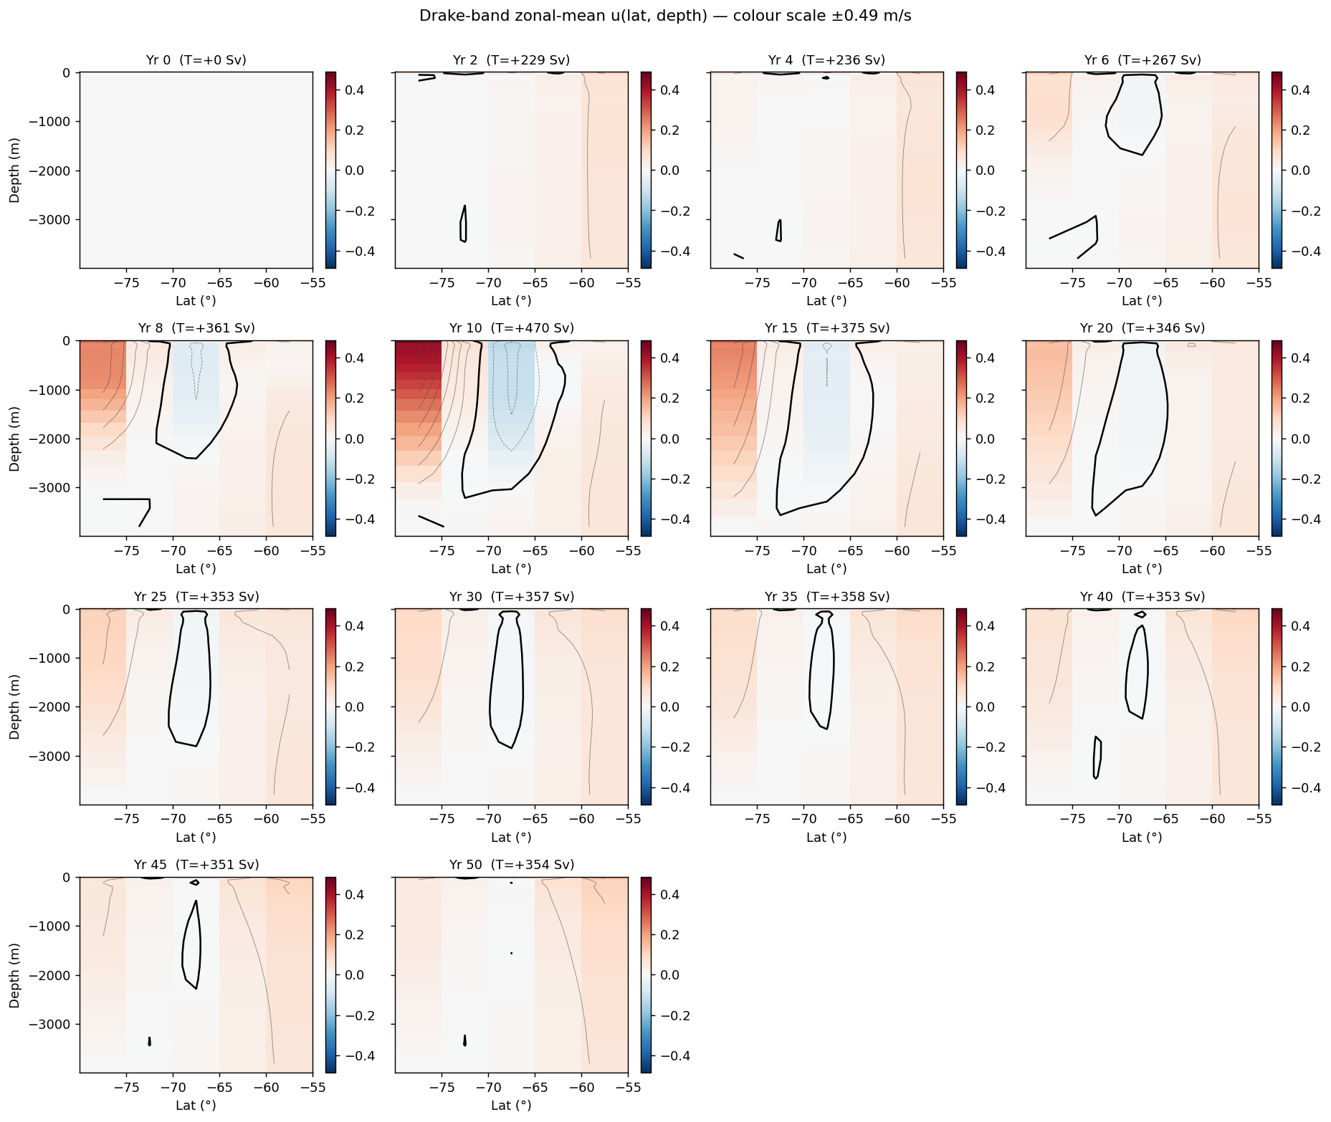
APPLICATIONS · OCEAN
Ocean experiments — Drake / DINO / OMIP-2
Ocean experiment suite
▸ Global overturning across all 4 grids (200-yr / 50-yr-implicit / GM-Redi / MPAS-baseline)
▸ DINO double-gyre (Hochet 2025)
▸ ACC channel · Phillips two-layer · Eady · Held–Larichev
▸ NeverWorld2-lite · ISOMIP+ (ice-shelf cavity)
▸ OMIP-2 JRA55-do multi-decadal across lat-lon / tripolar eORCA1 / cubed-sphere / MPAS
▸ Bryan THC distorted-physics centennial spin-up
▸ Veros fidelity harness — adapters for DINO, ACC, lock exchange, overflow, Eady uniform
Drake passage zonal-u evolution over 50 yr (implicit barotropic, cubed-sphere ocean).
legoESM · a differentiable Earth System Model in JAX
29 / 33

Slide 30
03
Validation strategy
Dycore progression suite · Williamson · DCMIP · Held-Suarez · ocean test matrix (57/57) · Veros fidelity harness · visual + budget verification.
legoESM · Pierre Gentine et al.

Slide 31
VALIDATION
Validation harness — what we run, when
Suite
Entry point
Coverage
Atmosphere test matrix
scripts/run_atmosphere_test_matrix.py
sw · hydro · nh · climate · tracer · dcmip2008 · dcmip2012 · dcmip2016 · hughes
Dycore progression suite
tests/validation/run_dycore_progression_suite.py
SW spectral → SW FV → hydro FV → spectral HS → NH FV → spectral NH
Ocean test matrix
scripts/run_ocean_test_matrix.py
57 / 57 PASS across lat-lon, tripolar, cubed-sphere, MPAS Voronoi
Sea ice test matrix
scripts/run_sea_ice_test_matrix.py
15 benchmarks: thermo · dynamics · transport · ITD · integration
MPI differentiability tests
tests/distributed/test_mpi_differentiability.py
AD safety of _sendrecv_vjp + allreduce(SUM), checked via 2-rank runs
Ocean fidelity vs Veros
ocean/fidelity/
DINO · ACC · lock exchange · overflow · Eady uniform — cross-model report
Each scientific change has a narrowest-relevant matrix; nontrivial numerical changes always run the dycore progression suite end-to-end before merge.
legoESM · a differentiable Earth System Model in JAX
31 / 33

Slide 32
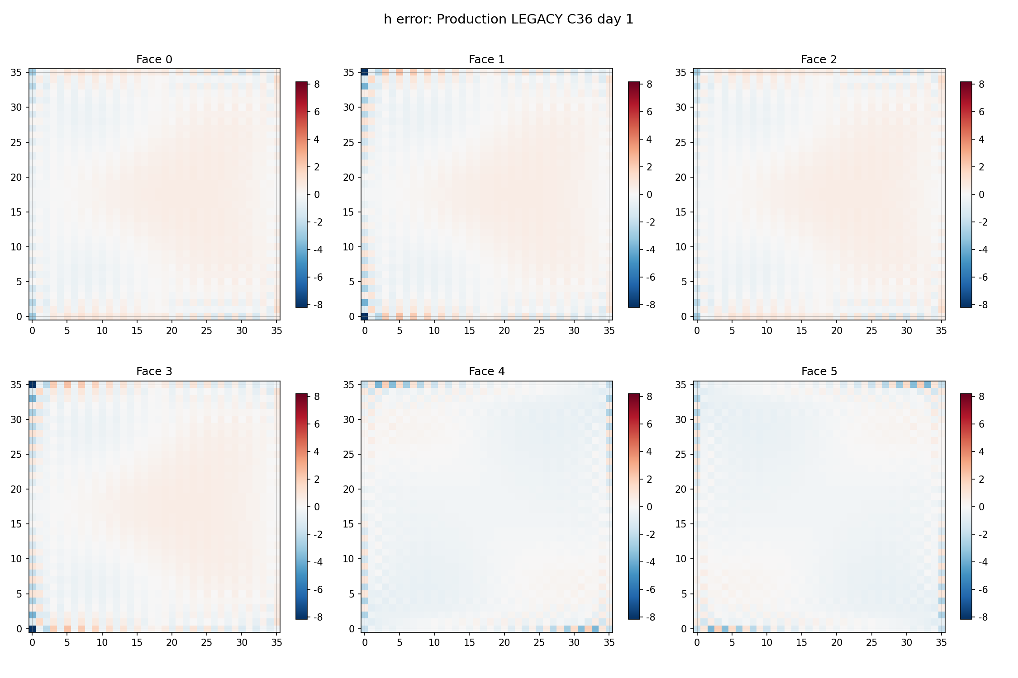
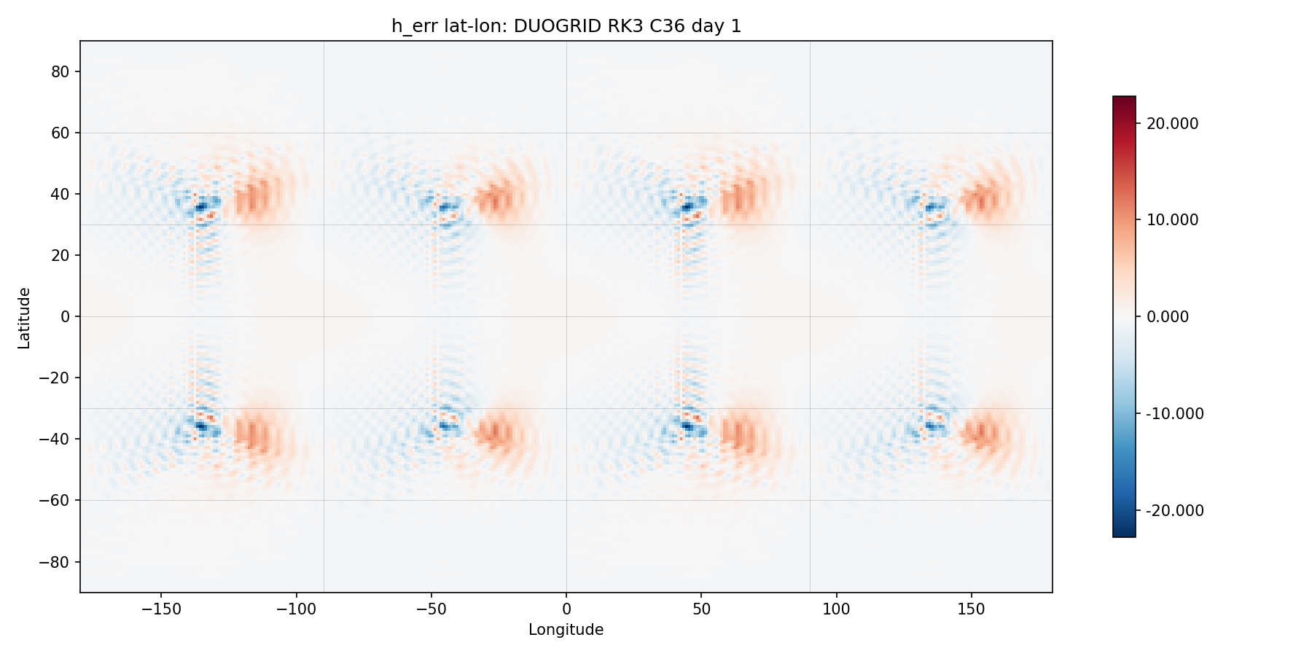
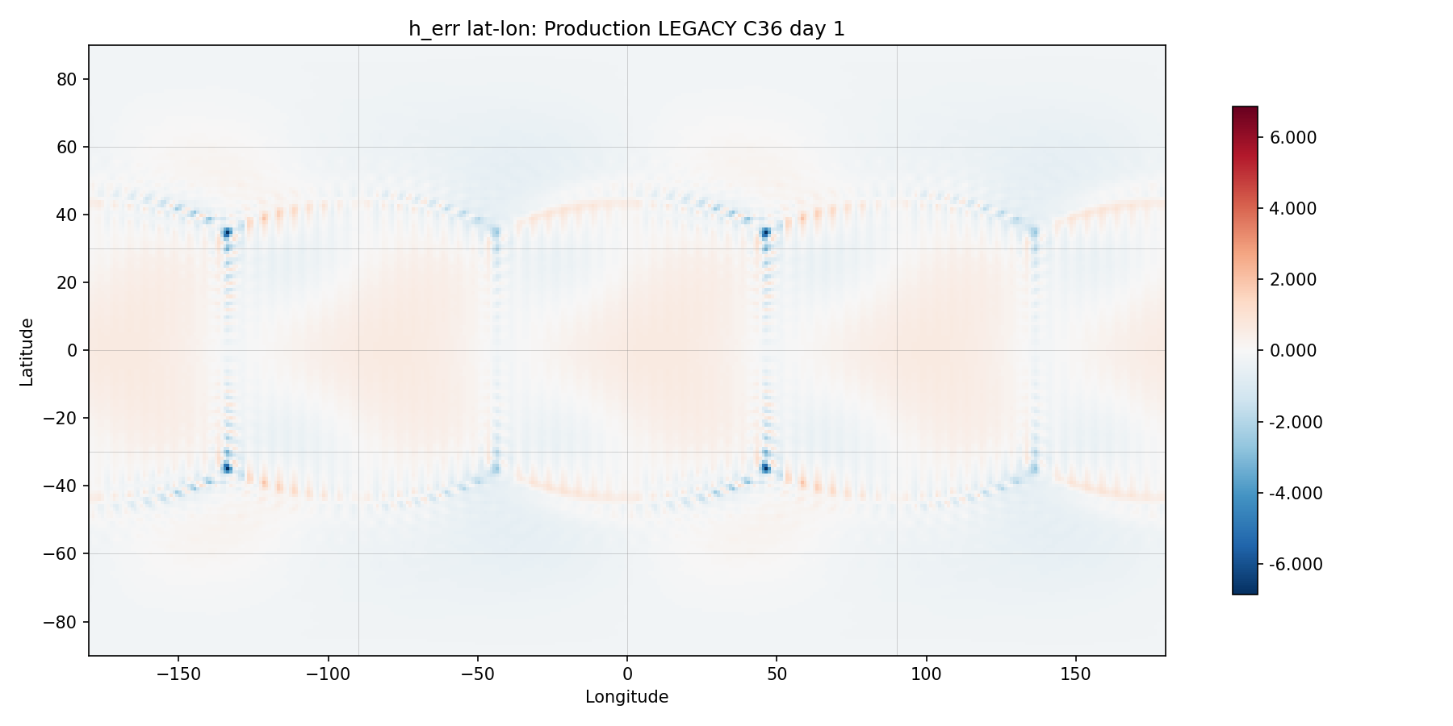
VALIDATION · DYCORE
Williamson SW benchmarks — same case, three cores
Duogrid · lat-lon
FV · lat-lon
FV · cubed-sphere
▸ Williamson 2 (steady-state geostrophic flow) — must reproduce the analytical solution to round-off; same case on three cores reveals grid imprinting and edge effects.
▸ Williamson 5 (zonal flow over an isolated mountain) — sensitive to PPM limiter and divergence damping; visual inspection of v-wind is the canonical edge-artifact check.
▸ Both cases also run on cubed-sphere native projection (field_snapshots_cube_native.png) to verify halo / corner handling.
legoESM · a differentiable Earth System Model in JAX
32 / 33

Slide 33
ROADMAP
Where we are, where we're going
Shipped
Next 12 months
▸ Coupled atm + ocean + ice + land + lake on 4 grid families
▸ End-to-end jax.grad through MPI distributed runs
▸ AMIP-CMIP6 deck (RRTMGP + Sundqvist + SBM + Louis)
▸ 57/57 ocean test matrix · 15/15 sea-ice tests · dycore progression suite
▸ AIMIP-style trainable classical physics
▸ SFNO + NeuralGCM-style hybrid cores · S2S slab campaigns
▸ Veros ocean fidelity harness · CMOR-compliant output
▸ Multi-year coupled AMIP+OMIP with prognostic sea ice
▸ Full incremental 4D-Var with ensemble B (gen-be)
▸ GPU strong-scaling beyond Levante baseline
▸ End-to-end gradient-based tuning against ERA5 + ARGO
▸ MPAS-Voronoi at production resolution (ico7)
▸ Public release: docs, tutorials, reference notebooks
▸ Community-contributed physics schemes via the lego interface
Thank you · Questions? github.com/legoESM · pg2328@columbia.edu
legoESM · a differentiable Earth System Model in JAX
33 / 33

