Slide 1
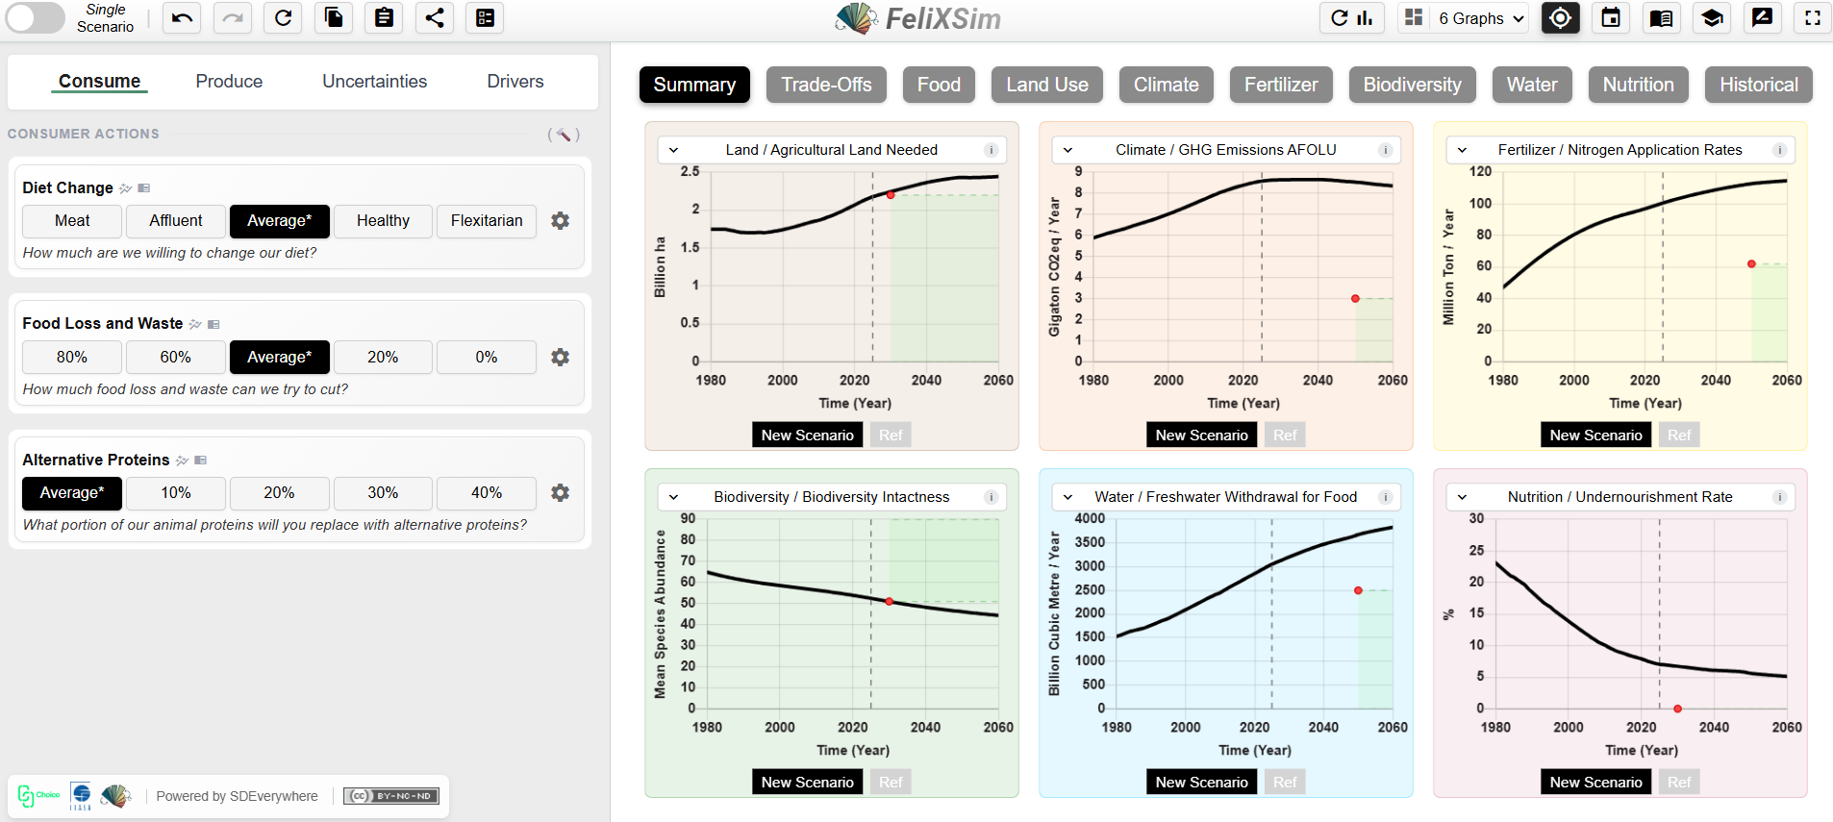
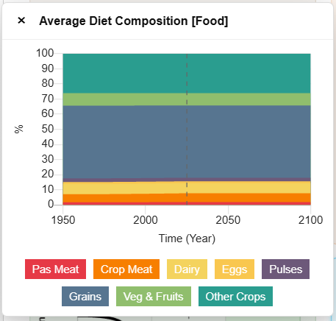
7
1
2
3
A
B
C
D
E
4
F
6
5
D
G
7
Input Features |  | Output Features
(1) Undo / Redo / Reset Scenario (2) Copy / Paste Scenarios (3) Scenario Summary (4) Survey Function (Scenario Builder) | (5) Custom Inputs (6) Mini Graph Preview (7) Extended Descriptions (8) Multi-/Single- Scenario Mode Toggle | (A) Reset Interface Configurations (B) Reset Graphs (C) Multi-graph Layouts (D) Toggle Targets (Hide/Unhide) | (E) Year Settings (Range and X-Intercept) (F) Graph Menu Selection (G) Link from Graph to System Tab
Quick Guide

