Slide 1
Workflow
Assign groups of 3-5 students
Students should:
Introduce themselves and discuss the climate change and health challenges in their country/region of origin (see slide 2)
Find their national/regional climate adaptation plan online (see slide 2)
Ideate adaptation strategies for nutrition and health issues (see slide 3)
Design a research project to test the effectiveness of the adaptation strategy using the Impact Pathway approach (slides 4 and 5)

Slide 2
Exercise – Design an adaptation package
Country | Pakistan | Burkina Faso | Germany
Climate change | Glacier melt → floods, heat waves | Delayed rainy season, mini droughts, increased temperature | Frequency of extreme weather events ↑ (heat waves, storms)
Health and nutrition impacts | Vector-borne and water-borne diseases, reduced work capacity | Agricultural yield losses → child undernutrition | Mental, respiratory and dermatological conditions, dehydration
National Adaptation Plan (health) | Nature-based solutions: trees, ecosystem restoration, bioconservation | Leadership & governance, health workforce, early warning, infrastructure | Technical measures, ecosystem measures, behavioural measures

Slide 3
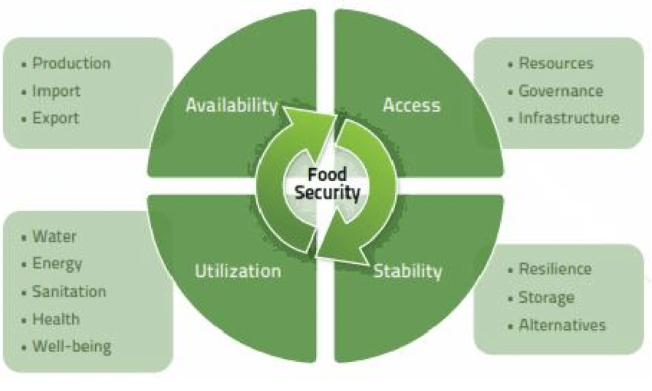
Exercise – Design an adaptation package

Slide 4
Exercise – Design an adaptation package
Target population and geographic area
Stakeholders and policy makers
Adaptation package
Remember experimental study designs
Impact pathways: Inputs, Outputs, Outcomes, Impacts

Slide 5
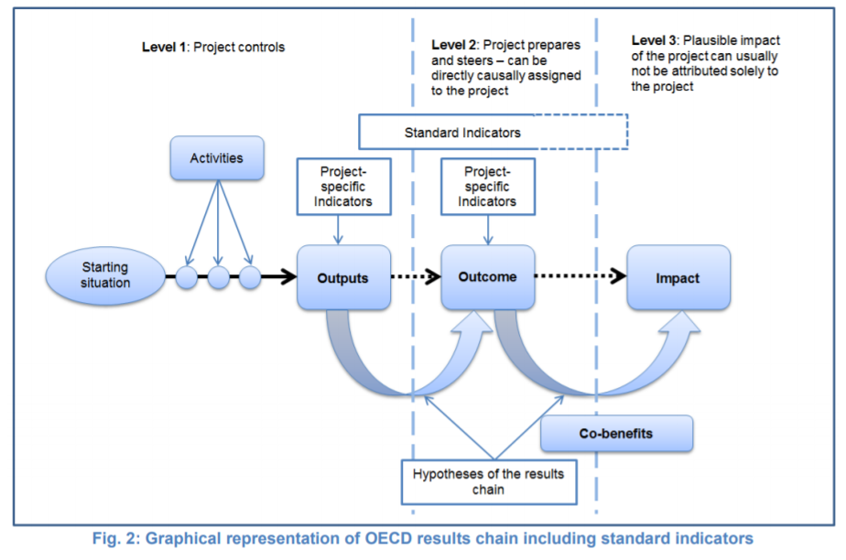
Exercise – Design an adaptation package

