Slide 1

Test Presentation
2026-Feb-14

Slide 2
Content Slide Test
This is a green subtitle for the content slide
First level bullet point
  Second level indented
  Another second level
Back to first level
  Nested point
1 / 4

Slide 3
Two Column Layout Test
Right column point 1
Right column point 2
Right column point 3
Left column point 1
Left column point 2
Left column point 3
2 / 4

Slide 4
Text and Image Layout
Slide 12 style with content left and image right
Key feature one
  Detail about feature one
Key feature two
  Detail about feature two
Key feature three
3 / 4

Slide 5
Conclusions
Summary of this presentation
Zentiva branding is fully preserved
Multiple slide layouts are supported
Hierarchical bullet points with color styling
Text and image layouts available
Slide management (hide, reorder) implemented
4 / 4

Slide 6
This is a test quote to verify the gradient background

Slide 7
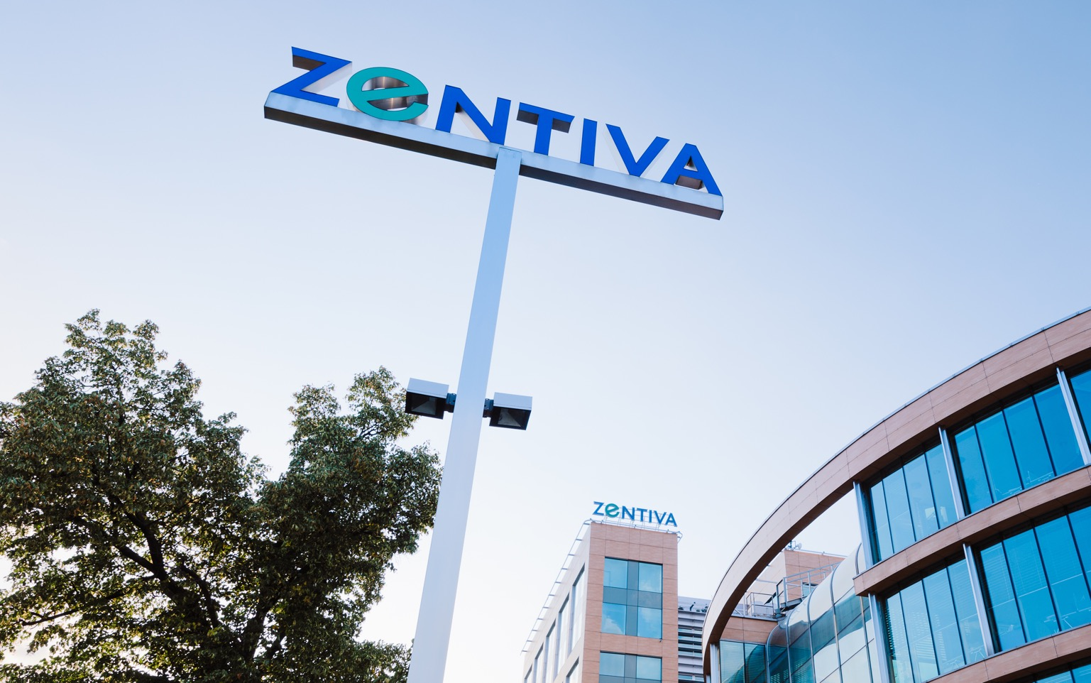
Split Layout Test
With Right Image
Notes:
Picture in of blue background
No e corner
Opt 1 : Full pict
Opt 2 : Third banner vertical
Reduce green, play with dark blue

