Slide 1
Reference
Install Microsoft Visual Studio Community 2017
https://www.visualstudio.com/zh-hans/downloads/
Getting started with Winsock
https://msdn.microsoft.com/en-us/library/ms738545(v=vs.85).aspx
Winsock reference
https://msdn.microsoft.com/en-us/library/ms741416(v=vs.85).aspx

Slide 2
Winsock Exercises 1
GetHostInfo

Slide 3
Contents
Task 1: gethostname
Task 2: GetHostAddress

Slide 4
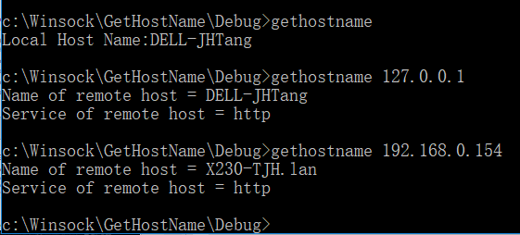
E1: A simple Winsock application
Task1: gethostname
Write a sockets program to get the host name of a given IP address.
Project name: gethostname
Command: gethostname (printing out the host information of your local computer)
Command : gethostinfo 192.168.100.104 (printing out the host information of a remote host)

Slide 5
E1 task1 : gethostname
We need to follow these steps
Creating a Basic Winsock Application
Initializing Winsock
Get the host information of a local or remote computer
Print the host information
Close the Windows sockets

Slide 6
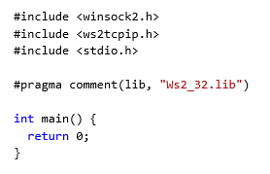
Steps for “Gethostname”
Creating a Basic Winsock Application
Initializing Winsock
Get the host information of a local or remote computer
Print the host information
Close the Windows sockets
1. Create a basic Winsock Application
Create a new empty project.
Add an empty C++ source file to the project.
Begin programming the Winsock application.
The Winsock2.h header file contains most of the Winsock functions, structures, and definitions.
Ws2tcpip.h header file contains newer functions and structures used to retrieve IP addresses.
links to the Winsock Library file Ws2_32.lib

Slide 7
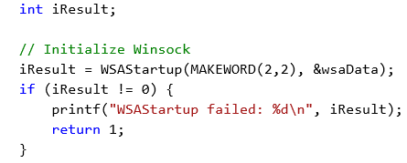
Steps for “Gethostname”
Creating a Basic Winsock Application
Initializing Winsock
Get the hostname of a local or remote computer
Print the host information
Close the Windows sockets
2. Initializing Winsock
Create a WSADATA object called wsaData.
Call WSAStartup and return its value as an integer and check for errors.

Slide 8
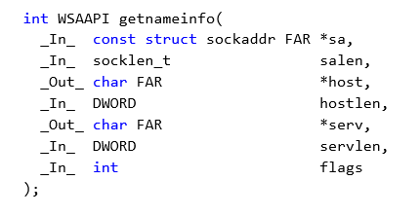
Steps for “Gethostname”
Creating a Basic Winsock Application
Initializing Winsock
Get the host information of a local or remote computer
Print the host information
Close the Windows sockets
3. Get the host information – functions and structures
The gethostname function retrieves the standard host name for the local computer.
int gethostname(
_Out_ char *name, //A pointer to a buffer that receives the local host name.
_In_ int namelen //The length, in bytes, of the buffer pointed to by the name parameter.
);
If no error occurs, gethostname returns zero.
The getnameinfo function provides protocol-independent name resolution from an address to an ANSI host name and from a port number to the ANSI service name..
//A pointer to a socket address structure
//length of sockaddr structure in bytes
//
//
//
//
//used to customize processing of the getnameinfo function
//

Slide 9
Steps for “Gethostname”
Creating a Basic Winsock Application
Initializing Winsock
Get the hostname of a local or remote computer
Print the host information
Close the Windows sockets
4. Print the hostname
5. Close the Windows sockets
//-----------------------------------------
// Call getnameinfo
dwRetval = getnameinfo((struct sockaddr *) &saGHN,
sizeof(struct sockaddr),
hostname,
NI_MAXHOST, servInfo, NI_MAXSERV, NI_NUMERICSERV);
if (dwRetval != 0) {
printf("getnameinfo failed with error # %ld\n", WSAGetLastError());
return 1;
}
else {
printf("getnameinfo returned hostname = %s\n", hostname);
return 0;
}
WSACleanup();

Slide 10
Contents
Task 1: gethostname
Task 2: GetHostAddress

Slide 11
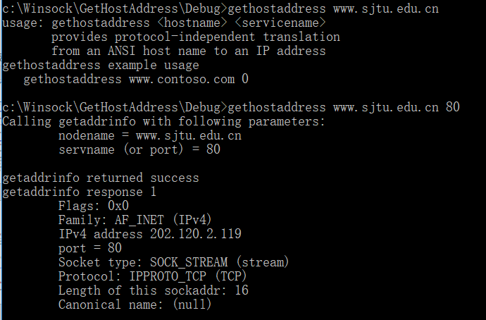
E1 task2 GetHostAddress: example output 1

Slide 12
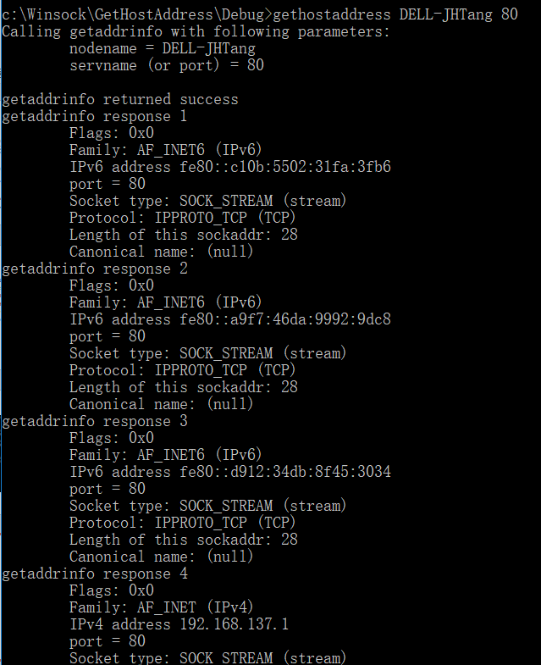
E1 task2 GetHostAddress: example output 2

Slide 13
E1 task2 : GetHostAddress
We need to follow these steps
Creating a Basic Winsock Application
Initializing Winsock
Get the address information of a local or remote host
Print the address information
Close the Windows sockets

Slide 14
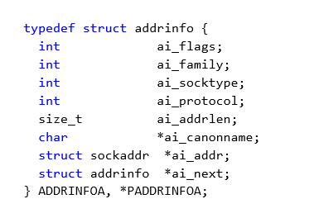
Steps for E1 task 2
Creating a Basic Winsock Application
Initializing Winsock
Get the address information of a local or remote host
Print the address information
Close the Windows sockets
3. addrinfo structure and getaddrinfo( ) function
/* int WSAAPI getaddrinfo (
_In_opt_ PCSTR pNodeName, //host (node) name or a numeric host address string
_In_opt_ PCSTR pServiceName, //a service name or port number represented as a string
_In_opt_ const ADDRINFOA *pHints, // provides hints about the type of socket the caller supports
_Out_ PADDRINFOA *ppResult // A pointer to a linked list of one or more addrinfo structures // that contains response information about the host.
); */
getaddrinfo( ): Success returns zero. Failure returns a nonzero Windows Sockets error code.
//indicate options used in the getaddrinfo function
//AF_INET or AF_INET6,
//SOCK_STREAM，SOCK_DGRAM
//IPPROTO_TCP，IPPROTO_UDP
//
//The canonical name for the host.
//A pointer to a sockaddr structure
//A pointer to the next structure in a linked list

Slide 15
Steps for E1 task 2
Creating a Basic Winsock Application
Initializing Winsock
Get the address information of a local or remote host
Print the address information
Close the Windows sockets
3. Call getaddrinfo function to find the IP address for the server name passed on the command line.
// Setup the hints address info structure
// which is passed to the getaddrinfo() function
ZeroMemory(&hints, sizeof(hints));
hints.ai_family = AF_UNSPEC;
hints.ai_socktype = SOCK_STREAM;
hints.ai_protocol = IPPROTO_TCP;
// Call getaddrinfo().
dwRetval = getaddrinfo(argv[1], DEFAULT_PORT, &hints, &result);
if ( iResult != 0 ) {
printf("getaddrinfo failed with error: %d\n", dwRetval);
WSACleanup();
return 1;
}
Notes:
Success returns zero. Failure returns a nonzero Windows Sockets error code, as found in the Windows Sockets Error Codes.
ppResult contains a pointer to a linked list of one or more addrinfo structures that match the address family, socket type, and protocol specified in the hints parameter.

Slide 16
Steps for E1 task 2
Creating a Basic Winsock Application
Initializing Winsock
Get the address information of a local or remote host
Print the address information
Close the Windows sockets
4. Retrieve each address and print out the hex.
//indicate options used in the getaddrinfo function
//AF_INET or AF_INET6,
//SOCK_STREAM，SOCK_DGRAM
//IPPROTO_TCP，IPPROTO_UDP
//
//The canonical name for the host.
//A pointer to a sockaddr structure
//A pointer to the next structure in a linked list
for (ptr = result; ptr != NULL; ptr = ptr->ai_next) {
……
}
Notes:
Success returns zero. Failure returns a nonzero Windows Sockets error code, as found in the Windows Sockets Error Codes.
ppResult contains a pointer to a linked list of one or more addrinfo structures that match the address family, socket type, and protocol specified in the hints parameter.

