Slide 1
Winsock Exercises 3
More details in WinsockExercises.docx

Slide 2
Contents
E3.1: A simple web client
E3.2: A simple web server
E3.3: Extended web server

Slide 3
HTTP overview
HTTP: hypertext transfer protocol
Web’s application layer protocol
client/server model
client: browser
server: Web server
HTTP request
PC running
Explorer
HTTP response
HTTP request
Server
running
Apache Web
server
HTTP response
Mac running
Navigator
Notes:
Backus-Naur Form (BNF)
Uniform Resource Identifier (URI) [2], as a location
(URL) [4] or name (URN) [16], for indicating the resource on which a
method is to be applied. Messages are passed in a format similar to
that used by Internet Mail [7] and the Multipurpose Internet Mail
Extensions (MIME) [5].

Slide 4
HTTP overview (continued)
Uses TCP:
client initiates TCP connection (creates socket) to server, port 80
server accepts TCP connection from client
HTTP messages exchanged
TCP connection closed
History
World-Wide Web since 1990
HTML2.0: RFC 1866 (1995)
HTTP 1.0: RFC 1945 (1996)
HTTP 1.1: RFC 2068 (1997)
HTTP 2: RFC 7540 (2015)
Notes:
HTTP1.0 HTTP 1.1主要区别
长连接：HTTP 1.0需要使用keep-alive参数来告知服务器端要建立一个长连接，而HTTP1.1默认支持长连接。
节约带宽：HTTP 1.1支持只发送header信息(不带任何body信息)，
Host 域：web server上的多个虚拟站点可以共享同一个ip和端口。HTTP1.0是没有host域的，HTTP1.1才支持这个参数。
HTTP1.1 HTTP 2.0主要区别
HTTP2.0使用了多路复用的技术，做到同一个连接并发处理多个请求，而且并发请求的数量比HTTP1.1大了好几个数量级。

Slide 5
HTTP connections
Nonpersistent HTTP
At most one object is sent over a TCP connection.
HTTP/1.0 uses nonpersistent HTTP
Persistent HTTP
Multiple objects can be sent over single TCP connection between client and server.
HTTP/1.1 uses persistent connections in default mode
Notes:
Persistent: continuing to do something, always it is difficult

Slide 6
HTTP request message
two types of HTTP messages: request, response
HTTP request message:
ASCII (human-readable format)
request line
(GET, POST,
HEAD commands)
GET /somedir/page.html HTTP/1.1
Host: www.someschool.edu
User-agent: Mozilla/4.0
Connection: close
Accept-language:fr
(extra carriage return, line feed)
header
lines
Carriage return,
line feed
indicates end
of message

Slide 7
Method types
HTTP/1.0
GET
POST
HEAD
Only message header fields are returned
HTTP/1.1
GET, POST, HEAD
PUT
uploads file in entity body to path specified in URL field
DELETE
deletes file specified in the URL field

Slide 8
HTTP response message
status line
(protocol
status code
status phrase)
HTTP/1.1 200 OK
Connection close
Date: Thu, 06 Aug 1998 12:00:15 GMT
Server: Apache/1.3.0 (Unix)
Last-Modified: Mon, 22 Jun 1998 …...
Content-Length: 6821
Content-Type: text/html
data data data data data ...
header
lines
data, e.g.,
requested
HTML file

Slide 9
HTTP response status codes
In first line in server->client response message.
A few sample codes:
200 OK
request succeeded, requested object later in this message
301 Moved Permanently
requested object moved, new location specified later in this message (Location:)
400 Bad Request
request message not understood by server
404 Not Found
requested document not found on this server
505 HTTP Version Not Supported

Slide 10
A simple WebClient
Write a client program to execute a single HTTP GET to a Web server.
A web client performs the following steps:
Initializes Winsock.
Creates a socket.
Connects to the server.
Sends and receives data.
Disconnects.

Slide 11
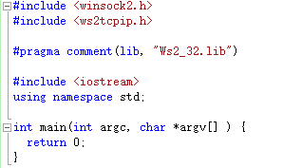
A simple WebClient
Create a new project: WebClient
Source Files →Add New Item → C++ File → WebClient.cpp
create a basic Winsock application

Slide 12
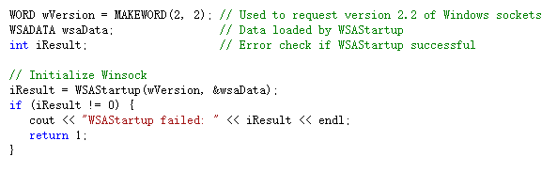
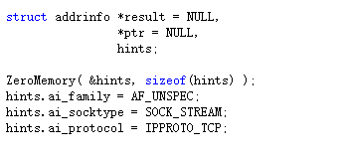
A simple WebClient
initialize Winsock and initiate use of WS2_32.dll
Declare an addrinfo object that contains a sockaddr structure

Slide 13
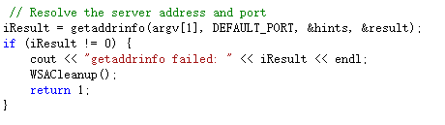
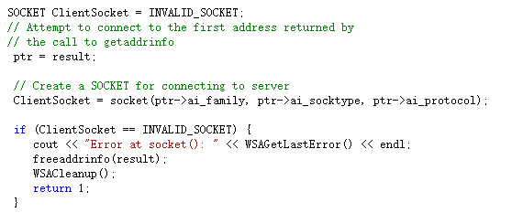
A simple WebClient
Call the getaddrinfo function requesting the IP address for the server name passed on the command line.
Create a SOCKET object called ClientSocket

Slide 14
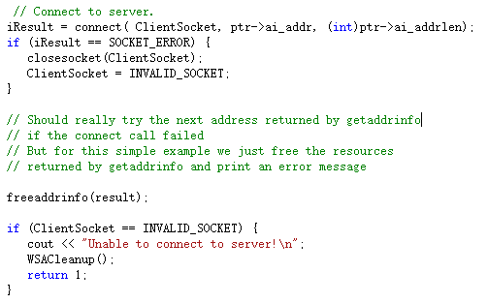
A simple WebClient
Call the connect function to connect to the Web server.

Slide 15
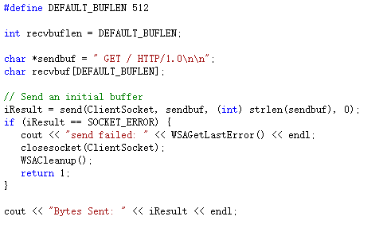
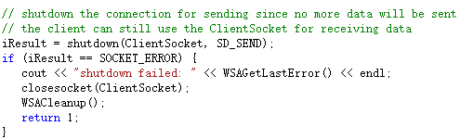
A simple WebClient
Send http get and shutdown the sending side of the socket

Slide 16
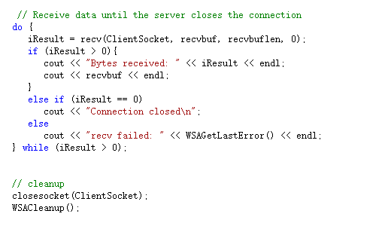
A simple WebClient
Receive data from server and cleanup

Slide 17
Contents
E3.1: A simple web client
E3.2: A simple web server
E3.3: Extended web server

Slide 18
A simple web server
A TCP server
Accept a single connection from a web browser.
port 80
Responds with an HTML message.

Slide 19
A simple web server
Hints
#define DEFAULT_PORT "80"
char outbuf[DEFAULT_BUFLEN];
// Receive from the Web browser
// iResult from recv() is the number of bytes received
iResult = recv(ClientSocket, recvbuf, BUF_SIZE, 0);
for (i=0; i<iResult; i++)
printf ("%c", recvbuf[i]);
// Copy the HTML response into the out buffer
strcpy_s(outbuf, "<html><body><hr>This is a response <b>message</b> in HTML format. <font color=red>Wow!</font><hr></body></html>");
// Send HTML response to the client
send(ClientSocket, outbuf, strlen(outbuf), 0);

Slide 20
Contents
E3.1: A simple web client
E3.2: A simple web server
E3.3: An Extended web server

Slide 21
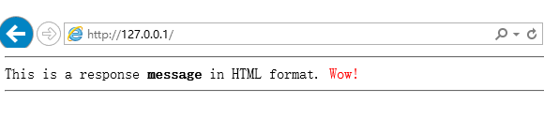
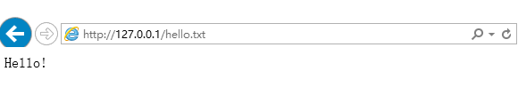
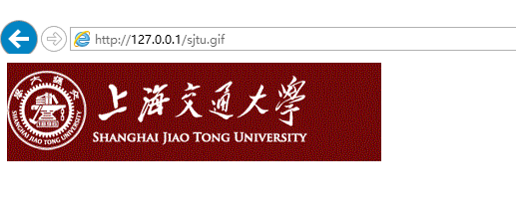
E4a: An Extended web server
Write an extended Web server for Windows
Handles multiple clients
Serves HTML, text, and GIF images

Slide 22
E4a: An Extended web server
#include <fcntl.h> // For binary handle options
#include <sys\stat.h> // For binary write()
#include <io.h> // Needed for open(), close(), write()
//----- HTTP response messages ----------------------------------------------
#define OK_IMAGE "HTTP/1.0 200 OK\r\nContent-Type:image/gif\r\n\r\n"
#define OK_TEXT "HTTP/1.0 200 OK\r\nContent-Type:text/html\r\n\r\n"
#define NOTOK_404 "HTTP/1.0 404 Not Found\r\nContent-Type:text/html\r\n\r\n"
#define MESS_404 "<html><body><h1>FILE NOT FOUND</h1></body></html>"
//----- Defines -------------------------------------------------------------
#define BUF_SIZE 1024 // Buffer size (big enough for a GET)
#define PORT_NUM 80 // Port number for a Web server
//----- Function prototypes -------------------------------------------------
void handle_get(void *in_arg); // Thread function to handle GET

Slide 23
// Main loop to listen, accept, and then spin-off a thread to handle the GET
while(1)
{
printf("main loop: linstening ... \n");
// Listen for connections and then accept
listen(ListenSocket, 50);
addr_len = sizeof(client_addr);
client_s = accept(ListenSocket, (struct sockaddr *)&client_addr, &addr_len);
if (client_s == -1)
{
printf("ERROR - Unable to create a socket \n");
exit(1);
}
printf("client socket accepted, %d... \n",client_s);
// Spin-off a thread to handle this request (pass only client_s)
if (_beginthread(handle_get, 4096, (void *)client_s) < 0)
{
printf("ERROR - Unable to create a thread to handle the GET \n");
exit(1);
}
}
printf("main loop completed. close server socket... WSAcleanup \n");
// Close the server socket and clean-up winsock
closesocket(server_s);
WSACleanup();

Slide 24
Reference
Install Microsoft Visual Studio Community 2017
https://www.visualstudio.com/zh-hans/downloads/
Getting started with Winsock
https://msdn.microsoft.com/en-us/library/ms738545(v=vs.85).aspx
Winsock reference
https://msdn.microsoft.com/en-us/library/ms741416(v=vs.85).aspx

