Slide 1
Winsock Exercises 5
myping

Slide 2
Internet Control Message Protocol (ICMP)
Functions
For routers to report errors or unexpected circumstances
For testing the Internet
Considered as part of IP, but is also an IP user
the ICMP message is encapsulated in an IP datagram
Frame header
IP header
ICMP message

Slide 3
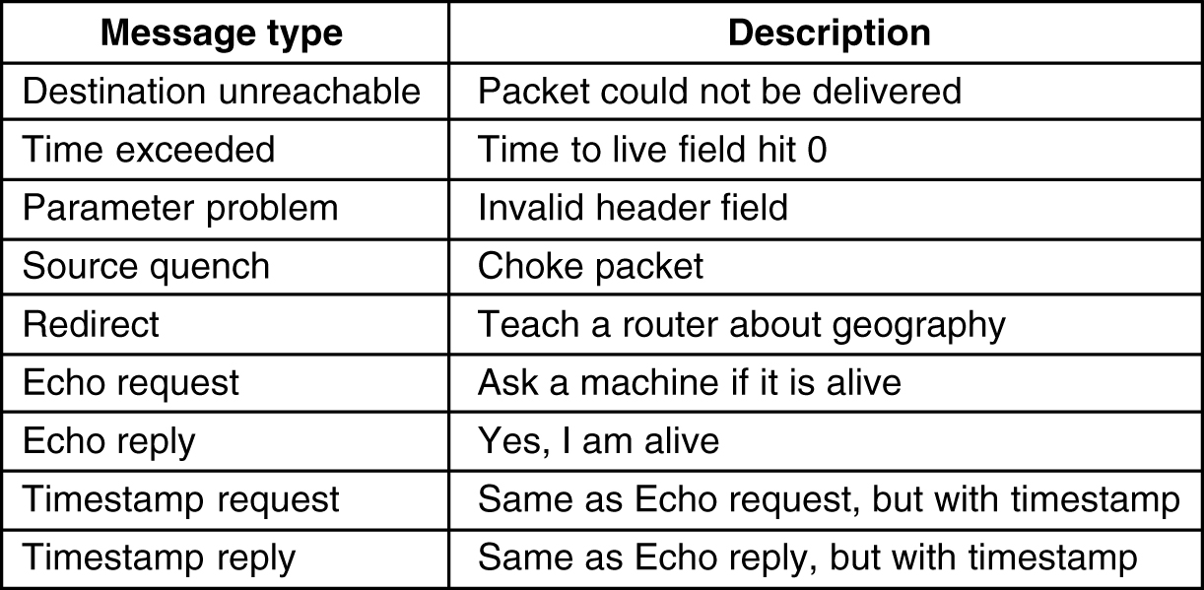
The Principal ICMP Message Types
Type
03
11
12
04
05
08
00
13
14

Slide 4
Ping uses ICMP ECHO, the response is Echo Reply
0
15
31
ping : ECHO
08
response :
ECHO Reply
00

Slide 5
ping -l 200 kahuna.sdsu.edu
Type: IP
Protocol: ICMP
0000: 00 60 2f dd 1d 20 00 10 4b 0a c3 23 08 00 45 00 | .`/.. ..K.Ã#..E.
0010: 00 e4 fe 34 00 00 20 01 4a eb 82 bf a5 78 82 bf | ..þ4.. .J....x..
0020: a6 02 08 00 a9 bd 03 00 11 00 61 62 63 64 65 66 | ..........abcdef
0030: 67 68 69 6a 6b 6c 6d 6e 6f 70 71 72 73 74 75 76 | ghijklmnopqrstuv
0040: 77 61 62 63 64 65 66 67 68 69 6a 6b 6c 6d 6e 6f | wabcdefghijklmno
0050: 70 71 72 73 74 75 76 77 61 62 63 64 65 66 67 68 | pqrstuvwabcdefgh
0060: 69 6a 6b 6c 6d 6e 6f 70 71 72 73 74 75 76 77 61 | ijklmnopqrstuvwa
0070: 62 63 64 65 66 67 68 69 6a 6b 6c 6d 6e 6f 70 71 | bcdefghijklmnopq
0080: 72 73 74 75 76 77 61 62 63 64 65 66 67 68 69 6a | rstuvwabcdefghij
0090: 6b 6c 6d 6e 6f 70 71 72 73 74 75 76 77 61 62 63 | klmnopqrstuvwabc
00a0: 64 65 66 67 68 69 6a 6b 6c 6d 6e 6f 70 71 72 73 | defghijklmnopqrs
00b0: 74 75 76 77 61 62 63 64 65 66 67 68 69 6a 6b 6c | tuvwabcdefghijkl
00c0: 6d 6e 6f 70 71 72 73 74 75 76 77 61 62 63 64 65 | mnopqrstuvwabcde
00d0: 66 67 68 69 6a 6b 6c 6d 6e 6f 70 71 72 73 74 75 | fghijklmnopqrstu
00e0: 76 77 61 62 63 64 65 66 67 68 69 6a 6b 6c 6d 6e | vwabcdefghijklmn
00f0: 6f 70 | op
ICMP Header
Type: 08 Echo Request
identifier

Slide 6
The Reply to Our Ping
Type:
00 Echo Reply
Identifier: 03 00
The same as Echo message
0000: 00 10 4b 0a c3 23 00 60 2f dd 1d 20 08 00 45 00 | ..K.Ã#.`/.. ..E.
0010: 00 e4 88 2b 40 00 fe 01 a2 f3 82 bf a6 02 82 bf | ...+@.þ.........
0020: a5 78 00 00 b1 bd 03 00 11 00 61 62 63 64 65 66 | .x........abcdef
0030: 67 68 69 6a 6b 6c 6d 6e 6f 70 71 72 73 74 75 76 | ghijklmnopqrstuv
0040: 77 61 62 63 64 65 66 67 68 69 6a 6b 6c 6d 6e 6f | wabcdefghijklmno
0050: 70 71 72 73 74 75 76 77 61 62 63 64 65 66 67 68 | pqrstuvwabcdefgh
0060: 69 6a 6b 6c 6d 6e 6f 70 71 72 73 74 75 76 77 61 | ijklmnopqrstuvwa
0070: 62 63 64 65 66 67 68 69 6a 6b 6c 6d 6e 6f 70 71 | bcdefghijklmnopq
0080: 72 73 74 75 76 77 61 62 63 64 65 66 67 68 69 6a | rstuvwabcdefghij
0090: 6b 6c 6d 6e 6f 70 71 72 73 74 75 76 77 61 62 63 | klmnopqrstuvwabc
00a0: 64 65 66 67 68 69 6a 6b 6c 6d 6e 6f 70 71 72 73 | defghijklmnopqrs
00b0: 74 75 76 77 61 62 63 64 65 66 67 68 69 6a 6b 6c | tuvwabcdefghijkl
00c0: 6d 6e 6f 70 71 72 73 74 75 76 77 61 62 63 64 65 | mnopqrstuvwabcde
00d0: 66 67 68 69 6a 6b 6c 6d 6e 6f 70 71 72 73 74 75 | fghijklmnopqrstu
00e0: 76 77 61 62 63 64 65 66 67 68 69 6a 6b 6c 6d 6e | vwabcdefghijklmn
00f0: 6f 70 | op

Slide 7
IP header checksum: adding up the 16-bit half-words using 1’s complement arithmetic, then take 1’s complement of the result.
Step1: add 16-bit integers using regular 32-bit addition
Step2: take the 16 higher-order bits in the sum, shifting them down by 16 positions, and add them back to the sum
Step3: take 1’s complement of the sum (convert 1 to 0 and vice versa)
Example: for an IP header given below
Hex 4500+003d+9b1a+0000+8011+0000+82bf+a578+82bf+a5c8=3 b126
Hex b126+3=b129
1’s complement of b129 = 4ed6
0000: 00 60 08 0a 9b 17 00 10 4b 0a c3 23 08 00 45 00 | .`......K.Ã#..E.
0010: 00 3d 9b 1a 00 00 80 11 4e d6 82 bf a5 78 82 bf | .=......N....x..
0020: a5 c8 05 bb 00 35 00 29 18 f0 00 01 01 00 00 01 | .....5.)........
0030: 00 00 00 00 00 00 06 6b 61 68 75 6e 61 04 73 64 | .......kahuna.sd
0040: 73 75 03 65 64 75 00 00 01 00 01 | su.edu.....
Checkup set to 0000

Slide 8
ICMP Error Message
Message Type: Destination Unreachable
Always contains the IP header and the first 64 bits of the IP datagram that caused the ICMP error to be generated
For the receiver to associate the message with one particular protocol (TCP or UDP) and a particular user (port number)
“Code” number (0~15) specifies the more detailed reason of the error
Host/network/protocol/port unreachable, source router failure, etc.
16 kinds of errors
0
8
16
31
Type
Code
Checksum
Additional information or unused (set to all 0’s)
IP Header + first 64 bits of original IP datagram data

Slide 9
ICMP-based Tools
Ping
Ping client sends “echo request”
The server must echo the “identifier” , “sequence number” fields and any optional data sent by the client
Ping client prints each reply that are returned
Used to test
destination reachability
compute round trip time
Ping client put the sent time in data field which is returned by ping server
Round trip time is obtained by subtracting this value from the current time
provide record route option
Ping sets the IP RR option in the outgoing IP datagram
This causes every router that handles the datagram to add its IP address to a list in the options field
Final destination copies the list of IP addresses into the outgoing ICMP echo reply
All the routers on the return path also add their IP addresses to the list
When ping receives the echo reply it prints the list of IP addresses

Slide 10
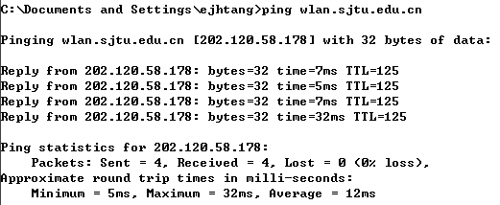
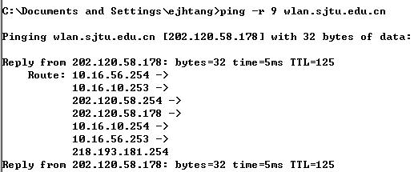
Ping Example

Slide 11
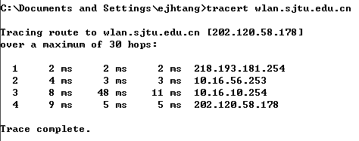
ICMP-based Tools
Traceroute: uses ICMP and TTL in the IP header
Send the packet with time-to-live = 1 (hop)
The first router discards the packet and sends an ICMP “time-to-live exceeded” message to source
IP datagram containing this ICMP message has the router’s IP address
The source can extract and print the IP address of the first router
The source then sends packet with time-to-live = 2 (hops) etc…
The second router discards the packet and sends an ICMP message to source…
Done when an ICMP “port unreachable” message is received
Does not use optional features like record route

Slide 12
E6: myping
Write a program to test the reachability of an Internet interface identified by an IP address or name. (The basic function of “ping” command)
Hints: Send an ICMP “echo request” to the destination, an ICMP “echo reply” will be sent back if the destination is reachable. (refer to RFC 792 for more information about ICMP)
Create a raw socket：socktype=SOCK_RAW, protocol=IPPROTO_ICMP;
Construct an ICMP message;
Use “sendto” to send the ICMP message to the remote machine;
Use “recvfrom” to receive any response.（ICMP message in IP packet RFC 791)
Wireshark

Slide 13
E6: myping
Hand in
myping.cpp
myping.pdf
the functions of your program and how to use them
theory and protocols used in your program
flow-chart of your program （showing the main APIs）
execution of your program (screen shots)
thoughts and discussion

Slide 14
Reference
Install Microsoft Visual Studio Community 2017
https://www.visualstudio.com/zh-hans/downloads/
Getting started with Winsock
https://msdn.microsoft.com/en-us/library/ms738545(v=vs.85).aspx
Winsock reference
https://msdn.microsoft.com/en-us/library/ms741416(v=vs.85).aspx

