Slide 1
Fundamentals of machine learning
김연우
2019-01-08

Slide 2
4.1. Four branches of machine learning
해결할 문제에 맞는 학습 알고리즘 선택
Supervised learning
Unsupervised learning
Self-supervised learning
Reinforcement learning

Slide 3
4.1. Four branches of machine learning
Supervised learning
mapping input data to known targets(annotations)
classification, scalar regression
Sequence generation
Given a picture, predict a caption describing it.
Syntax tree prediction
Given a sentence, predict its decomposition into a syntax tree.
Object detection
Given a picture, draw a bounding box around certain objects inside the picture.
Image segmentation
Given a picture, draw a pixel-level mask on a specific object.

Slide 4
4.1. Four branches of machine learning
Unsupervised learning
transformations of the input data without the help of any targets
data visualization, data compression, or data denoising
to better understand the correlations present in the data at hand
Dimensionality reduction and clustering

Slide 5
4.1. Four branches of machine learning
Self-supervised learning
learning without human-annotated labels
autoencoders
to predict the next frame in a video, given past frames
to predict the next word in a text, given previous words
Reinforcement learning
an agent receives information about its environment and learns to choose actions that will maximize some reward.
self-driving cars
robotics
resource management

Slide 6
4.2 Evaluating machine-learning models
머신 러닝의 목표
신규 데이터에서 잘 작동하는 일반화된 모델을 얻는 것
how to measure generalization
how to evaluate machine-learning models.

Slide 7
4.2.1 Training, validation, and test sets
데이터 분할에 관한 튜닝
Training / validation / test
one of the hyperparameters (others: choosing the number of layers or the size of the layers etc. )
주의 사항
information leak: tuning the configuration of the model based on its performance on the validation set can quickly result in overfitting to the validation set
주요 방법
simple hold-out validation
K-fold validation
iterated K-fold validation with shuffling

Slide 8
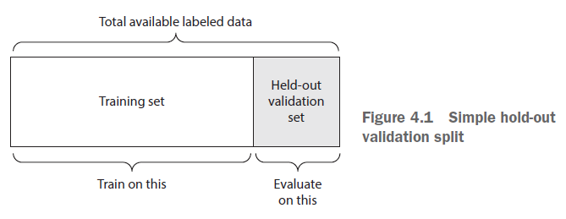
4.2.1 Training, validation, and test sets
SIMPLE HOLD-OUT VALIDATION

Slide 9
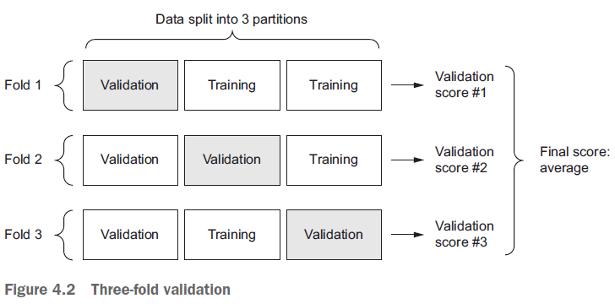
4.2.1 Training, validation, and test sets
K-FOLD VALIDATION
데이터가 적을 때 사용
최종 스코어: 각 K-fold 실행에서 얻은 스코어의 평균

Slide 10
4.2.1 Training, validation, and test sets
ITERATED K-FOLD VALIDATION WITH SHUFFLING
데이터가 적을 때 사용
K개로 분할 하기 전에 데이터를 셔플링
최종 스코어: 각 K-fold 실행에서 얻은 스코어의 평균

Slide 11
4.2.2 Things to keep in mind
Data representativeness
traning/test 데이터 모두 대표성이 있는 데이터 사용
The arrow of time
시간선이 있는 데이터는 셔플링하면 안됨
traning 데이터가 test 데이터보다 시간선이 앞서야 함
Redundancy in your data
traning 데이터와 test 데이터에 중복된 데이터 포인트가 있으면 안됨

Slide 12
4.3.1 Data preprocessing for neural networks
VECTORIZATION
단어 리스트를 정수 인덱스 리스트로 변환
one-hot encoding
VALUE NORMALIZATION
각 데이터 포인트를 동일한 스케일로 인코딩
스케일이 다른 자질은 각 자질을 독립적으로 정규화
Take small values—Typically, most values should be in the 0–1 range.
Be homogenous—That is, all features should take values in roughly the same range.
HANDLING MISSING VALUES
어떤 데이터 포인트에 누락된 값이 있다면 0으로 채움

Slide 13
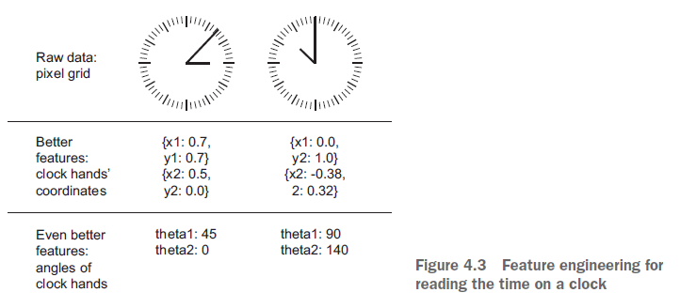
4.3.2 Feature engineering
더 좋은 데이터 표현으로 변환

Slide 14
4.4 Overfitting and underfitting
Optimization:
refers to the process of adjusting a model to get the best performance possible on the training data.
generalization:
refers to how well the trained model performs on data it has never seen before.
머신 러닝의 목표는 generalization
generalization을 위해서는 가능한 많은 훈련 데이터를 모으는 것

Slide 15
4.4 Overfitting and underfitting
underfitting
모델의 성능이 계속 발전될 여지가 있는 경우
overfitting
Training 세트 혹은 Validation 세트 에 지나치게 최적화되어 일반화를 잃은 경우

Slide 16
4.4 Overfitting and underfitting
to prevent overfitting (training set에 대한)
Reducing the network’s size
레이어의 수를 줄이거나
각 레이어의 유닛 수를 줄임
Adding weight regularization
weight이 복잡할 수록 패널티를 부여함 (loss score에 반영)
L1 regularization—The cost added is proportional to the absolute value of the weight coefficients (the L1 norm of the weights).
L2 regularization—The cost added is proportional to the square of the value of the weight coefficients (the L2 norm of the weights).
Adding dropout
훈련 시 층의 일부 출력을 0으로 만드는 것
[0.2, 0.5, 1.3, 0.8, 1.1] -> [0, 0.5, 1.3, 0, 1.1]

Slide 17
4.5 The universal workflow of machine learning
Defining the problem and assembling a dataset
Choosing a measure of success
Deciding on an evaluation protocol
Preparing your data
Developing a model that does better than a baseline
Scaling up: developing a model that overfits
Regularizing your model and tuning your hyperparameters

Slide 18
4.5 The universal workflow of machine learning
Defining the problem and assembling a dataset
입력 데이터의 형식 및 특성 파악
해결할 문제의 종류 파악 classification? Scalar regression?
가설 설정
You hypothesize that your outputs can be predicted given your inputs.
You hypothesize that your available data is sufficiently informative to learn the relationship between inputs and outputs.

Slide 19
4.5 The universal workflow of machine learning
Choosing a measure of success
loss function을 선택하는 기준
accuracy? Precision and recall?
area under the receiver operating characteristic curve (ROC AUC)
Deciding on an evaluation protocol
Maintaining a hold-out validation set—The way to go when you have plenty of data
Doing K-fold cross-validation—The right choice when you have too few samples for hold-out validation to be reliable
Doing iterated K-fold validation—For performing highly accurate model evaluation when little data is available

Slide 20
4.5 The universal workflow of machine learning
Preparing your data
As you saw previously, your data should be formatted as tensors.
The values taken by these tensors should usually be scaled to small values: for example, in the [-1, 1] range or [0, 1] range.
If different features take values in different ranges (heterogeneous data), then the data should be normalized.
You may want to do some feature engineering, especially for small-data problems.

Slide 21
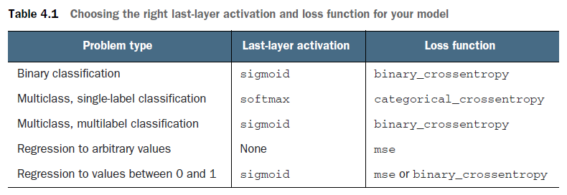
4.5 The universal workflow of machine learning
Developing a model that does better than a baseline
적어도 랜덤한 분류보다 높은 정확도를 가지게 만드는 것
마지막 레이어(출력 레이어)를 어떻게 구성할 것인가
Optimization configuration—In most cases, it’s safe to go with rmsprop and its default learning rate.

Slide 22
4.5 The universal workflow of machine learning
Scaling up: developing a model that overfits
일단은 충분히 overfited 된 모델을 만들어 본다
Add layers.
Make the layers bigger.
Train for more epochs.

Slide 23
4.5 The universal workflow of machine learning
Regularizing your model and tuning your hyperparameters
training set에 대한 overfitting 패턴을 보고 더 좋은 모델을 만드는 과정
이 단계가 대부분의 시간을 차지함
Add dropout
Try different architectures: add or remove layers.
Add L1 and/or L2 regularization.
Try different hyperparameters (such as the number of units per layer or the learning rate of the optimizer) to find the optimal configuration.
Optionally, iterate on feature engineering: add new features, or remove features that don’t seem to be informative.
여기에 지나치게 집중하면 validation set에 대한 overfitting 발생 information leak

