Slide 1




Computational and Informatics Resources for Glycoscience
PI: Raja Mazumder
The George Washington University
PI: William York
CCRC, University of Georgia
NIH Common Fund Glycoscience Program
1U01GM125267-01 (York & Mazumder)

Slide 2
What is GlyGen?
Computational and Informatics Resources for Glycoscience
GlyGen is a data integration and dissemination project for carbohydrate and glycoconjugate related data. GlyGen retrieves information from multiple international data sources and integrates and harmonizes this data. This web portal allows exploring this data and performing unique searches that cannot be executed in any of the integrated databases alone.
GlyGen is an international project funded by The National Institutes of Health

Slide 3
GlyGen goals and effort
Integrating up-to-date glycobiology-related information from diverse disciplines
Creating an intuitive web portal to browse and search for knowledge in glycobiology
Developing essential new information resources, including:
An open, comprehensive Glycan Microarray Database
A Glycan Naming Ontology (GNOme) that facilitates interpretation of incomplete structural information in the context of biological function
An open, standardized environment for independent development
GOALS
EFFORT
GlyGen is a cooperative, community-driven project, and an international project funded by The National Institutes of Health.
An open, standardized environment for independent development and integration of additional research tools by other investigators.
More than 15 investigators in four countries play key roles in the project.
Two years of organized discussion and planning involving nearly 100 investigators.

Slide 4
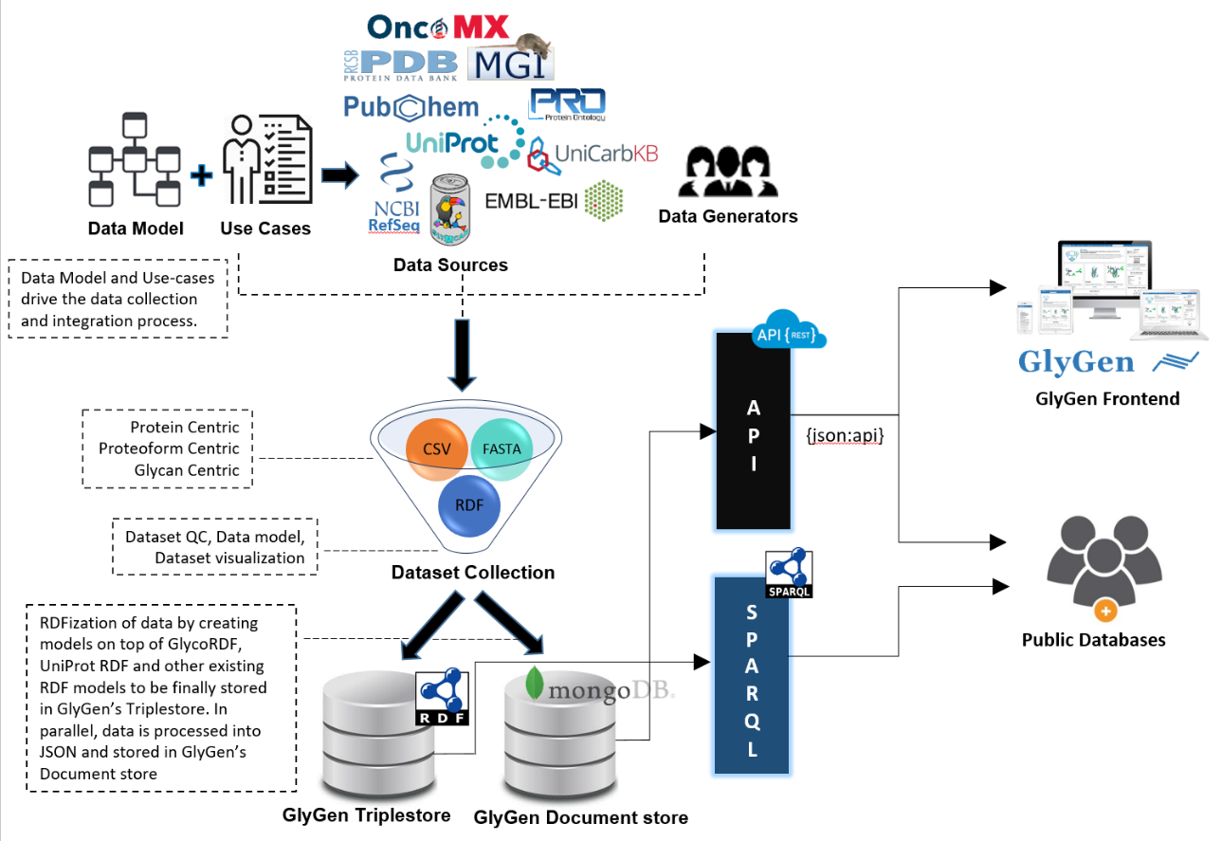














Data Collection and Integration
Data model and use-cases drive GlyGen’s data collection and integration.
The data from various sources are harmonized and QC’d after collection and processed into open format datasets.
The datasets are further processed into RDF and JSON format to be stored in GlyGen Triple Store and Document Store that can be accessed by SPARQL endpoint and WS APIs.
GlyGen frontend retrieves data through the WS APIs whereas the Public databases and users can retrieve the data through both the and the SPARQL endpoint.
GlyGen’s
Data Sources
RefSeq
GlyTouCan
Human Phenotype Ontology
https://data.glygen.org

Slide 5
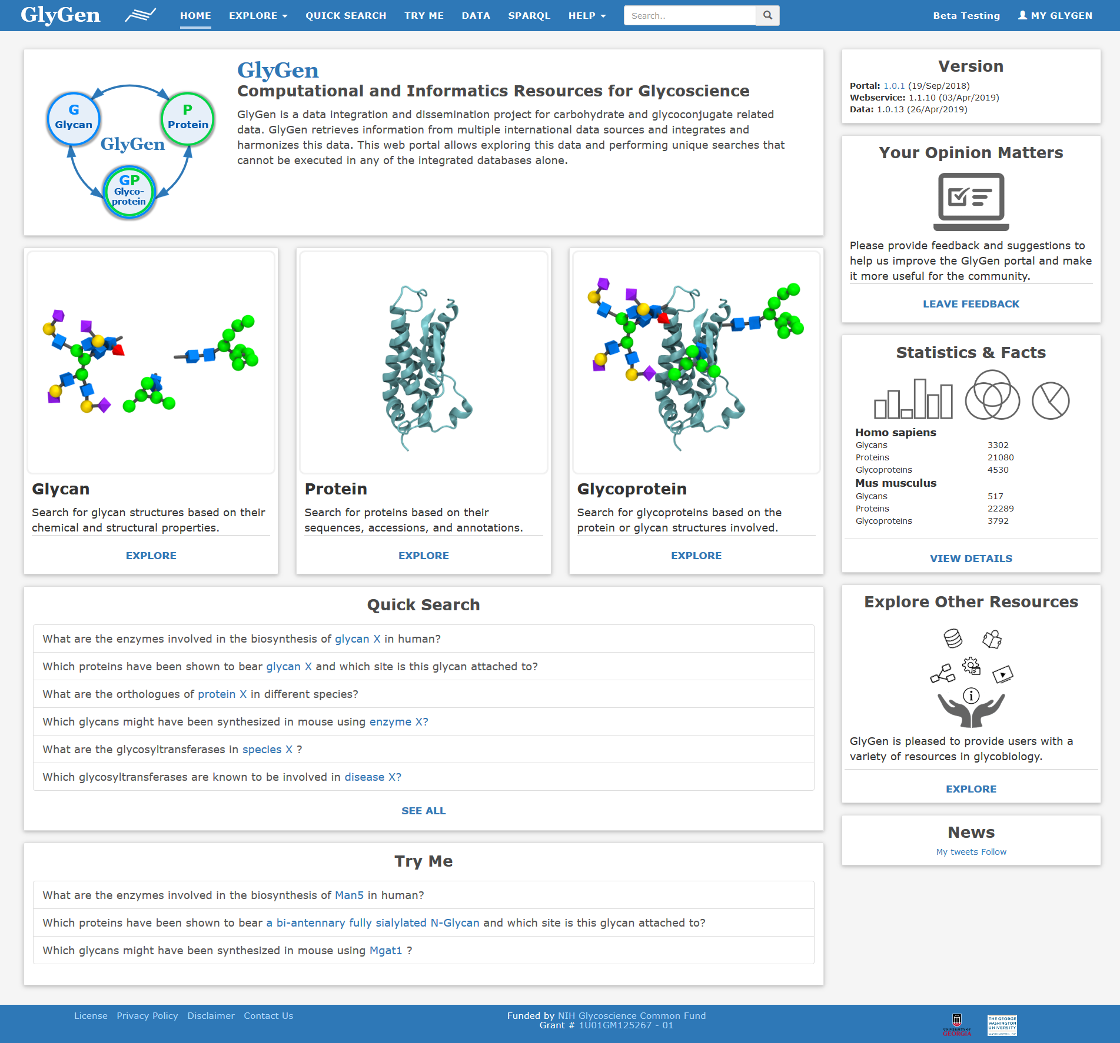
GlyGen portal Homepage
Glycan, Protein, Glycoprotein searches by choosing intuitive simple or advanced search.
Quick Search to answer user-specific question
GlyGen data can be accessed from the Data page, API and SPARQL endpoint
Helpful tutorials, data resources, tools, learning materials, social media, contact us, and feedback.
Use of open public license for data and source code
https://glygen.org

Slide 6
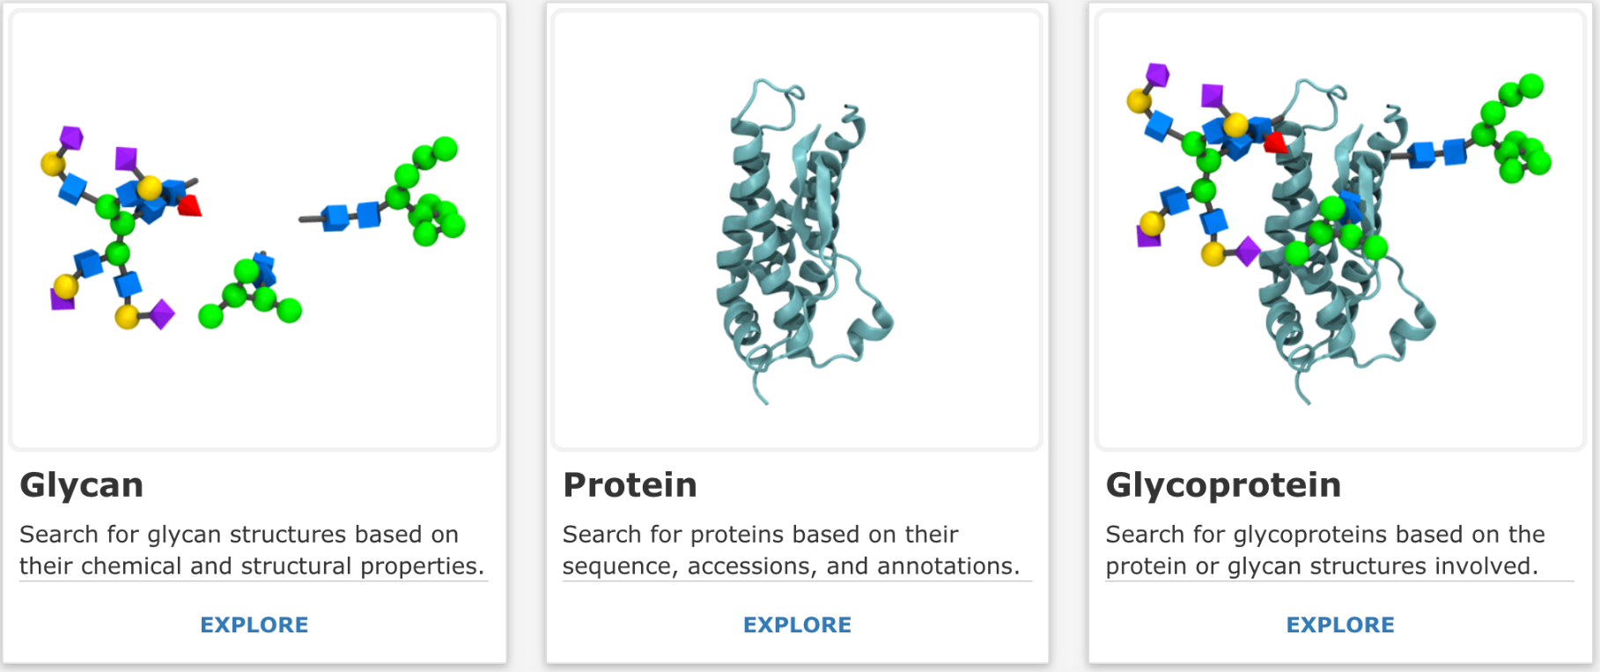
Explore searches
Glycan search - Data types and information that is about specific glycans.
Protein search - Data types and information that is about some particular protein coding gene, or that can be mapped to the canonical protein sequence representing that gene.
Glycoprotein search - Data types and information of proteins that are glycosylated at specific sites with or without glycan information.
Current Species Data in GlyGen – Human and Mouse

Slide 7
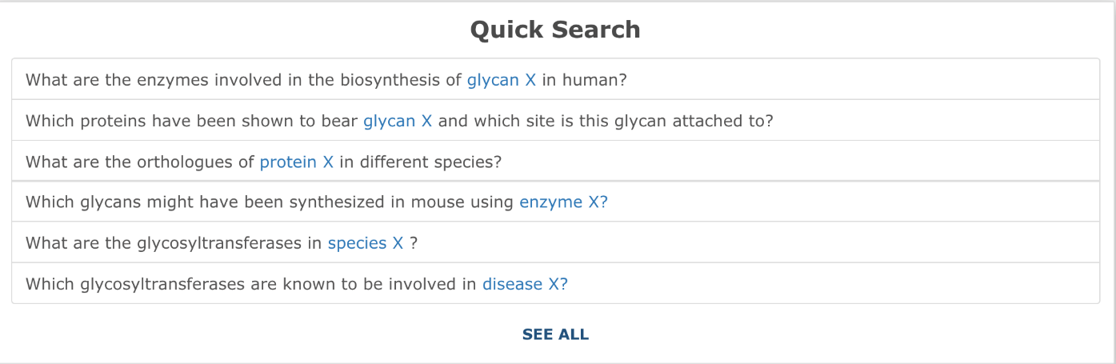
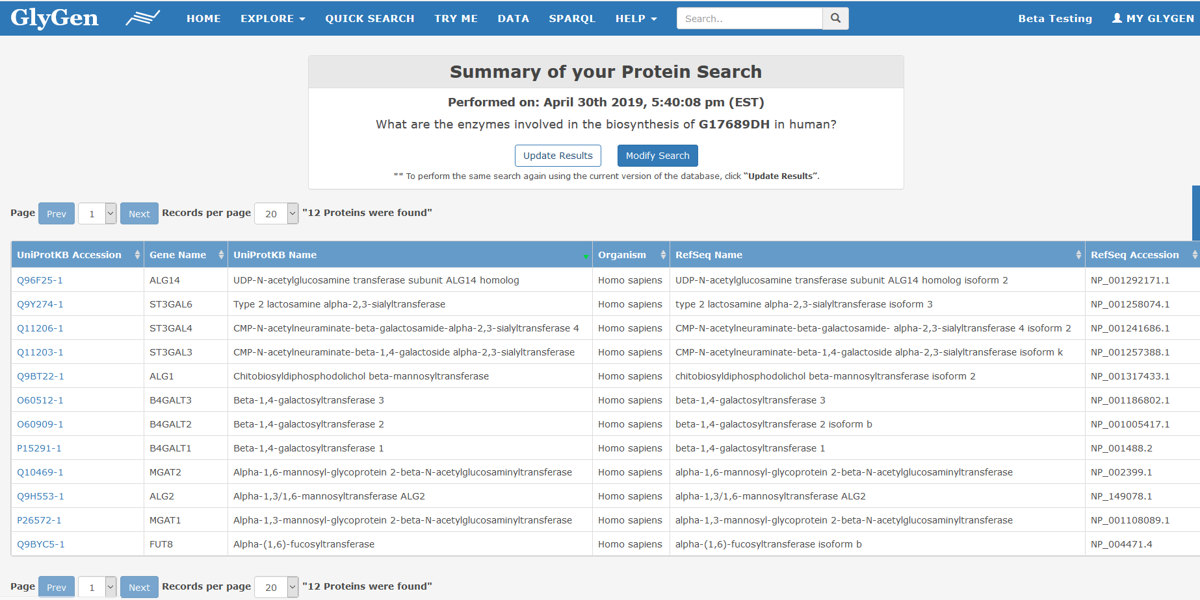
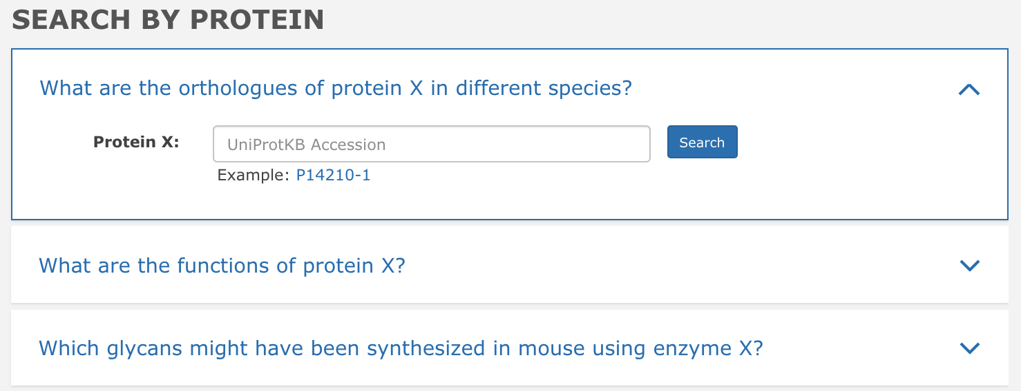
Quick Search
Complex multi-domain search queries can be performed using the quick searches which are based on user requests.
Search by glycan, protein, species, and disease.
List page and details of your protein comes after entering accession number.

Slide 8
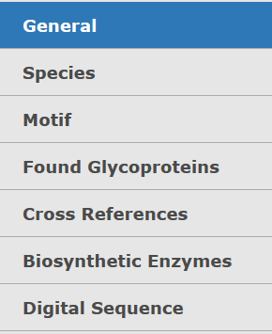
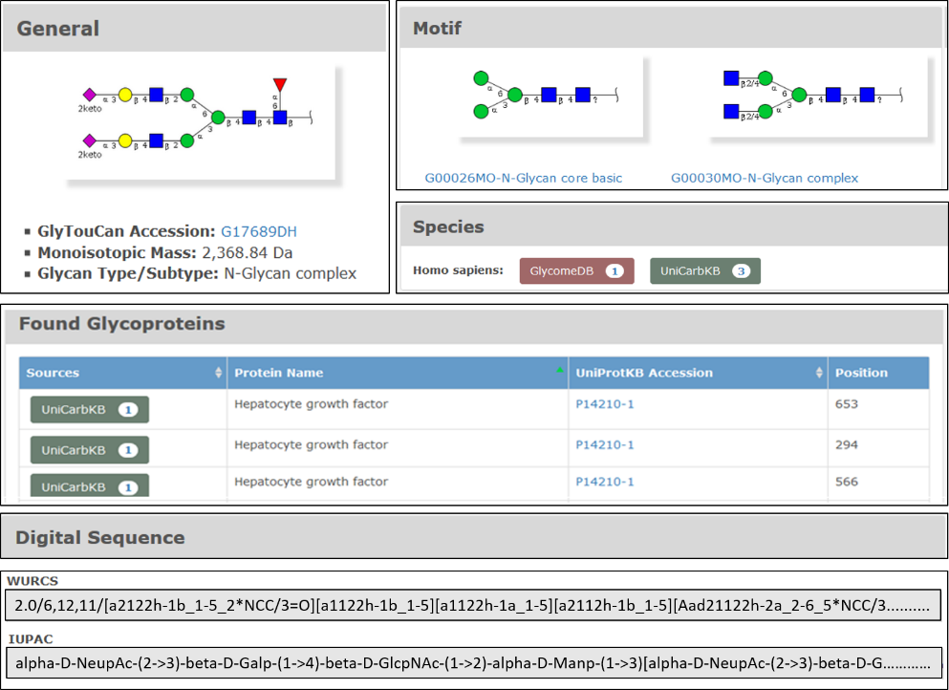
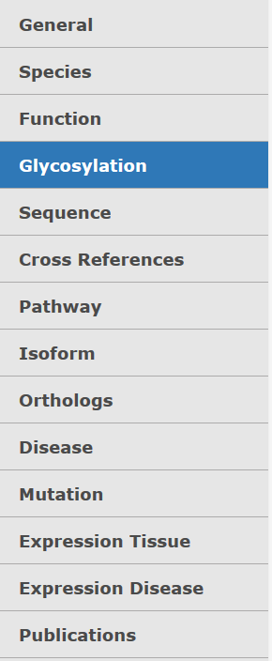
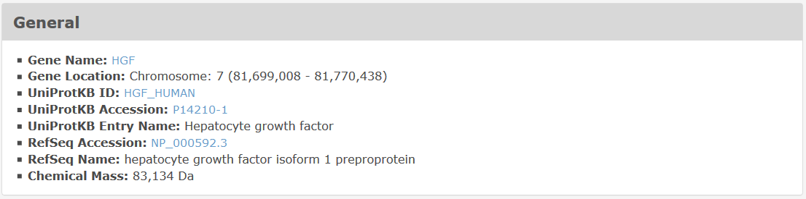
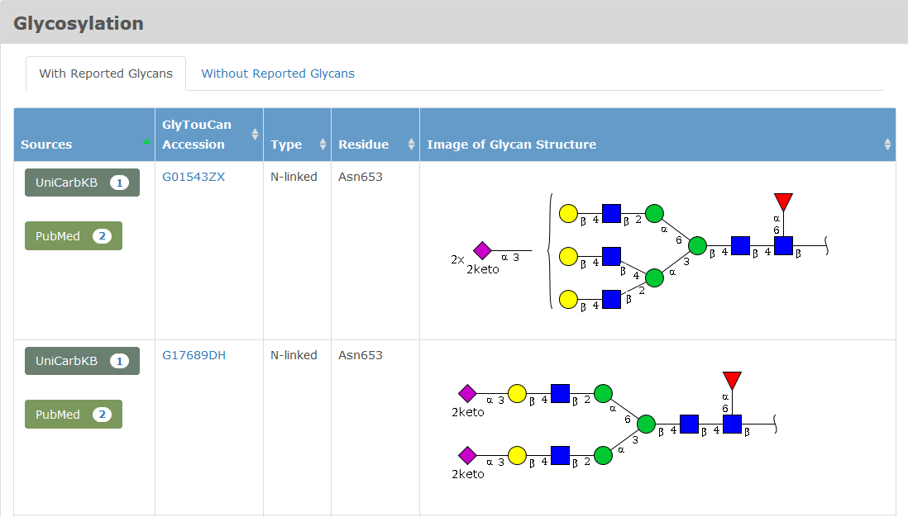
Detail pages
Glycan Detail Page for G17689DH
G17689DH - Bi-antennary N-Glycan Complex (reduced overview)
Protein Detail Page for HGF
Highlighting General and Glycosylation section information (reduced overview)

Slide 9
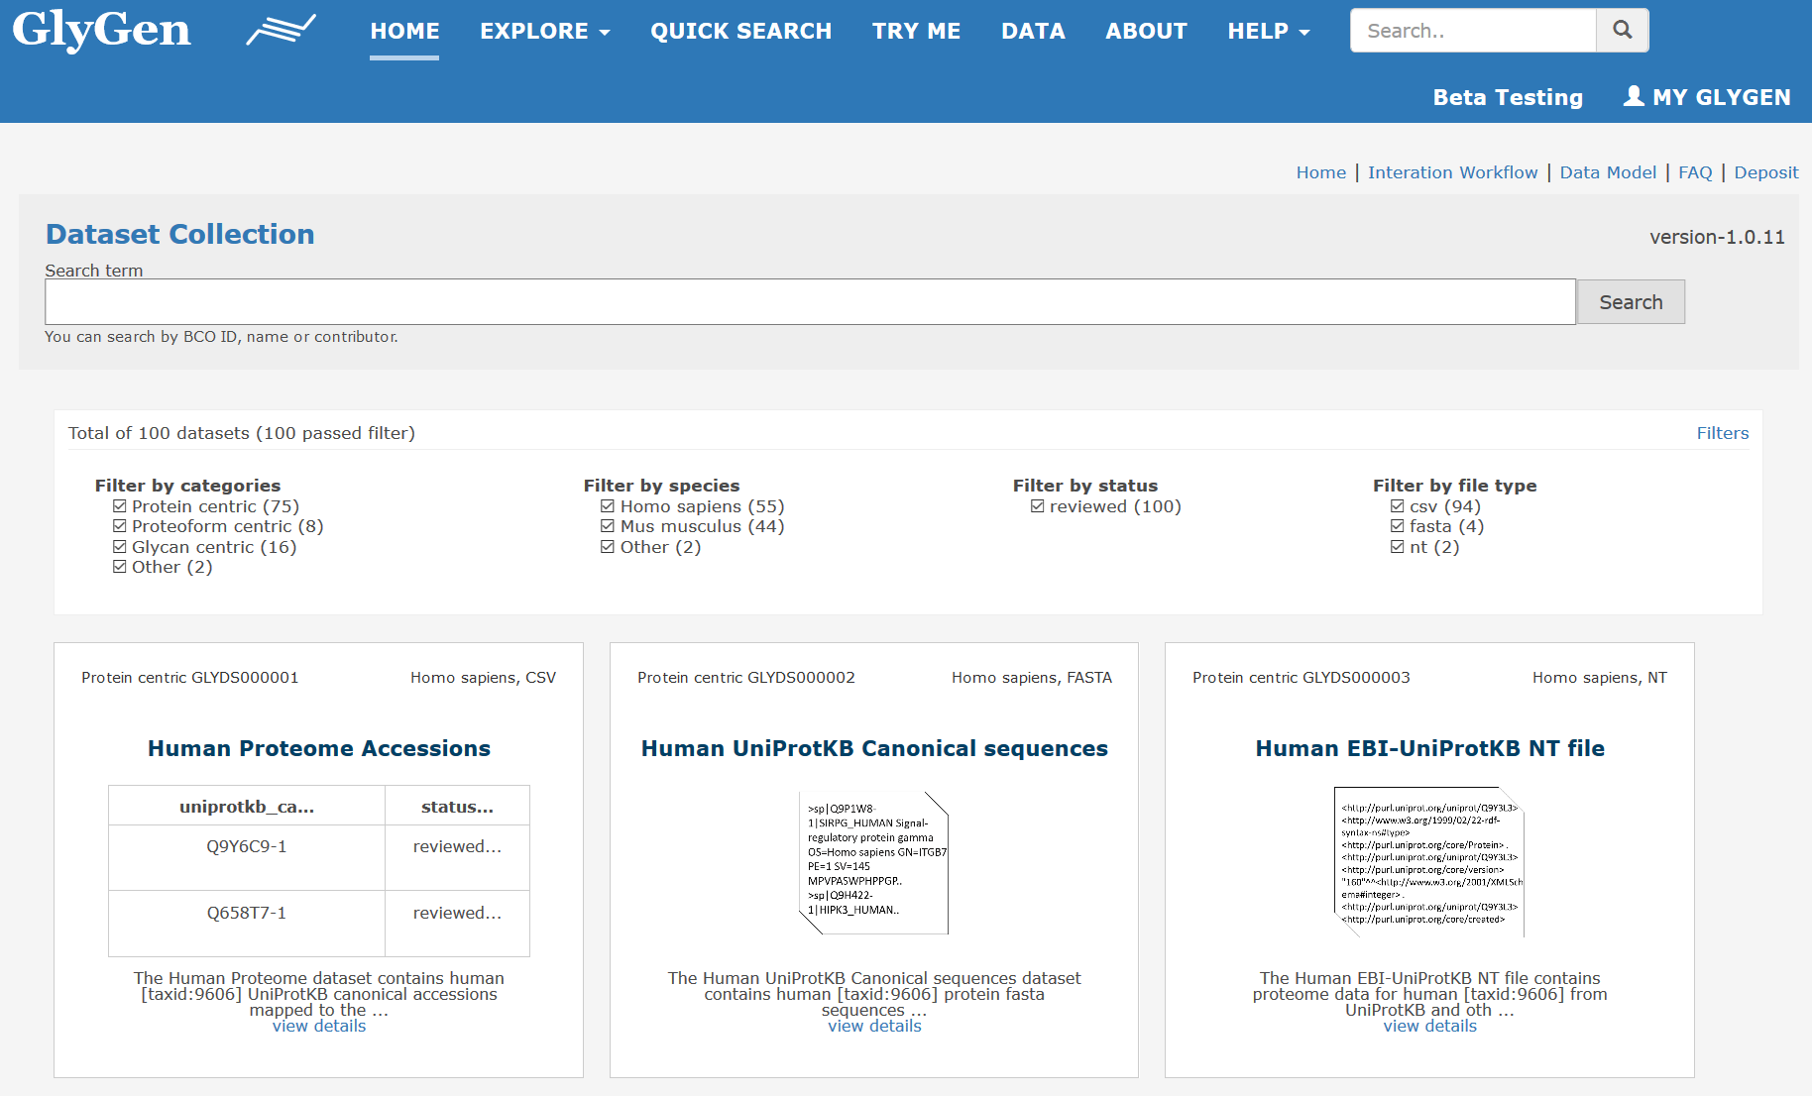
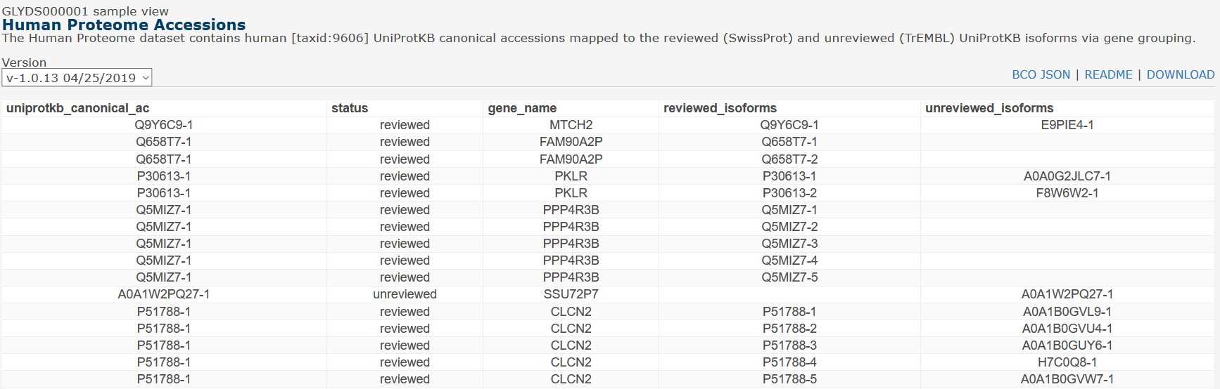
GlyGen Data page
Data page contains all the datasets collected by GlyGen.
The datasets can be easily searched and filtered.
FAQs helps to understand the data.
Each dataset is downloadable, has a sample view, JSON dataset BCO and a conventional readme with extensive metadata.
https://data.glygen.org

Slide 10
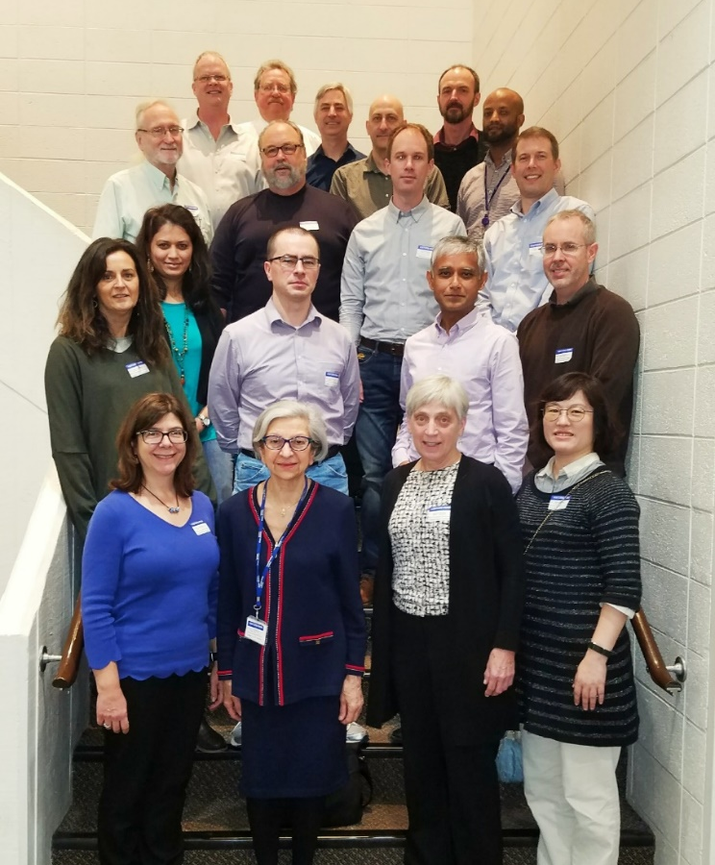







Acknowledgements
University of Georgia
Will York
Rene Ranzinger
Michael Pierce
Robert Woods
Rupali Mahadik
Tatiana Williamson
Sena Arpinar
Sanath Bhatt
Sujeet Kulkarni
Sandeep Nakarakommula
EMBL-EBI
Maria Martin
Leyla Jael Garcia Castro
Preethi Vasudev
NCBI
Kim Pruitt
Evan Bolton
The George Washington University
Raja Mazumder
Robel Kahsay
Jeet Vora
Rahi Navelkar
Reza Mousavi
Nagarajan Pattabiraman
Xavier Holmes
Brian Fochtman
Georgetown University
Nathan Edwards
Radoslav Goldman
Darren Natale
Karen Ross
Wenjin Zhang
Harvard University
Richard Cummings
The Jackson Laboratory
Judith Blake
Soka University
Kiyoko Aoki-Kinoshita
The Griffith University
Matthew Campbell
Imperial College London
Ten Feizi
Macquarie University
Nicki Packer
NIH-NCI
Jefferey Gildersleeve
NIH Grant - U01 GM125267-01

