Slide 1



GlyGen – Glycomics and Glycoproteomics Data Integration and Presentation
Georgetown University
Nathan Edwards
Radoslav Goldman
Darren Natale
Karen Ross
The George Washington University
Raja Mazumder
Robel Kahsay
Brian Fochtman
Jeet Vora
Rahi Navelkar
Reza Mousavi
Nagarajan Pattabiraman
EMBL- EBI
Maria Martin
Leyla Jael Garcia Castro
Preethi Vasudev
NCBI
Kim Pruitt
Evan Bolton
The University of Georgia
Will York
Rene Ranzinger
Michael Pierce
Robert Woods
Rupali Mahadik
Gaurav Agarwal
Vinamra Jain
Tatiana Williamson
Sena Arpinar
Richard Cummings – Harvard University
Judith Blake – The Jackson Laboratory
Kiyoko Aoki-Kinoshita – Soka University
Matthew Campbell – The Griffith University
Richard Cummings – Harvard University
Ten Feizi – Imperial College
Nicki Packer – Macquarie University
Jefferey Gildersleeve - NIH
NIH Grant - U01 GM125267-01

Slide 2
has
Allele
Navigating GlyGen Objects
has
is-in
Organism
Gene
Context
“Omics Data”
has
encodes
has
Expression
has
Protein
is-a
is-a
has
Glycan-Binder
has
Enzyme
is-in
has
Glycoprotein
is-a
is-a
Binding
Interaction
has
has
Glycosylhydrolase
Glycosyltransferase
cleaves
adds
“Array Data”
Glycan
contains
Residue
contains

Slide 3
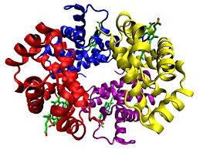
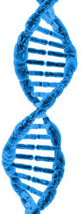
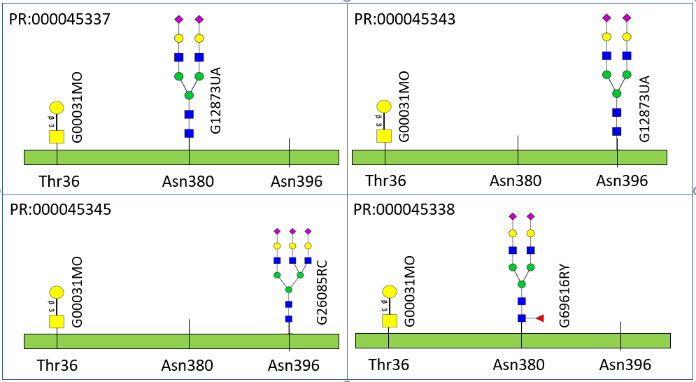
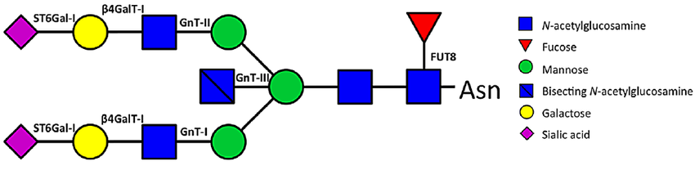


Data in GlyGen
Data is categorized into 3 data categories
Protein Centric
Data types and information that is about some particular protein coding gene, or that can be mapped to the canonical protein sequence representing that gene. Examples include pathways, Gene Ontology, localization, etc.
Glycoprotein (proteoform) Centric
Data types and info)rmation of all the different molecular forms in which the protein product of a single gene can be found, including changes due to genetic variations, alternatively spliced RNA transcripts and post-translational modifications
Glycan Centric
Glycan-centric data include data types and information that is about specific glycans.
Currently focus on two species: Human and Mouse

Slide 4
Portal Infrastructure, Look and Feel
UI/UX analysis and preliminary design
Query generation and formatting
Type-ahead support for text fields
Name spaces for textual input
Widgets to facilitate query generation
Search interfaces
Glycan Search Page
Protein Search Page
Glycoprotein Search Page
Predefined “Quick Searches” for high-priority use cases
”Try Me” demonstration queries that require no user input
Display infrastructure for search results
Display interfaces
Glycan List Page
Protein List Page
My GlyGen - user privacy and query history

Slide 5
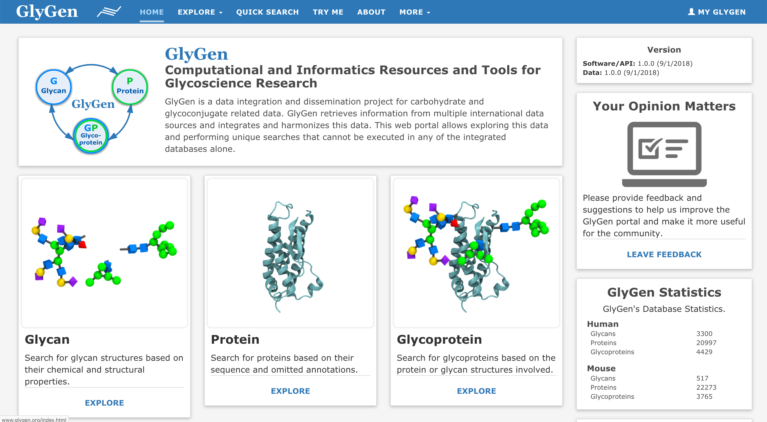
The GlyGen Home Page

Slide 6
Use Cases for GlyGen Version 1
What are the enzymes involved in the biosynthesis of glycan X in human/mouse?
Which glycans might have been synthesized in human/mouse using enzyme X?
Which proteins have been shown to bear glycan X and which site is this glycan attached to?
What are the orthologs of glycoprotein X in different species?
What are the functions of protein X?
What are the gene locations of the enzymes involved in the biosynthesis of glycan X in human/mouse?
What are the glycoslytransferases in human/mouse?
What are the glycohydrolases in human/mouse?
What are the reported or predicted glycosylated proteins in human/mouse?
Which glycosyltransferases are known to be involved in disease X?

Slide 7
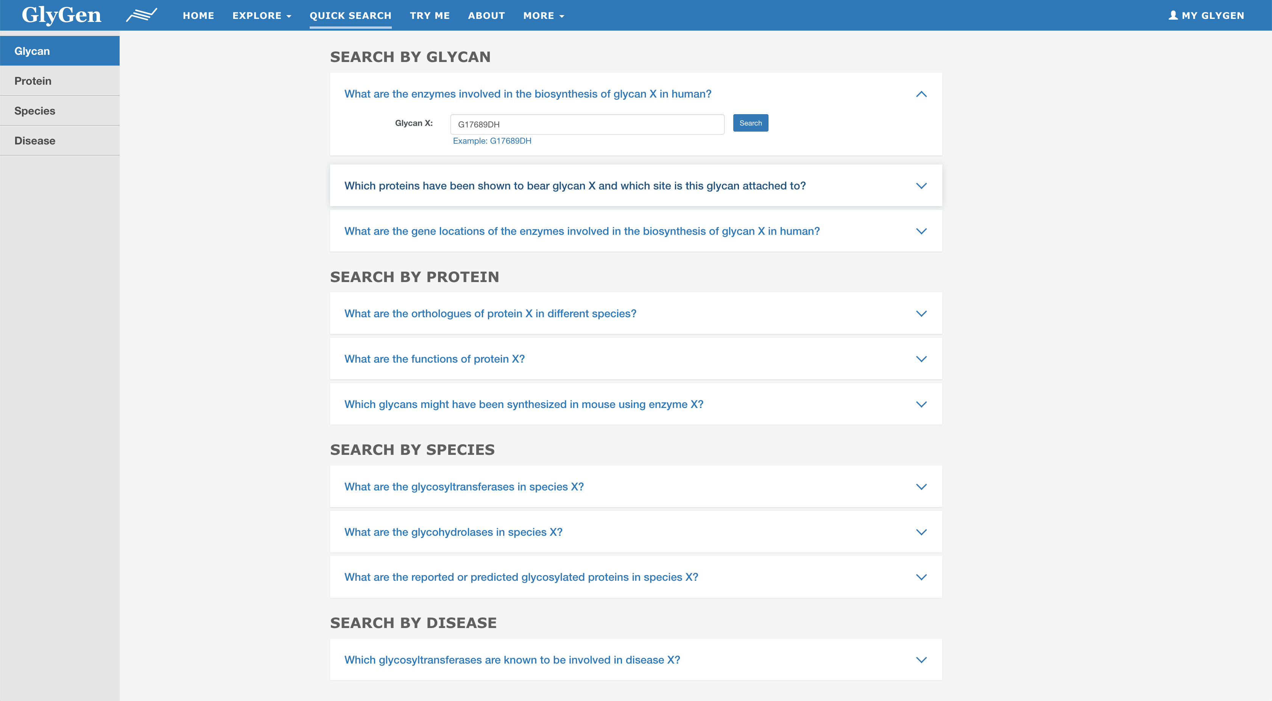
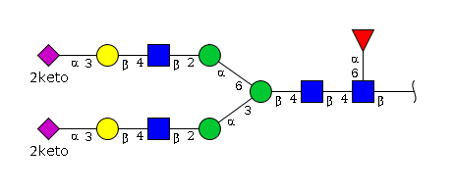
Quick Search – Predefined Queries

Slide 8
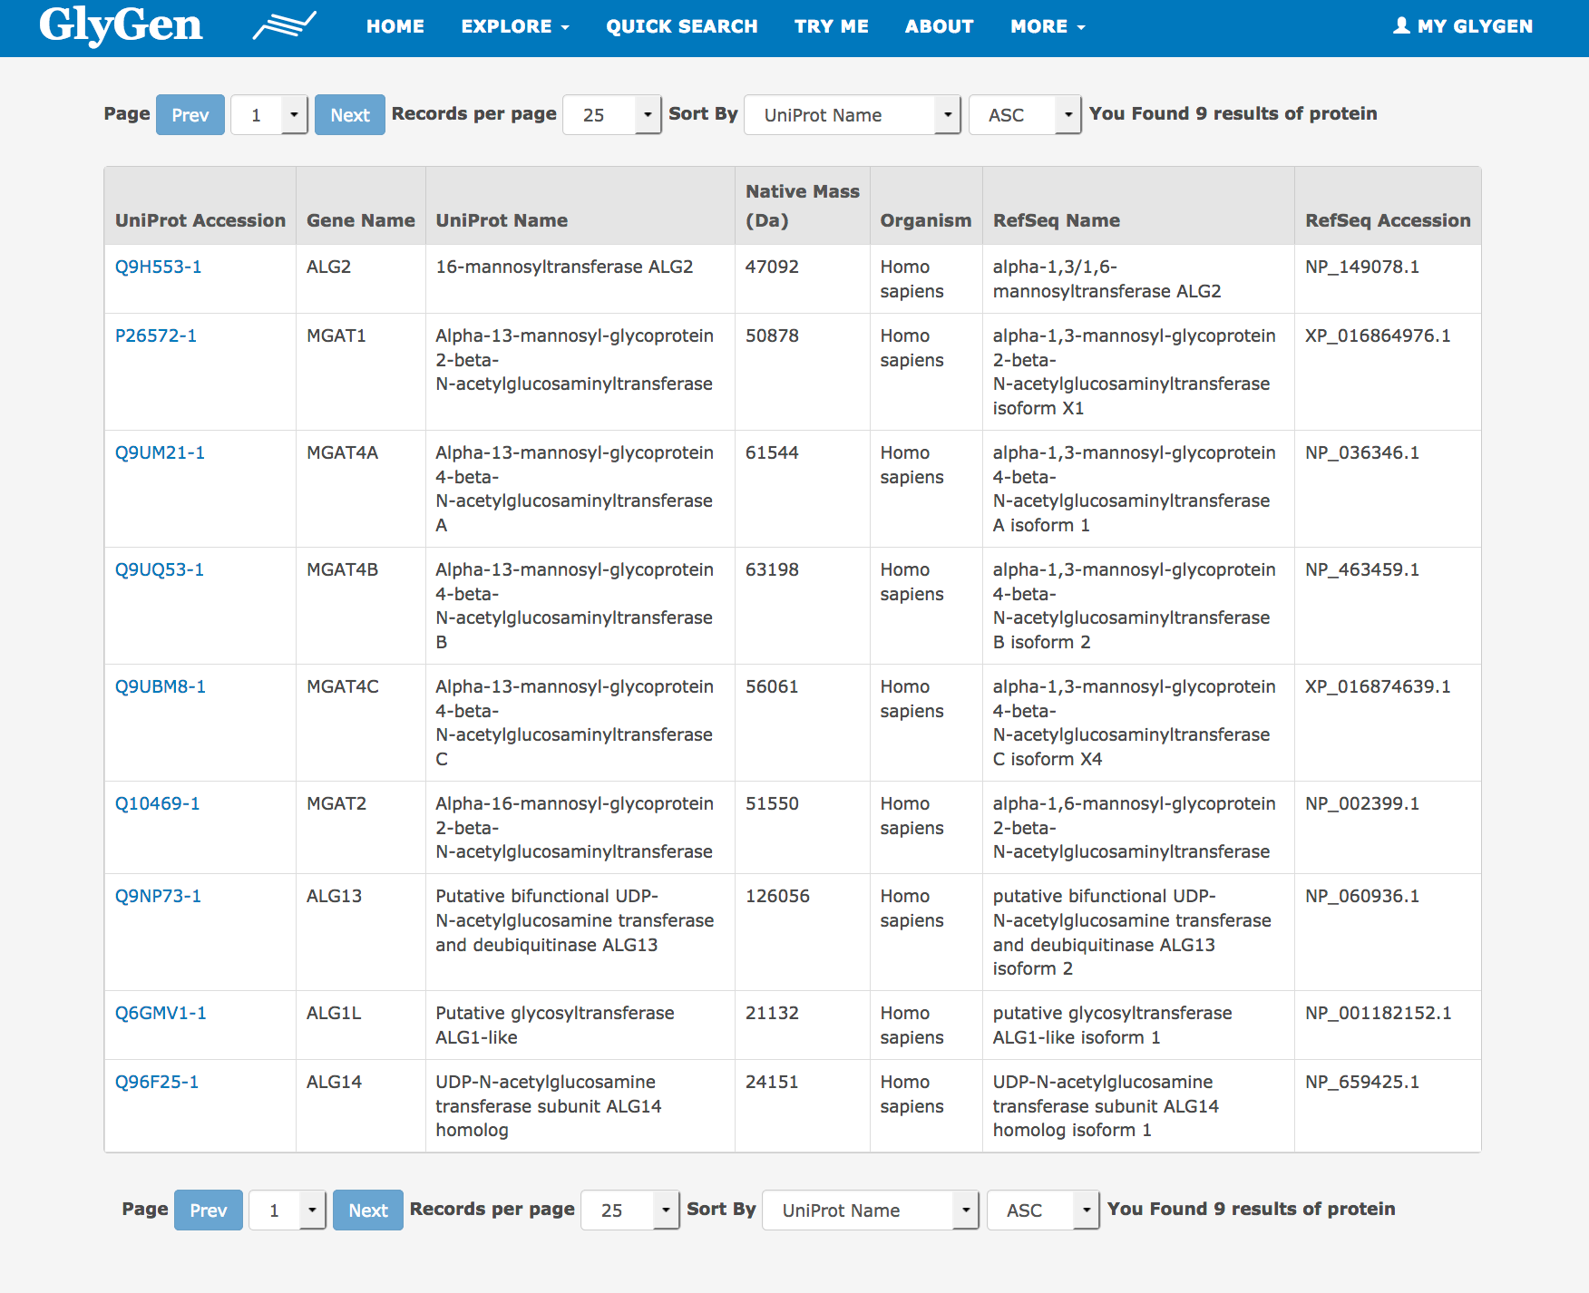
Quick Search – Predefined Queries

Slide 9



GlyGen Licenses
For Data
Share — copy and redistribute the material in any medium or format
Adapt — remix, transform, and build upon the material for any purpose, even commercially.
Attribution — You must give appropriate credit, provide a link to the license, and indicate if changes were made.
For Software/Source code
The GNU General Public License v3.0
Freedom to use the software for any purpose,
Freedom to change the software to suit your needs,
Freedom to share the software with your friends and neighbors, and
Freedom to share the changes you make.
Notes:
Licenses for most software and other practical works are designed to take away your freedom to share and change the works.

Slide 10
We Need Your Help
Comments and suggestions to improve the Portal
Identify errors in our data
Data-processing algorithms
New data sets and standard data formats
Quantitative Glycoproteomics with robust meta data

Slide 11
Our Data-Sharing Plan Facilitates Collaboration!

Slide 12
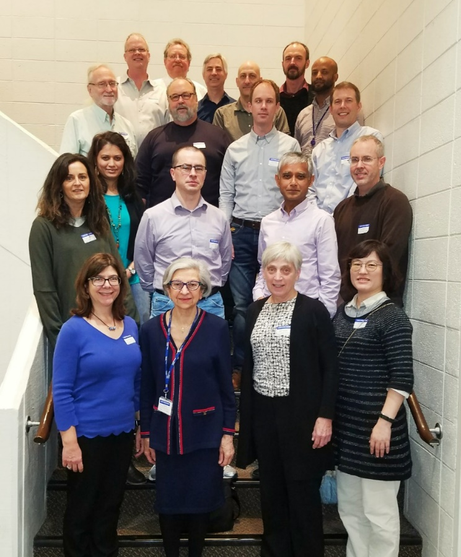








Acknowledgements
University of Georgia
Will York
Rene Ranzinger
Michael Pierce
Robert Woods
Rupali Mahadik
Tatiana Williamson
Sena Arpinar
Sanath Bhatt
Sujeet Kulkarni
Sandeep Nakarakommula
EMBL-EBI
Maria Martin
Leyla Jael Garcia Castro
Preethi Vasudev
NCBI
Kim Pruitt
Evan Bolton
The George Washington University
Raja Mazumder
Robel Kahsay
Jeet Vora
Rahi Navelkar
Reza Mousavi
Nagarajan Pattabiraman
Xavier Holmes
Brian Fochtman
Georgetown University
Nathan Edwards
Radoslav Goldman
Darren Natale
Karen Ross
Wenjin Zhang
Harvard University
Richard Cummings
The Jackson Laboratory
Judith Blake
Soka University
Kiyoko Aoki-Kinoshita
The Griffith University
Matthew Campbell
Imperial College London
Ten Feizi
Macquarie University
Nicki Packer
NIH-NCI
Jefferey Gildersleeve
NIH Grant - U01 GM125267-01

