Slide 1



Spatial analytics can draw automated congressional districts without bias.
Scenario:
Occasionally, the boundaries of congressional districts are purposefully drawn in a way to give an unfair advantage to a political party within a given state.
Objective:
Leverage population data, GPS data, and spatial analytics to generate unbiased congressional districts and reduce the drive time among congressional districts.
Built new potential congressional districts for New Jersey. The spatial analytic districts reduced the drive time within a district for 9 out of 12 districts while eliminating unnatural, biased drawings that may grant an unfair advantage to a political party.
Result:

Slide 2
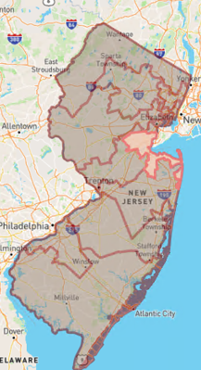
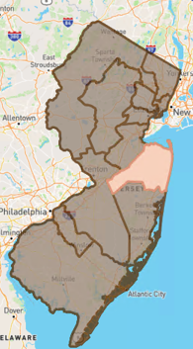
Unnatural and potentially biased drawn districts are eliminated when using spatial analytics.
Spatial Analytics Districts
Original Districts
Using spatial analytics, we can:
Draw boundaries that keep nearby communities together
Eliminate potentially biased hand drawn districts
Reduce the drive time within a district
Automate a manual process using a purely data driven approach

Slide 3
The spatial analytics approach analyzes New Jersey's 6,305 block groups to generate optimized congressional districts.
Step 1: Data Prep
Step 2: Define Constraints
Step 3: Solve Optimization
Identify the population % within each of New Jersey's 6,305 block groups
Calculate and create a matrix of the drive time from each block group centroid to another
Combine block groups to create millions of potential districts. Districts must be contiguous
Districts must contain a population % that falls within the set floor and ceiling range
New Jersey has 12 districts. If evenly split, each district would have ~8.3% of the population
I set the floor and ceiling at +/- 2.5% of 8.3% (Floor = 5.8%; Ceiling = 10.8%)
All block groups must be in the final selection
Use mixed integer linear programming to select the best set of districts while staying within the constraints
Goal = Minimize drive time

Slide 4
Future improvements include experimenting with a genetic algorithm for optimization
Consider Advanced Optimization Algorithms
Genetic Algorithm
Add Expert Based Rules
Consider Voting Rights Compliance Act
Granulary
Explore if population data is available at a lower level granularity than block group
Consider keeping cultural and/or economic communities intact
Tighten population % floor and ceiling bounds

