Slide 1





NEST Desktop (v2.4.0)
A web-based GUI for NEST Simulator
Sebastian Spreizer
CNS Workshop, 18th July 2020

Slide 2
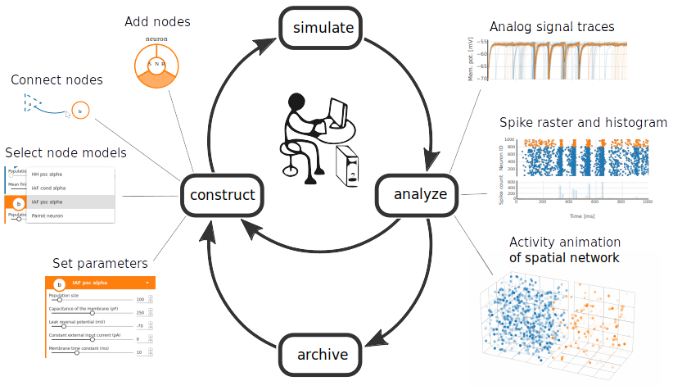
Conceptual approach
Spreizer et al. in preparation

Slide 3
Network editor
Spreizer et al. in preparation

Slide 4
From sketch to code
Spreizer et al. in preparation

Slide 5
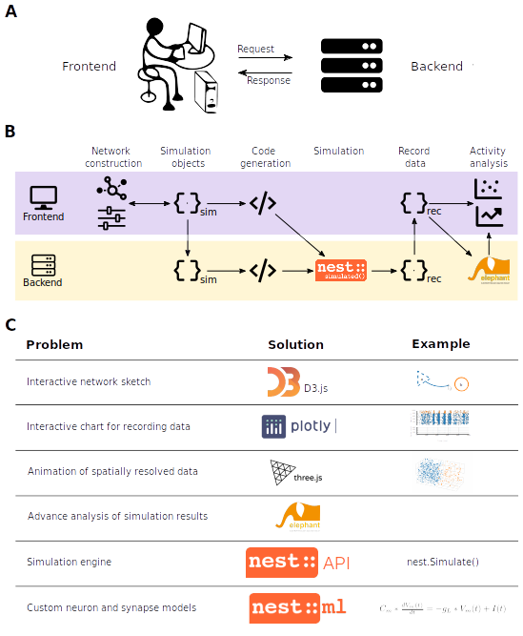
Workflow
Spreizer et al. in preparation

Slide 6
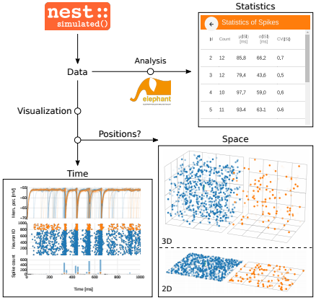
Explore activity
Spreizer et al. in preparation

Slide 7
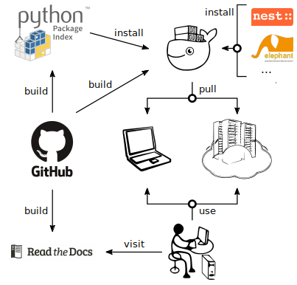
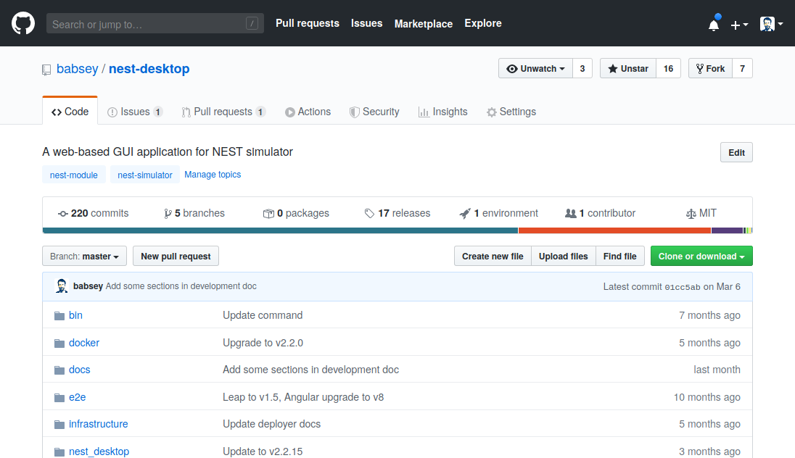
Open-source code
Spreizer et al. in preparation
https://github.com/babsey/nest-desktop

Slide 8
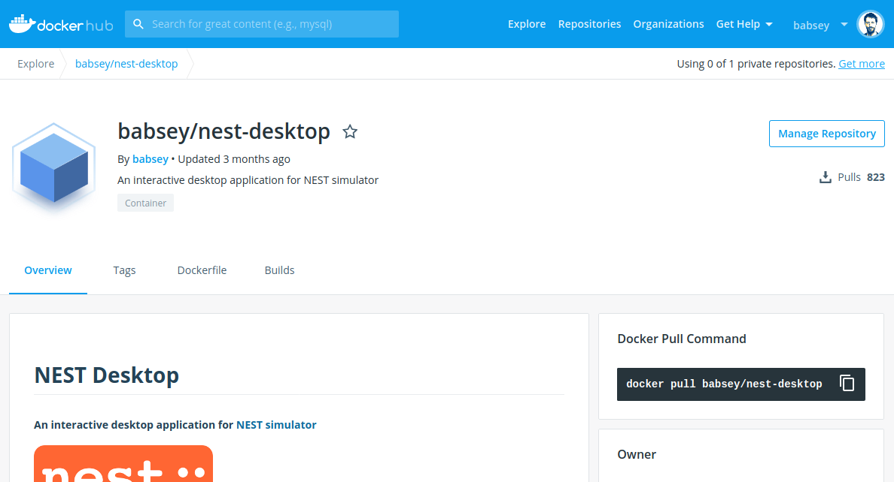
Run NEST Desktop locally
# Start nest-desktop in bash
docker run -it -p 5000:5000 -p 8000:8000 babsey/nest-desktop
Spreizer et al. in preparation

Slide 9
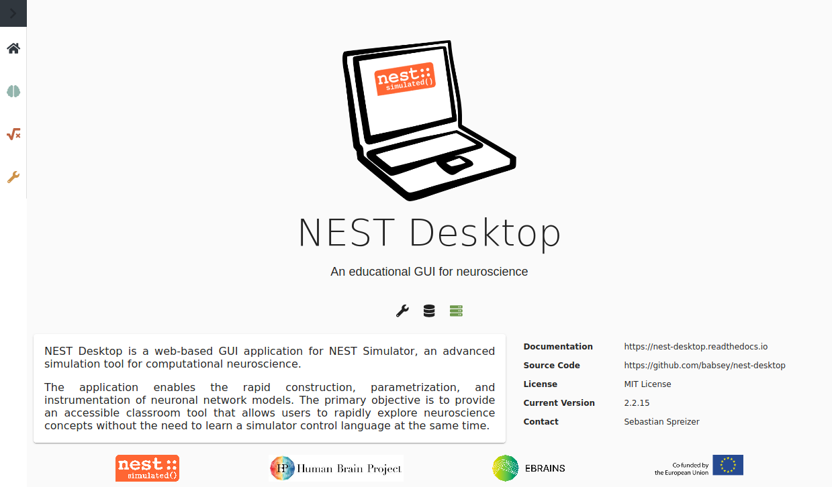
Online accessible
Spreizer et al. in preparation
https://nest-desktop.apps.hbp.eu

Slide 10
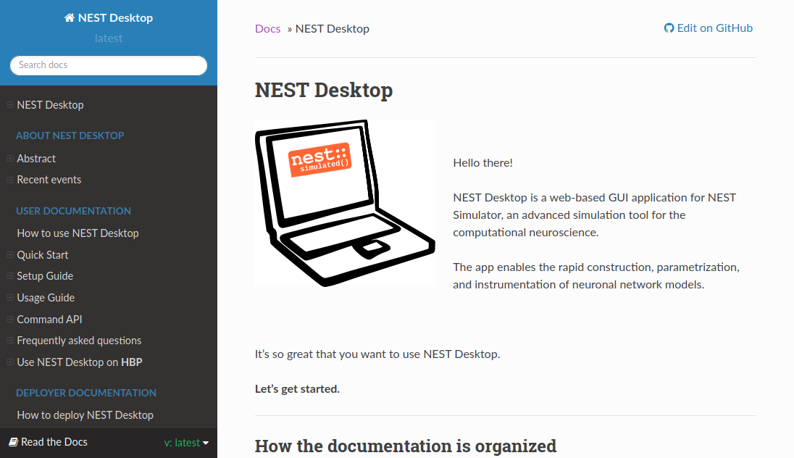
Documentation
Spreizer et al. in preparation
https://nest-desktop.readthedocs.io

Slide 11
Future perspectives
Feature | Projects
Custom neuron / synapse models | NESTML
Live simulation | Insite
Advance analysis | Elephant

Slide 12
Thank you.

Slide 13
Technical challenges
Spreizer et al. in preparation

