Slide 1



Modelling astrocyte functions with NEST
CNS 2024 Tutorial, 20.07.2024
PhD student Iiro Ahokainen
iiro.ahokainen@tuni.fi

Slide 2
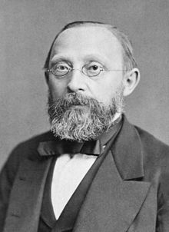
What are glial cells?
Glial cells are non-neuronal cells in the central and peripheral nervous system
that contribute to various functions in the developing and adult brain.
Types of glial cells:
Schwann cells – Axonal conduction
Oligodendrocytes – Axonal conduction
Astrocytes – Neuronal and vascular control
Microglia - Maintenance
Ependymal cells – Cerebrospinal fluid control
Radial glia – Guidance of neuronal development
NG2 glia – ”Multipotent” cells
Discovered by a pathologist Rudolf Virchow in 1856.
Glial complexity and number increases with the overall complexity of the nervous system.
Kettenmann & Ransom, 2013
Kettenmann & Verkhartsky, 2013

Slide 3
Astrocytes have important roles in many brain functions
Pre- and postnatal development
Energy metabolism
Homeostasis and survival
Neurology and neuropsychiatry diseases
Plasticity learning memory cognition
Epilepsy
Initiate neurogenesis
Support blood-brain barrier functions
Maintain extracellular ionic balance
Synaptic transmission (controversy)
Schizophrenia
Structure the brain
Control glucose
Take up neuro-transmitters
Parkinson’s disease
Synaptic plasticity
(controversy)
Maturate and prune synapses
Provide nutrients
Dementias, Alzheimer’s
Linne (2024) Current Opinion in Neurobiology
De Ceglia et al. (2023) Nature
Bazargani & Attwell (2016) Nature Neuroscience
Notes:
During development, astrocytes help initiate neurogenesis, form the physical structure of the brain and take part in maturation and pruning of synapses.
They are thought to play a number of active roles, including the absorption and secreation of neural transmitters and maintenance of the blood–brain barrier.
The concept of a tripartite synapse has been proposed, referring to the tight relationship occurring at synapses among a presynaptic element, a postsynaptic element and a glial element.

Slide 4
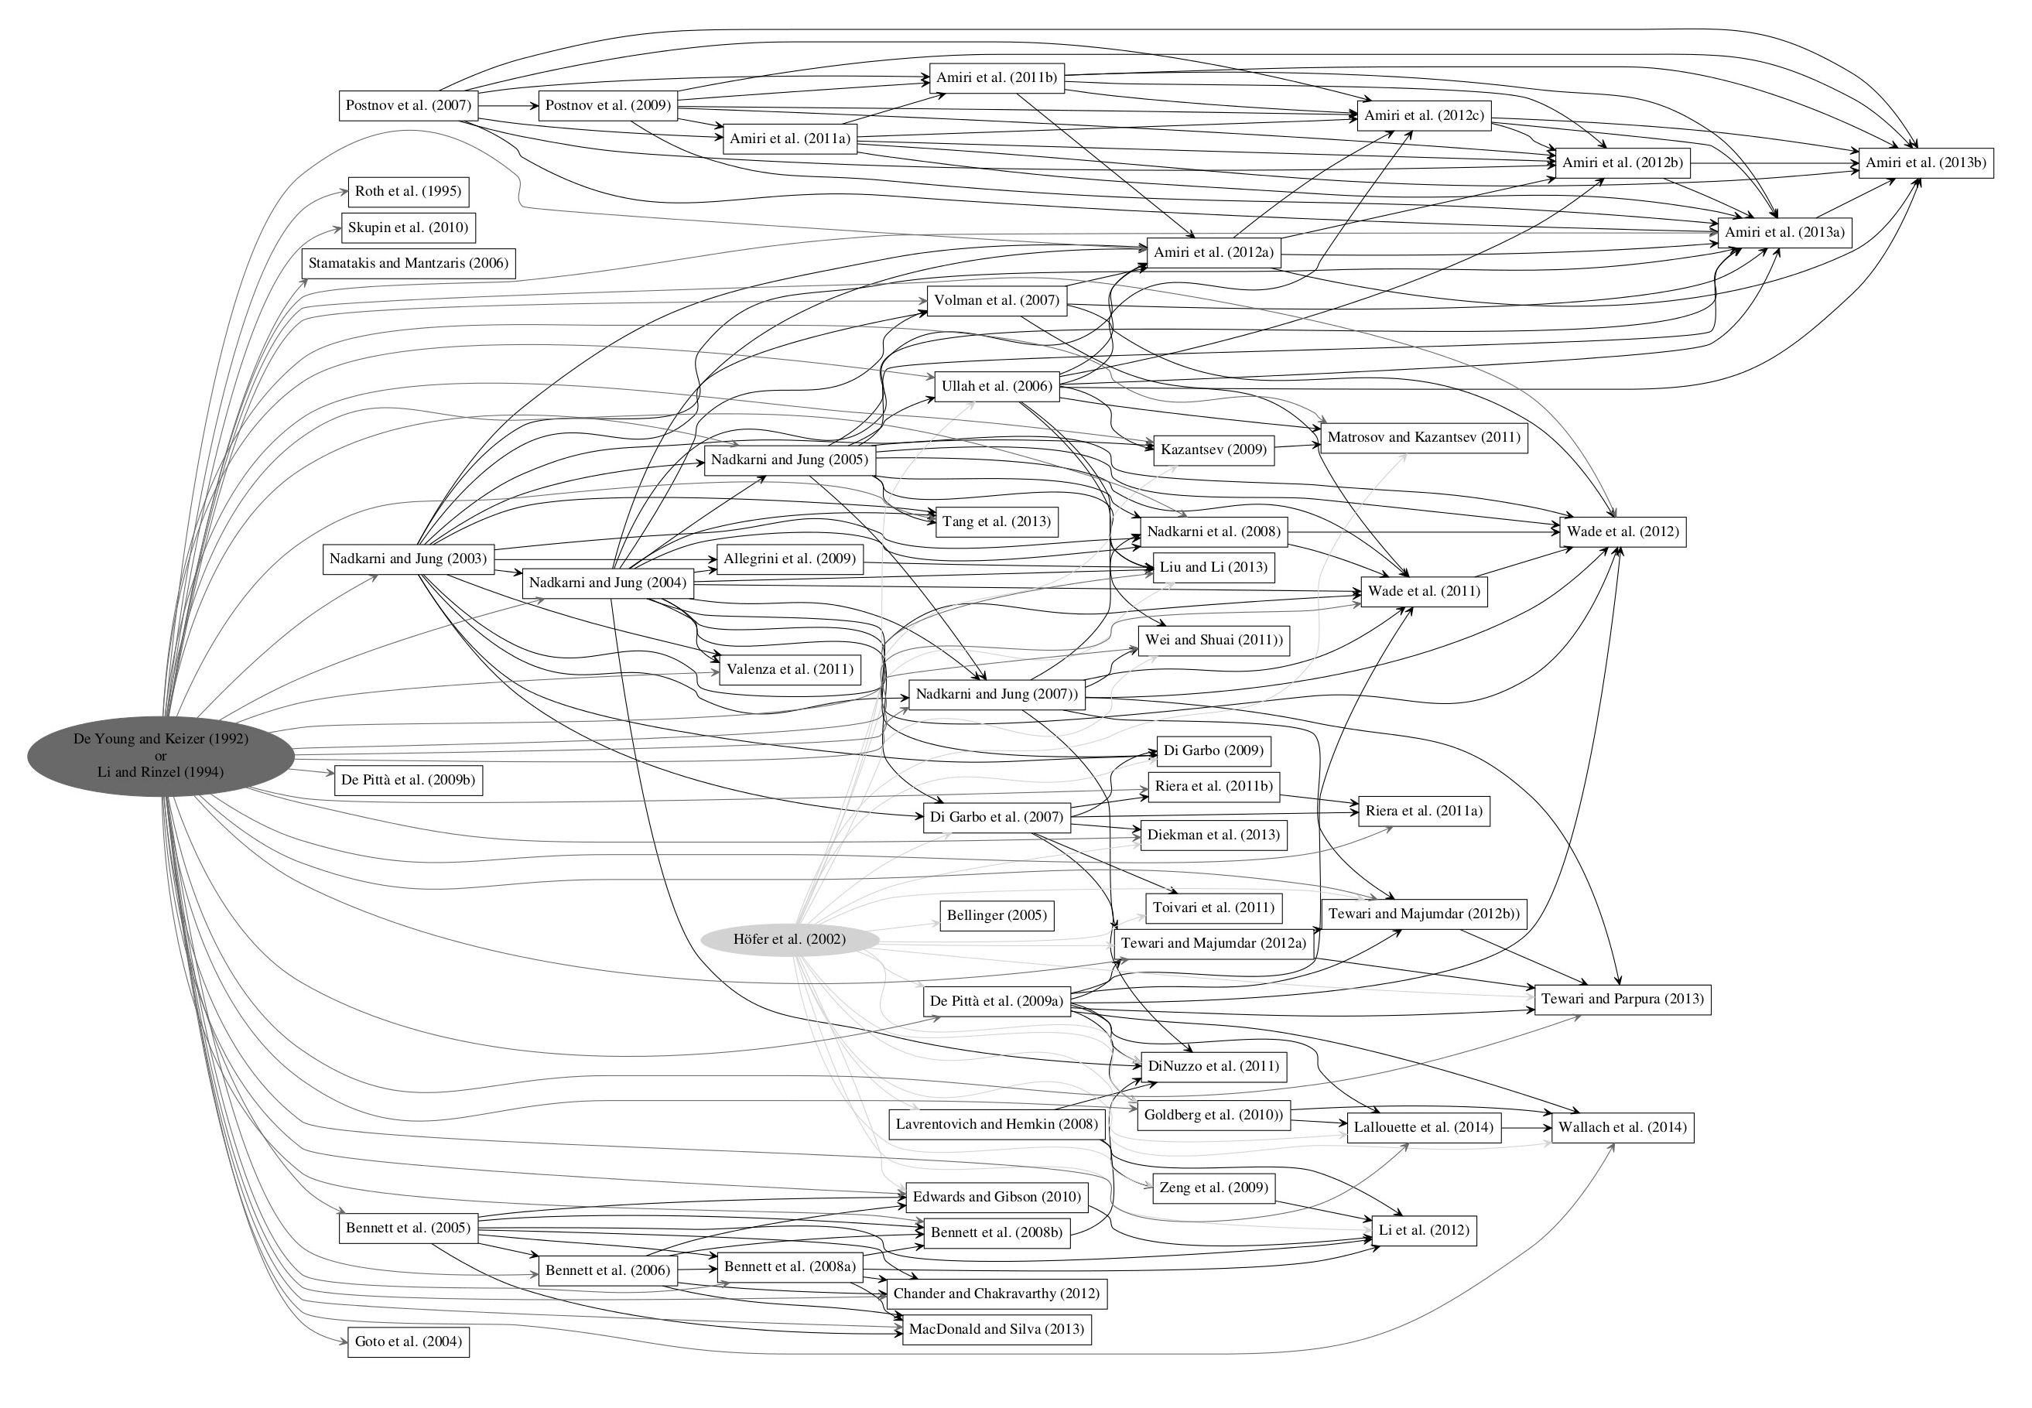
De Young and Keizer 1992
Li and Rinzel 1994
(more phenomenological
than Höfer et al.)
Höfer et al. 2002
(more biophysical)

Slide 5
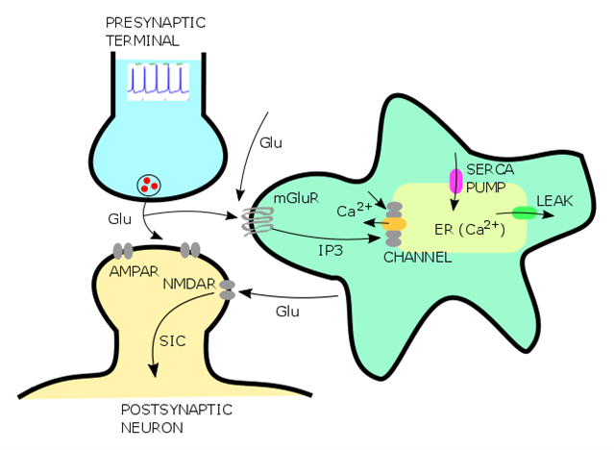
Modelling Slow Inward Current (SIC)
Modelled astrocyte components (dynamic states):
  Cytosolic calcium [Ca²⁺]c(t)
  Free Inositol Trisphosphate (IP3) [IP3](t)
  Fraction of open IP3 receptor channels h
The total amount of calcium in astrocyte is fixed
SIC is given as a logarithmic transformation from a scaled [Ca²⁺]c(t)
See Refs.
Young&Keizer (1992) Proceedings of National Academy of Sciences,
Li&Rinzel (1994) Journal of Theoretical Biology,
Nadkarni&Jung (2003) Physical Review Letters

Slide 6
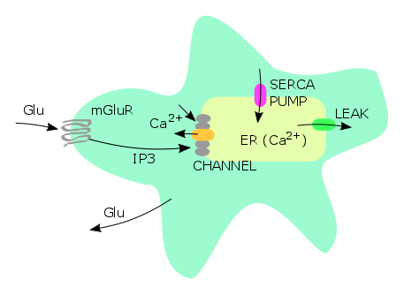
Calcium dynamics in astrocyte
IP3 concentration:
Cytosolic calcium:
Calcium currents:
IP3R gating variable:
Intermediate variables:

Slide 7
SIC to postsynaptic neuron
SIC from astrocyte to postsynaptic neuron is modelled as a logarithm of a scaled calcium (Nadkarni&Jung, 2003):

Slide 8
Model in brief
Presynaptic excitatory spike releases glutamate which activates free IP3 production in astrocyte.
IP3 opens SERCA channel which releases calcium from ER to cytosol
Cytosolic calcium induces glutamate release to perisynaptic areas of the postsynpatic neuron.
Perisynaptic NMDA receptors are activated and SIC is generated.

Slide 9
Notebooks outlook
astrocyte_single.ipynb - calcium dynamics in astrocyte
astrocyte_interaction.ipynb - single astrocyte interacting with pre- and postsynaptic neurons
astrocyte_small_network.ipynb - exploring different coupling rules
astrocyte_brunel.ipynb - balanced network simulation with astrocytes

