Slide 1
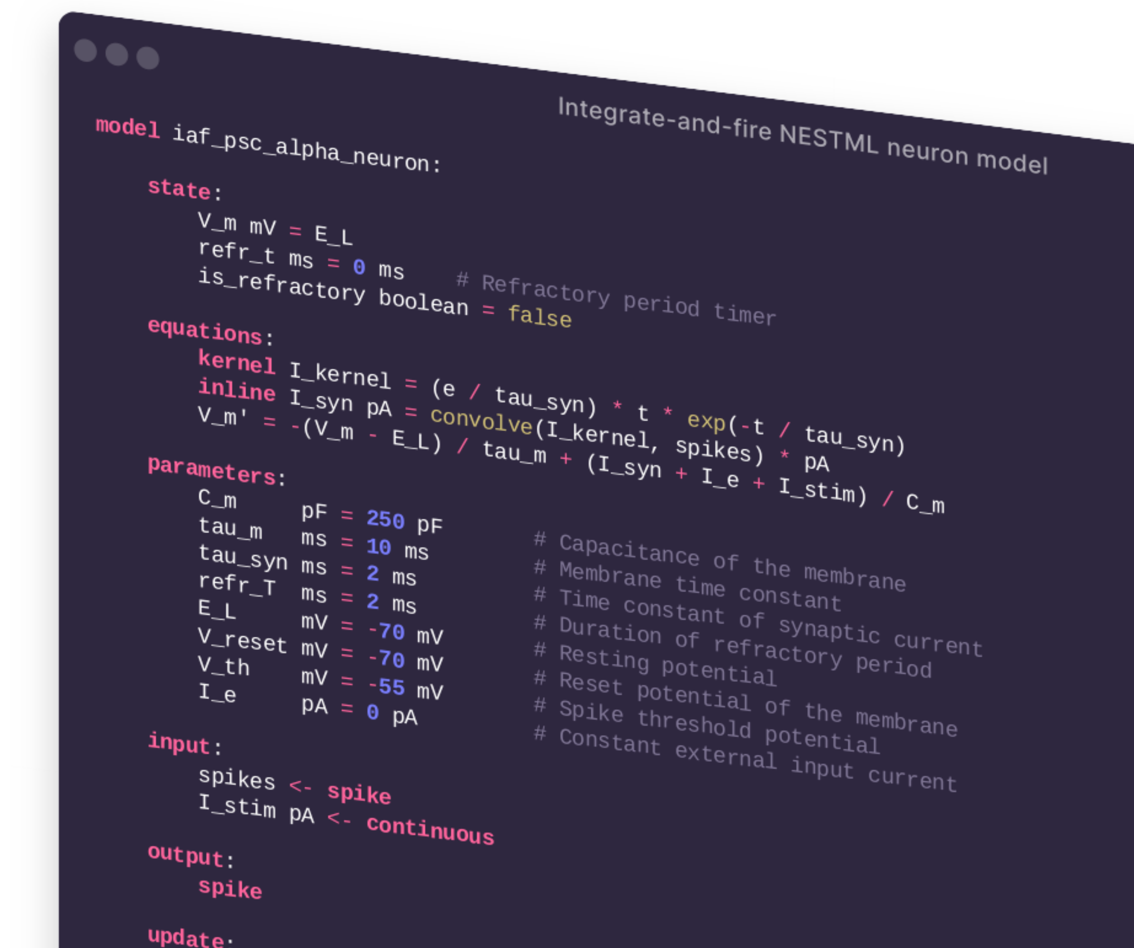
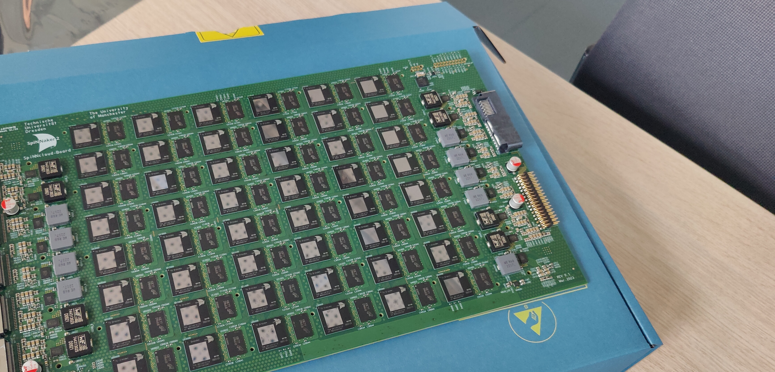



Modeling and simulating neuron models from NESTML on neuromorphic hardware
Charl Linssen & Pooja Babu | NEST Conference 2026 | ​June 16th, 2026
Co-funded by
the European Union
Notes:
XML is a classic political compromise: it balances the needs of man and machine by being equally unreadable to both.
- Matthew Might
1

Slide 2


Welcome!
T+00:00 Tutorial overview and accounts setup
T+00:10 Introduction to NESTML
T+00:20 Hands-on part 1: Generating code
T+00:30 Hands-on part 2: Single-neuron characterisation
T+00:40 Hands-on part 3: Balanced network
Charl Linssen
Pooja N. Babu
Notes:
2

Slide 3
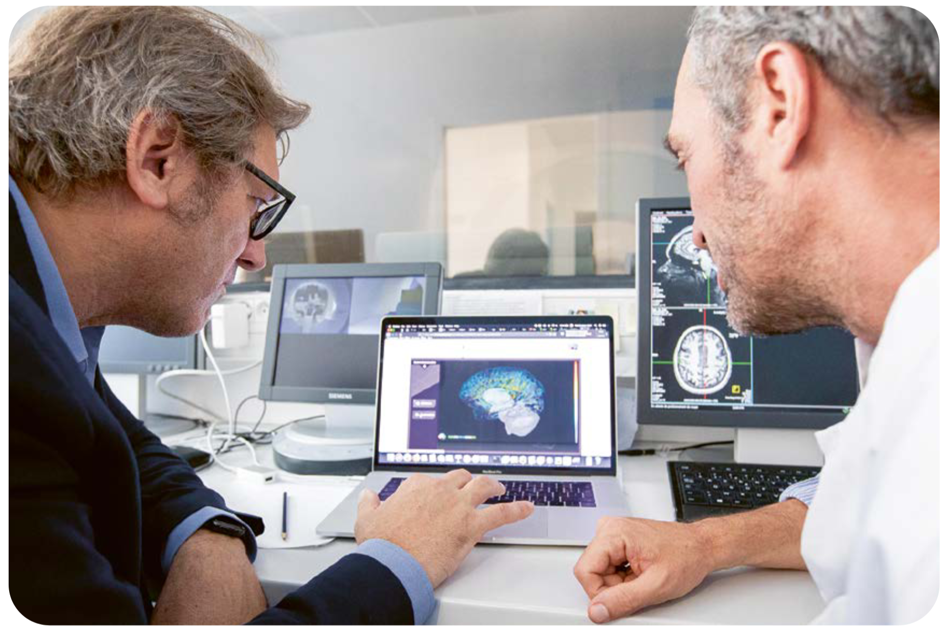
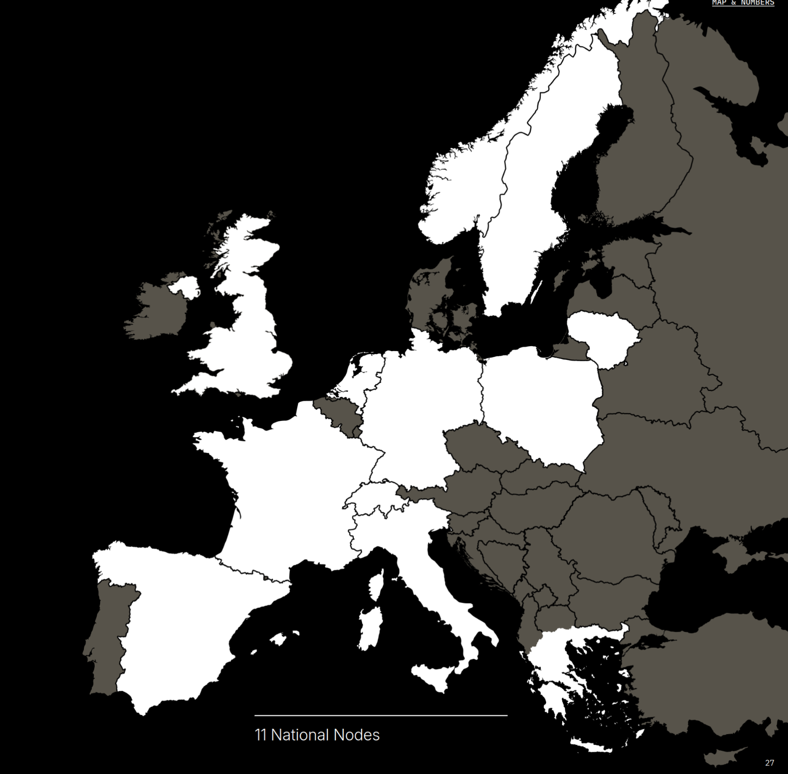
Prerequisites: access SpiNNaker via EBRAINS
EBRAINS is an integrated digital brain research and simulation platform. It provides cloud computing services for free.
To run the software used in this tutorial on EBRAINS, please create an account at:
https://ebrains.eu/sign-up
Co-funded by
the European Union
Notes:
- browser: Chrome or Firefox
3

Slide 4
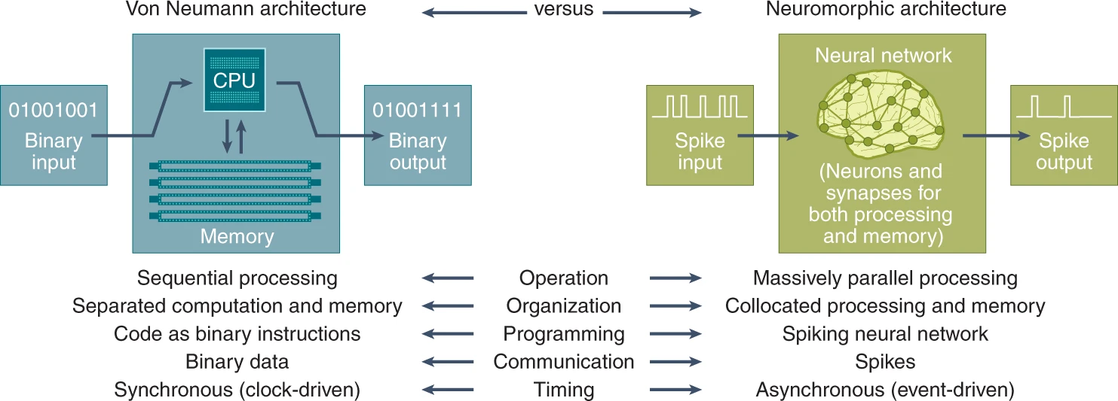
Introduction to neuromorphic computing
Schuman et al. 2022
Notes:
Highly parallel operation: neuromorphic computers are inherently parallel, where all of the neurons and synapses can potentially be operating simultaneously; however, the computations performed by neurons and synapses are relatively simple when compared with the parallelized von Neumann systems.
Collocated processing and memory: there is no notion of a separation of processing and memory in neuromorphic hardware. Although neurons are sometimes thought of as processing units and synapses are sometimes thought of as memory, the neurons and synapses both perform processing and store values in many implementations. The collocation of processing and memory helps mitigate the von Neumann bottleneck regarding the processor/memory separation, which causes a slowdown in the maximum throughput that can be achieved. In addition, this collocation helps avoid data accesses from main memory, as in conventional computing systems, which consume a considerable amount of energy compared with the compute energy⁴.
Inherent scalability: neuromorphic computers are meant to be inherently scalable as adding additional neuromorphic chips entails increasing the number of neurons and synapses that can be realized. It is possible to take multiple physical neuromorphic chips and treat them as a single large neuromorphic implementation to run larger and larger networks. This has been successfully accomplished across a variety of large-scale neuromorphic hardware systems, including SpiNNaker^{5,6} and Loihi⁷.
Event-driven computation: neuromorphic computers leverage event-driven computation (meaning, computing only when data are available) and temporally sparse activity to allow for extremely efficient computation^{8,9}. Neurons and synapses only perform work when there are spikes to process, and typically, spikes are relatively sparse within the operation of the network.
Many current examples: IBM TrueNorth; Intel Loihi (both digital); BrainScaleS project in Heidelberg (actual analog electronics!)

Slide 5
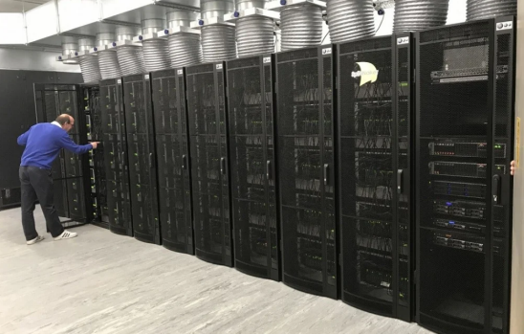
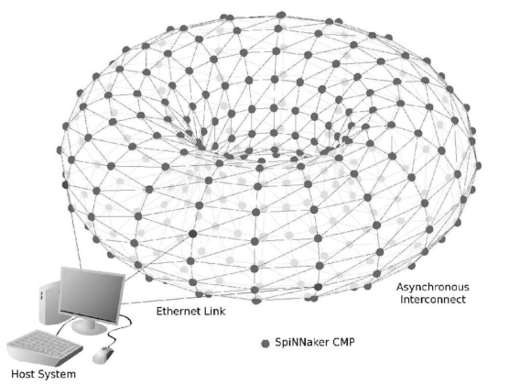
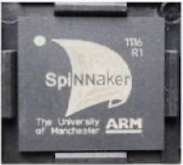
Introduction to SpiNNaker
SpiNNaker is a neuromorphic computing system designed to simulate large-scale spiking neural networks in real-time.
It features a massively parallel architecture comprising up to a million 32-bit ARM9 cores, interconnected through a toroidally wired, packet-based communication network, achieving high-speed, low-latency interprocessor communication.
Notes:
- browser: Chrome or Firefox
5

Slide 6
Accessing SpiNNaker via EBRAINS
EBRAINS is an integrated digital brain research and simulation platform. It provides cloud computing services for free.
To run the software used in this tutorial on EBRAINS, please create an account at:
https://ebrains.eu/sign-up
Co-funded by
the European Union
Notes:
- browser: Chrome or Firefox
6

Slide 7
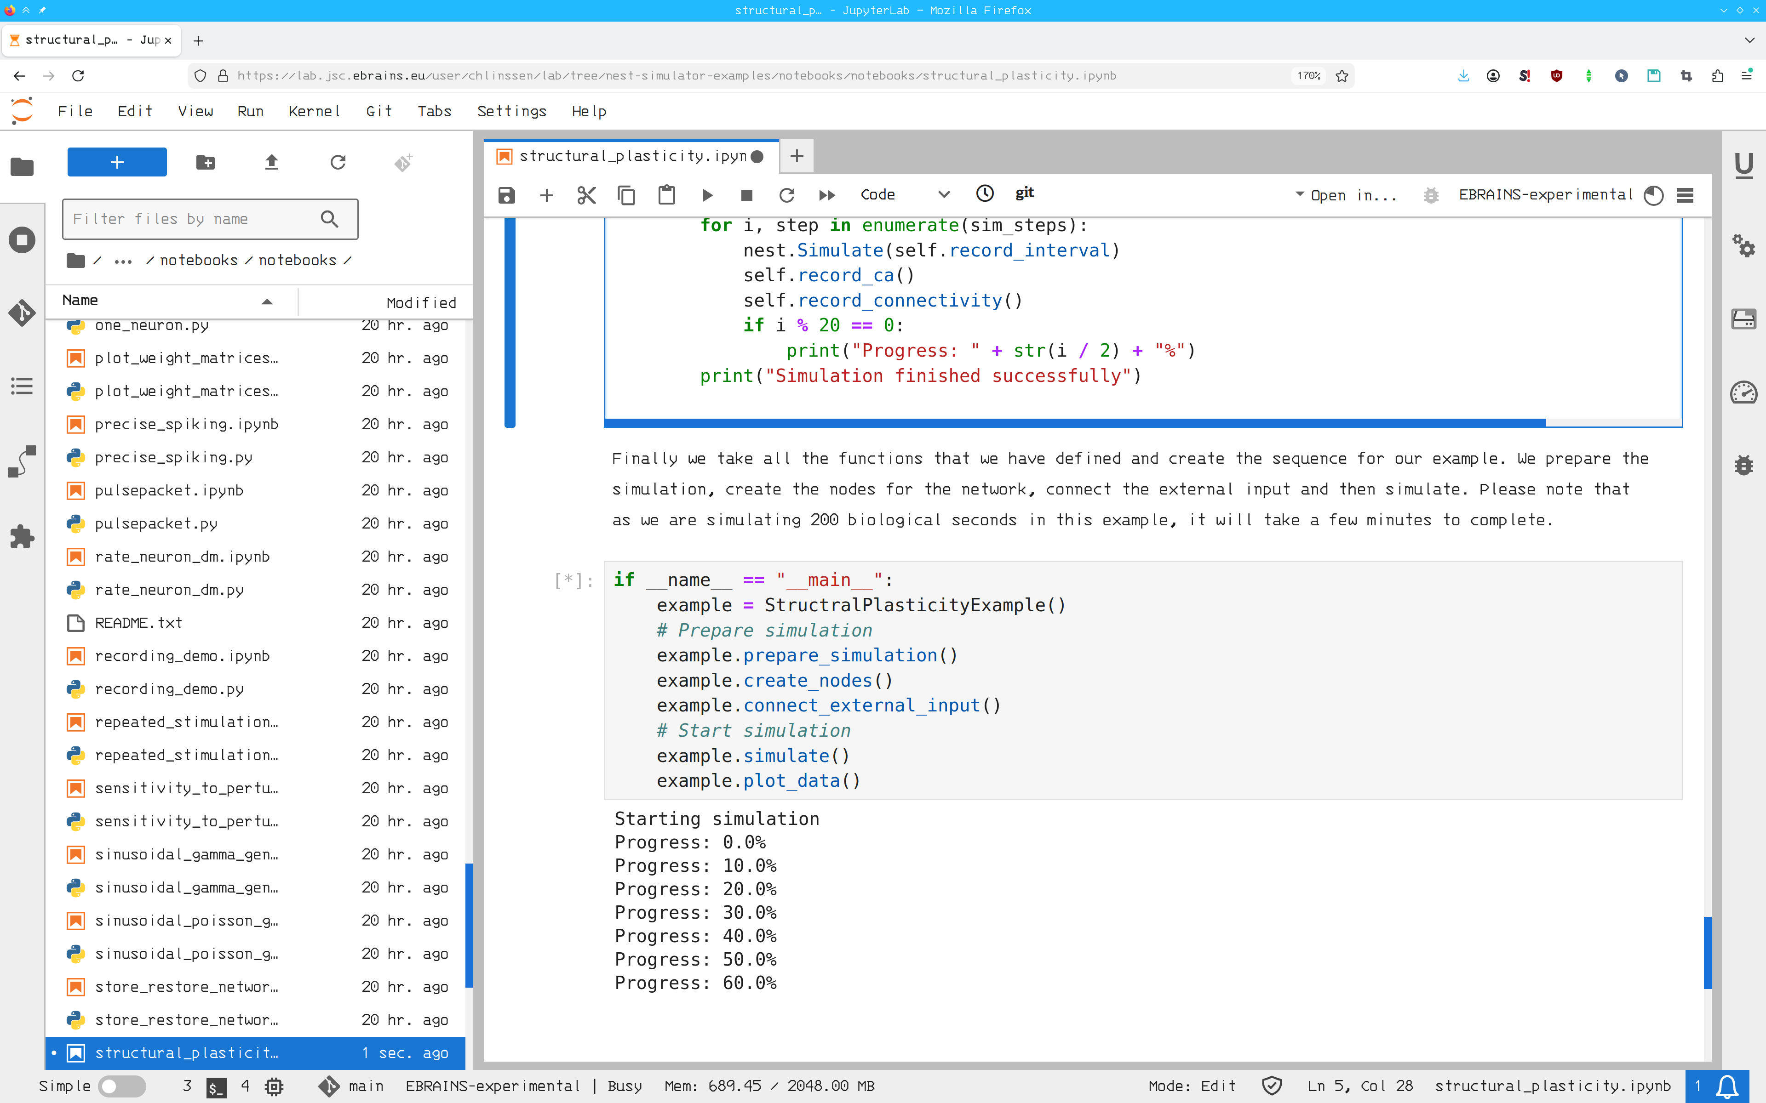

Python programming and JupyterLab
JupyterLab is an interactive graphical user interface (GUI) for the Python programming language.
Usage tips:
Shift+Return runs a single cell.
Use the icon in the toolbar to run all cells.
For an advanced JupyerLab tutorial, see e.g. https://realpython.com/using-
jupyterlab/
Code will run inside an EBRAINS VM with 2 GB RAM. Files stored in your VM home directory can disappear—save them locally for safekeeping!
Notes:
- browser: Chrome or Firefox
7

Slide 8
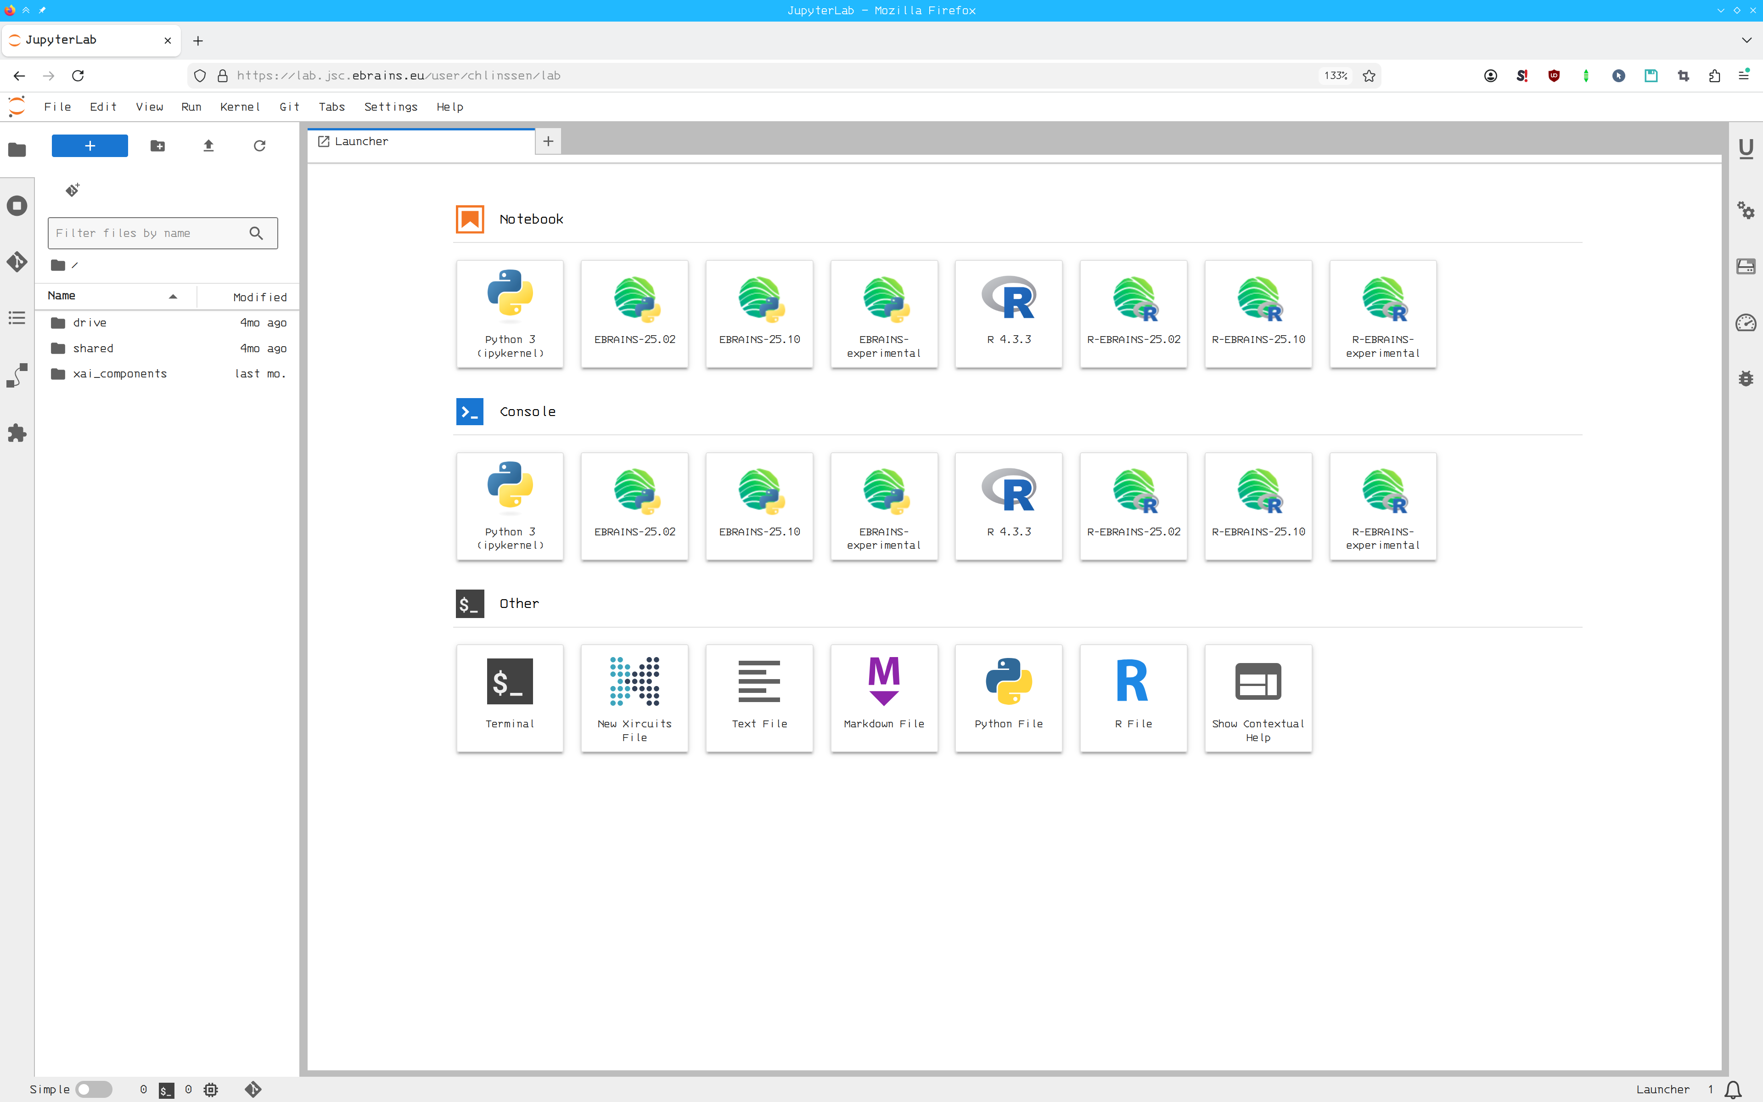
Where to find materials?
① Use your browser to go to the URL:
https://lab.ebrains.eu/
Select JSC as execution site.
② Open a terminal and run (one line):
git clone https://github.com/clinssen/ebrains-nestml-spinnaker
③ Open any of the downloaded
notebooks
①
③
②
Notes:
- browser: Chrome or Firefox
8

Slide 9
Part 1: Generating code for the neuron model
① Open the notebook:
spinnaker_nestml_code_gen.ipynb
② Run the entire notebook by clicking
the icon.
This may take a few minutes as it
installs and compiles the entire
SpiNNaker development software
stack.
It then generates and compiles code
for SpiNNaker for the NESTML
iaf_psc_exp model.
①
Notes:
9

Slide 10
Part 2: Characterising the single-neuron model
① Open the notebook:
spinnaker_nestml_neuron
_characterisation_exercise.ipynb
② Run the entire notebook by clicking
the icon.
A simulation will run that produces a
plot of excitatory postsynaptic
potentials.
③ Excercise: Add another spike
generator for inhibitory spikes.
①
Notes:
10

Slide 11
Part 3: Balanced network model
① Open the notebook:
spinnaker_balanced_network.ipynb
② Run the entire notebook by clicking
the icon.
A simulation will run that produces a
rastergram and a plot of membrane
potentials.
③ Excercise: Change the ratio of excitation
to inhibition and external input rate to
achieve synchronous network firing.
Add code for plotting firing rate and ISI
distribution.
①
Notes:
11

Slide 12
Further reading
NESTML:
https://nestml.readthedocs.io/
SpiNNaker:
https://spinnakermanchester.github.io/
Questions? Email Charl or Pooja!
<c.linssen@fz-juelich.de>
<p.babu@fz-juelich.de>
Notes:
12

