Slide 1
Diabetes Prediction Using Machine Learning
- SELVA CLINTON M

Slide 2
Introduction
Diabetes is a chronic disease affecting millions worldwide.
Early detection through machine learning can help manage and prevent complications.
This project compares different machine learning models for diabetes prediction.

Slide 3
Dataset - PIMA Indian Diabetes Dataset
The dataset contains 768 records of female patients aged 21 and above.
Features include glucose level, BMI, insulin, age, and more.
The outcome variable indicates diabetes diagnosis (1: Diabetic, 0: Non-Diabetic).

Slide 4
Data Preprocessing
Handled missing values using median imputation.
Applied SMOTE for handling class imbalance.
Scaled features using StandardScaler.
Splitted data into 80% training and 20% testing.

Slide 5
Machine Learning Models Used
1. Logistic Regression
2. Support Vector Machine (SVM)
3. Random Forest Classifier
4. XGBoost
5. Multi-Layer Perceptron (MLP)

Slide 6
Evaluation Metrics
Accuracy: Measures the percentage of correctly predicted cases.
Precision: Identifies the proportion of actual positives among predicted positives.
Recall: Measures the proportion of actual positives correctly identified.
F1 Score: Harmonic mean of precision and recall.

Slide 7
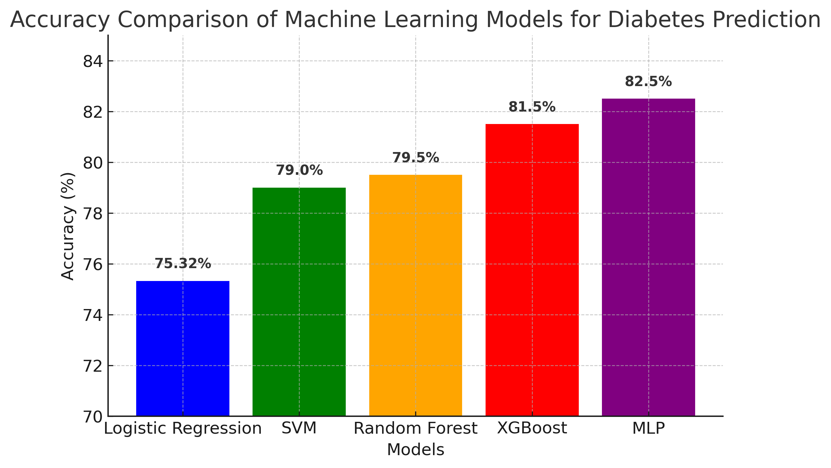
Model Accuracy Comparison

Slide 8
Conclusion
Machine learning is effective for diabetes prediction.
XGBoost and MLP showed the highest accuracy among all models.
Early detection of diabetes can help in effective treatment and management.
Future work can explore deep learning for enhanced accuracy.

