Slide 1

UNIVERSITY COLLEGE OF ENGINEERING VILLUPURAM
(A Constituent College of Anna University, Chennai)
DEPARTMENT OF INFORMATION TECHNOLOGY - 2025
DETECTION OF ACUTE LYMPHOBLASTIC LEUKEMIA USING MULTI-CNN FEATURE EXTRACTION AND XGBOOST CLASSIFIER
GUIDED BY :
Mr. R. MURALIKRISHNAN,
Teaching Fellow,
Department of IT,
UCEV .
PRESENTED BY:
AROCKIA MATHAN S (422521205005),
RAMAN R (422521205307),
SARATHY P (422521205038),
SELVA CLINTON M (422521205040).

Slide 2
AGENDA
ABSTRACT
INTRODUCTION
LITERATURE SURVEY
EXISTING WORK
PROBLEM DEFINITION
PROPOSED WORK
PSUDOCODE
FLOW DIAGRAM
MODULES
TOOLS REQUIRED
OUTPUT

Slide 3
ABSTRACT
This study presents a deep learning ensemble model for the early detection of Acute Lymphoblastic Leukemia (ALL) using microscopic blood smear images. Features are extracted using four pre-trained CNNs—EfficientNetB7, ResNet152V2, DenseNet201, and InceptionV3. These features are fused and classified using an XGBoost meta-learner for high diagnostic accuracy. The model achieved 98.65% accuracy with excellent precision, recall, and AUC scores. Data augmentation and transfer learning enhanced generalization. The system supports reliable multi-class classification of leukemia stages, aiding timely and accurate medical diagnosis.

Slide 4
INTRODUCTION
Acute Lymphoblastic Leukemia (ALL) is a rapidly spreading blood cancer that affects white blood cells. Early detection is crucial to improve treatment outcomes and survival rates.
Traditional diagnostic methods are slow and require expert interpretation. They can lead to errors, especially in identifying early-stage leukemia.
Artificial Intelligence and deep learning can analyze medical images with high speed and accuracy. These technologies help detect subtle changes that may be missed by human eyes.
This project uses an ensemble of deep learning models to classify blood smear images. It identifies four stages of leukemia: Benign, Early, Pre, and Pro.
The system improves diagnostic accuracy and reduces the time needed for analysis. It supports healthcare professionals in making quicker and more reliable decisions.

Slide 5
LITERATURE REVIEW
S.No | Title | Authors (Year) | Model/Method | Drawbacks
1 | DL4ALL: A Multi-Task, Cross-Dataset Transfer Learning Framework for ALL Detection | Genovese et al. (2023) | EfficientNet-B0, Multi-task learning (classification + segmentation) | Requires significant computational resources for multi-task training
2 | Deep Transfer Learning for Leukemia Cell Detection Using ResNet50 and VGG16 | Fata et al. (2023) | ResNet50, VGG16 with transfer learning | May overfit small datasets despite transfer learning; limited model customization

Slide 6
S.No | Title | Authors (Year) | Model/Method | Drawbacks
3 | Hybrid CNN-ML Classifier for Leukemia Detection | Ahmed et al. (2023) | CNNs (VGG19, DenseNet121, InceptionV3) + ML classifiers (SVM, RF, DT, k-NN) | Increased complexity and risk of overfitting due to multi-model fusion
4 | ALLNet: A Specialized CNN for ALL Detection | Mattapalli and Athavale (2023) | Custom CNN (ALLNet) | Limited generalizability beyond ALL due to domain-specific design
6 | Leukemia Diagnosis Using Deep Learning in Clinical Environments | Zhou et al. (2021) | CNNs with real clinical data | Requires thorough preprocessing; affected by inconsistent data quality

Slide 7
EXISTING WORK
DL4ALL: Multi-Task Cross-Dataset Transfer Learning for Acute Lymphoblastic Leukemia Detection - Angelo Genovese, Vincenzo Piuri, Konstantinos N. Plataniotis, and Fabio Scotti.
IEEE ACCESS (Volume 11, 2023).
Existing work focuses on using deep learning models like ResNet, VGG, and EfficientNet for leukemia detection from blood smear images. One advanced method, DL4ALL, uses cross-dataset transfer learning to improve model performance by learning from both source and target domains.
These models extract features from images and classify them into leukemia or non-leukemia. Some combine classification and segmentation to highlight affected cells more accurately.

Slide 8
Although effective, existing methods often rely on a single CNN model, which limits feature diversity and generalization. They also require large datasets, complex training processes, and high computational resources.
Because of these challenges, existing systems may not perform well in real-time clinical environments, especially where data and hardware are limited.
Extracted features may not be rich enough when using a single network, leading to reduced classification accuracy, especially in multi-class scenarios.

Slide 9
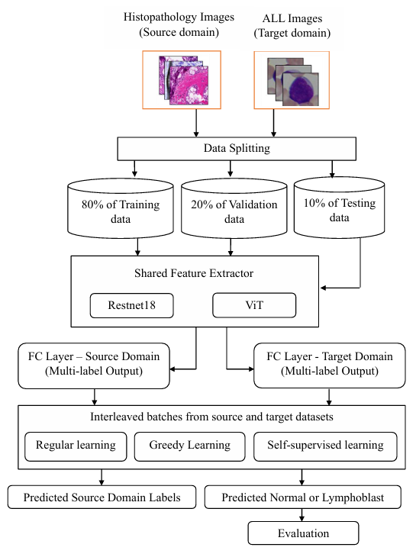
EXISTING WORK ARCHITECTURE

Slide 10
PROBLEM STATEMENT
Most existing models rely on a single CNN architecture, which limits the diversity of extracted features and affects classification accuracy.
DL4ALL and similar methods require large, labeled datasets and high computational resources, making them hard to deploy in real-world clinical settings.
Training procedures are complex, involving multiple stages like cross-dataset learning and self-supervision, which increase implementation difficulty.
These models may overfit to specific datasets and struggle to generalize well across varied image sources and patient demographics.
There is limited support for multi-class classification of different leukemia stages, reducing their effectiveness in early and detailed diagnosis.

Slide 11
PROPOSED WORK
Acute Lymphoblastic Leukemia (ALL) is a fast-growing blood cancer requiring early diagnosis.
Manual diagnosis via blood smear images is time-consuming and error-prone.
This project proposes a deep learning-based ensemble model for classifying ALL subtypes.
Combines features from EfficientNetB7, ResNet152V2, DenseNet201, InceptionV3.
A meta-learner (XGBoost) is trained on the fused features to classify:
Benign, Early, Pre, Pro ALL subtypes.

Slide 12
Ensemble Learning for Blood Cancer Detection
Ensemble learning enhances accuracy by combining multiple deep learning models, leveraging their strengths for robust and precise predictions.
Stacked Ensemble Model:
I utilize a stacking-based ensemble method combining four deep learning models for feature extraction and an XGBoost meta-learner for final classification.
Model Architecture:
EfficientNetB7
Extracts fine-grained blood cell details for high-resolution image analysis.
ResNet152V2
Captures deep hierarchical features, improving detection of subtle abnormalities.
DenseNet201
Enhances gradient flow, preventing information loss in complex patterns.
InceptionV3
Identifies multi-scale features, detecting variations in blood cell structures.
XGBoost (Meta-Learner)
Combines predictions from the above models for improved classification accuracy.

Slide 13
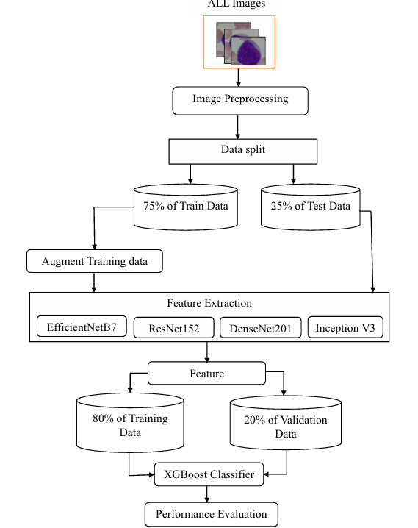
PROPOSED WORK ARCHITECTURE

Slide 14
FLOW DIAGRAM
User Input
(Blood Cell Image)
Preprocessing
Dataset Splitting
Feature Extraction
Feature Concatenation
XGBoost Classification
Diagnosis Result

Slide 15
MODULES
1. Data Ingestion Module
Loads blood smear images from four categories: Benign, Pre, Pro, and Early.
Uses OpenCV to read and convert images to a consistent format (RGB).
Resizes all images to 224×224 pixels to match CNN input requirements.
Assigns numeric labels based on folder names for further processing.
2. Preprocessing Module
Normalizes pixel values to the [0,1] range to improve training efficiency.
Applies data augmentation using Albumentations (rotation, flipping, CLAHE, etc.).
Enhances model generalization and addresses class imbalance.Ensures consistent image format and dimensions across the dataset.

Slide 16
3. Dataset Splitting Module
Splits the dataset into training (60%), validation (15%), and testing (25%) sets.
Uses stratified sampling to maintain equal class distribution in each split.
Enables separate stages for training, tuning, and evaluation.
Prevents data leakage and supports unbiased model performance analysis.
4. CNN Feature Extraction Module
Uses four pre-trained models: EfficientNetB7, ResNet152V2, DenseNet201, and InceptionV3.
Removes top classification layers and applies Global Average Pooling.
Extracts deep spatial features from each image.Produces four separate feature vectors per image (total of 8576 dimensions).

Slide 17
5. Feature Fusion Module
Concatenates the feature vectors from all four CNNs into a single vector.
Combines the strengths of different architectures for better representation.
Enhances the model’s ability to capture complex patterns.
Prepares the fused features for classification by the meta-learner.
6. Classification Module
Uses XGBoost as the meta-classifier for final prediction.
Trained on the fused feature vectors to classify images into four ALL stages.
Handles multi-class classification using softmax probability outputs.
Optimized using hyperparameters like learning rate, depth, and estimators.

Slide 18
7. Evaluation Module
Calculates performance metrics: Accuracy, Precision, Recall, F1-score, and AUC.
Generates confusion matrix and ROC curves for visual performance analysis.
Evaluates the model on unseen test data to assess generalization.
Compares results against baseline methods like DL4ALL.
8. Deployment Module (Optional for future enhancement)
Saves trained models for later use (CNN extractors + XGBoost classifier).
Can be integrated into a web or mobile interface using Flask or Streamlit.
Enables real-time diagnosis support in clinical environments.
Designed to be scalable and adaptable for different hardware setups.

Slide 19
TOOLS REQUIRED
Programming Environment
Python 3.8 or above is used for the entire pipeline, including data processing, model training, and evaluation.
Development Platforms
Google Colab is used for cloud-based training with GPU support, while Jupyter Notebook is used for local development and testing.
Deep Learning and ML Libraries
TensorFlow and Keras are used for CNN-based feature extraction, and XGBoost is used for final classification.
Supporting Python Libraries
OpenCV, Albumentations, NumPy, Pandas, Scikit-learn, Matplotlib, and Seaborn support image handling, augmentation, data manipulation, and visualization.
Hardware Requirements
A system with at least 8 GB RAM (preferably 16 GB), SSD storage, and a GPU (e.g., NVIDIA Tesla T4 or better) is recommended for efficient training.

Slide 20
OUTPUT
Classification Report:
Class | Precision | Recall | F1-Score | Support
0 (Benign) | 0.98 | 0.97 | 0.97 | 154
1 (Early) | 1.00 | 0.99 | 0.99 | 252
2 (Pre) | 0.99 | 0.99 | 0.99 | 169
3 (Pro) | 0.98 | 0.99 | 0.98 | 242
Overall Report | 0.9865 | 0.9854 | 0.9859 | 817
Overall Performance:
Metric | Score
Accuracy | 0.98
Macro Avg | 0.98
Weighted Avg | 0.98

Slide 21
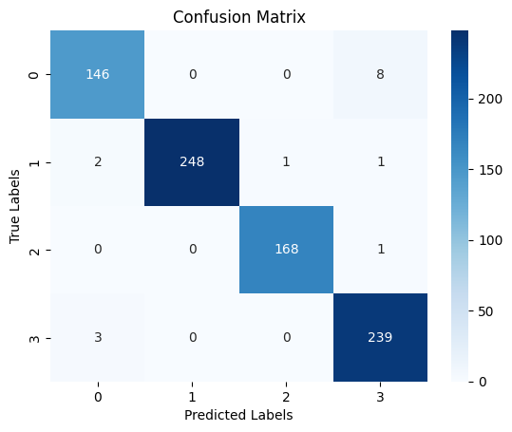
CONFUSION MATRIX

Slide 22
Performance Comparison Between Existing Model and Proposed Model

Slide 23
REFERENCES
Ahmed, A.M., Hossain, M.S. and Muhammad, G. (2023) ‘Hybrid CNN-ML classifier for leukemia detection’, IEEE Access, Vol.11, pp.45912–45924.
A. S. Panayides, A. Amini, N. D. Filipovic, A. Sharma, S. A. Tsaftaris, A. Young, D. Foran, N. Do, S. Golemati, T. Kurc, K. Huang, K. S. Nikita, B. P. Veasey, M. Zervakis, J. H. Saltz, and C. S. Pattichis, ‘‘AI in medical imaging informatics: Current challenges and future directions,’’ IEEE J. Bi
Fata, M.S., Rahim, M.S. and Dey, N. (2023) ‘Deep transfer learning for leukemia cell detection using ResNet50 and VGG16’, Computers in Biology and Medicine, Vol.158, 106769.
Genovese, F., Bianchi, F.M., Fecchi, R., Leonardi, R. and Secco, E.L. (2023) ‘DL4ALL: A multi-task cross-dataset transfer learning framework for acute lymphoblastic leukemia detection’, IEEE Journal of Biomedical and Health Informatics.
H. Shin, H. R. Roth, M. Gao, L. Lu, Z. Xu, I. Nogues, J. Yao, D. Mollura, and R. M. Summers, ‘‘Deep convolutional neural networks for computer aided detection: CNN architectures, dataset characteristics and transfer learning,’’ IEEE Trans. Med. Imag., vol. 35, no. 5, pp. 1285–1298, May 2016.

Slide 24
J. Du, K. Guan, Y. Zhou, Y. Li, and T. Wang, ‘‘Parameter-free similarity aware attention module for medical image classification and segmenta tion,’’ IEEE Trans. Emerg. Topics Comput. Intell., vol. 7, no. 3, pp. 1–13, Jun. 2022.
Kocatürk, T., Kocatürk, F. and Durdu, A. (2022) ‘Comparative study of machine learning algorithms for acute lymphoblastic leukemia detection’, Procedia Computer Science, Vol.199, pp.575–582.
Kumar, D., Singh, B.K. and Sinha, R. (2020) ‘Early CNN-based approach for leukemia detection from bone marrow images’, Computers in Biology and Medicine, Vol.123, 103928.
Mattapalli, A. and Athavale, V. (2023) ‘ALLNet: A specialized CNN for acute lymphoblastic leukemia detection’, Biomedical Signal Processing and Control, Vol.82, 104570.
Mondal, A.K., Ghosh, S., Dhar, A. and Dey, N. (2021) ‘Weighted ensemble learning for leukemia detection’, Applied Soft Computing, Vol.101, 107033.

Slide 25
Thank You !!!

