Slide 1


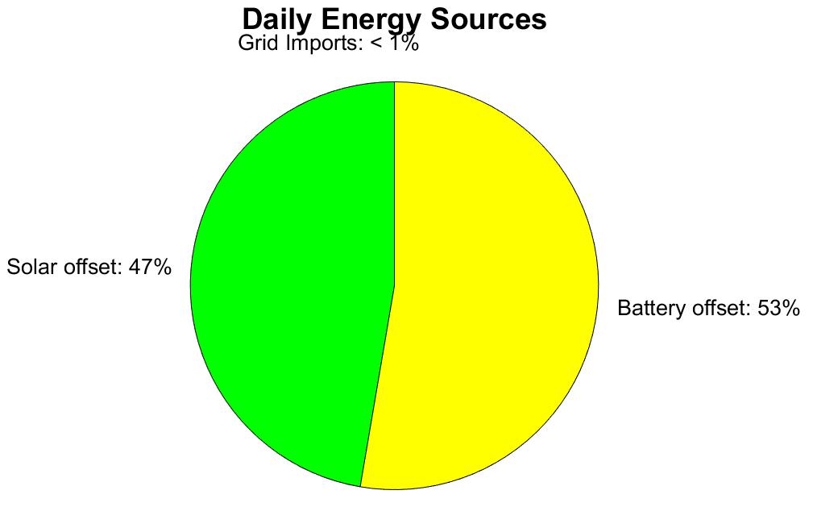
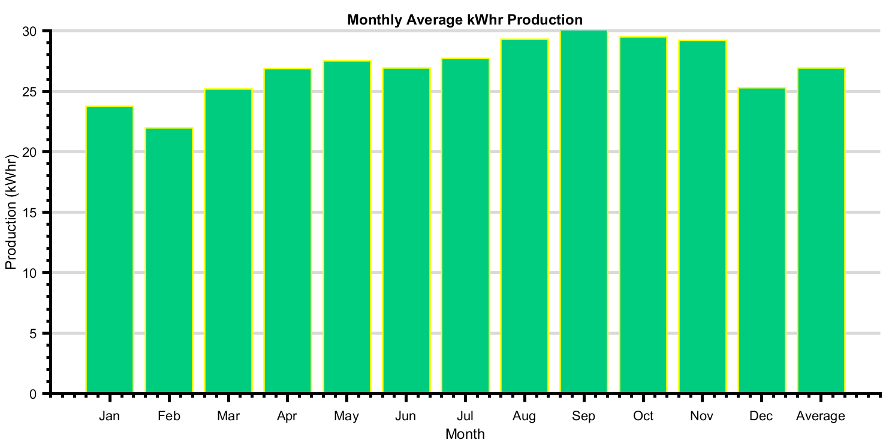
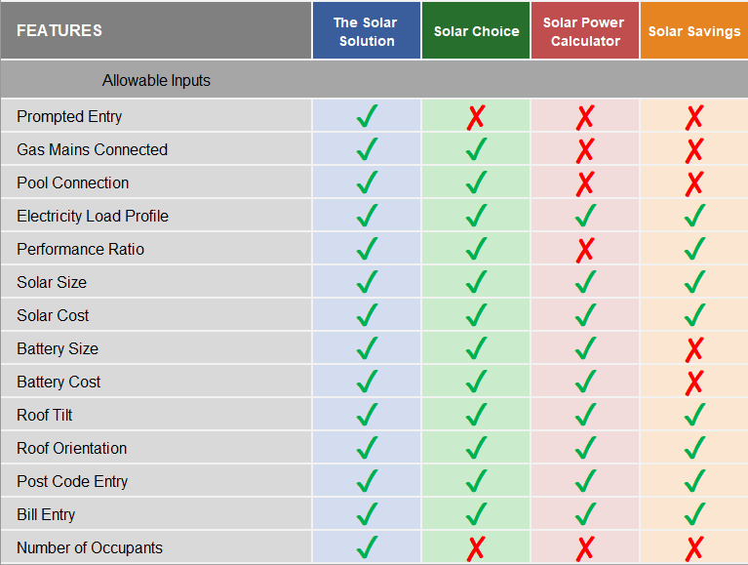
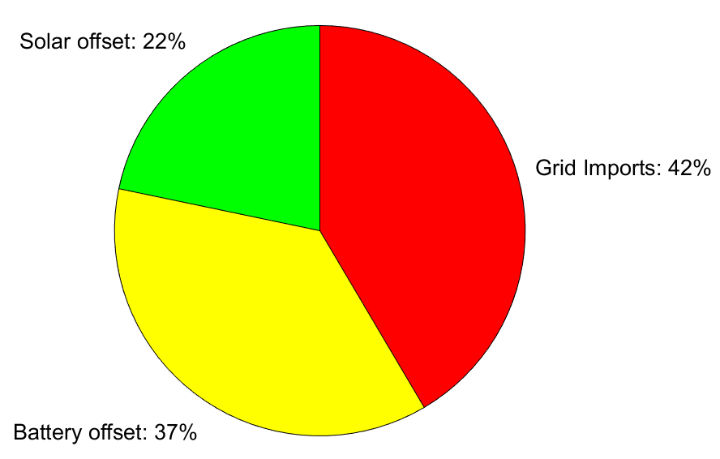
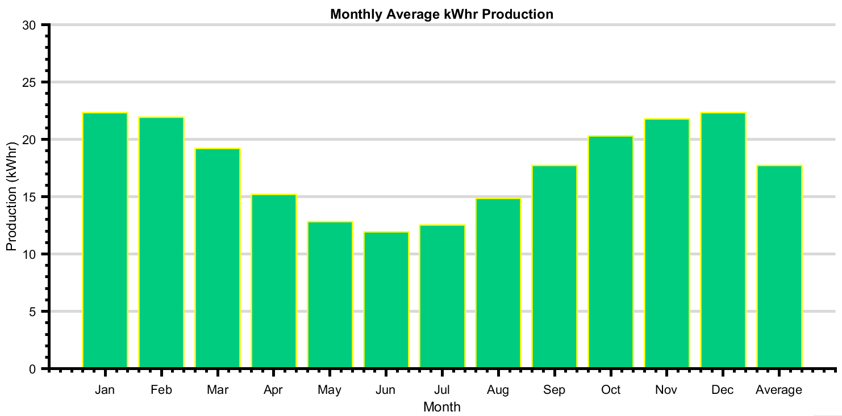

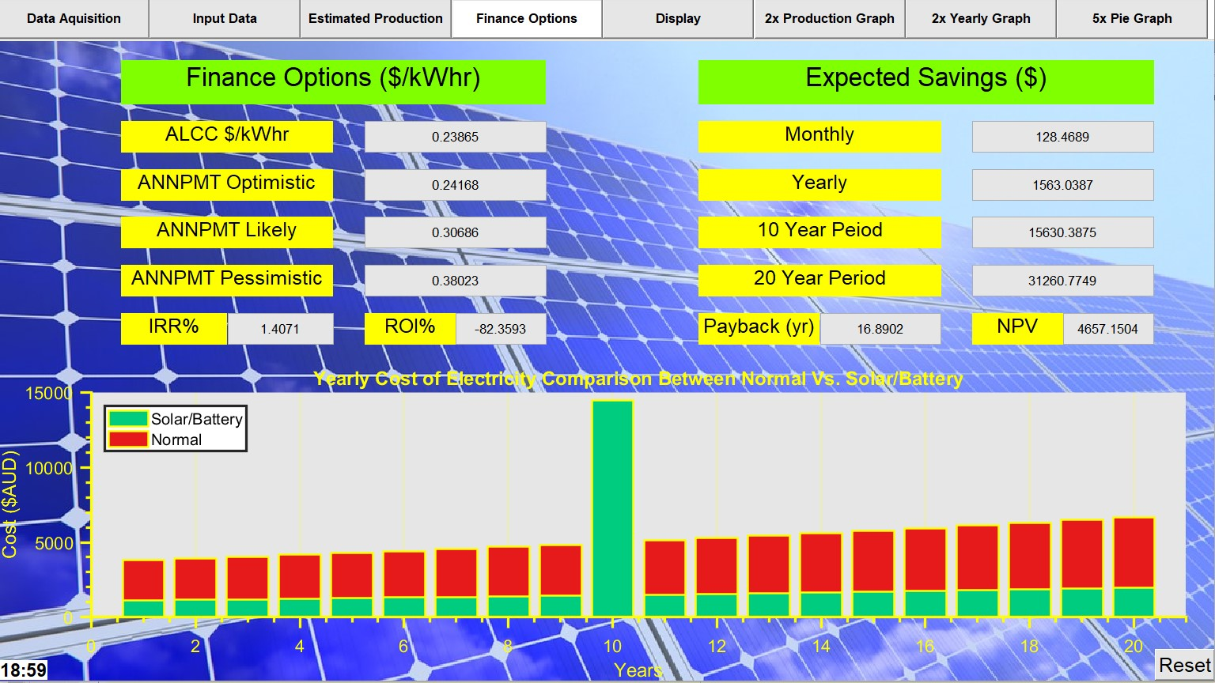
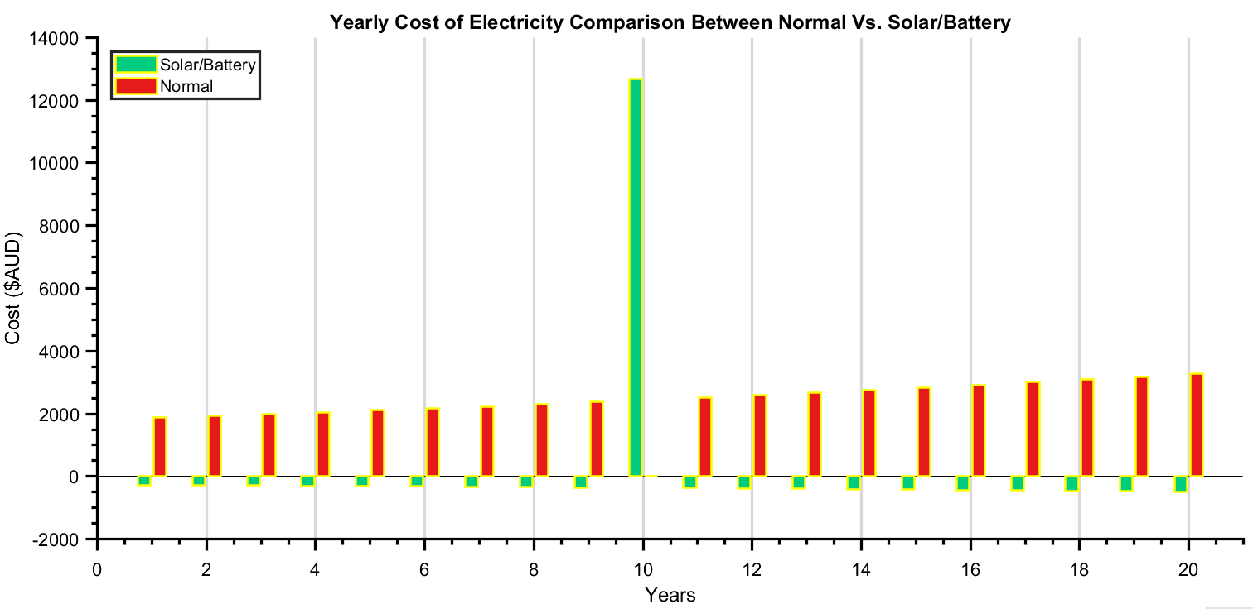
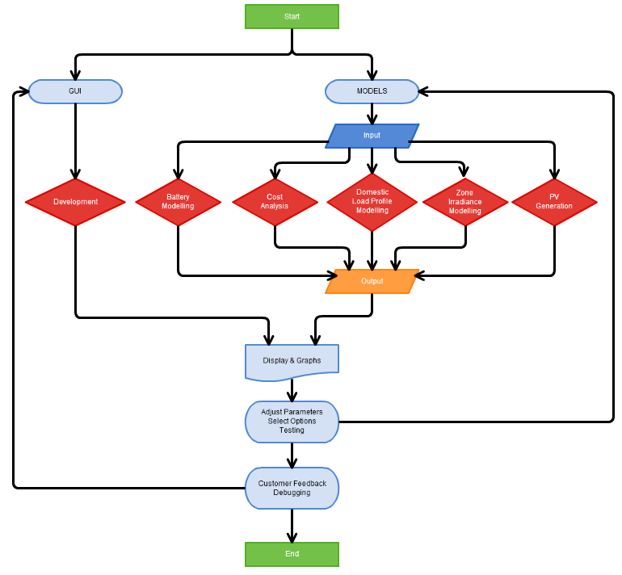
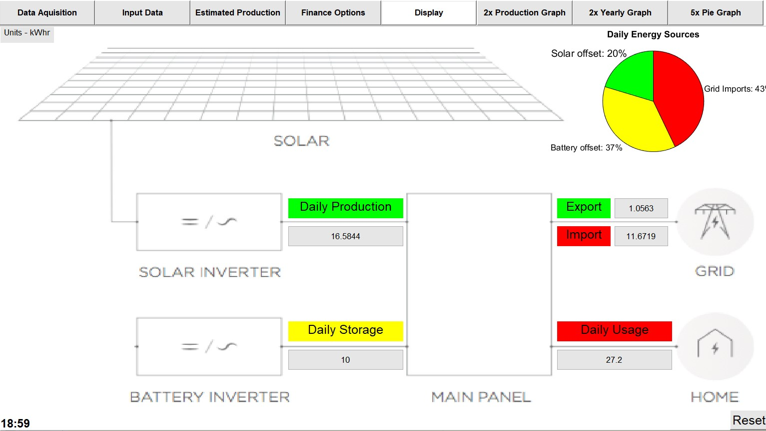
Solar Photovoltaic and Storage for Domestic Use in Varying Australian Latitudes
Clinton G. Elliott – Electrical Engineering
Acknowledgements I would first like to thank my thesis supervisor Associate Professor Ahmad Zahedi of Electrical Engineering at James Cook University. The door to Professor Zahedi’s office was always open whenever I ran into issues or had a question about my research or writing. With a special mention to my family for their emotional support Project Catalyst Currently, the largest quantities of carbon dioxide emissions produced by any sector worldwide, are from the generation of electrical energy. 10 giga-tonnes of carbon dioxide is released into the atmosphere each year - poisoning the air we breathe and the air of our children. The expected 13 billion people in 2100 will require more than 10,000 terawatts of electricity, while this energy cannot continue to come from the current methods of burning fossil fuels - as they are completely unsustainable and devastating our planet. The call for clean, environmentally friendly, and sustainable energy is ubiquitous. The wave of developments in solar storage technology has pushed their cost of electricity production down to parity, and even lower in at least 19 countries - with respect to gas and coal. Experimental Design This thesis coded into the Matrix Laboratory workspace, a program dubbed the Solar Solution, which indexed data from the Australian Government, National Aeronautics and Space Administration, and a geographical positioning system in its algorithms. The program design topology is shown in Fig. 3-1. | Results The Solar Solution hosted a graphical user interface (Fig. 4.1 & Fig 4-2) which aided user prompted used data collection and display. The Solar Solution was compared to several programs on the market as shown in Table 4-1. Effects of Latitude on Photovoltaic Production The Solar Solution was tested by selecting three different locations: Darwin, NT; Townsville, QLD; and Hobart, TAS; and analysing the outputs | against set criteria and expected results. Fig. 3-3 and Fig. 3-4 show the expected energy source and production graphs for a Darwin and Hobart domestic residence respectively. Conclusions Based on the results from the output data of the Solar Solution, it was shown that due to the lower latitudes receiving higher PSH, the kWhr production per day for a given PV system was increased. It was found that data for domestic residential households for kWhr usage, namely gas connected configurations, was not sufficient. Households with combined installation of PV/BES in each location produced a reduced cost of electricity per kWhr with respect to the Australian benchmark cost. A Darwin residence supplied with the sizing specified in this document of PV/BES was found to be self-supportive - without the importation of electricity from the grid. The annual payment costs of a PV/BES system were found to be economically feasible in the mortgage climate rates of optimistic and likely, while the pessimistic figures were viable in most situations with a lower latitude. All simple payback periods were within the lifetime of the projects and net savings were substantial compared to investment cost. Discounted return on investment yields were calculated at negative integer values, due to the methodology used in assuming a higher discount rate against lower inflation rates.
Fig. 3-3. Darwin – Household Energy Sources (left) and Solar Production Values in kilowatt hour (right)
100µm
100µm
Table 3-1. Comparison Table between Solar Solution other Market Software
Fig. 3-4. Hobart – Household Energy Sources (left) and Solar Production Values in kilowatt hour (right)
Fig. 3-1. depicts the expected cost of electricity for a solar storage system in Darwin. Note the cost of battery replacement at the tenth year.
Fig. 3-1. Finance Display Tab on the Graphical User Interface
Fig. 3-5. Expected Savings for a Darwin Residence with Solar Storage (green) and without (red)
Fig. 3-2. Household Display Tab on the Graphical User Interface
Fig. 3-1. Project Design Topology
For more information, please contact Clinton G. Elliott (clinton.elliott@my.jcu.edu.au)

