Slide 1
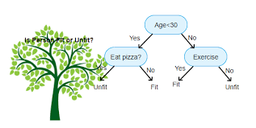
Decision Tree for Classification

Slide 2
What are decision trees?
A decision tree is a decision support tool that uses a tree-like graph and their possible consequences, including chance event outcomes, resource costs, and utility.
It is one way to display an algorithm that only contains conditional control statements. It has a natural if..else structure.
Each internal node represents an attribute and an edge represents outcome of that node and the leaves represent the final class or decision.

Slide 3
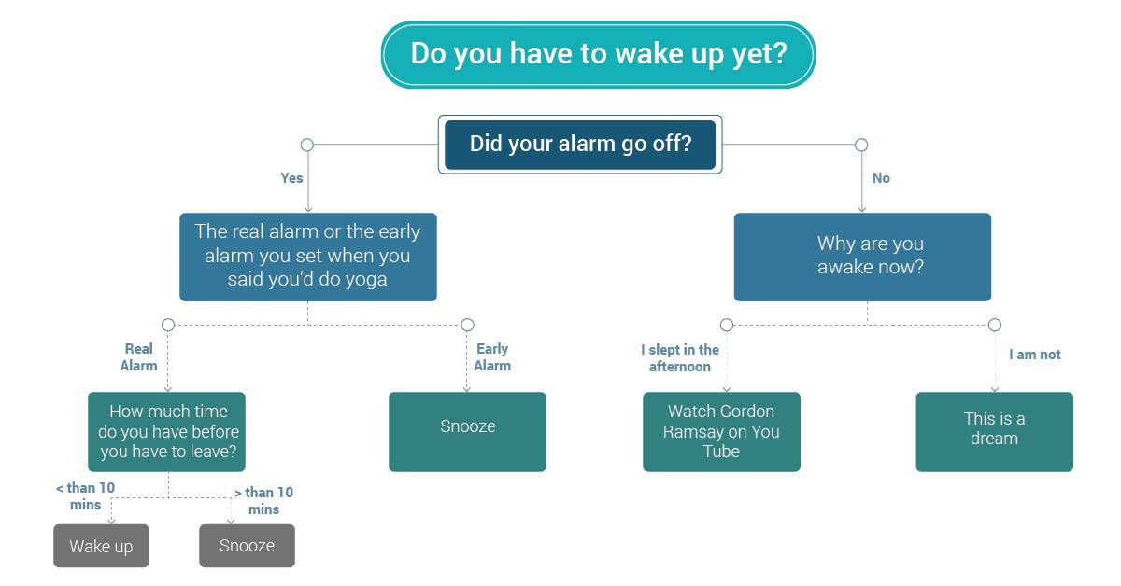
What is a decision tree ?

Slide 4
What is a decision tree ?

Slide 5
What is a decision tree ?

Slide 6
What is a decision tree ?

Slide 7
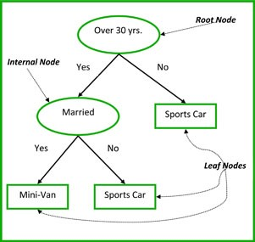
Decision Tree For Classification
Supervised learning method
The decision variable is discrete/categorical that is your final answer is of the form yes/no in case of binary classification or class labels in case of multi-class classification.

Slide 8
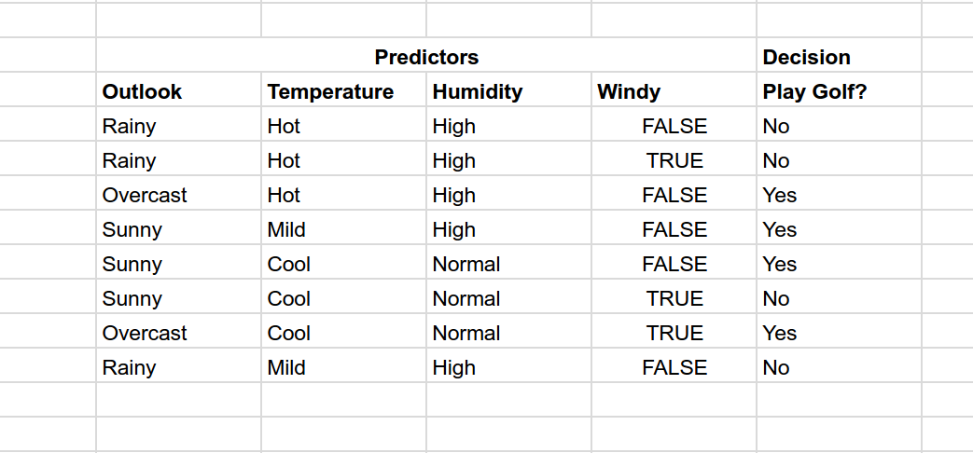
Classification using Decision Trees - Algorithm
Given : A dataset with various attributes, their possible values and corresponding class label for each of the data points.

Slide 9
Building a Decision Tree
Use divide and conquer algorithm
Place the best attribute at the root node that is the attribute for which the randomness decreases.Let’s compare the attributes for the dataset and find the best root node.

Slide 10
Building a Decision Tree
Use divide and conquer algorithm
Place the best attribute at the root node that is the attribute for which the randomness decreases.Let’s compare the attributes for the dataset and find the best root node.
Outlook Rainy(NNN) Overcast(YY) Sunny(YYN)

Slide 11
Building a Decision Tree
Use divide and conquer algorithm
Place the best attribute at the root node that is the attribute for which the randomness decreases.Let’s compare the attributes for the dataset and find the best root node.
Outlook Rainy(NNN) Overcast(YY) Sunny(YYN)
Temperature Hot(NNY) Mild(YN) Cool(YYN)

Slide 12
Building a Decision Tree
Use divide and conquer algorithm
Place the best attribute at the root node that is the attribute for which the randomness decreases.Let’s compare the attributes for the dataset and find the best root node.
Outlook Rainy(NNN) Overcast(YY) Sunny(YYN)
Temperature Hot(NNY) Mild(YN) Cool(YYN)
Humidity High(NNNYY) Normal(YYN)

Slide 13
Building a Decision Tree
Use divide and conquer algorithm
Place the best attribute at the root node that is the attribute for which the randomness decreases.Let’s compare the attributes for the dataset and find the best root node.
Outlook Rainy(NNN) Overcast(YY) Sunny(YYN)
Temperature Hot(NNY) Mild(YN) Cool(YYN)
Humidity High(NNNYY) Normal(YYN)
Windy True(NNY) False(YYYNN)

Slide 14
Building a Decision Tree
Use divide and conquer algorithm
Place the best attribute at the root node that is the attribute for which the randomness decreases.Let’s compare the attributes for the dataset and find the best root node.
Outlook Rainy(NNN) Overcast(YY) Sunny(YYN)
Temperature Hot(NNY) Mild(YN) Cool(YYN)
Humidity High(NNNYY) Normal(YYN)
Windy True(NNY) False(YYYNN)
We can clearly see that using Outlook as our root node the randomness in the subtrees is lesser. That is it reduces the amount of further questions we need to ask to determine our decision.

Slide 15
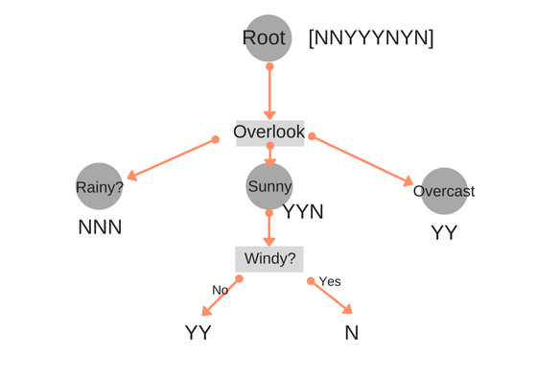
Algorithm cont..
2. After selecting the root node, create branches for each outcome of root node.

Slide 16
Algorithm cont..
3. Split instances into subsets, one for each branch extending from the node.
4. Repeat recursively for each branch, using only instances that reach the branch.
5. Stop recursion for a branch if all its instances have the same class.

Slide 17
Applying algorithm on the dataset
We don’t need to split the branches which are homogenous.
Next splitting on data points which have overlook as Sunny
Windy False(YY) True(N)
Temperature Mild(Y) Cool(YN)
Humidity High(Y) Normal(YN)
Notes:
Describe if the attribute values are continous what will happen

Slide 18
Complexity analysis
The algorithm is essentially greedy in the sense that at every node it is trying to find the locally optimum fit.
Let N = number of training examples , d = depth of tree , k = number of features
For each of the splits in the tree, you will need to test every feature for all values to determine the value split that minimizes the loss function.
Hence time complexity = O(Nkd)
Building a globally optimal decision tree is an NP-hard problem. Proof

Slide 19
How to determine which attribute to use for splitting?
There are three methods popularly used to quantify the impurity in the sample and find the best attribute at each branch that will give the best split.
Information Gain
Gini impurity
Variance reduction

Slide 20
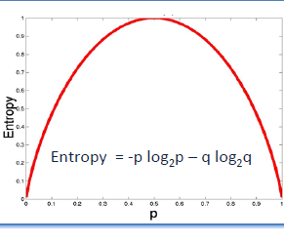
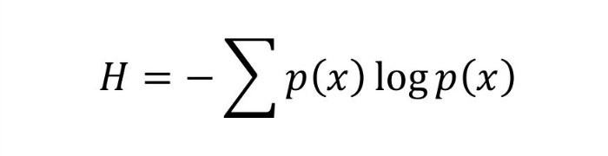
Information Gain
To discuss about information gain we first need to define a few terms:
Entropy : It is a measure of degree of randomness in a sample or impurity. It is defined mathematically as
Information gain is defined as the decrease in the magnitude of entropy after splitting.
IG(n) = Entropy(x) - sum(weighted average * entropy(children for feature)
If base 10 is used then the graph will be scaled down by a factor of 0.3
Base used for log is 2 here

Slide 21
Let’s understand IG by our example
Initially all samples are considered as root. Hence,
Dataset = { YYYYNNNN}
P(yes) = 4/8 = 0.5 , P(no) = 4/8 = 0.5
Entropy = -P(yes)*log(P(yes)) - P(no)*log(P(no)) = 0.3
If data labels = { YYY}
Entropy = 0 as p(Y) = 1 , hence we would not need any further splitting and the sample is pure

Slide 22
Node selection and Information Gain
IG( Overlook) = Entropy(root) - sum(weighted average * entropy(children))
Rainy (NNN) Sunny(NYY) Overcast(YY)
Entropy 0 -0.277 0
Weights 3/8 3/8 2/8
IG(Overlook) = 0.3 - (0*3/8 + 3/8 * ( -0.277) + 2/8 * 0) = 0.289
Calculate the Information gain for each attribute with the available dataset at that branch and split according to the attribute with the highest magnitude of Information Gain.

Slide 23
Information Gain
Similarly IG calculated for
Temperature - 0.017
Humidity - 0.013
Windy - 0.013
Overlook - 0.289
The best information gain is by Overlook, hence it will become our root node for splitting.

Slide 24
Splitting Further
Now the dataset has been split in three parts: Rainy , Sunny and overcast.
Since we have homogenous outputs for Rainy and Overcast, there is no need of further splitting.
For Sunny we need to split it further.While splitting for Sunny we need to consider only this data not any other data.
Now calculate Entropy and Information gain as calculated previously.

Slide 25
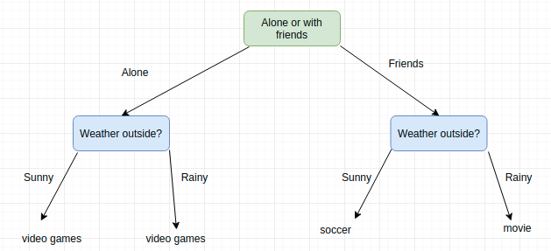
Why are Decision Trees Important?
Information becomes easy when it is presented in the form of smaller pieces.
Decision trees are a combination of logical statements that represent a step by step way of finding solution for a given issue.
A series of steps represent a complete guided way towards a final solution, explaining the process in a simplified manner.

Slide 26
Cont...
They can be used to model non-linearity in data and give an intuitive explanation for it too.
You can model data which consists of both discrete and continuous types , that is attribute values can be discrete or spread over a range of values.
Decision trees combined into an ensemble create some of the best binary classifiers.
They are easy to understand. Particularly a naive binary decision tree is easy for anyone to code, visualize, manipulate, and explain. More advanced classifiers, clustering, and machine learning may be more accurate for large data sets, but the advanced algorithms can't be easily visualized or manipulated.

Slide 27
Where are decision trees used in today's scenario?
Complexity in information can be made easier with decision trees, so every business which posses complex knowledge can be simplified with the help of decision trees.
Decision trees are important for the betterment of customer service as reduce complex interactions to a few clicks, making it easy for agents and customers to understand technical processes and troubleshooting issues. Every Business aims to deliver quick and precise resolutions to their customers.

Slide 28
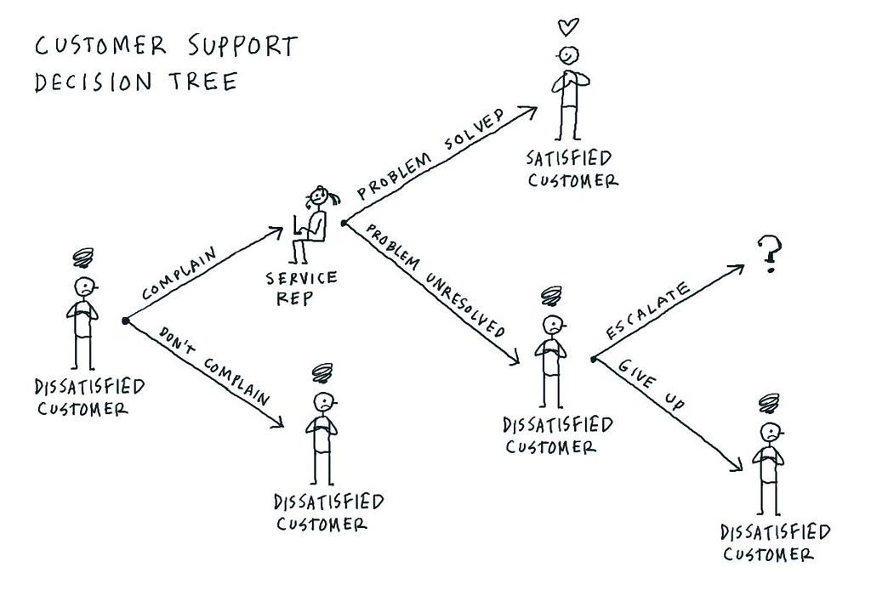
Providing decision trees to their support representatives, and integrating them with websites & self-care apps, companies can largely enhance their customer service level.
Example : Decision trees for customer service

Slide 29
Disadvantages of Decision Tree

Slide 30
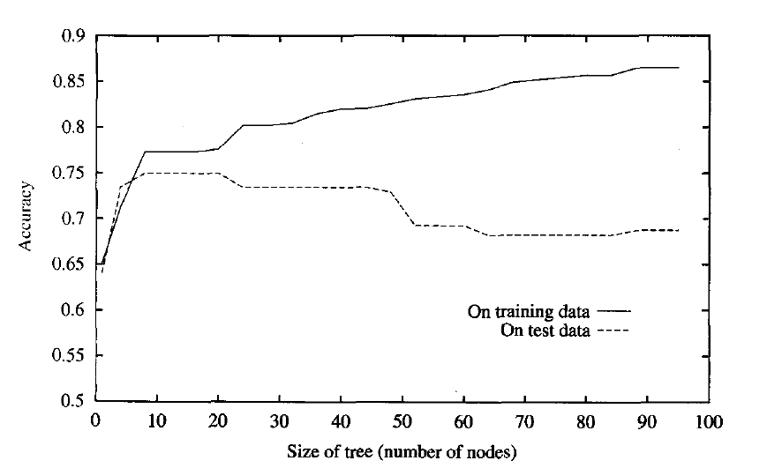
Overfitting
Decision-tree learners can create over-complex trees that do not generalize the data well.
Overfitting is one of the most practical difficulty for decision tree models.
This problem gets solved by setting constraints on model parameters and pruning.

Slide 31
Decision Tree on Iris Dataset
I illustrate by fitting a decision tree model to the iris dataset, which collects measurement data on 3 species of flowers
I focus on two of those measurements: sepal length and sepal width.
Only two attributes were considered to make a simple decision tree for understanding.

Slide 32
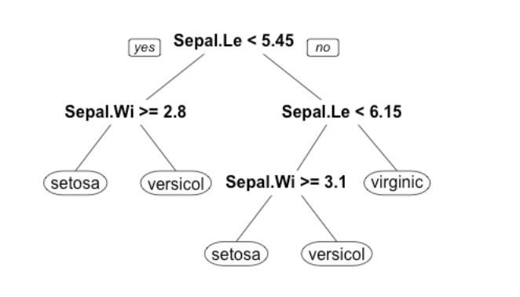
Decision Tree on Iris Dataset
Decision Tree obtained after fitting a decision tree model to the original iris dataset is given in the figure.

Slide 33
Decision Tree on Iris Dataset
Now, I will perturb the data by adding 0.1 to each datapoint with probability 0.25, and subtracting 0.1 to each datapoint with probability 0.25.
The probability and the value are taken randomly.

Slide 34
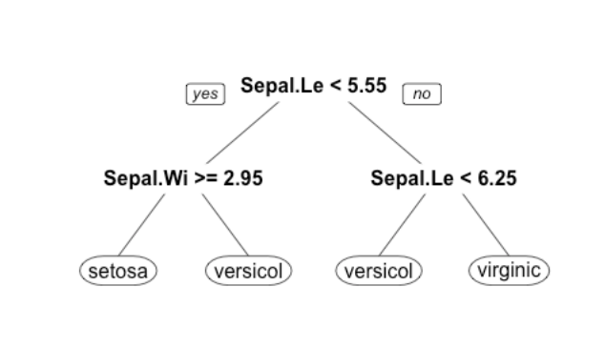
Decision Tree on Iris Dataset
After perturbing the dataset we get the following decision tree from the same algorithm.

Slide 35
Key Observation?

Slide 36
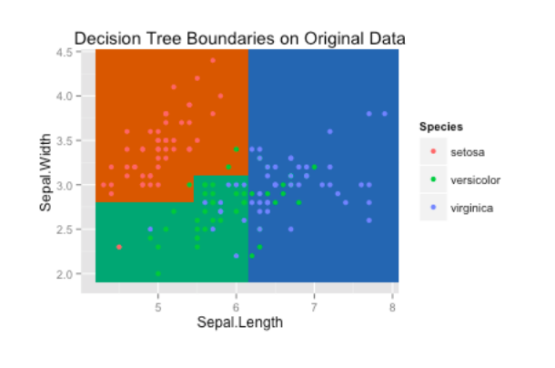
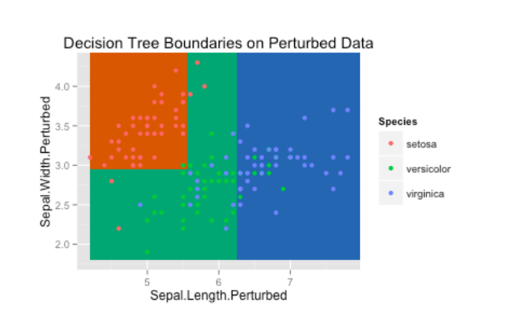
Decision Tree on Iris Dataset
To get a better look at what’s happening, I plot the decision tree boundaries and actual data points on a scatter plot.

Slide 37
Decision Tree on Iris Dataset
The problem with decision trees is that they are very unstable.
Even a small change in dataset can lead to a completely different decision tree.
This is not desirable as we want our classification algorithm to be pretty robust to noise and be able to generalize well to future observed data.

Slide 38
Decision Tree on Iris Dataset
One other problem is that the decision boundaries are parallel to the axes.
In the iris dataset we could imagine diagonal decision boundaries that would perform better, e.g. separating the setosa flowers and the versicolor flowers.

Slide 39
Decision Tree on Iris Dataset

Slide 40
Applications of Decision Tree in Real Life Problems

Slide 41
Applications of Decision Tree in various fields
Because of their simplicity, tree diagrams have been used in a broad range of industries and disciplines
Manufacturing - Quality Control.

Slide 42
Applications of Decision Tree in various fields
Because of their simplicity, tree diagrams have been used in a broad range of industries and disciplines
Manufacturing - Quality Control.
Astronomy - Classify different types of galaxies.

Slide 43
Applications of Decision Tree in various fields
Because of their simplicity, tree diagrams have been used in a broad range of industries and disciplines
Manufacturing - Quality Control.
Astronomy - Classify different types of galaxies.
Physics - Particle Detection.

Slide 44
Applications of Decision Tree in various fields
Because of their simplicity, tree diagrams have been used in a broad range of industries and disciplines
Manufacturing - Quality Control.
Astronomy - Classify different types of galaxies.
Physics - Particle Detection.
Analysis - Customer Satisfaction with a product or service.

Slide 45
Question Time

Slide 46
Q1. How to reduce variance in a decision tree?
Q.2 Should we use decision trees if we have continuous values in dataset? If yes/no why?
Q.3 How are Neural Networks different from Classification Trees?

Slide 47
Thank You!

