Slide 1
Improving local search: tabu search vs simulated annealing
By Pallav Mathur, Dushyant Chetiwal and Tejas Mayekar

Slide 2
What is Local Search?
Local search is a heuristic method for solving computationally hard optimization problems. Local search can be used on problems that can be formulated as finding a solution maximizing a criterion among a number of candidate solutions.
Local search algorithms move from solution to solution in the space of candidate solutions (the search space) by applying local changes, until a solution deemed optimal is found or a time bound is elapsed.

Slide 3
How does it work?
• In many optimization problems, the state space is the space of all possible complete solutions
• We have an objective function that tells us how “good” a given state is, and we want to find the solution (goal) by minimizing or maximizing the value of this function
• The start state may not be specified
• The path to the goal doesn’t matter
In such cases, we can use local search algorithms that keep a single “current” state and gradually try to improve it

Slide 4
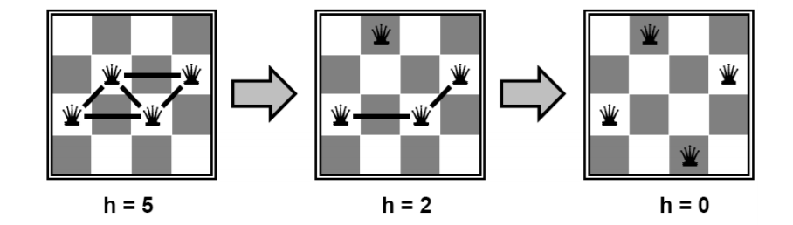
Example: n-queens problem
• Put n queens on an n × n board with no two queens on the same row, column, or diagonal
• State space: all possible n-queen configurations
• Objective function: number of pairwise conflicts
• What’s a possible local improvement strategy? – Move one queen within its column to reduce conflicts

Slide 5
So, what’s the problem with local search?

Slide 6
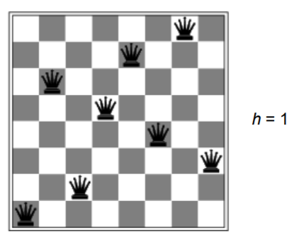
It’s not optimal!
The algorithm can easily get stuck in local optima
Example: local optimum for the 8-queens problem

Slide 7
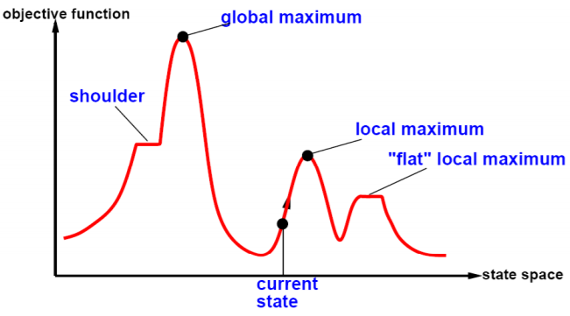
The state space “landscape”

Slide 8
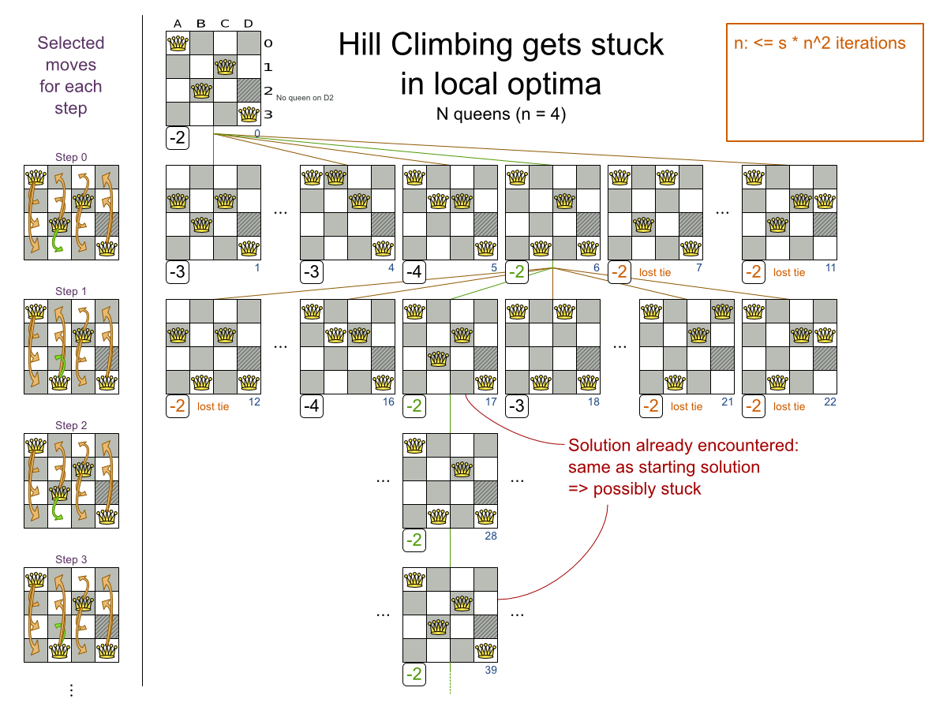

Slide 9
How do we escape local optima?

Slide 10



Option 1: Tabu Search
Not this!

Slide 11

Tabu Search, created by Fred W. Glover in 1986 and formalized in 1989, is a metaheuristic search method employing local search methods used for mathematical optimization.

Slide 12
Tabu Search, created by Fred W. Glover in 1986 and formalized in 1989, is a metaheuristic search method employing local search methods used for mathematical optimization.
A metaheuristic is a higher-level procedure or heuristic designed to find, generate, or select a heuristic (partial search algorithm) that may provide a sufficiently good solution to an optimization problem, especially with incomplete or imperfect information or limited computation capacity.

Slide 13
The Approach
Tabu search enhances the performance of local search by relaxing its basic rule.
Worsening First, at each step worsening moves can be accepted if no improving move is available (like when the search is stuck at a strict local optima).
Prohibitions In addition, prohibitions (henceforth the term tabu) are introduced to discourage the search from coming back to previously-visited solutions.

Slide 14
Pseudocode
1 sBest ← s0
2 bestCandidate ← s0
3 tabuList ← []
4 tabuList.push(s0)
5 while (not stoppingCondition())
6 sNeighborhood ← getNeighbors(bestCandidate)
7 for (sCandidate in sNeighborhood)
8 if ( (not tabuList.contains(sCandidate)) and (fitness(sCandidate) > fitness(bestCandidate)) )
9 bestCandidate ← sCandidate
10 end
11 end
12 if (fitness(bestCandidate) > fitness(sBest))
13 sBest ← bestCandidate
14 end
15 tabuList.push(bestCandidate)
16 if (tabuList.size > maxTabuSize)
17 tabuList.removeFirst()
18 end
19 end
20 return sBest

Slide 15
Pseudocode
1 sBest ← s0
2 bestCandidate ← s0
3 tabuList ← []
4 tabuList.push(s0)
5 while (not stoppingCondition())
6 sNeighborhood ← getNeighbors(bestCandidate)
7 for (sCandidate in sNeighborhood)
8 if ( (not tabuList.contains(sCandidate)) and (fitness(sCandidate) > fitness(bestCandidate)) )
9 bestCandidate ← sCandidate
10 end
11 end
12 if (fitness(bestCandidate) > fitness(sBest))
13 sBest ← bestCandidate
14 end
15 tabuList.push(bestCandidate)
16 if (tabuList.size > maxTabuSize)
17 tabuList.removeFirst()
18 end
19 end
20 return sBest
Tabu Search maintains a “tabu list” which holds recently used objects that are taboo to use for now. Moves that involve an object in the tabu list, are not accepted. The tabu list objects can be anything related to the move, such as the planning entity, planning value, move, solution, …​Here’s an example with entity tabu for four queens, so the queens are put in the tabu list.

Slide 16
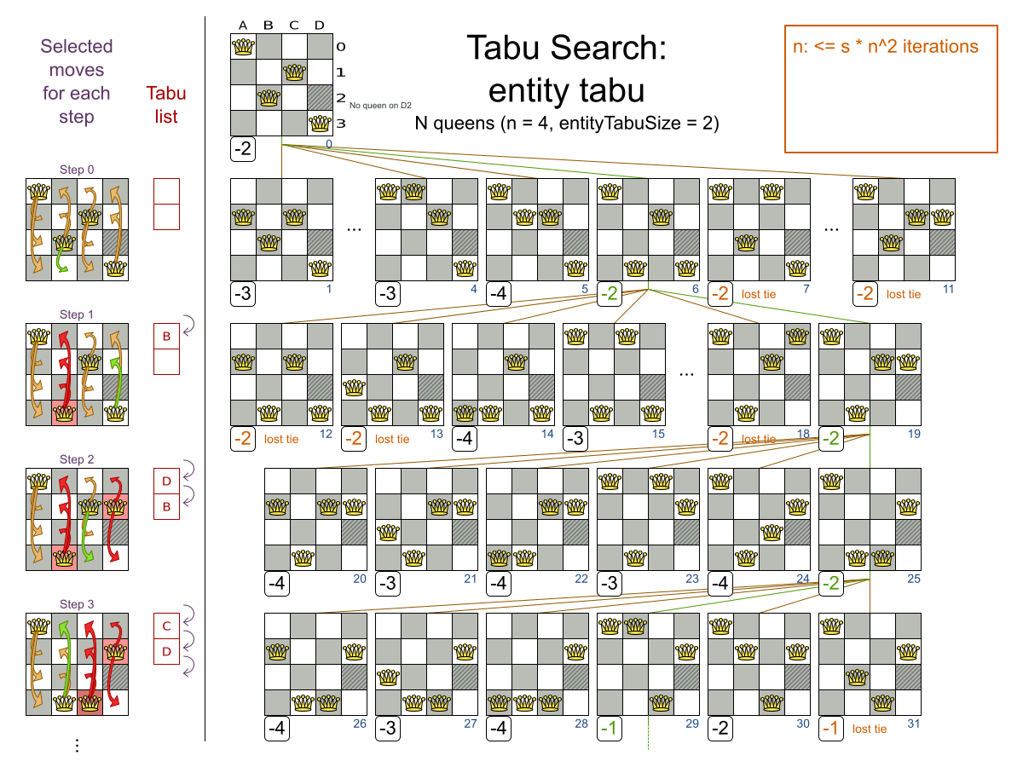

Slide 17
Option 2: Simulated Annealing

Slide 18
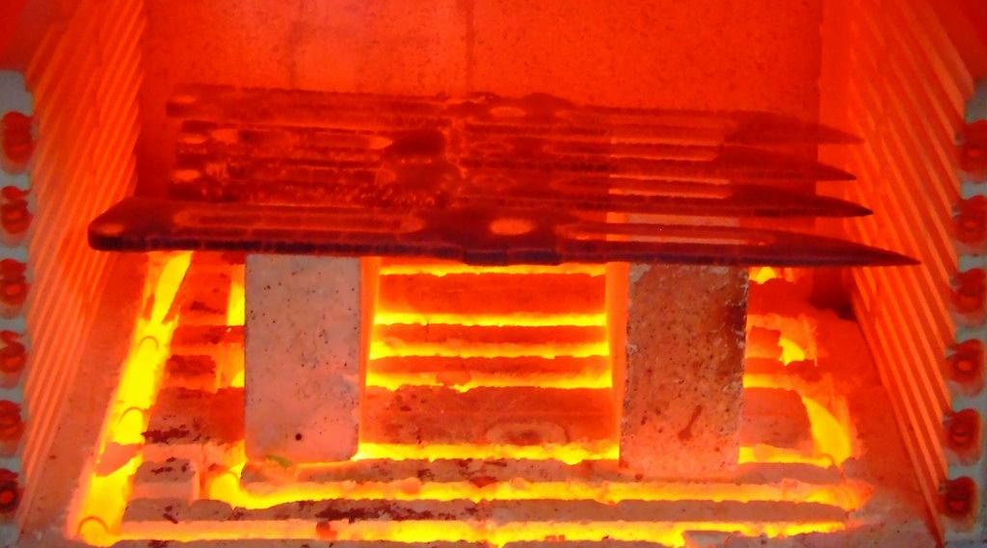
Simulated Annealing is a probabilistic technique for approximating the global optimum of a given function. The name and inspiration come from annealing in metallurgy, a technique involving heating and controlled cooling of a material.

Slide 19
The Approach
Step 1: Initialize – Start with a random initial placement. Initialize a very high “temperature”.
Step 2: Move – Perturb the placement through a defined move.
Step 3: Calculate score – calculate the change in the score due to the move made.
Step 4: Choose – Depending on the change in score, accept or reject the move. The probability of acceptance depending on the current “temperature”.
Step 5: Update and repeat– Update the temperature value by lowering the temperature. Go back to Step 2.
The process is done until “Freezing Point” is reached.

Slide 20

Remember me?
In order to achieve our objective of putting all the rings through the hooks we start by randomly pressing the buttons initially. As we progress our approach becomes more and more careful.

Slide 21
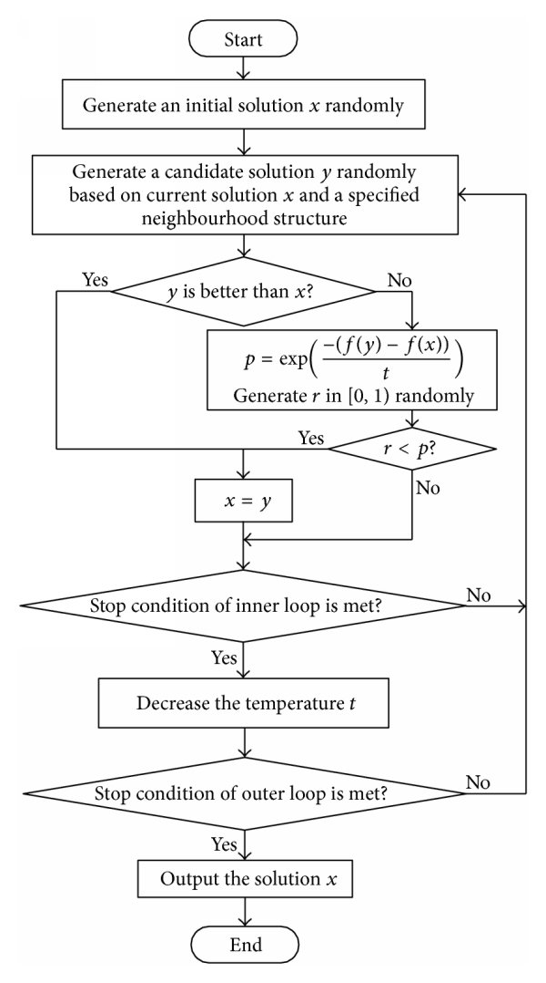
The Approach
Step 1: Initialize – Start with a random initial placement. Initialize a very high “temperature”.
Step 2: Move – Perturb the placement through a defined move.
Step 3: Calculate score – calculate the change in the score due to the move made.
Step 4: Choose – Depending on the change in score, accept or reject the move. The probability of acceptance depending on the current “temperature”.
Step 5: Update and repeat– Update the temperature value by lowering the temperature. Go back to Step 2.
The process is done until “Freezing Point” is reached.

Slide 22
Pseudocode
1 Let s = s0
2 For k = 0 through kmax (exclusive):
3 T ← temperature( kmax/(k+1) )
4 Pick a random neighbour, snew ← neighbour(s)
5 If P(E(s), E(snew), T) ≥ random(0, 1):
6 s ← snew
7 Output: the final state s

Slide 23
Pseudocode
Simulated Annealing evaluates only a few moves per step, so it steps quickly. In the classic implementation, the first accepted move is the winning step. A move is accepted if it doesn’t decrease the score or - in case it does decrease the score - it passes a random check. The chance that a decreasing move passes the random check decreases relative to the size of the score decrement and the time the phase has been running (which is represented as the temperature).
1 Let s = s0
2 For k = 0 through kmax (exclusive):
3 T ← temperature( kmax/(k+1) )
4 Pick a random neighbour, snew ← neighbour(s)
5 If P(E(s), E(snew), T) ≥ random(0, 1):
6 s ← snew
7 Output: the final state s

Slide 24
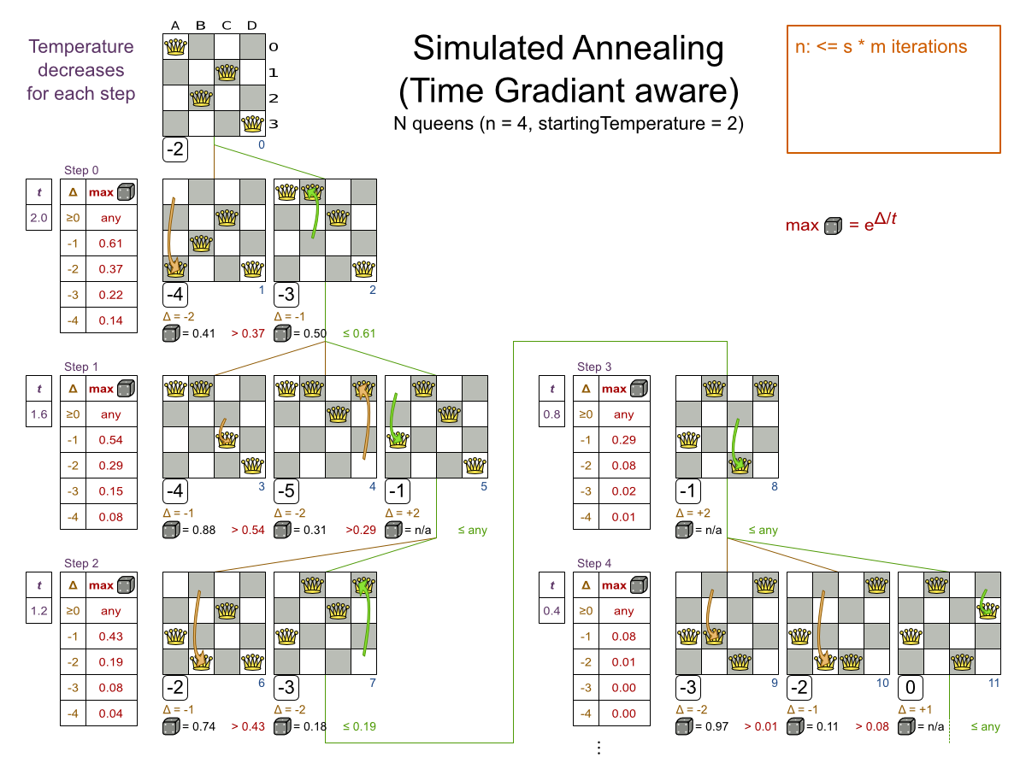

Slide 25
Thank
You!

Slide 26
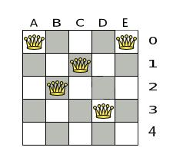
Homework
Execute Tabu search on the given 5 queens problem and find a global optima with tabu lists of size 2 and 3.
Maintain the tabu list for each step.

