Slide 1

Adversarial search in the context of a game: Alpha-Beta pruning
By
Bhavam Gupta , Rajat Kumar Dalai, Naresh Kumar Kaushal

Slide 2

Adversarial Search ??
examine the problem which arises when we try to plan ahead of the world and other agents are planning against us.

Slide 3
Adversarial Search ??
examine the problem which arises when we try to plan ahead of the world and other agents are planning against us.
So, Searches in which two or more players with conflicting goals are trying to explore the same search space for the solution, are called adversarial searches, often known as Games.

Slide 4
Picture and careful observation → Game Tree

Slide 5
Picture and careful observation → Game Tree
Tree:
Nodes - Game State
Edges - Moves by player
Example - Tic-Tac-Toe game tree

Slide 6
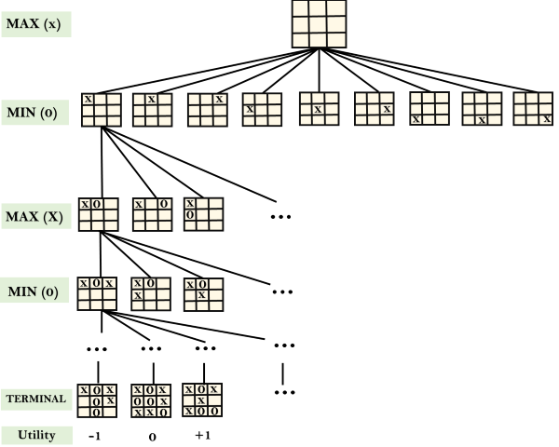

Slide 7
Aim: Optimal Strategy for MAX to win the game

Slide 8
Aim: Optimal Strategy for MAX to win the game
Approach: Depth-First Search

Slide 9
Aim: Optimal Strategy for MAX to win the game
Approach: Depth-First Search
Time Complexity: O(b^{m})

Slide 10
Aim: Optimal Strategy for MAX to win the game
Approach: Depth-First Search
Time Complexity: O(b^{m})
Drawback: It gets really slow for complex games such as Chess, Go etc.

Slide 11
Aim: Optimal Strategy for MAX to win the game
Approach: Depth-First Search
Time Complexity: O(b^{m})
Drawback: It gets really slow for complex games such as Chess, Go etc.
This type of games has huge branching factor and the player has a lot of choices.

Slide 12
Aim: Optimal Strategy for MAX to win the game
Approach: Depth-First Search
Time Complexity: O(b^{m})
Drawback: It gets really slow for complex games such as Chess, Go etc.
This type of games has huge branching factor and the player has a lot of choices.
Improvement: Alpha Beta Pruning

Slide 13
Alpha-Beta Pruning:
Alpha-beta pruning can be applied at any depth of a tree, and sometimes it not only prune the tree leaves but also entire sub-tree.

Slide 14
Alpha-Beta Pruning:
Alpha-beta pruning can be applied at any depth of a tree, and sometimes it not only prune the tree leaves but also entire sub-tree.
Two parameter :
Alpha: The best (highest-value) choice we have found so far at any point along the path of Maximizer. The initial value of alpha is -∞

Slide 15
Alpha-Beta Pruning:
Alpha-beta pruning can be applied at any depth of a tree, and sometimes it not only prune the tree leaves but also entire sub-tree.
Two parameter :
Alpha: The best (highest-value) choice we have found so far at any point along the path of Maximizer. The initial value of alpha is -∞
Beta: The best (lowest-value) choice we have found so far at any point along the path of Minimizer. The initial value of beta is +∞.

Slide 16
Alpha-Beta Pruning:
Alpha-beta pruning can be applied at any depth of a tree, and sometimes it not only prune the tree leaves but also entire sub-tree.
Two parameter :
Alpha: The best (highest-value) choice we have found so far at any point along the path of Maximizer. The initial value of alpha is -∞
Beta: The best (lowest-value) choice we have found so far at any point along the path of Minimizer. The initial value of beta is +∞.
The Alpha-beta pruning to a standard minimax algorithm returns the same move as the standard algorithm does, but it removes all the nodes which are not really affecting the final decision but making algorithm slow. Hence by pruning these nodes, it makes the algorithm fast.

Slide 17
Alpha-Beta Pruning:
Alpha-beta pruning can be applied at any depth of a tree, and sometimes it not only prune the tree leaves but also entire sub-tree.
Two parameter :
Alpha: The best (highest-value) choice we have found so far at any point along the path of Maximizer. The initial value of alpha is -∞
Beta: The best (lowest-value) choice we have found so far at any point along the path of Minimizer. The initial value of beta is +∞.
The Alpha-beta pruning to a standard minimax algorithm returns the same move as the standard algorithm does, but it removes all the nodes which are not really affecting the final decision but making algorithm slow. Hence by pruning these nodes, it makes the algorithm fast.
Condition: α>=β

Slide 18
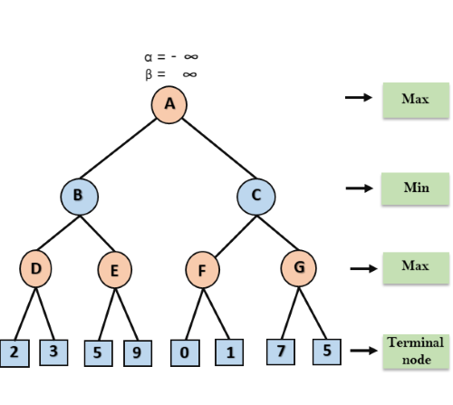

Slide 19
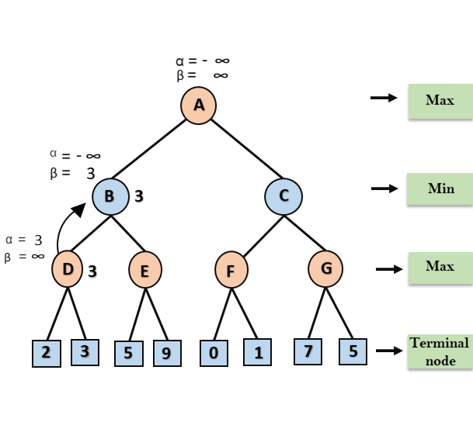

Slide 20
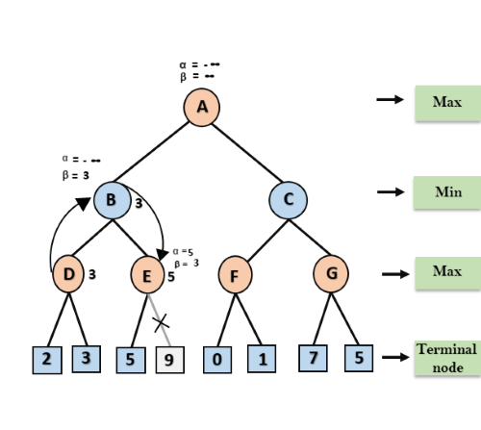

Slide 21
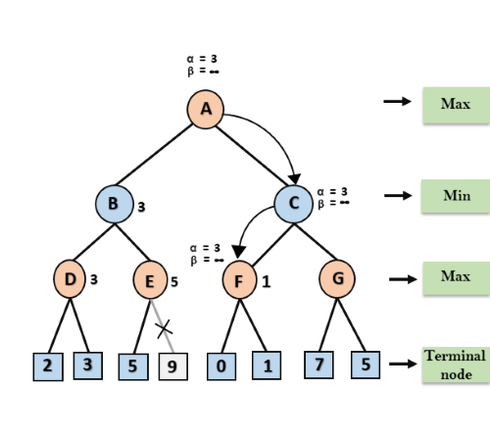

Slide 22
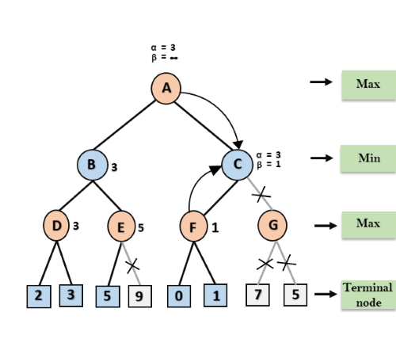

Slide 23
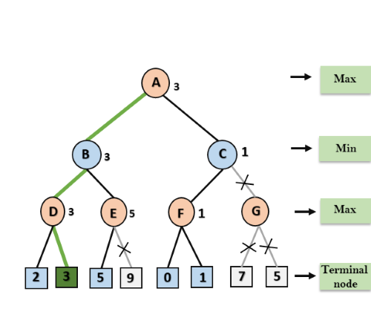

Slide 24
Conceptual Overview and Code Walkthrough of Alpha-Beta Pruning.
By Rajat Kumar Dalai

Slide 25
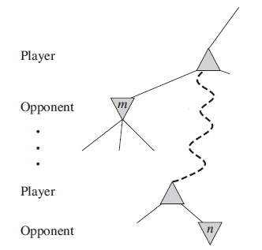
Alpha-beta Pruning Algorithm
1.The problem with minimax search is that the number of game states it has to examine is exponential in the depth of the tree. Unfortunately, we can’t eliminate the exponent, but it turns out we can effectively cut it in half.
2.When applied to a standard minimax tree, it returns the same move as minimax would, but prunes away branches that cannot possibly influence the final decision.
3.The general principle is this: consider a node n somewhere in the tree, such that Player has a choice of moving to that node.
If Player has a better choice m either at the parent node of n or at any choice point further up, then n will never be reached in actual play. So once we have found out enough about n (by examining some of its descendants) to reach this conclusion, we can prune it.

Slide 26
4.α = the value of the best (i.e., highest-value) choice we have found so far at any choice point along the path for MAX.
β = the value of the best (i.e., lowest-value) choice we have found so far at any choice point along the path for MIN.
5.Alpha–beta search updates the values of α and β as it goes along and prunes the remaining branches at a node (i.e., terminates the recursive call) as soon as the value of the current node is known to be worse than the current α or β value for MAX or MIN, respectively.

Slide 27
Intuition behind the algorithm :
>In an adversarial situation, one player tries to maximize his gain and the other player tries to minimize the latter's gains.
>Let the maximizing player be A and the minimizing one be B.
Player A knows that after his move, player B will play the move
that minimizes his gain. Hence, player A will try to play a move which maximizes this minimum gain.
>Let at some node in the game tree, say node Y, player B have n choices. For each move let the minimum score
that player A will get after player B's move be an element of array S, i.e. S(j) = score obtained after B plays the jth possible choice.
>Since, minimax uses dfs, let the selected choice for analysis be the ith of the n possible moves.

Slide 28
>Let us say that at some node before this point, player A has a minimum possible score of X1.
>Now, if X1 > S(i), then A need not search beyond this node, i.e. he can prune the sub-tree at node Y.
>This is possible because, A knows that at node Y, B will select a move which will entitle him to a score less than/ equal to current choice of S(i) i.e. as B traverses across S, he will select the minimum possible score for A, and that is less than or equal to S(i). So, if A has already a better choice at some node before, hence, he need not search further node Y.
>Similarly, B can prune sub trees that yield scores better than the current minimum for A.
>When applied over the whole search tree, this can lead to considerable savings on the number of states expanded.

Slide 29
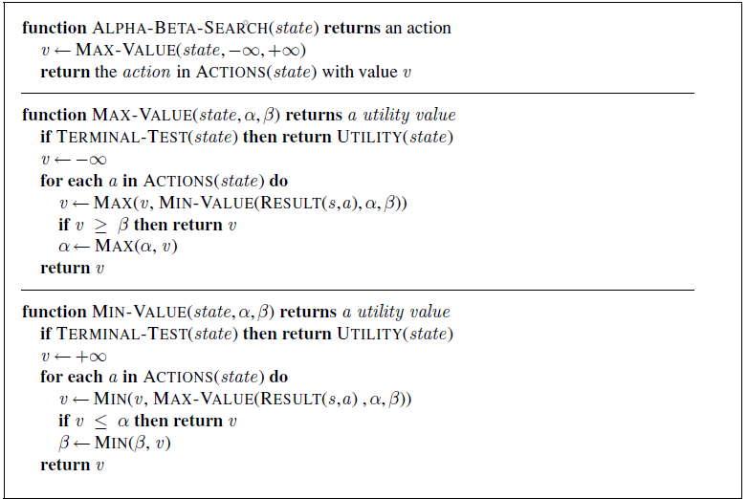
Algorithm:

Slide 30
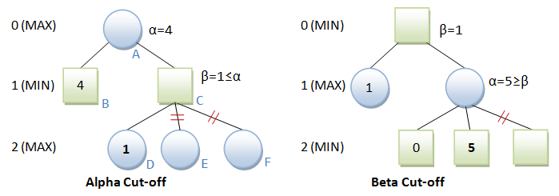
How does the algorithm work?
>The above is a recursive algorithm.
>Function ALPHA-BETA-SEARCH returns the action which player A should use to ensure optimal score at the end of the game. It initialises α,β with −∞,+∞. It then calls function MAX-VALUE to update the value of α, since A is the maximising player. Finally when the flow control comes back to ALPHA-BETA-SEARCH, A selects that action which helps it achieve the current score of α.

Slide 31
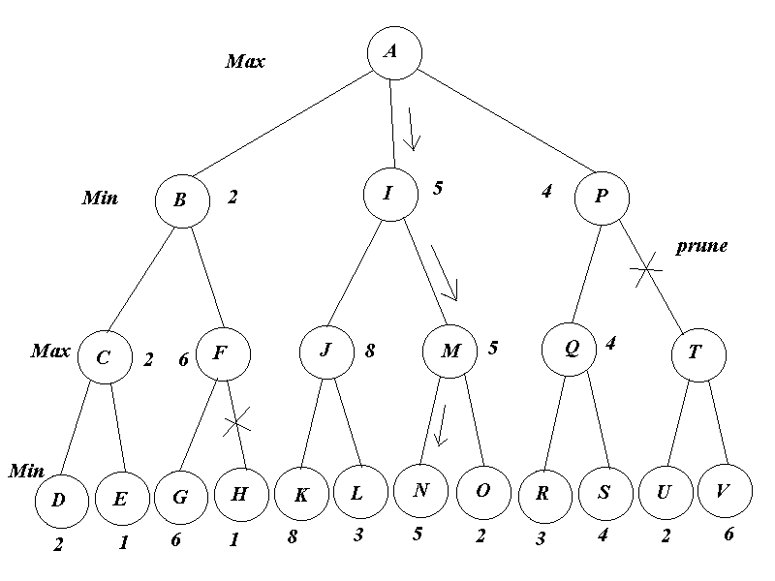
>Function MAX-VALUE is called to find the action which will give A the best possible score, if A is at the current node. The value of α is updated with each possible action, so that α gets to store the highest score that A can possibly reach.This value of α will be used in further recursion calls to prune sub-optimal sub-trees. The score resulting from each action is compared with β, if it is greater then v is returned i.e. pruning takes place. β's usage comes when the current MAX node is at depth 4 or more, as likely β would have been updated to some definite value and this value will help the parent MIN node before the current node to prune the sub-tree at the current node, if possible. If the current state is a leaf node, then the state's utility is calculated using UTILITY function for the game, which accordingly returns a score for A, if the game ever ends at that terminal node.
>Function MIN-VALUE does similar task, but for the minimising player. It helps minimise the score that A can achieve and prunes the sub-trees not decisive in the gameplay.
>As the recursion unrolls, and values of α,β are backed up, the actions that lie on the optimal path of the game are chosen one after the other and finally, the score at the optimal terminal node is achieved.

Slide 32
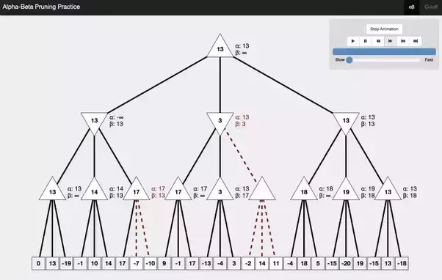

Slide 33
Applications of Alpha-Beta pruning and its drawbacks.
By Naresh Kumar Kaushal

Slide 34

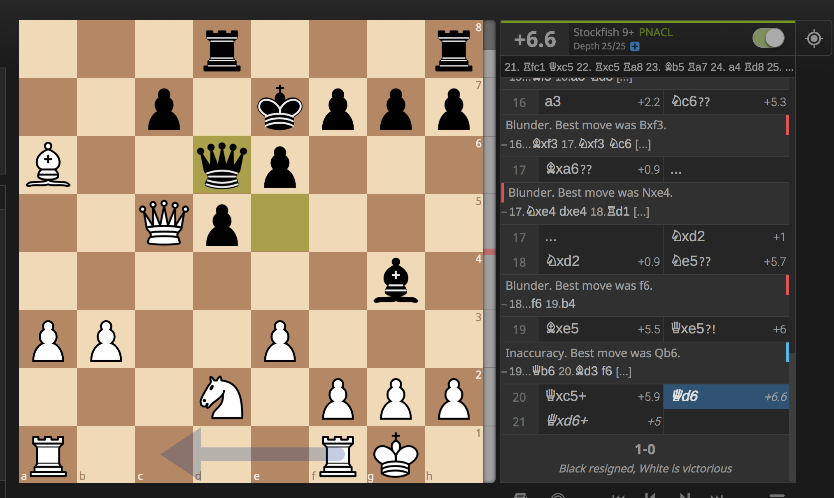
Application 1 :- StockFish
Algorithm Involved :- Alpha Beta Pruning and Monte Carlo Tree Search
Stock Fish is a free and open source UCI(Universal Chess Interface) chess engine, available for various desktop and mobile platforms.
Stock Fish was consistently ranked first or near the top most chess engine in the world. It won the various chess championships.
Stock Fish defeated the best Human Chess players.
But in December 2017, Stockfish was defeated by Google’s AlphaZero. Alpha Zero was trained through self-play for a total of nine hours, and reached stockfish level after just four. In 100 games from the normal starting position Alpha Zero won 25 games as white, won 3 as Black, and drew remaining 72, with 0 losses.

Slide 35
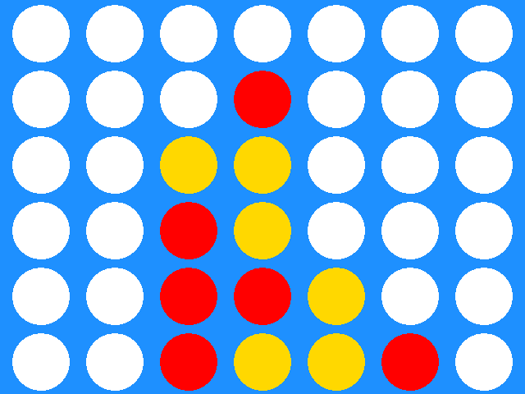
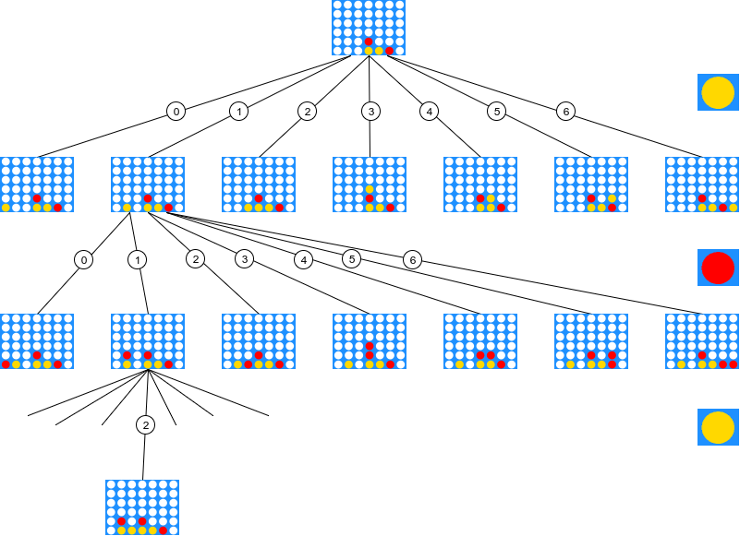
Application 2 :- Alpha Go
Algorithm Involved :- Alpha Beta Pruning and Monte Carlo Tree Search
Alpha Go is a computer program that plays the board game Connect Four, Chess and more. It was developed by Deepmind Technologies.
Connect four is the 2 player strategy game played using board and discs of 2 different colors. The objective of the game is to match four of your discs in a connected line either horizontally, vertically or diagonally.
This may seem like an easy task until we draw its game tree. Because of huge state space, Alpha-Beta pruning comes as a rescue and prune those branches which can never be traversed if we were to play optimally.
With Alpha-Beta pruning Game tree is expanded up till specific depth, after which scores are allotted for different orientations and these scores are then backtracked to the point where we need to make a decision and the best move is chosen which has maximum score.

Slide 36
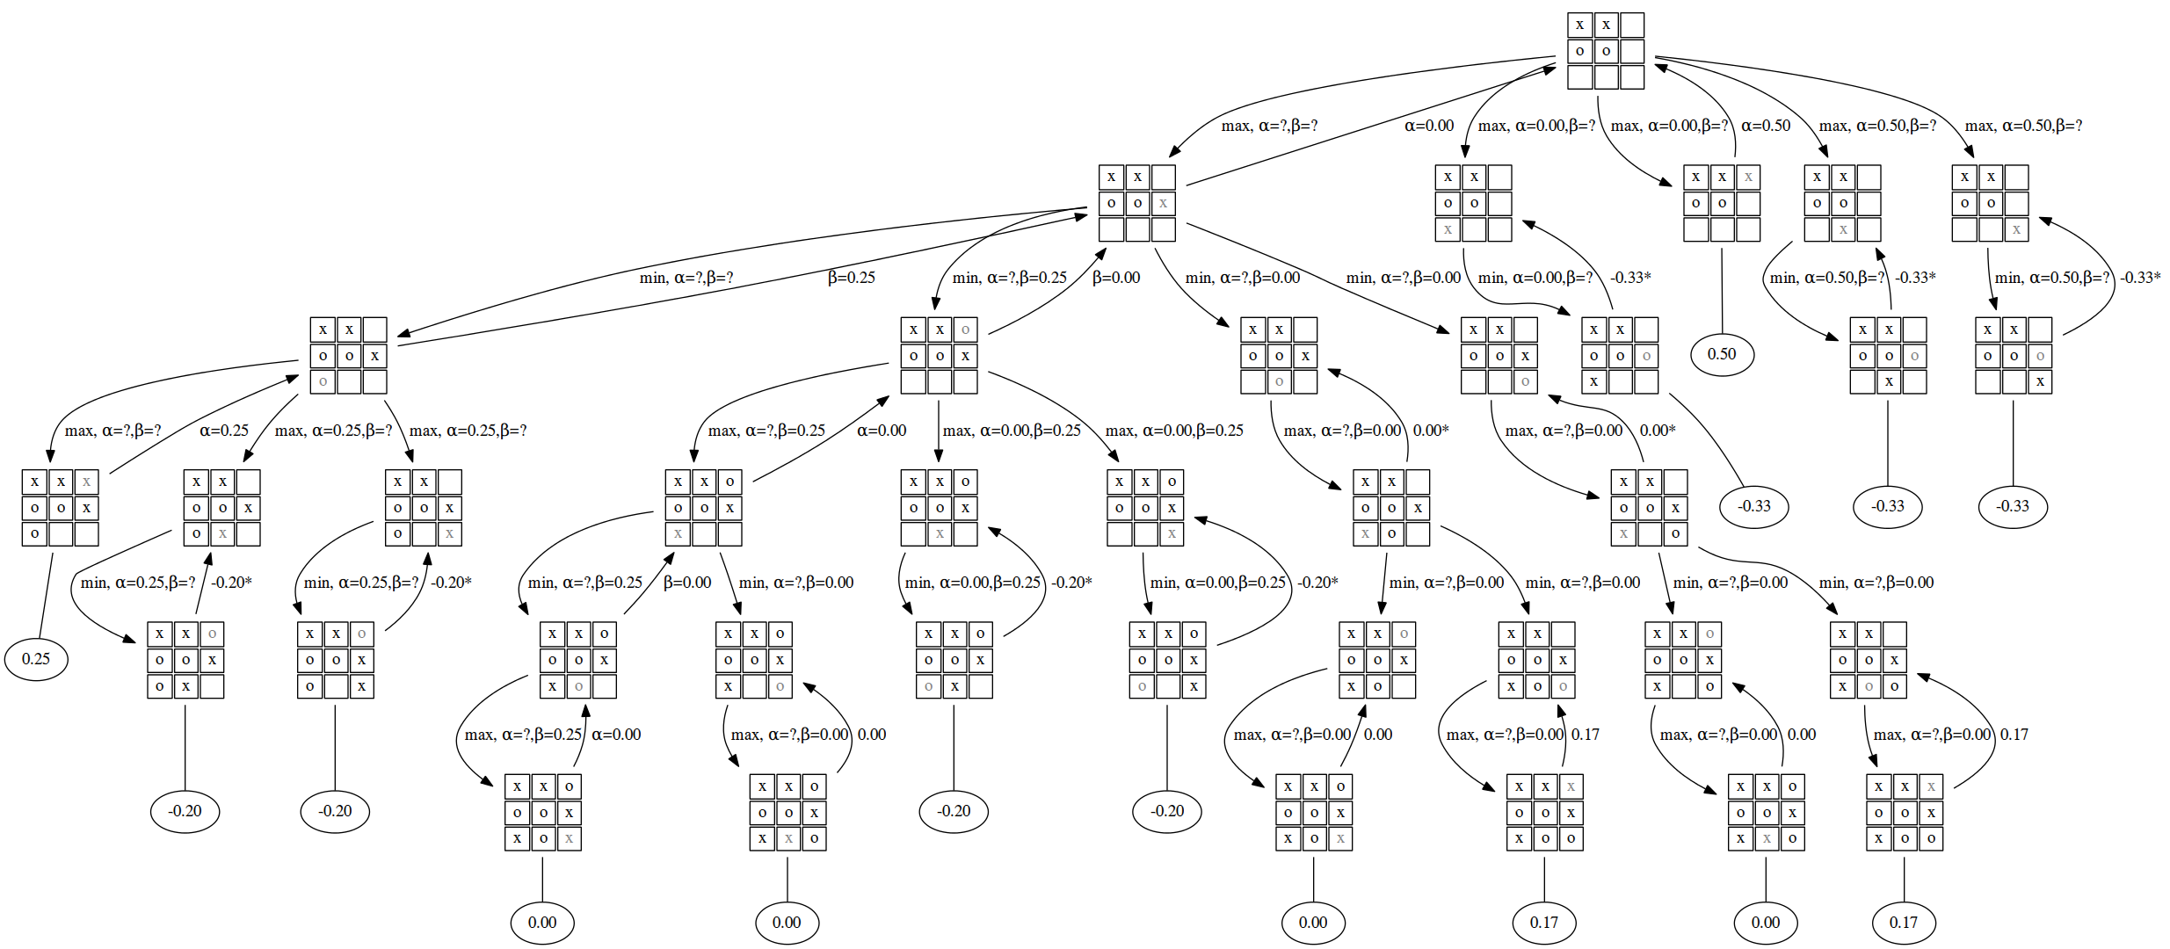
Drawbacks of Alpha Beta Pruning.
Alpha Beta Pruning Algorithm searches the whole state space to produce final tree.
Even in simple games like Tic-Tac Toe state space is huge and traversing every node in worst case involves a large computation which is difficult to perform sometimes on best PC’s.
Alpha Beta Pruning is modified version of DFS and in DFS we start exploring first the nodes present on the extreme left which is not an optimal way of searching as our best move may be present on the extreme right.

Slide 37

Dusk of Alpha-Beta Pruning and Dawn of Monte-Carlo Tree Search.

Slide 38
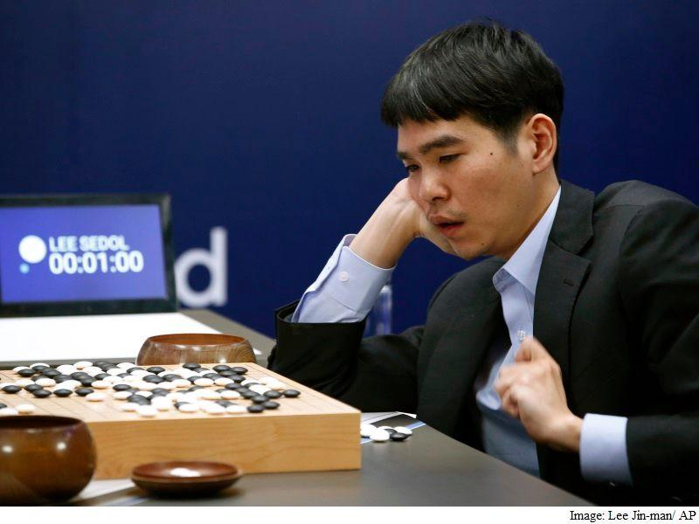
Rise of MCTS……...
Monte Carlo Tree Search
Since Alpha Beta Pruning searches the game tree up to specific depth which restricts its ability to find the best move.
MCTS works differently in the context of games, it do not require any prior knowledge in this procedure apart from the rules of the game and possible outcomes of the game:win,defeat or draw.
By playing out a larger number of games to the end, conclusions are drawn about the best moves in particular position based on best performance.
It is well known that Alpha Zero played countless games against itself for nine hours and learned from the results. Afterwards Alpha Zero was able to defeat Stockfish 8.

Slide 39
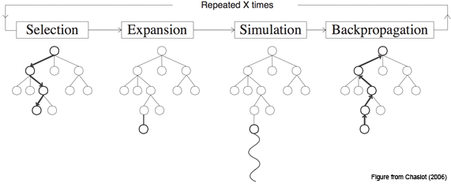
Abbreviated version of MCTS.
Monte Carlo Tree Search
Monte Carlo Tree Search has four parts of Algorithm:-
Selection - This process is used to select a node on the tree that has the highest possibility of winning which is determined using UCB.
Expansion - After selecting the right node. Expanding is used to increase the options further in the game by expanding the selected node and creating many children nodes.
Simulation - Run a simulated playout from a node with higher UCB(Upper Confidence Bound) value until a result is achieved.
Backpropagation - Update the current move sequence with the simulation result.
Its Important to note here that MCTS is not reducing the time or space Complexity in any way rather it is better than alpha beta pruning if it is used with some heuristics.

Slide 40
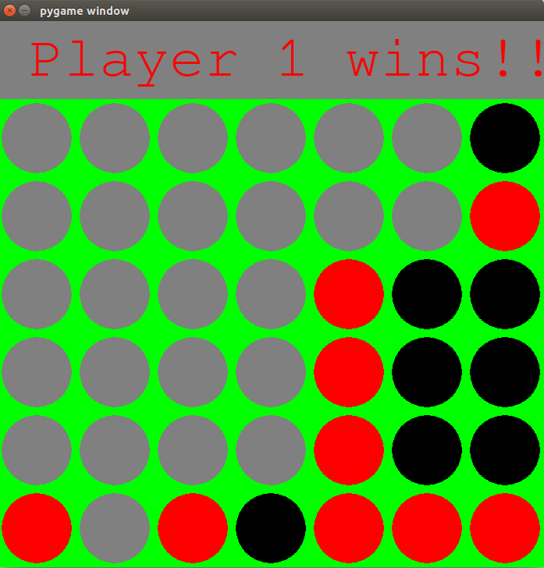
Summer Internship
Internship :- Naresh Kumar Kaushal and Priyanshu Singh
Me and Priyanshu did a summer internship in IIT Bombay which involves Alpha Beta pruning and Monte Carlo Tree search Algorithm, where our job was to infer which of the two algorithms is efficient.
We designed Connect Four Game which has two search agents Alpha Beta Pruning and Monte Carlo Tree search, they competed against each other. After few simulations done by MCTS it became very efficient and then defeated Alpha Beta Pruning Algorithm. Since our state space was huge so we have to set the certain depth up to which our Alpha Beta Pruning algo needs to run.
Screenshot of Connect Four Game made by us in Summer Internship

Slide 41
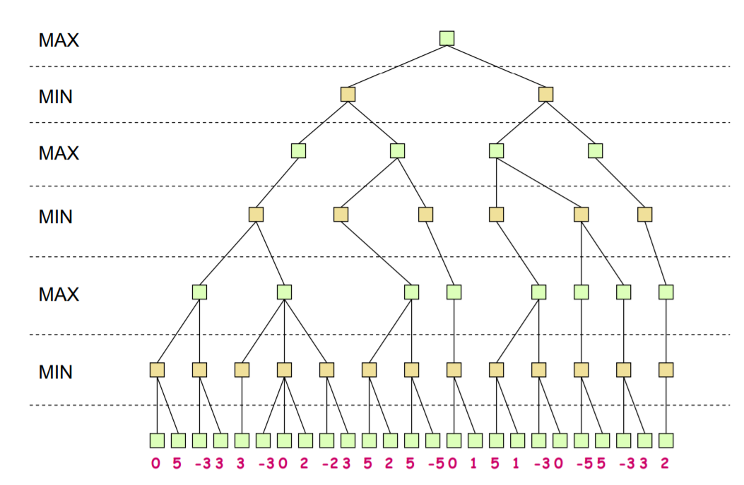
Follow up Questions?
Question 1 :-
Run Alpha Beta Pruning Algorithm on the Game Tree given in the figure, and count the number of nodes expanded and pruned during evaluation?
Question 2 :-
Calculate the worst case, best case Runtime complexity of this algorithm?
Question 3 :-
Is there any method to increase the efficiency of alpha beta pruning algorithm to some extent?
Hint :- ( Think about how to improve DFS)

Slide 42



THANK YOU
Bhavam Gupta
Rajat Kumar Dalai
Naresh Kumar Kaushal
9034103780
9284427315
7973862057
For Further Queries Drop an Email on :-
Bhavam.gupta.17002@iitgoa.ac.in
rajat.kumar.17001@iitgoa.ac.in
naresh.kaushal.17003@iitgoa.ac.in

Slide 43
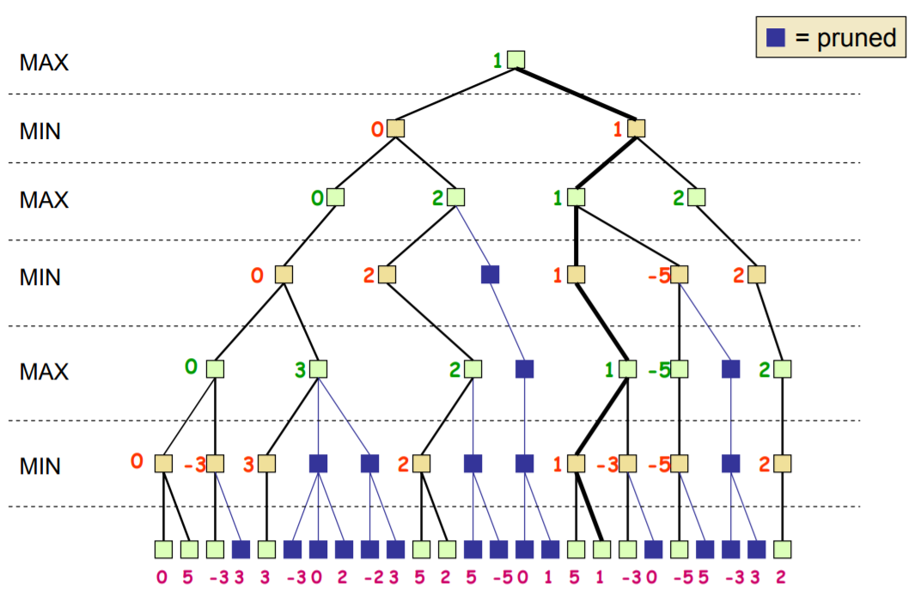
Answer 1
Number of nodes expanded = 37
Number of nodes pruned = 22
Answer 2
Best Case :- O(b^(m/2))
Worst Case :- O(b^m)
Answer 3
Iterative Deepening Approach or with some heuristics like A*

