Slide 1
Ensemble Learning
Bagging and Random Forest

Slide 2
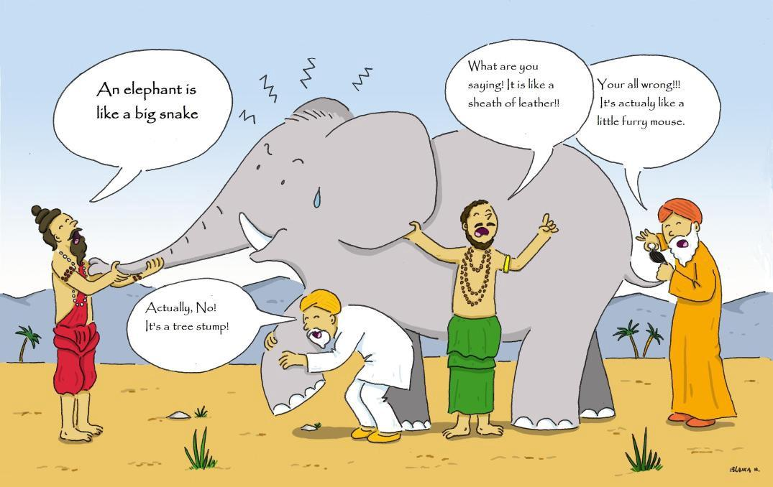
Overview

Slide 3
What does Ensemble mean?
A group of items, viewed as a whole rather than individually.
In AI, a group of learners combine to form a better learner.

Slide 4
What is Ensemble learning ?
Ensemble learning is a machine learning paradigm where multiple learners are trained to solve the same problem.
Ensemble learning take the attitude that more predictors can be better than any single one and by learning many we can do a better job.
Notes:
A time-series of temperature readings. By looking at the data, you want to predict what will be the temperature in the near future. You have 3 algorithms that each look at the same data, and give you their own estimate. You know that those algorithms can be inaccurate, at different degrees, so you might want to take a weighted average of the 3 readings, giving more weight to the most accurate algorithm estimate. This whole procedure of having 3 sub-algorithms reading the data, computing their own estimates, and then create an overall estimate, is known as ensemble learning.

Slide 5
Ensemble of classifiers:
We build a collection of classifiers, say h₁, h₂, h₃, ….. h_{n}
And then we construct a final classifier by combining their individual decisions.

Slide 6
Real Life Ensemble Classification Examples
In “Kaun Banega Crorepati (Who wants to be a Millionaire)”, audience poll is more reliable than phone friend.
Let us demonstrate with a Live Example.
Notes:
Somehow a collection of 100 non-experts turns out to be a far better predictor of the correct answer than the prediction of the one predetermined expert that the contestant is able to select,fundamentally this is what ensembles try to do

Slide 7
Diversity:
No gain if all the classifier make the same mistake.
What if classifier make mistakes independently?

Slide 8
So Why Does This Work?
•“No Free Lunch"Theorem:
•No single algorithm wins all the time!
•Wisdom of the Crowd: When combining multiple independent decisions, each of which is at least more accurate than random guessing,random errors cancel each other out and correct decisions are reinforced.
•Human ensembles are demonstrably better.
•How many jellybeans are in the jar?
•Who Wants to Be a Millionaire: “Ask the audience"

Slide 9
Core of Ensemble Learning
Combining weak classifiers (of the same type) in order to produce a strong classifier
•Condition: diversity among the weak classifiers (No gain if all the classifier make the same mistake).
Each classifier is “weak" but the ensemble is “strong."

Slide 10
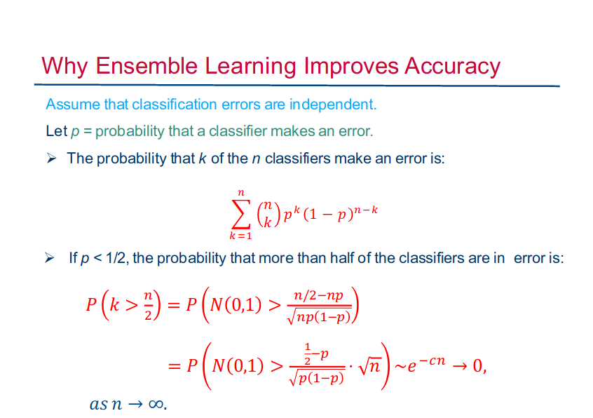

Slide 11
Two Key Questions
How to get different learners?
How to combine learners?

Slide 12
Where Do Learners Come From
Partitioning the data.
Using
Different feature subsets.
Different algorithms.
Different parameters of the same algorithm.

Slide 13
Combining learners
Voting
Bagging
Random Forest
Boosting
AdaBoost

Slide 14
Bagging
By Priyanshu Singh

Slide 15
What is Bagging?
Bagging comes from a combination of words, Bootstrap + Aggregating
A machine learning ensemble meta-algorithm designed to improve the stability and accuracy of machine learning algorithms used in statistical classification and regression.
It also reduces variance and helps to avoid overfitting.

Slide 16
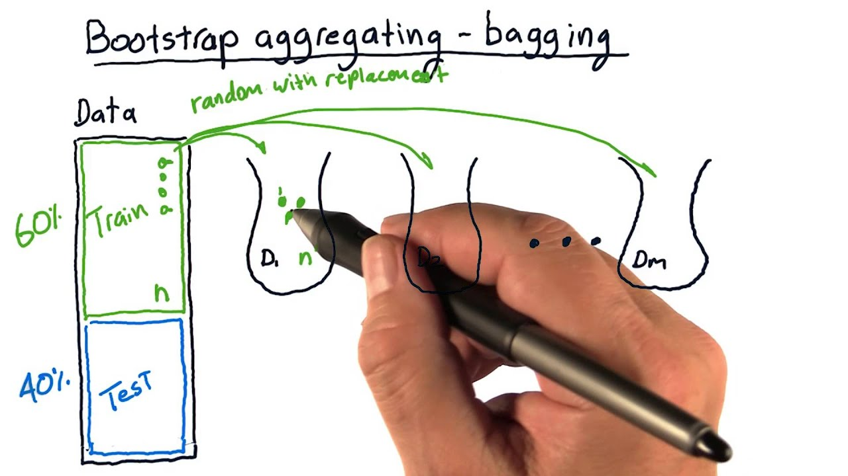
Bagging in Layman’s Terms

Slide 17
Examples of Bagging
Let us see two examples of Bagging :
In Regression
In Classification

Slide 18
Bagging
On Regression

Slide 19
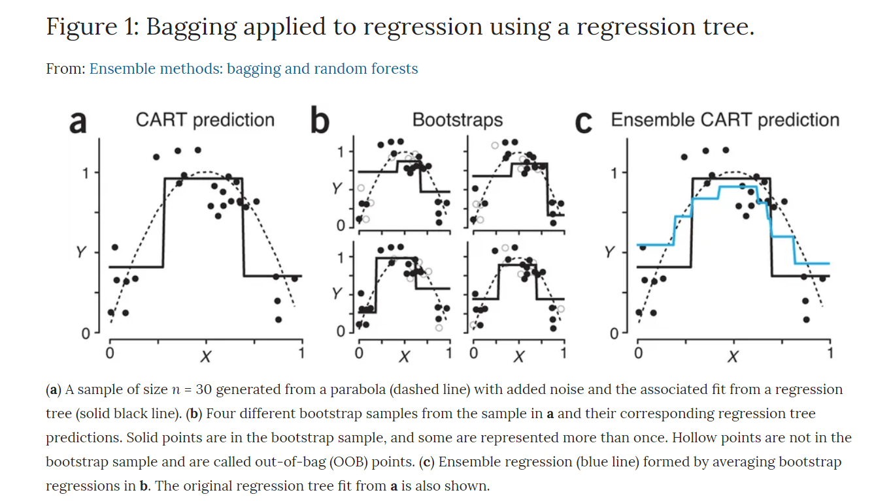

Slide 20
Errors in Bagging
There are two types of errors :
Mean Square Prediction Error
Out of Bag Error
Bag Error

Slide 21
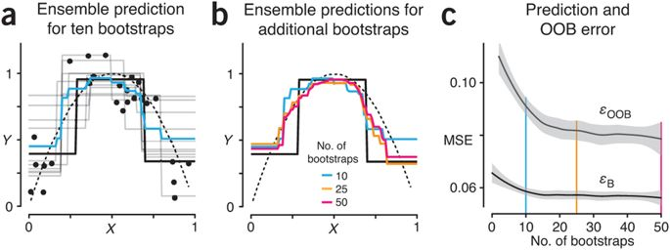
Effect of n on MSE and OOB error

Slide 22
How to choose the perfect ‘n’
As we increase the n, we see that the OOB error stabilizes.
This value of n is the optimal value of Bags.
If we further increase the value of n, due to similar contents in bootstraps, the computation time increases.

Slide 23
Bagging
On Classification

Slide 24
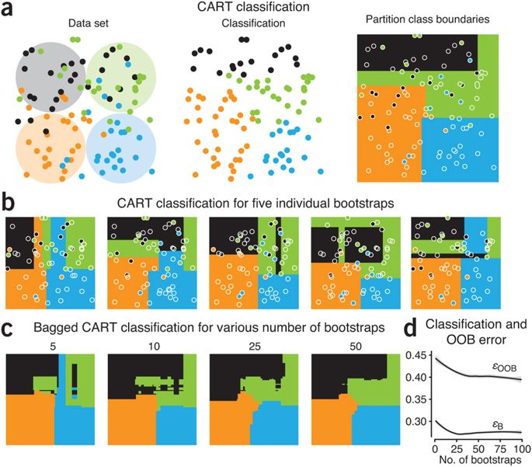

Slide 25
We can see, the Regression or classification fits generated from different bootstrap samples are correlated because of the observations that have been selected in both samples.
The higher the correlation, the more similar the fit from each bootstrap and the smaller the effect of the Bagging algorithm in reducing variance.

Slide 26
Assignment:
Prove that, variance for classification and regression fit by Bagging is lower. (given that the algorithm for regression is not very stable)
Stable- eg.- Linear regression with no influential points(points which greatly affect the slope of the line)

Slide 27
Random Forest

Slide 28
What is Random Forest?
Forests are made up of trees and Random forests are made up of Decision Trees.
Random Forest is an ensemble learning method for classification, regression that operates by creating a multitude of decision trees.
A general method random forest was first proposed by Ho in 1995.

Slide 29
Why Random Forest?
Bagging simply reruns the algorithm on different subsets of the data.
This can result in highly correlated predictors and a biased model.
But random forest can decorrelate the base learners by randomly choosing the input variables, as well as sample of datasets.

Slide 30
Why does it work?
Variance and Bias Reduction

Slide 31
Variance Reduction
The trees are more independent because of bootstrap samples and random draws.
Random forests are form of bagging and averaging over trees can reduce instability.
Consequently, the gains from averaging over a large number of trees can be more dramatic.

Slide 32
Bias Reduction
A large number of predictors can be considered. More information may be brought to reduce bias of fitted values and estimated splits.
Local feature predictor can play a role in tree construction.
There are often some predictors that dominate the decision-tree fitting process because they consistently perform a bit better than their competitors.

Slide 33
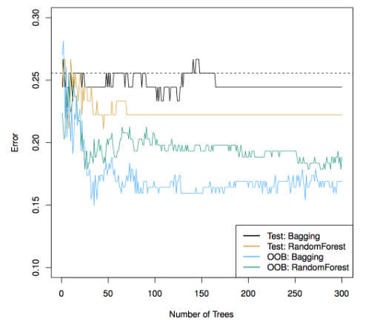
Bagging VS Random Forest
Random Forest are among the best classifiers in the world.
The 3 tuning parameters:
Minimum Node Size
Number of Trees
Number of Predictors Sampled

Slide 34
Pros of Random Forest
High Predictive Accuracy
Efficient on large dataset
Works well with missing values on the dataset.

Slide 35
Disadvantages of Random Forest
Not easily interpretable
Overfit with Noisy Classification or Regression

Slide 36
Uses of Random Forest
In 2006, Netflix held a competition, with given 8 Billion ratings and 4,80,189 users.
The winners BellKor’s Pragmatic Chaos used Random Forest for making the recommendation system.
The runner ups had the same score for recommendation but what did they use as decision trees.

Slide 37
Questions
How do we select the perfect ‘n’ for Random Forest?
How is the accuracy increased from Bagging to Random Forest?
How do we calculate the weighted index of decision trees when taking into consideration for the random forest?

Slide 38
Thank You
Any Questions?

