Slide 1
EXPECTIMAX SEARCH
By:-
Jaswanth Gorthi
Abhay Sharma
Rahul Ratneshwar Mandal

Slide 2
Uncertain Outcomes
In solitaire, next card is unknown
In minesweeper, mine locations
In pacman, the ghosts act randomly

Slide 3
Expectation
The expected value of a function of a random variable is the average, weighted by the probability distribution over outcomes
How long to get to the airport?
Probability of being no traffic, traffic and heavy traffic are 25%, 50% and 25% respectively
Time:
20 min
30 min
60 min
+
+
35 min
x
x
x
Probability:
0.25
0.50
0.25

Slide 4
Expectimax Search
Max
Values should now reflect average-case (expectimax) outcomes, not worst-case (minimax) outcomes.
Expectimax search: compute the average score under optimal play.
Max nodes as in minimax search
Chance nodes are like min nodes but the outcome is uncertain
Calculate their expected utilities
I.e. take weighted average (expectation) of children
Chance
10
10
100
9

Slide 5
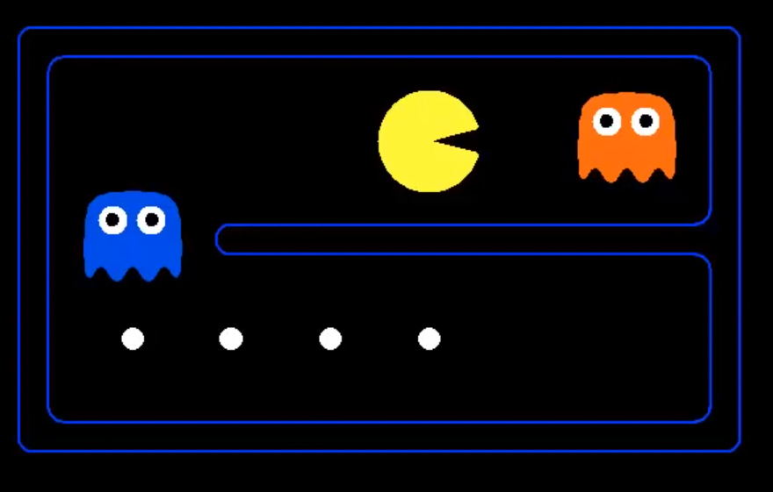

Slide 6
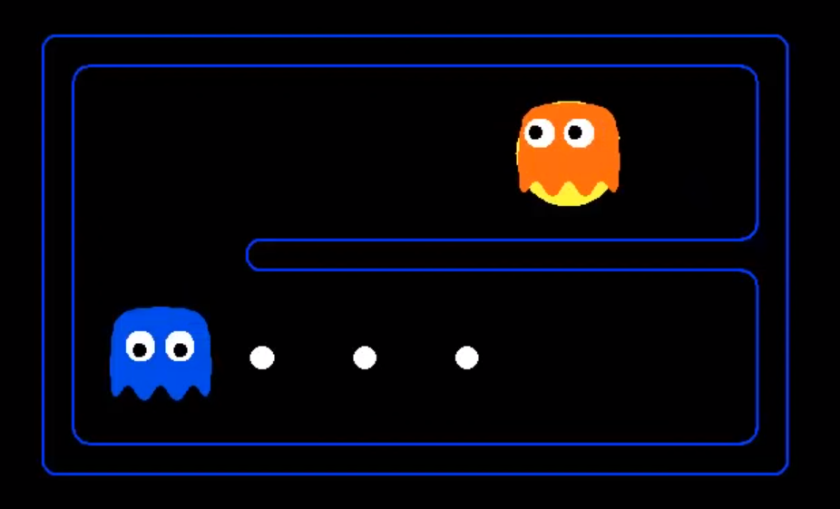

Slide 8
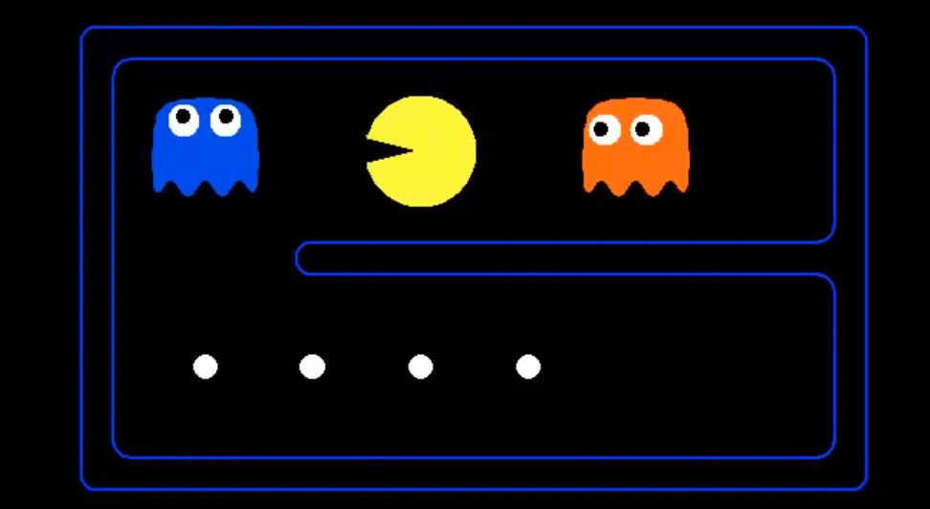

Slide 9
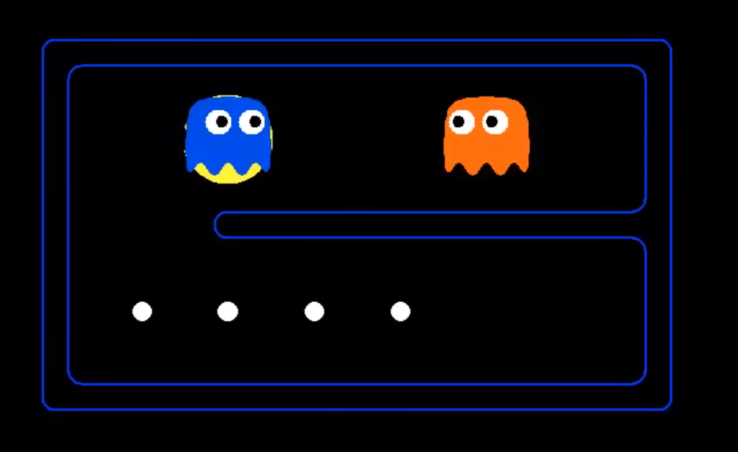

Slide 11
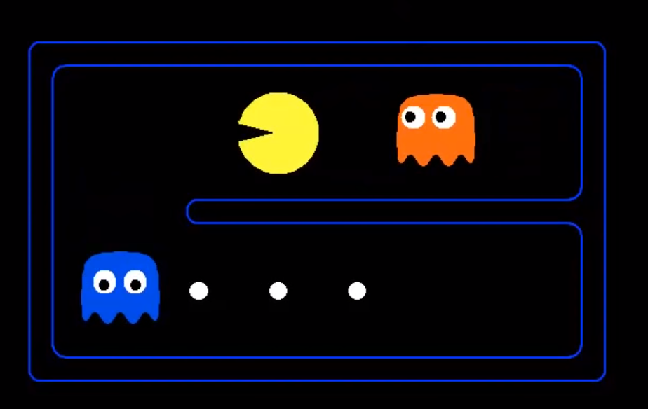

Slide 12


Slide 13
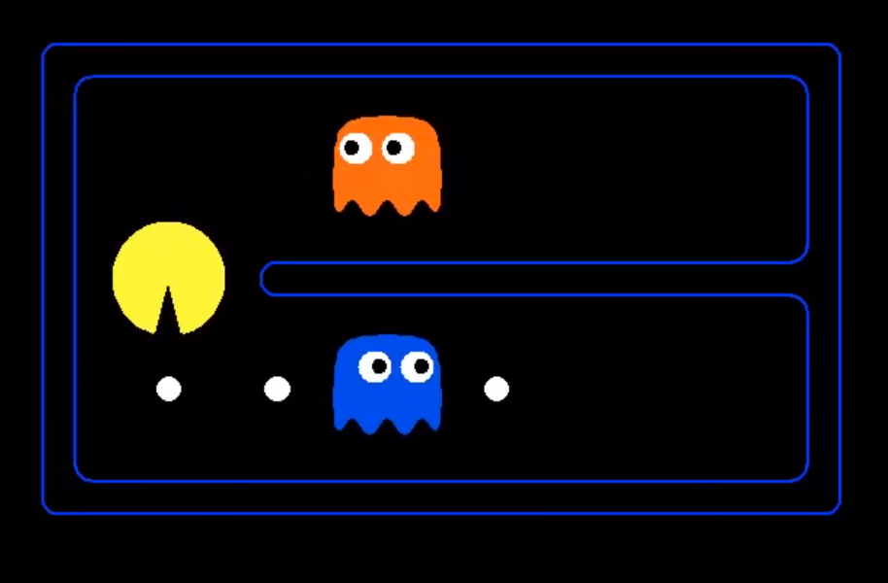

Slide 14
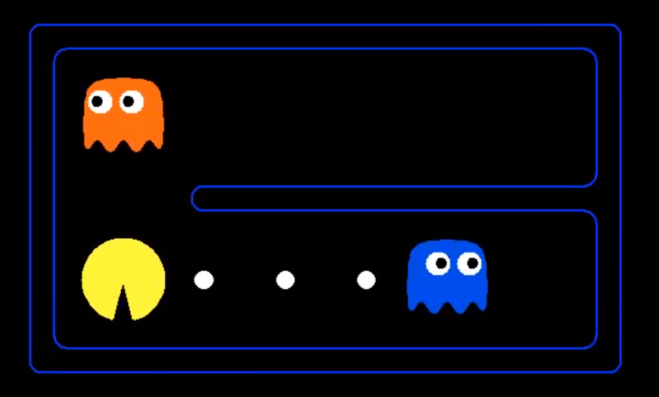

Slide 15


Slide 16
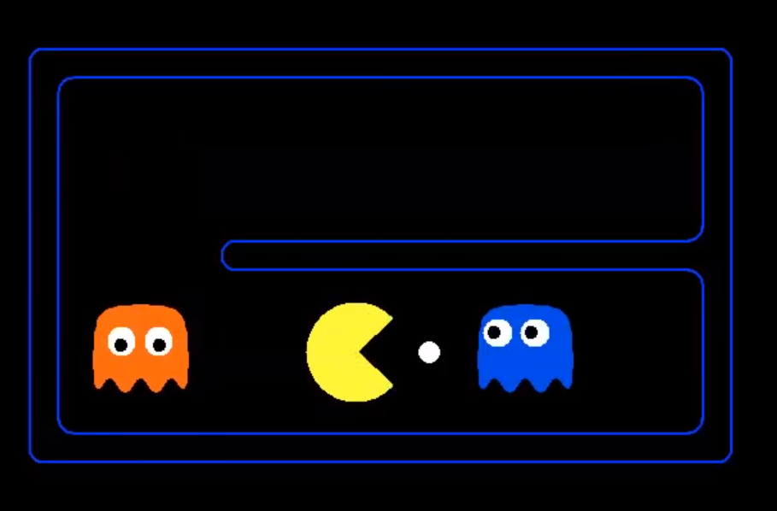

Slide 17


Slide 18
Properties of Expectimax
The other node is not adversarial, also not in your control. we just do not know what is going to happen.
Using expectimax is not 100% safe, you might loose.
Usually chance nodes are governed by probabilities (instead of just selecting min) and average is weighted by those probabilities.
In many games the probability is uniform, flipping a coin, rolling a dice.
In real world probabilities governing outcome reflects our knowledge and expectations about the world problems.

Slide 19
Expectimax Pseudocode

Slide 20
Expectimax Pseudocode
def value(state):
if the state is a terminal state: return the state’s utility
if the next agent is MAX: return max-value(state)
if the next agent is EXP: return exp-value(state)

Slide 21
def max-value(state):
initialize v = -∞
for each successor of state:
v = max(v, value(successor))
return v
def exp-value(state):
initialize v = 0
for each successor of state:
p = probability(successor)
v += p * value(successor)
return v

Slide 22
Calculating Expectation
def exp-value(state):
initialize v = 0
for each successor of state:
p = probability(successor)
v += p * value(successor)
return v
1/2
1/6
1/3
8
24
-12

Slide 23
Calculating Expectation
def exp-value(state):
initialize v = 0
for each successor of state:
p = probability(successor)
v += p * value(successor)
return v
1/2
1/6
1/3
8
24
-12
v = (1/2) (8) + (1/3) (24) + (1/6) (-12) = 10

Slide 24
Expectimax Example
3
12
9
2
4
6
15
6
0

Slide 25
Expectimax Example
8
3
12
9
2
4
6
15
6
0

Slide 26
Expectimax Example
8
4
3
12
9
2
4
6
15
6
0

Slide 27
Expectimax Example
8
4
7
3
12
9
2
4
6
15
6
0

Slide 28
Expectimax Example
8
8
4
7
3
12
9
2
4
6
15
6
0

Slide 29



Depth-Limited Expectimax
Estimate of true expectimax value (which would require a lot of work to compute)
400
300
…
…
492
362
…

Slide 30
Mixed Layer Types
Expectiminimax
Environment is an extra “random agent” player that moves after each min/max agent
Each node computes the appropriate combination of its children
E.g. Backgammon

Slide 31
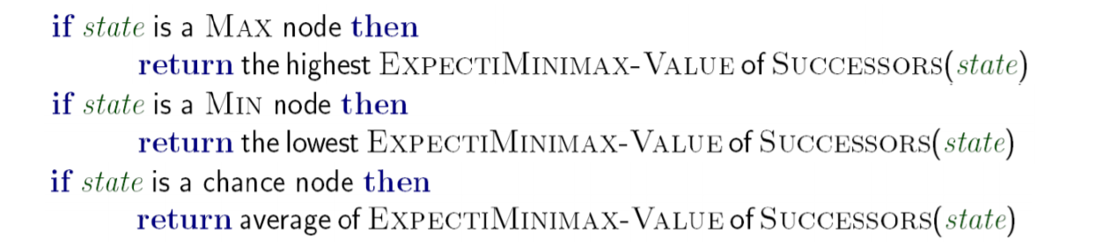
Expectiminimax Pseudocode
ExpectiMinimax-Value(state ) :

Slide 32
Utilities
Utilities are functions from outcomes (states of the world) to real numbers that describe an agent’s preferences
Where do utilities come from?
– In a game, may be simple (+1/-1)
– Utilities summarize the agent’s goals
– Theorem: any “rational” preferences can be summarized as a utility function

Slide 33
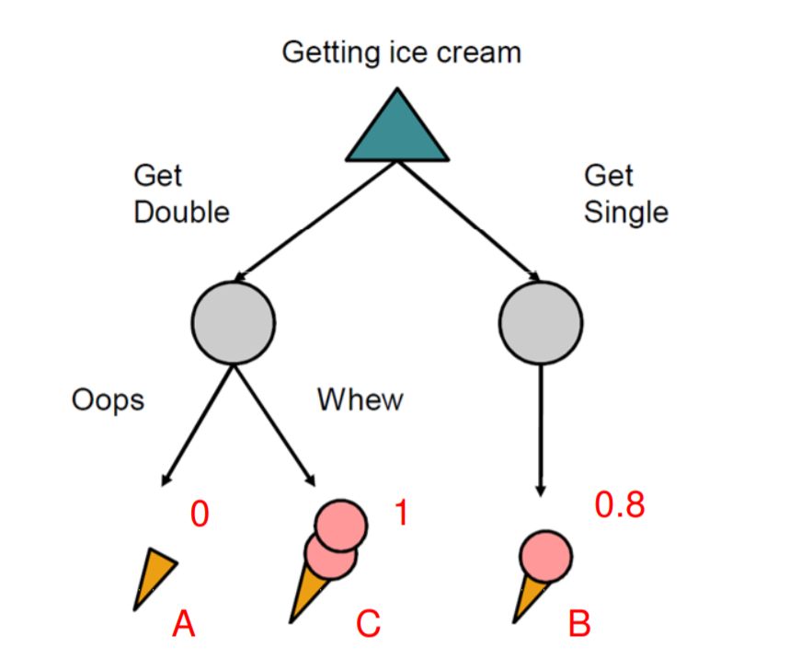
Utilities: Uncertain Outcomes

Slide 34
Maximum Expected Utility
Why should we average utilities? Why not minimax?
Principle of maximum expected utility (MEU) : –
A rational agent should choose the action which maximizes its expected utility, given its knowledge

Slide 35
What Utilities to Use?
0
40
20
30
x²
0
1600
400
900
For worst-case minimax reasoning, terminal function scale doesn’t matter
We just want better states to have higher evaluations (get the ordering right)
We call this insensitivity to monotonic transformations
For average-case expectimax reasoning, we need magnitudes to be meaningful

Slide 36
APPLICATIONS

Slide 37
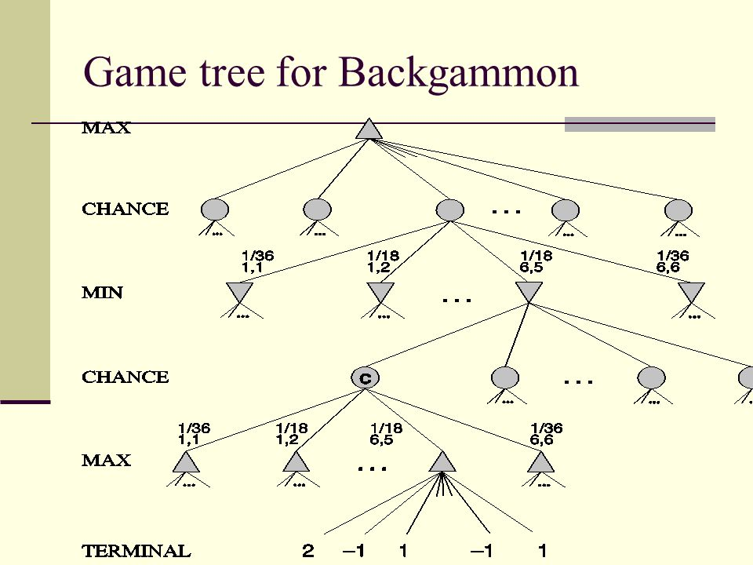
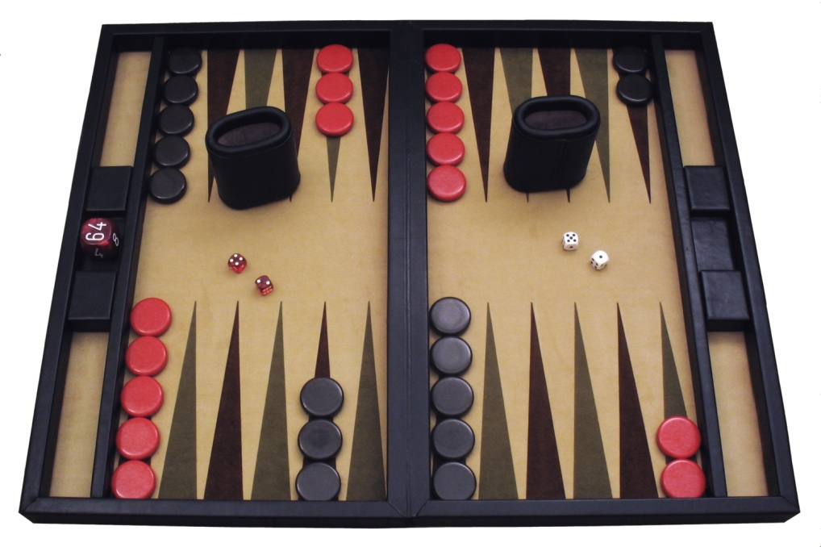
Backgammon

Slide 38
Backgammon
Dice rolls increase b: 21 possible rolls with 2 dice
Backgammon ≈ 20 legal moves
As depth increases, probability of reaching a given search node shrinks
So usefulness of search is diminished
So limiting depth is less damaging
Historic AI: TDGammon uses depth-2 search + very good evaluation function + reinforcement learning: world-champion level play
1st AI world champion in any game!

Slide 39
Questions
Can we apply pruning in expectimax search?
What is the time complexity of expectimax search algorithm?
Can we apply pruning in expectiminimax search?

Slide 40
Expectimax Pruning
3
12
9
2

Slide 41
Expectimax Pruning
There is no pruning for expectimax
There is no concept of “optimal play” by adversary, it is just unknown
No matter what you have seen so far, the content of unexplored children could change expectimax value remarkably .Thus, expectimax is slow.
Strategies exist to speed up

Slide 42
Bibliography
We would like to thank Dan Klein(University of California, Berkeley) for their slides and for sharing his knowledge on this topic through youtube videos
References:
https://www.youtube.com/watch?feature=player_embedded&v=GevK0-9n24g

Slide 43
THANK YOU!!

